Slide 1
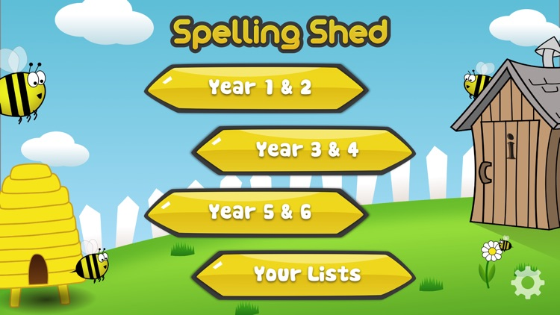
Y5&6 TOP SPELLERS TODAY
1st = Jack 31 points
2nd = Henry 29 points
3rd = Rhys 12 points
4th = Nelly 11 points
5th = Heidi 10 points
6th = Ruby 6 points
7th = Zoe and Zac 5 points
8th – Reuben 4 points
9th = Harvey 1 point
These are the amount of dojos you have received for your efforts today!
Everybody else earns 1 dojo for practising their spellings today!

Slide 2
Here’s what Y5&6 have been
focusing on at home today.

Slide 3
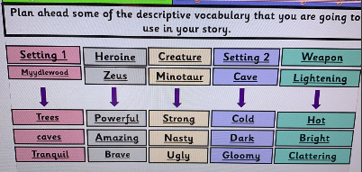
Here’s what Y5&6 have been
focusing on at home today.
Henry’s choices of synonyms for his Greek myth……………….

Slide 4
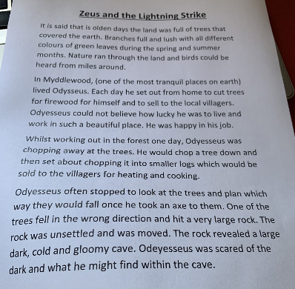
Here’s what Y5&6 have been
focusing on at home today.
….before producing his story start...... ‘Zeus and the Lightning Strike’!

Slide 5
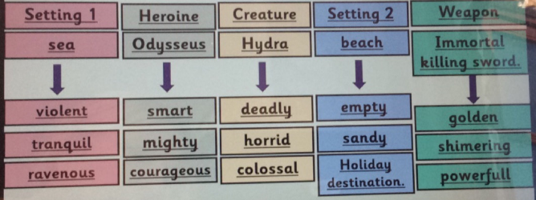
Here’s what Y5&6 have been
focusing on at home today.
Reuben’s choices of synonyms for his Greek myth……………….

Slide 6
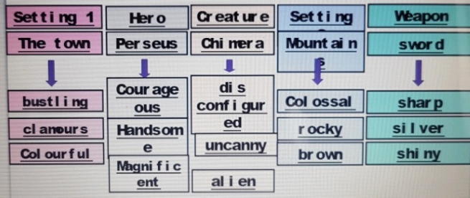
Here’s what Y5&6 have been
focusing on at home today.
Bethany’s choices of synonyms for her Greek myth……………….

Slide 7
Here’s what Y5&6 have been
focusing on at home today.
Plucky Perseus and the hunt for Treasure
Zeus stood on top of the great Mount Olympus, eyes looking down beyond the grey clouds. He thought for a moment and then said
“Whom shall I send to retrieve the treasure that I lost those many years ago?” He took another moment to think and then whispered to the lucky one,
“It shall be you Perseus. A young, brave man whom shall go on the hunt for my treasure.”
***
Perseus was shocked. He had heard that calling that Zeus had whispered to him. Suddenly another calling shot into Perseus’ ears.
“I have sensed it always that it is in the underworld. You shall go there and retrieve it. I have been too busy to go myself over these years, looking over all the gods doing their jobs. I have finally decided it is time for one of my citizens to go and retrieve it for me.”
“I shall go lord. I shall find that treasure and bring it back to you.” With that Perseus sped through the bustling city to the tallest mountain. His quest has now begun.
….before producing her story start...... ‘Plucky Perseus and the Hunt for Treasure’

Slide 8
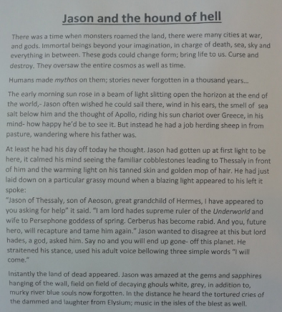
Here’s what Y5&6 have been
focusing on at home today.
Amy’s start to her myth story, ‘Jason and the Hound of Hell’

Slide 9
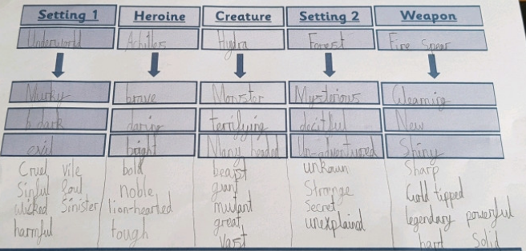
Here’s what Y5&6 have been
focusing on at home today.
Cameron’s choices of synonyms for his Greek myth……………….

Slide 10
Here’s what Y5&6 have been
focusing on at home today.
Cameron’s start to his myth story, ‘Hades underworld game’

Slide 11
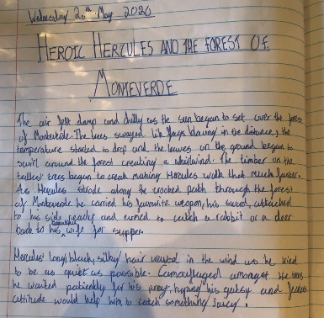
Here’s what Y5&6 have been
focusing on at home today.
Harvey’s start to his myth story, ‘Heroic Hercules and the Forest of Monteverde’

Slide 12
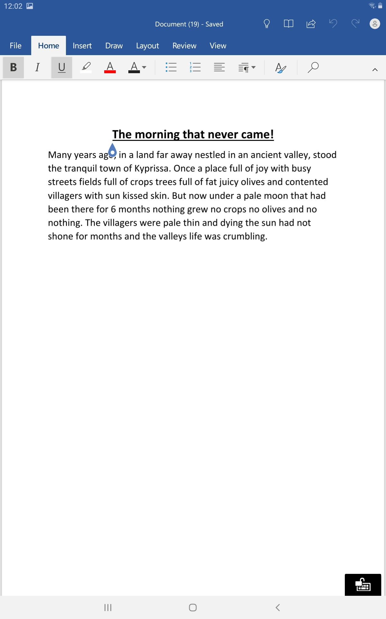
Here’s what Y5&6 have been
focusing on at home today.
Katie’s start to her myth story, ‘The Morning That Never Came’

Slide 13
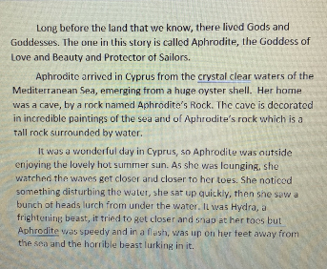
Here’s what Y5&6 have been
focusing on at home today.
Zoe’s start to her myth story

Slide 14
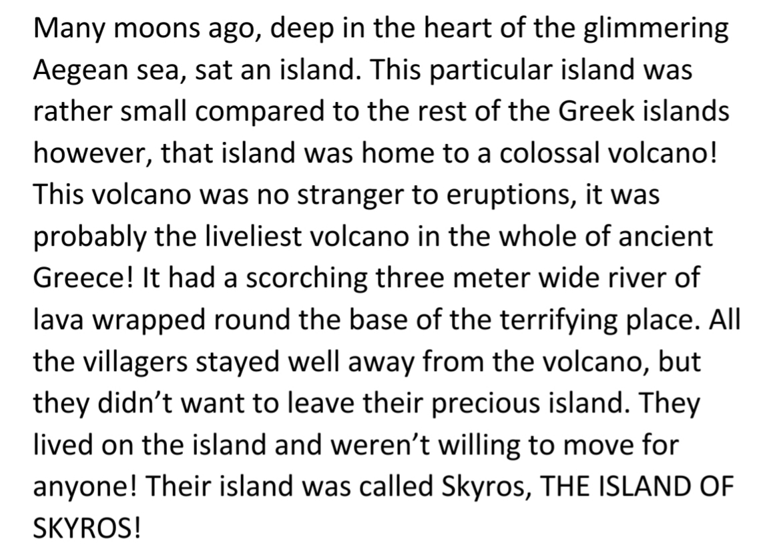
Here’s what Y5&6 have been
focusing on at home today.
Lucy’s start to her myth story

Slide 15
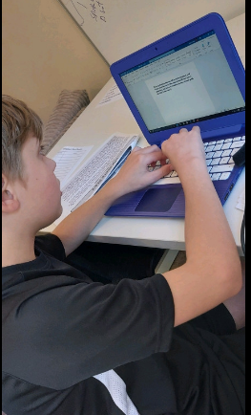
Here’s what Y5&6 have been
focusing on at home today.
I’m focusing on the start of my Greek myth.
Do you like the large white board I’ve got in front of me? It’s like being in a classroom!

Slide 16
Here’s what Y5&6 have been
focusing on at home today.

Slide 17
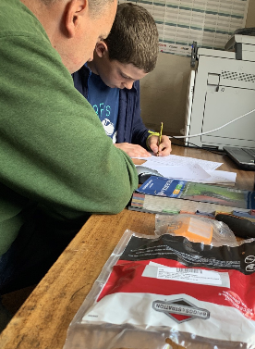
Here’s what Y5&6 have been
focusing on at home today.
Maths teamwork to find the solutions to this tricky problem……..

Slide 18
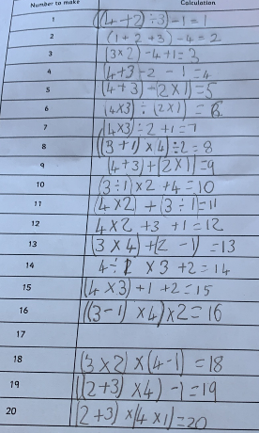
Here’s what Y5&6 have been
focusing on at home today.
and with great determination, he got there.

Slide 19
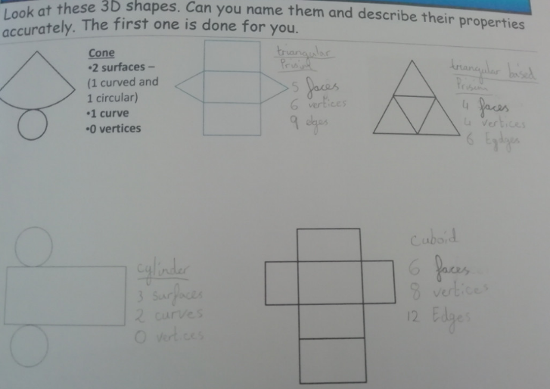
Here’s what Y5&6 have been
focusing on at home today.
Amy has been studying the properties of these 3D shapes carefully.

Slide 20
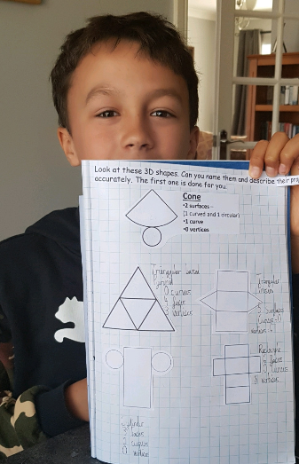
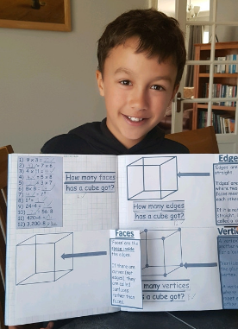
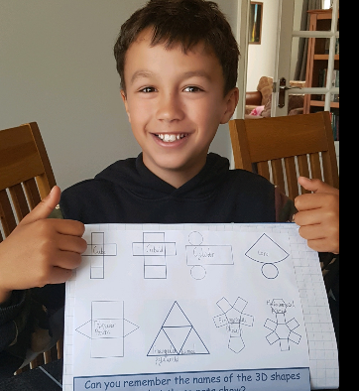
Here’s what Y5&6 have been
focusing on at home today.
Cameron has been studying the properties of these 3D shapes carefully.

Slide 21
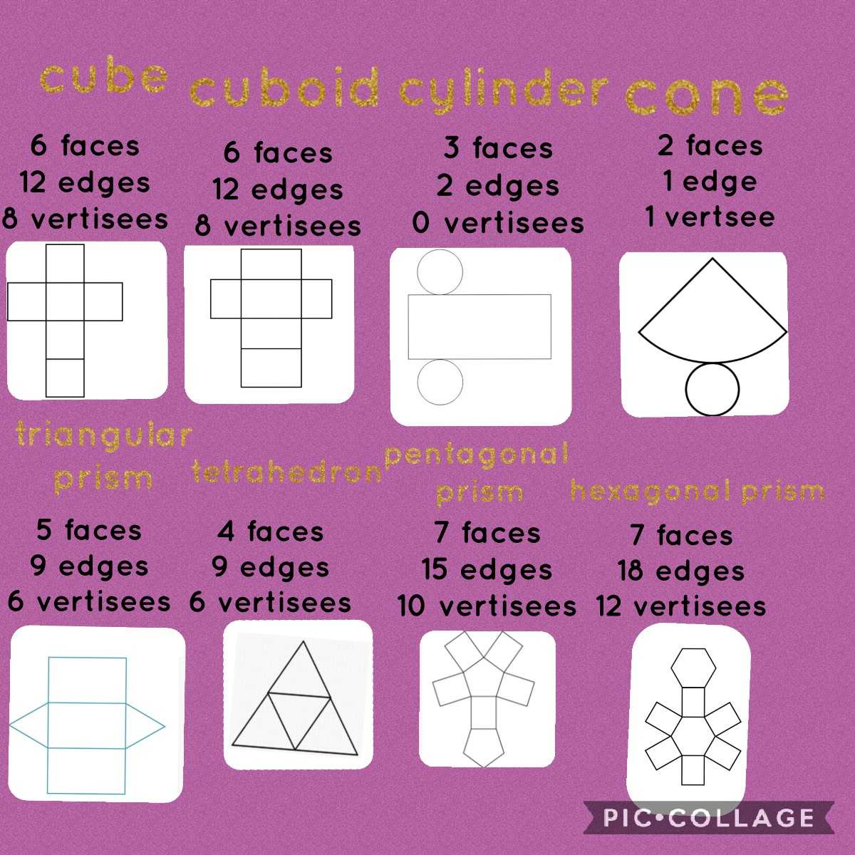
Here’s what Y5&6 have been
focusing on at home today.
Lucy has been studying the properties of these 3D shapes carefully.
surfaces
surfaces
curves
curve
0

Slide 22
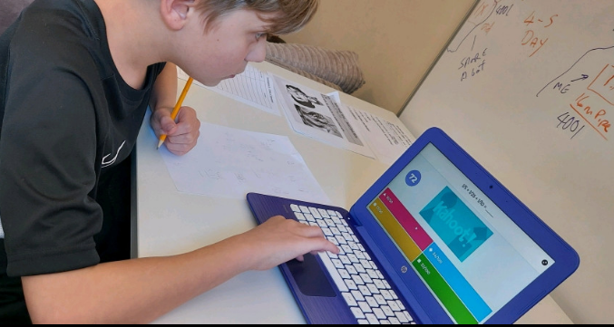
Here’s what Y5&6 have been
focusing on at home today.
I needed a pencil and paper ready for the tricky questions on the Kahoot maths quiz

Slide 23
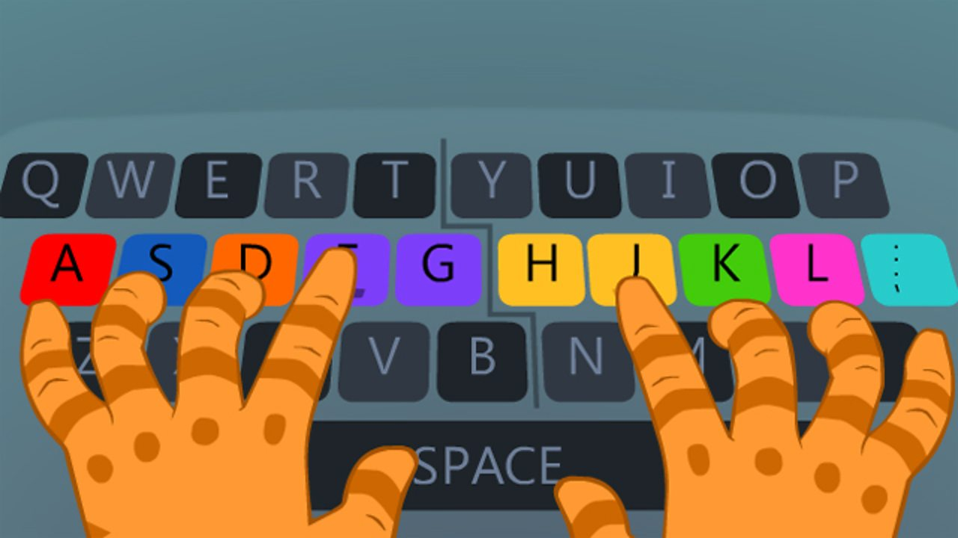
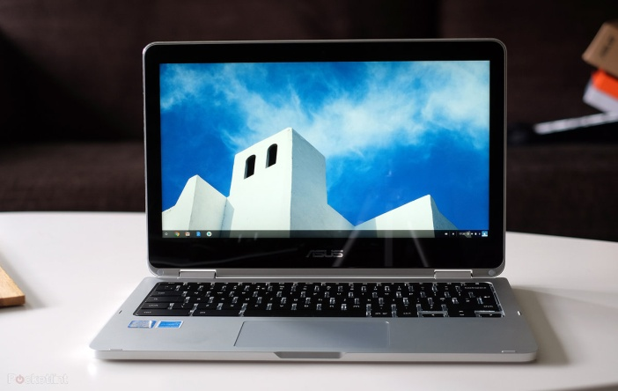
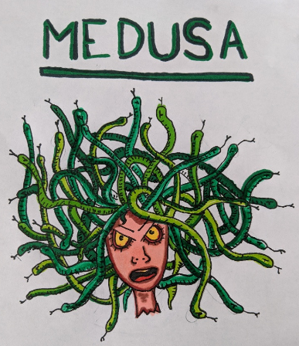
Here’s what Y5&6 have produced at home today.
Here’s what Y5&6 have been
focusing on at home today.
Heidi has been producing her own superb art work of Medusa.

Slide 24
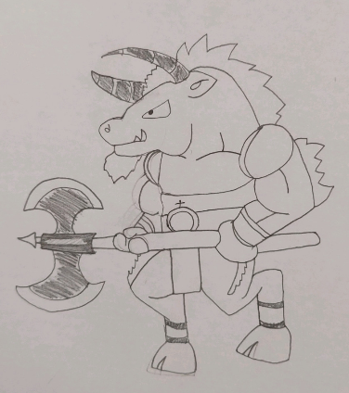
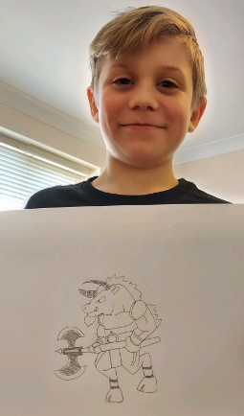
Here’s what Y5&6 have produced at home today.
Here’s what Y5&6 have been
focusing on at home today.
Dante has been producing his own superb art work of the Minotaur.

Slide 25
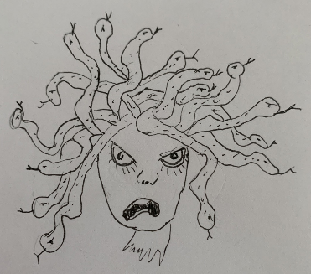
Here’s what Y5&6 have produced at home today.
Here’s what Y5&6 have been
focusing on at home today.
Zoe has been producing her own superb art work of Medusa.

Slide 26
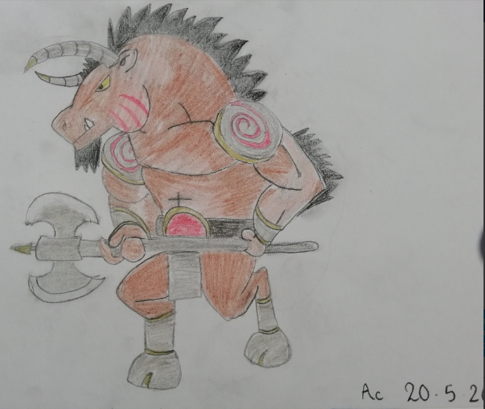
Here’s what Y5&6 have produced at home today.
Here’s what Y5&6 have been
focusing on at home today.
Amy has been producing her own superb art work of the Minotaur.

Slide 27
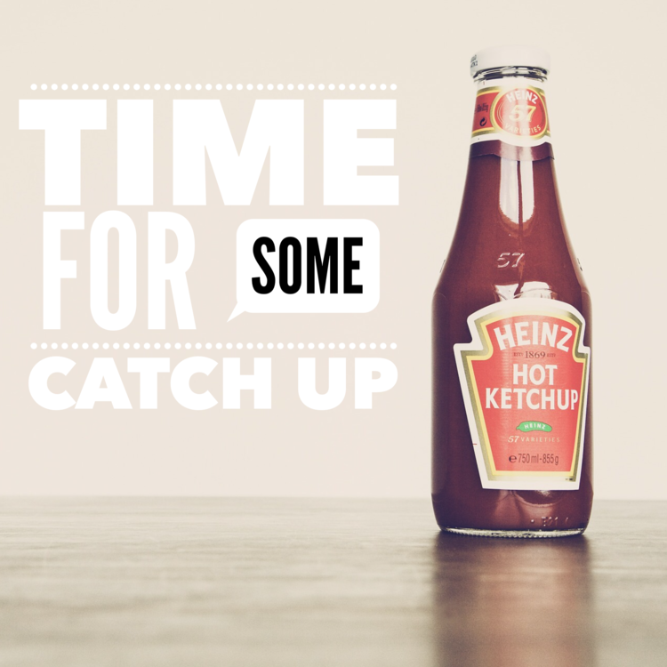
Here’s some more of the work at home that’s just been handed in…….

Slide 28
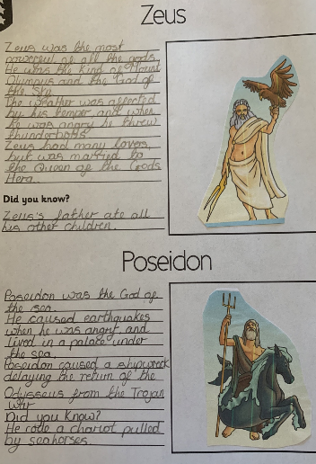
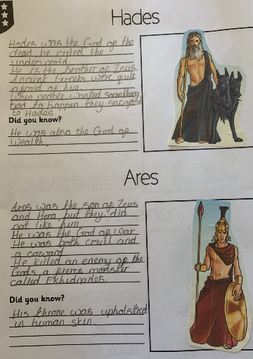
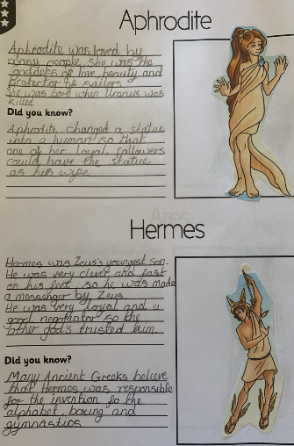
What else have we been doing at home?
Nelly’s study of the Greek gods and goddesses

Slide 29
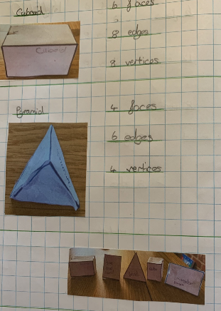
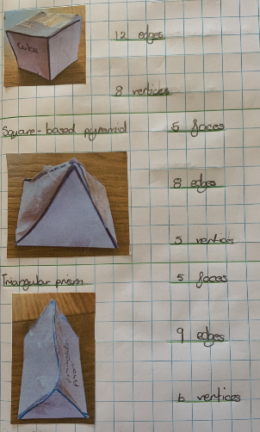
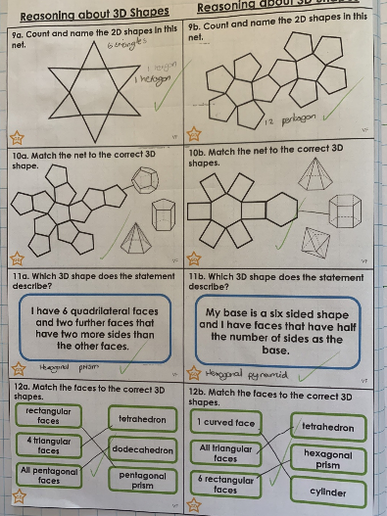
What else have we been doing at home?
Nelly has been studying and focusing hard on her 3D shapes and their special features.

Slide 30
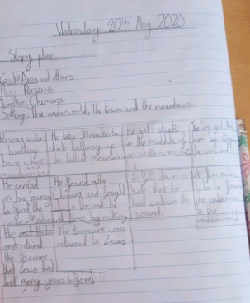
What else have we been doing at home?
Bethany’s storyboard for the planning of her ancient Greek myth.

Slide 31
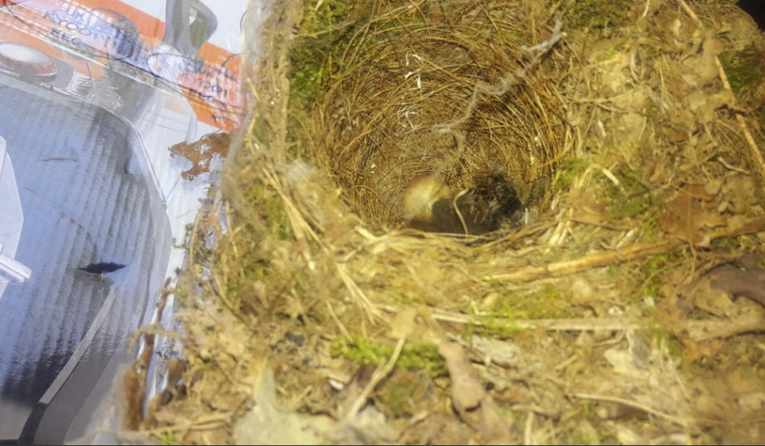
What else have we been doing at home today?
Birds have been nesting in Chloe’s shed.

Slide 32
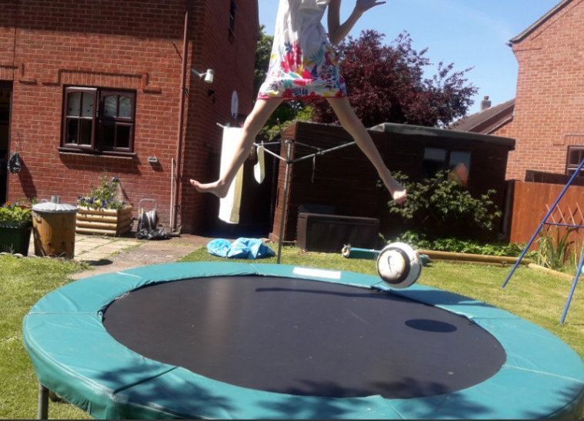
What else have we been doing at home today?
Trampoline time for Chloe in the sun

Slide 33
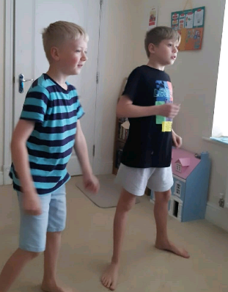
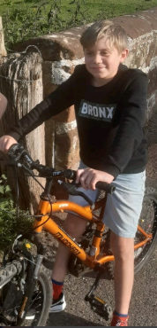
What else have we been doing at home today?
Joe Wickes fitness followed by a bike ride

Slide 34
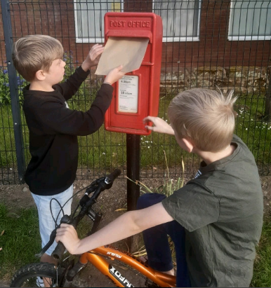
What else have we been doing at home today?
We’ve posted another letter to our nan and grandfather today.

Slide 35
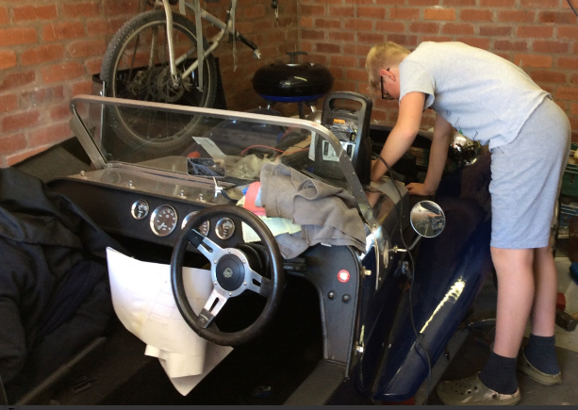
What else have we been doing at home today?
I’ve been helping my dad with this car engine.

Slide 36
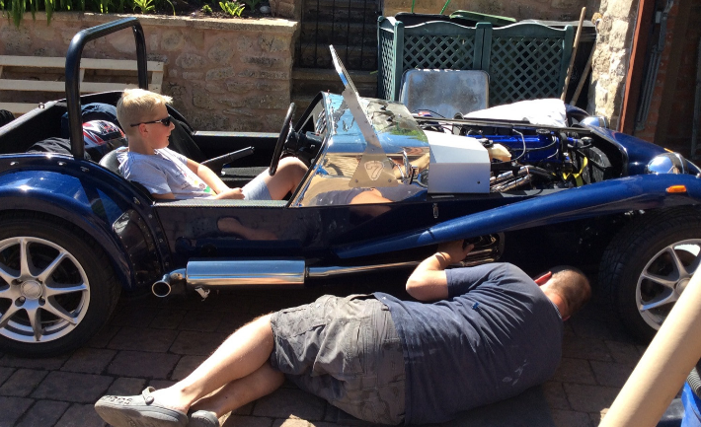
What else have we been doing at home today?
Dad can work and I will drive!
🤔

