Slide 1
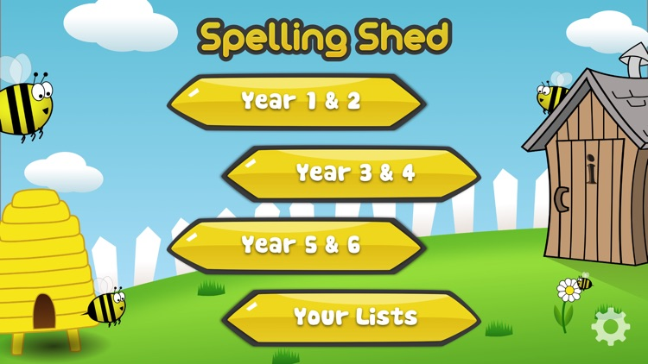
Y5&6 TOP SPELLERS TODAY
1st = Nelly 45 points
2nd = Zoe 32 points
3rd = Jack 17 points
4th= Toby and Nia 8 points
5th = Rhys 6 points
6th = Bethany and Cassie 5 points
7th = Henry and Harvey 3 points
8th = Dante 2 points
9th = Zac 1 point
These are the amount of dojos you have received for your efforts today!
Everybody else earns 1 dojo for practising their spellings today!

Slide 2
Here’s what Y5&6 have been
focusing on at home today.

Slide 3
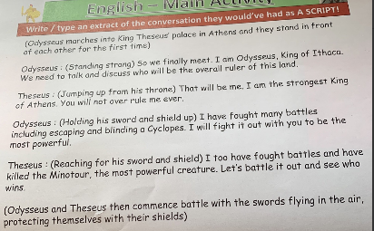
Here’s what Y5&6 have been focusing on at home today.
Henry practised his dialogue sentences before he wrote his own script for when Theseus meets Odysseus.

Slide 4
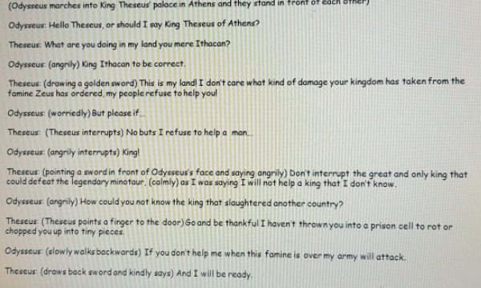
Here’s what Y5&6 have been focusing on at home today.
Cameron practised his dialogue sentences before he wrote his own script for when Theseus meets Odysseus.

Slide 5
Here’s what Y5&6 have been focusing on at home today.
Cyclops: (confidently) Well I am neither your friend nor do I fear you.
Theseus: Princess, how can I thank you, without your help, I would have never found my way out of that terrible place.
Isobel practised her dialogue sentences before she wrote her own script for when Theseus meets Odysseus.
(Odysseus marches into King Theseus’ palace in Athens and they stand in front of each other)
Theseus: (confused) And who are you?
Odysseus: I am Odysseus, King of Ithaca.
Theseus: (warily) And why are you here in my palace? Odysseus: (confidently) I am here to ask you if we could join up to protect both kingdoms.
Theseus: And why would we want to do that?
Odysseus: We would want to do it because if we can work together as a team we can protect our kingdom even more.
(Theseus turns to the window to think)
Theseus: But my kingdom is already protected and is in great hands.
Odysseus: (trying to persuade him) I know that but if one day we stumble along a big problem then we’ll both know we have someone to rely on.
Theseus: Okay… I guess so. What do we do first ?
Odysseus: Let’s have a big party and banquet to celebrate!

Slide 6
Here’s what Y5&6 have been focusing on at home today.
Cyclops: (confidently) Well I am neither your friend nor do I fear you.
Theseus: (lovingly with arms out wide) Princess, how can I thank you? Without you help, I would never have found my way out of that terrible place.
Toby practised his dialogue sentences before he wrote his own script for when Theseus meets Odysseus.
King Theseus: (loudly and smugly) Are you here as tea for the minotaur?
Odysseus: (laughed) I could kill your minotaur with one foul slash of my sword!
King Theseus: (smugly) I am not sure about that but please take some rest in one of the caverns before you try.

Slide 7
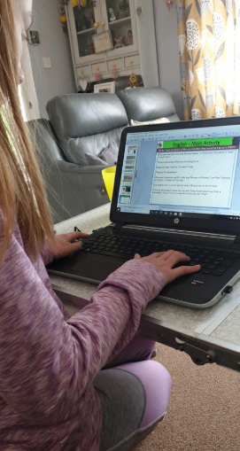
Here’s what Y5&6 have been focusing on at home today.
Bethany has been practising her sentences when writing dialogue for a script.

Slide 8
Here’s what Y5&6 have been focusing on at home today.
(Odysseus marches into King Theseus’ palace in Athens and they stand in front of each other)
Theseus: (shouting) What are you doing here?
Odysseus: May I ask you the same thing?
Theseus: It’s my palace?
Odysseus: (remembering) Oh, hello king Theseus of Athens. I am King Odysseus of Ithaca . I blinded the Cyclops.
(He walked over to a chair and sat down. Theseus sat on his throne)
Theseus: (Knowingly) I know who you are! I have heard about you from a messenger. You put a hot sizzling stick in his eye but forgot he was son of Poseidon.
(Odysseus stands up)
Odysseus: Well… yes. He then set a huge storm on me.
Theseus: I know about that too.
Odysseus: (surprised) Wow, you do know a lot don’t you? You were so great when you killed the Minotaur.
(He sat back down)
Theseus: You were great too. You’re so clever of thinking how to blind him and get away.
Odysseus: Thanks.
Theseus: (hand out in front of him) Shall we be friends?
Odysseus: (shaking Theseus’ hand) That would be tremendous.
(They both smiled)
Bethany has been writing her own script for when Theseus meets Odysseus.

Slide 9
Here’s what Y5&6 have been focusing on at home today.
Odysseus: Out of all these brave, strong and powerful warriors, I came across land and sea to meet you, a mighty soldier!
Theseus: Why thank you Odysseus! I think of you as a kind, outstanding warrior.
Odysseus: Would you like to hear one of my greatest stories ever?
Theseus: (Intrigued) What is this story you speak of, Odysseus?
Odysseus: The one with the Cyclopes and the cave.
Theseus: (Clueless) Oh yeah, that one.
Odysseus: I’m glad you have heard of my heroic story, What about you?
Theseus: Well, I killed a Minotaur and saved lots of children.
Odysseus: (sarcastic) Wow, you killed a monster. I’m so proud!
Theseus: (Getting his sword out) You know I’m allowed to thrash you.
Odysseus: (Getting ready to beat Theseus) Ok, it’s on!
Theseus: Alright, Let’s battle!
(Odysseus and Theseus charge towards each other and fight)
Odysseus: I AM SPARTAN!
Theseus: Err, no you’re not.
(Theseus and Odysseus finish the match)
Odysseus: (Giving his sword to Theseus) I give you my sword, use it on one of your brave battles, I shall be going, since I have Azeus to kill!
Theseus: Thank you, I shall remember this fight always.
Dante practised his dialogue sentences before he wrote his own script for when Theseus meets Odysseus.

Slide 10
Here’s what Y5&6 have been focusing on at home today.
Harvey has written his own script for when Theseus meets Odysseus.

Slide 11
Here’s what Y5&6 have been focusing on at home today.
Reuben has written his own script for when Theseus meets Odysseus………….

Slide 12
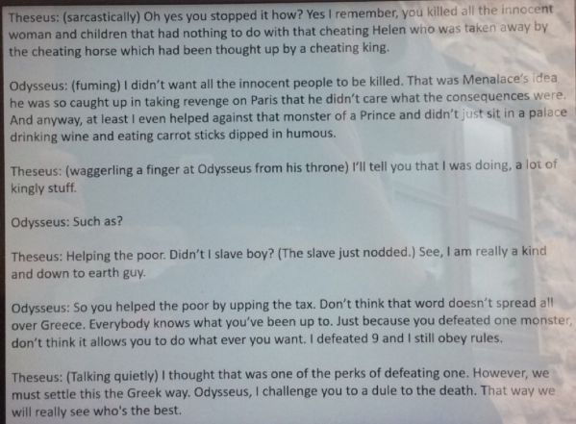
Here’s what Y5&6 have been focusing on at home today.

Slide 13
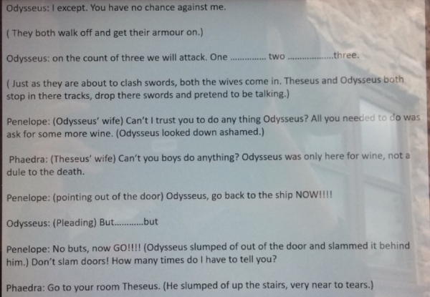
Here’s what Y5&6 have been focusing on at home today.

Slide 14
Here’s what Y5&6 have been focusing on at home today.
It was a long script but it was well worth it!

Slide 15
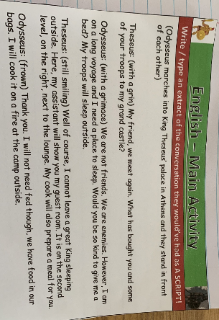
Here’s what Y5&6 have been focusing on at home today.
Zoe has written her own script for when Theseus meets Odysseus.

Slide 16
Here’s what Y5&6 have been focusing on at home today.
Amy has written her own script for when Theseus meets Odysseus.

Slide 17
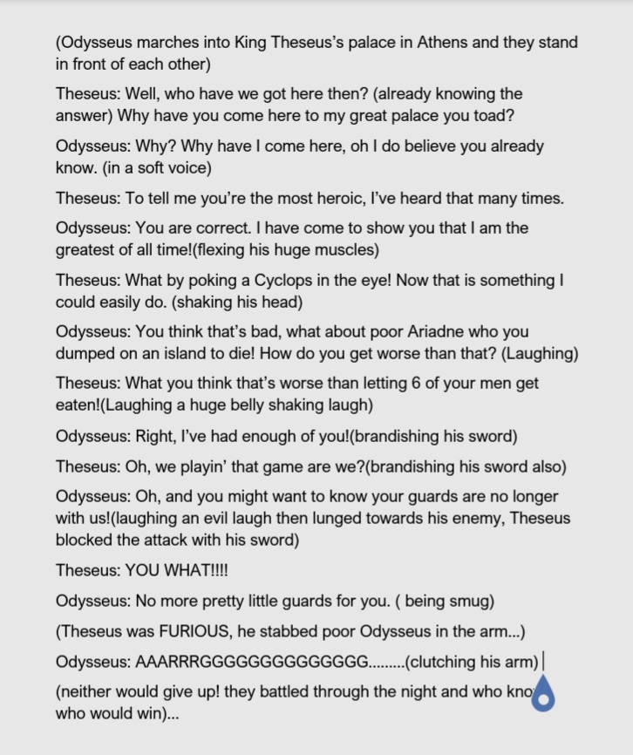
Here’s what Y5&6 have been focusing on at home today.
Lucy has written her own script for when Theseus meets Odysseus.

Slide 18
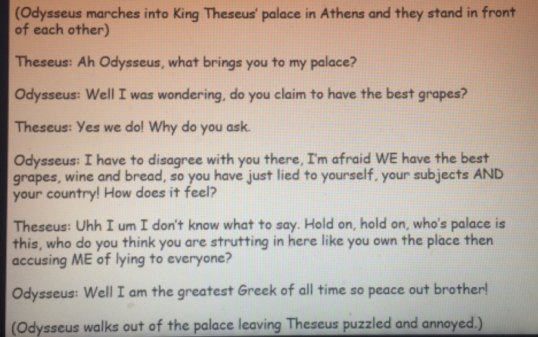
Here’s what Y5&6 have been focusing on at home today.
Megan has written her own script for when Theseus meets Odysseus.

Slide 19
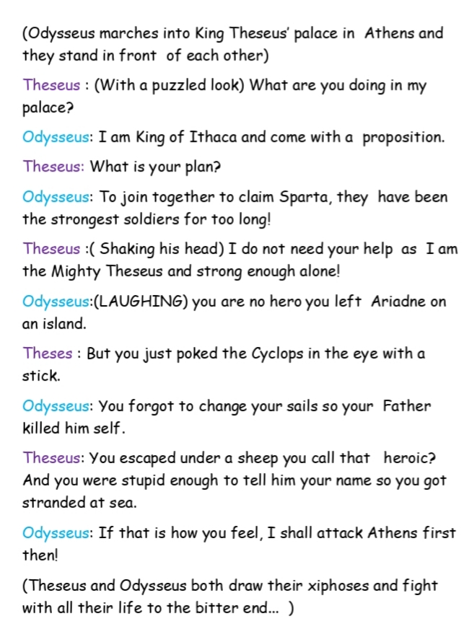
Here’s what Y5&6 have been focusing on at home today.
Katie has written her own script for when Theseus meets Odysseus.

Slide 20
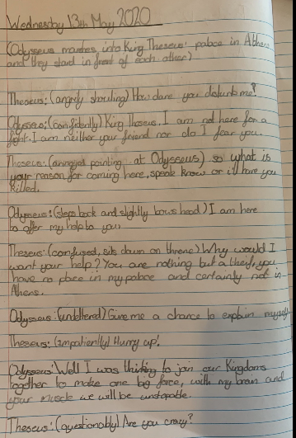
Here’s what Y5&6 have been focusing on at home today.
Nelly has written her own script for when Theseus meets Odysseus.

Slide 21
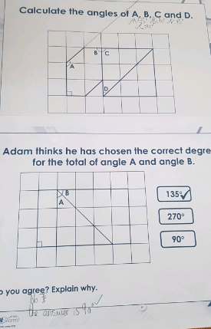
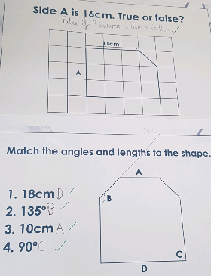
Here’s what Y5&6 have been focusing on at home today.
Cameron has used the squares and measurements provided to help her to calculate the lengths of the sides, as well as identifying the amounts of turn for the angles.

Slide 22
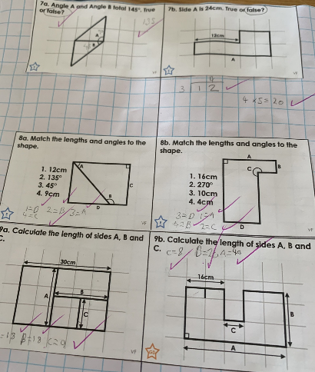
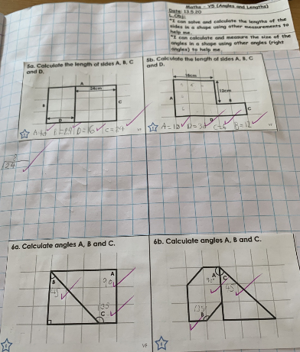
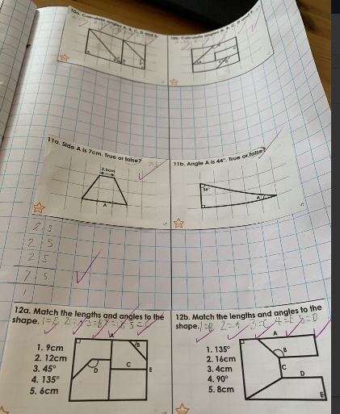
Here’s what Y5&6 have been focusing on at home today.
Zoe has used the squares and measurements provided to help her to calculate the lengths of the sides, as well as identifying the amounts of turn for the angles.

Slide 23
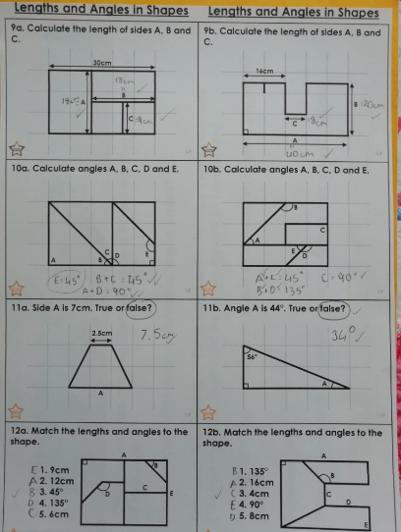
Here’s what Y5&6 have been focusing on at home today.
Amy has been studying these carefully to identify the size of the angles and the lengths of the sides.

Slide 24
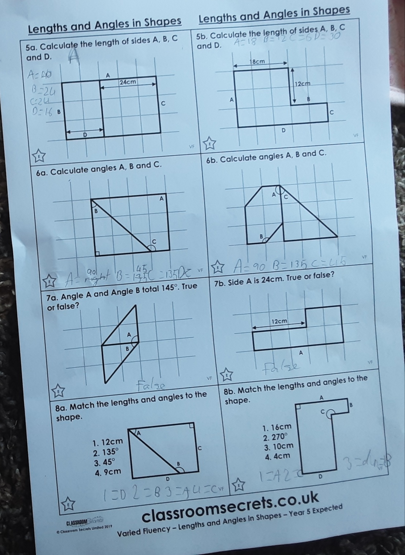
Here’s what Y5&6 have been focusing on at home today.
Katie has been studying these carefully to identify the size of the angles and the lengths of the sides.

Slide 25
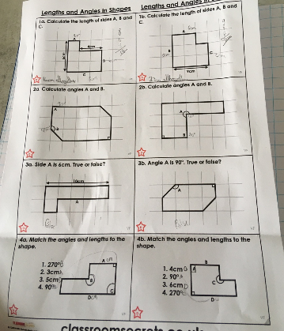
Here’s what Y5&6 have been focusing on at home today.
Isla has been studying these carefully to identify the size of the angles and the lengths of the sides.

Slide 26
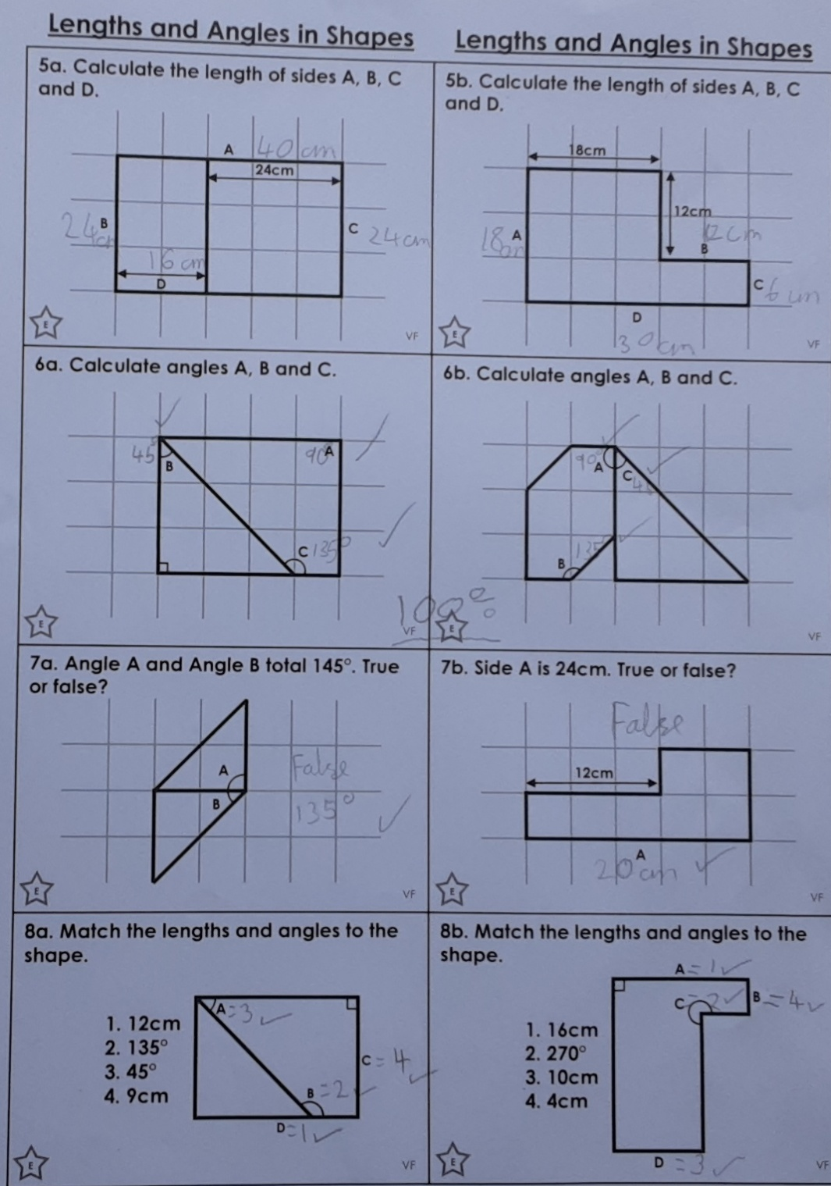
Here’s what Y5&6 have been focusing on at home today.
Lucy has been studying these carefully to identify the size of the angles and the lengths of the sides.

Slide 27
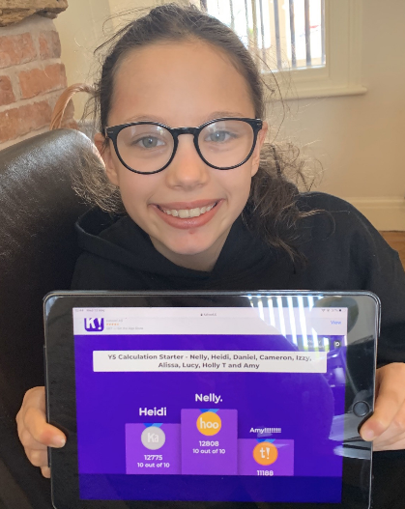
Here’s what Y5&6 have been focusing on at home today.
I finished top of the leaderboard in my Maths Kahoot calculation quiz today.

Slide 28
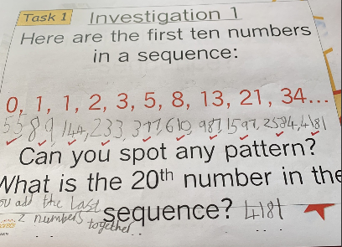
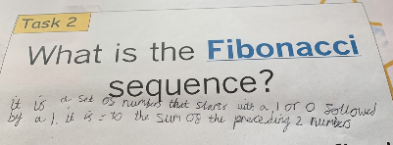
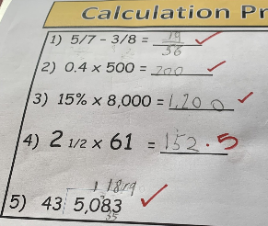
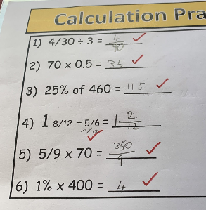
Here’s what Y5&6 have been focusing on at home today.
Henry has been learning that the Fibonacci sequence is when you add up the two previous numbers to get the next number in the sequence.
He has also been using pencil and paper today to help to solve these calculations.

Slide 29
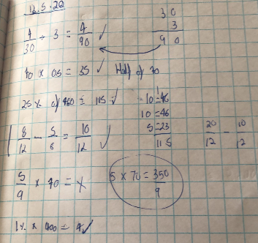
Here’s what Y5&6 have been focusing on at home today.
Harvey has been using pencil and paper today to help to solve these calculations.

Slide 30
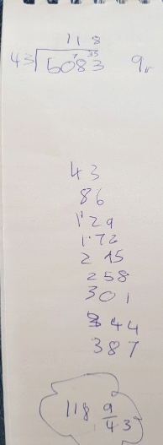
Here’s what Y5&6 have been focusing on at home today.
Elizabeth reaches the answer to the division calculation.
118r9 or 118 9/43

Slide 31
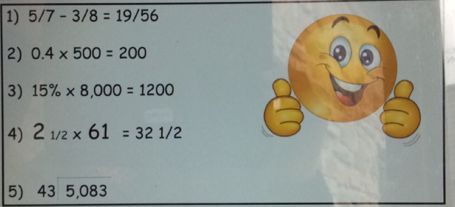
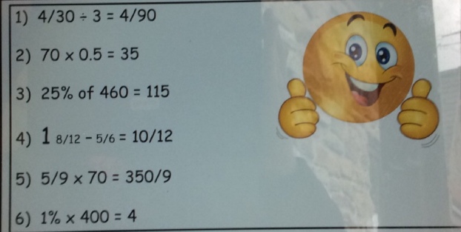
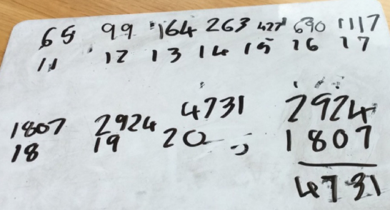
Here’s what Y5&6 have been focusing on at home today.
Reuben practising his calculations and trying to continue the Fibonacci sequence

Slide 32
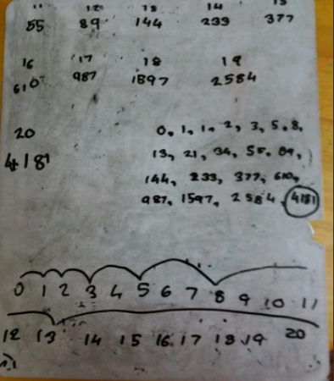
Here’s what Y5&6 have been focusing on at home today.
Jack has been trying to continue the Fibonacci sequence in maths.

Slide 33
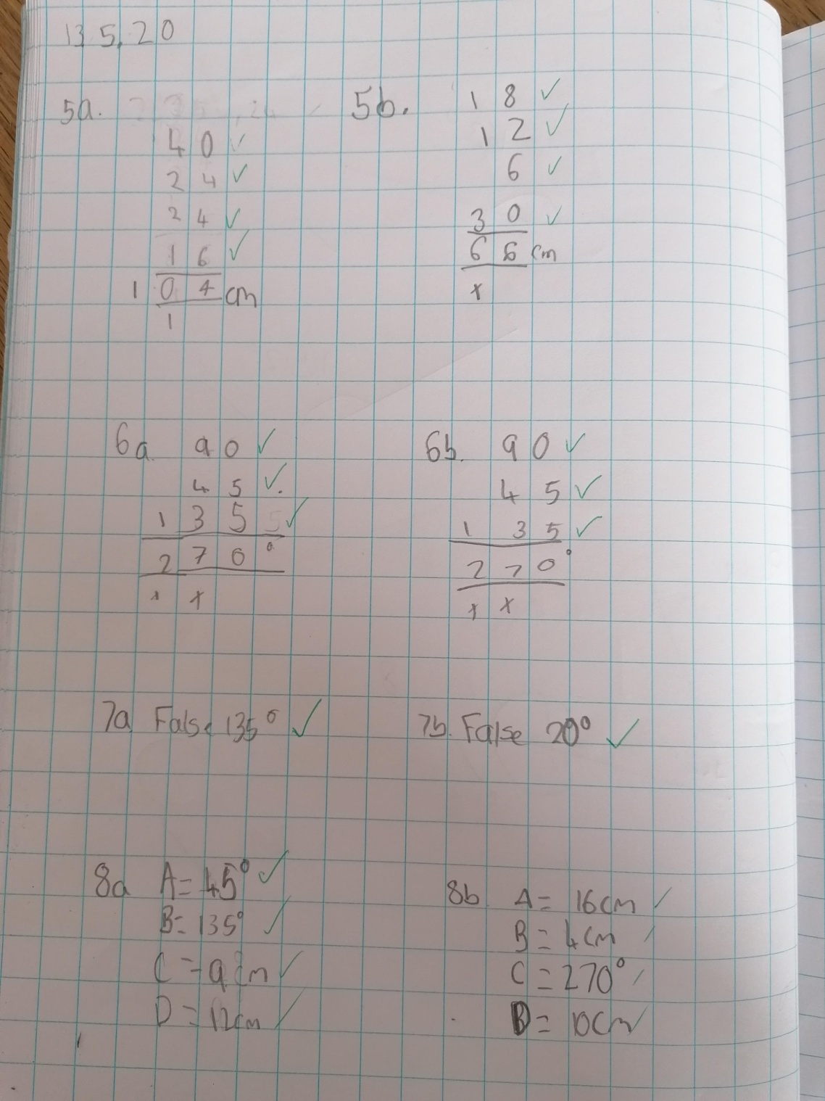
Here’s what Y5&6 have been focusing on at home today.
Isobel has been studying these carefully to identify the size of the angles and the lengths of the sides.

Slide 34
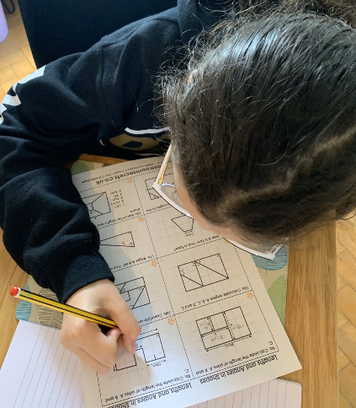
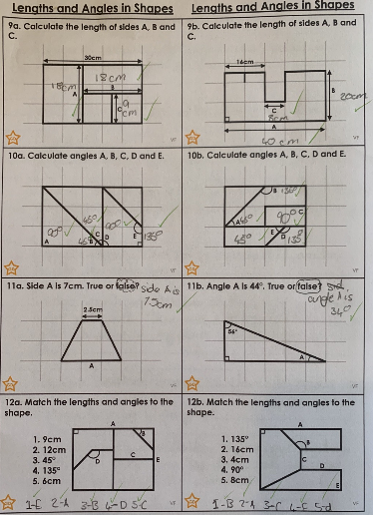
Here’s what Y5&6 have been focusing on at home today.
I’ve been studying these carefully to identify the size of the angles and the lengths of the sides.

Slide 35
Here’s what Y5&6 have been
focusing on at home today.

Slide 36
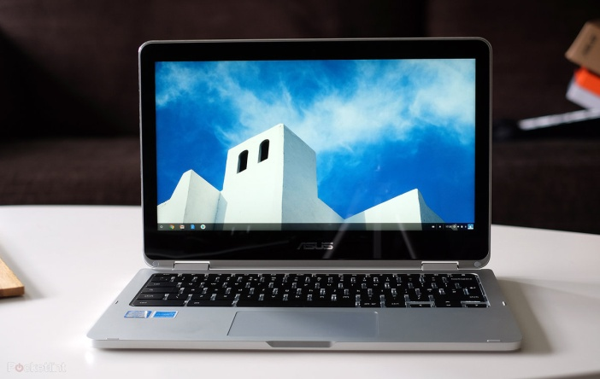
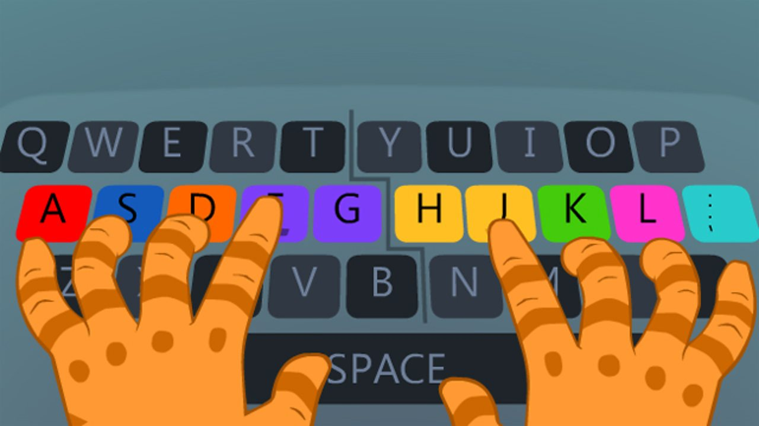
Here’s what Y5&6 have been
focusing on at home today.

Slide 37
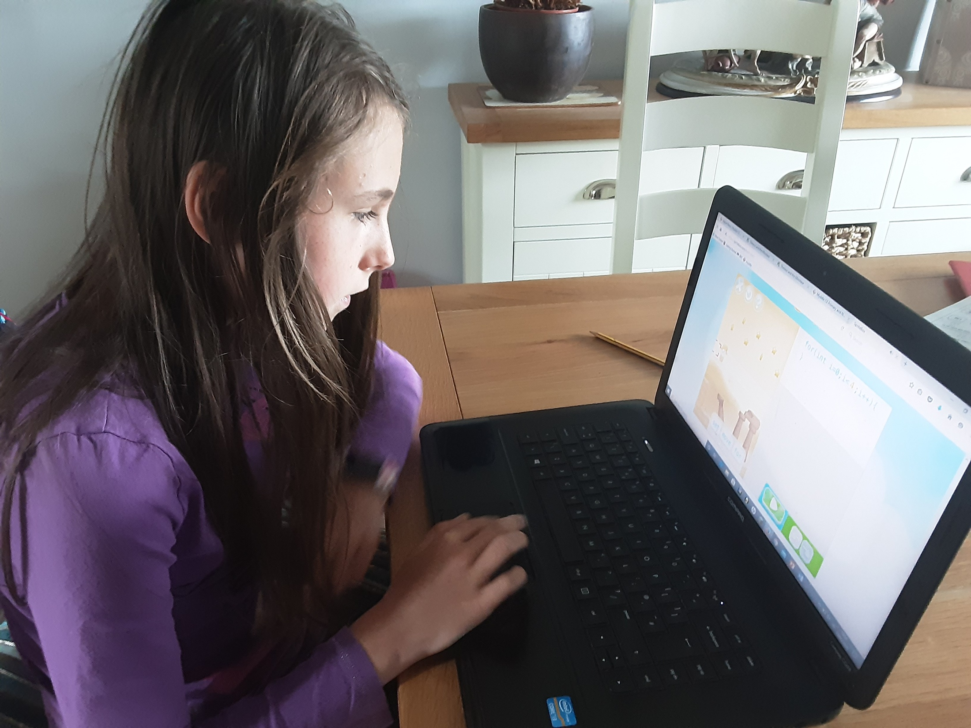
Here’s what Y5&6 have been focusing on at home today.
I’m enjoying the game that involves programming.

Slide 38
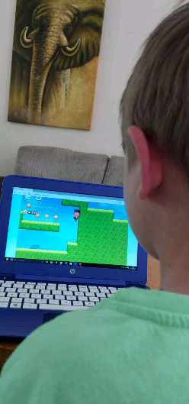
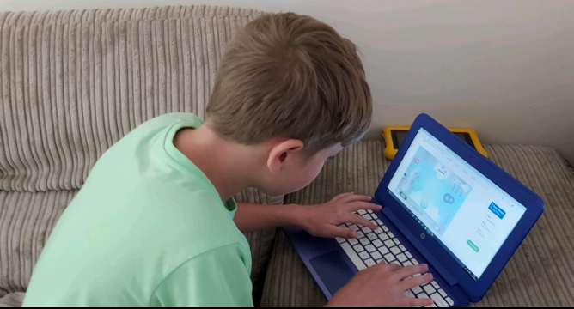
Here’s what Y5&6 have been focusing on at home today.
I’m enjoying the game that involves programming.

Slide 39
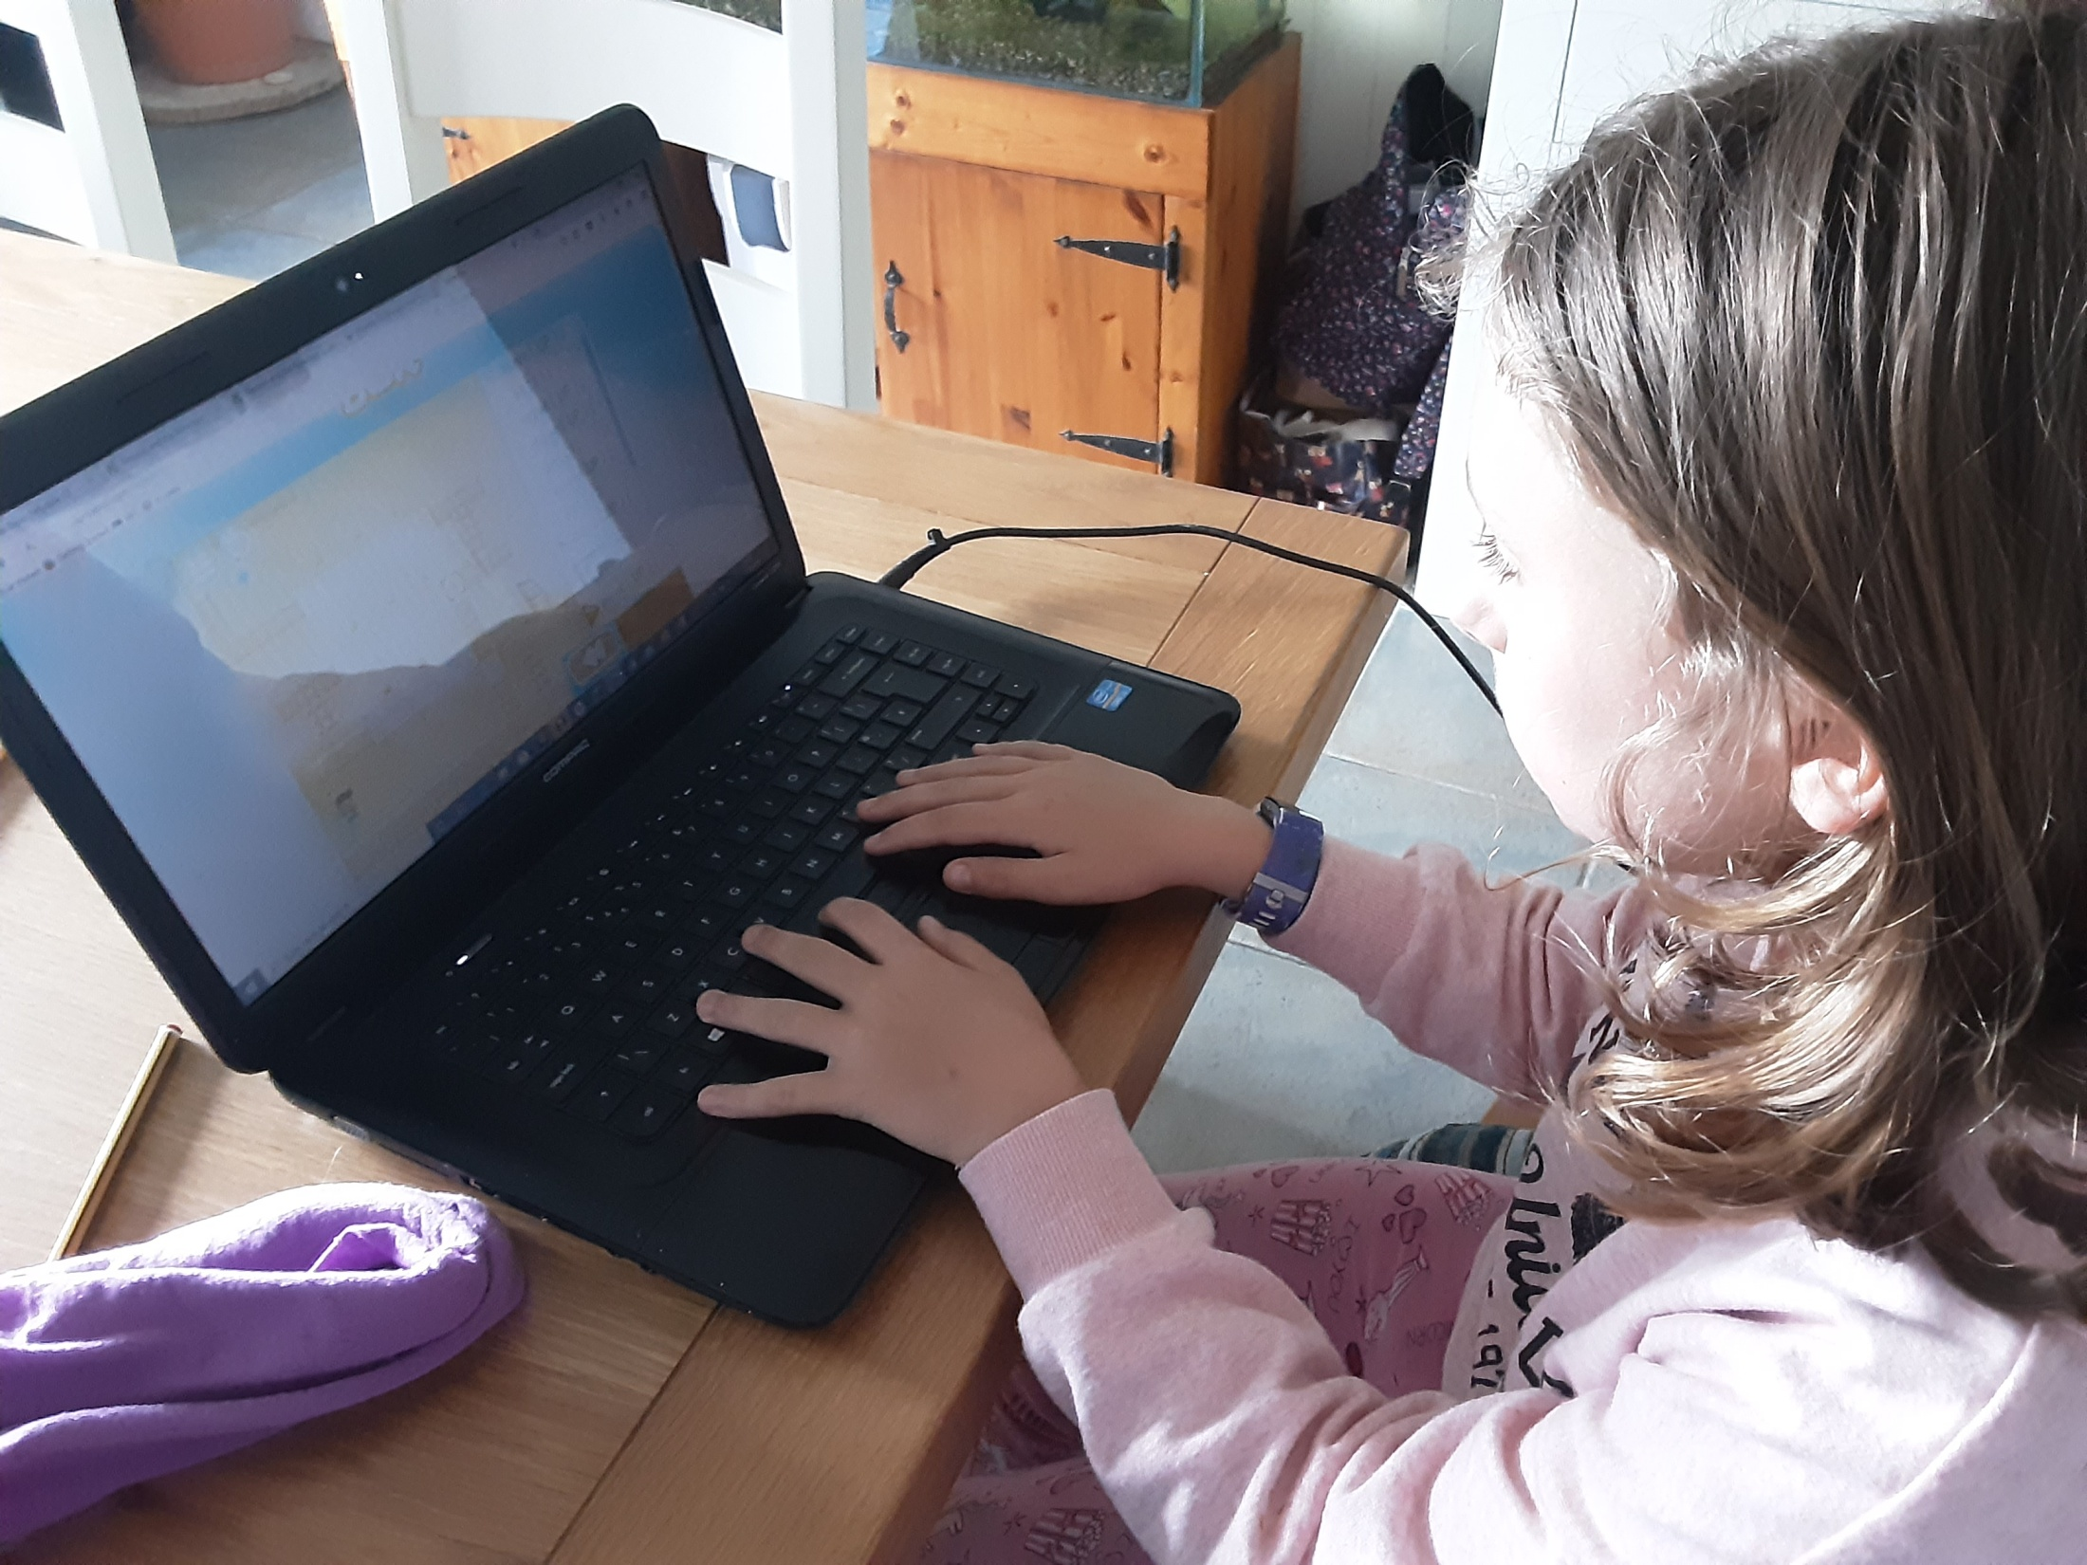
Here’s what Y5&6 have been focusing on at home today.
I’m enjoying the game that involves programming.

Slide 40
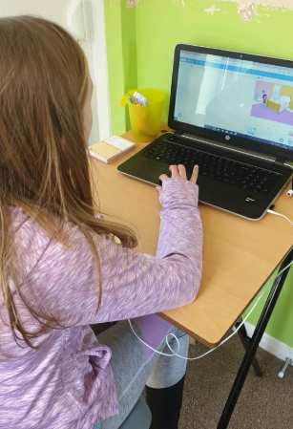
Here’s what Y5&6 have been focusing on at home today.
I’m enjoying the game that involves programming.

Slide 41
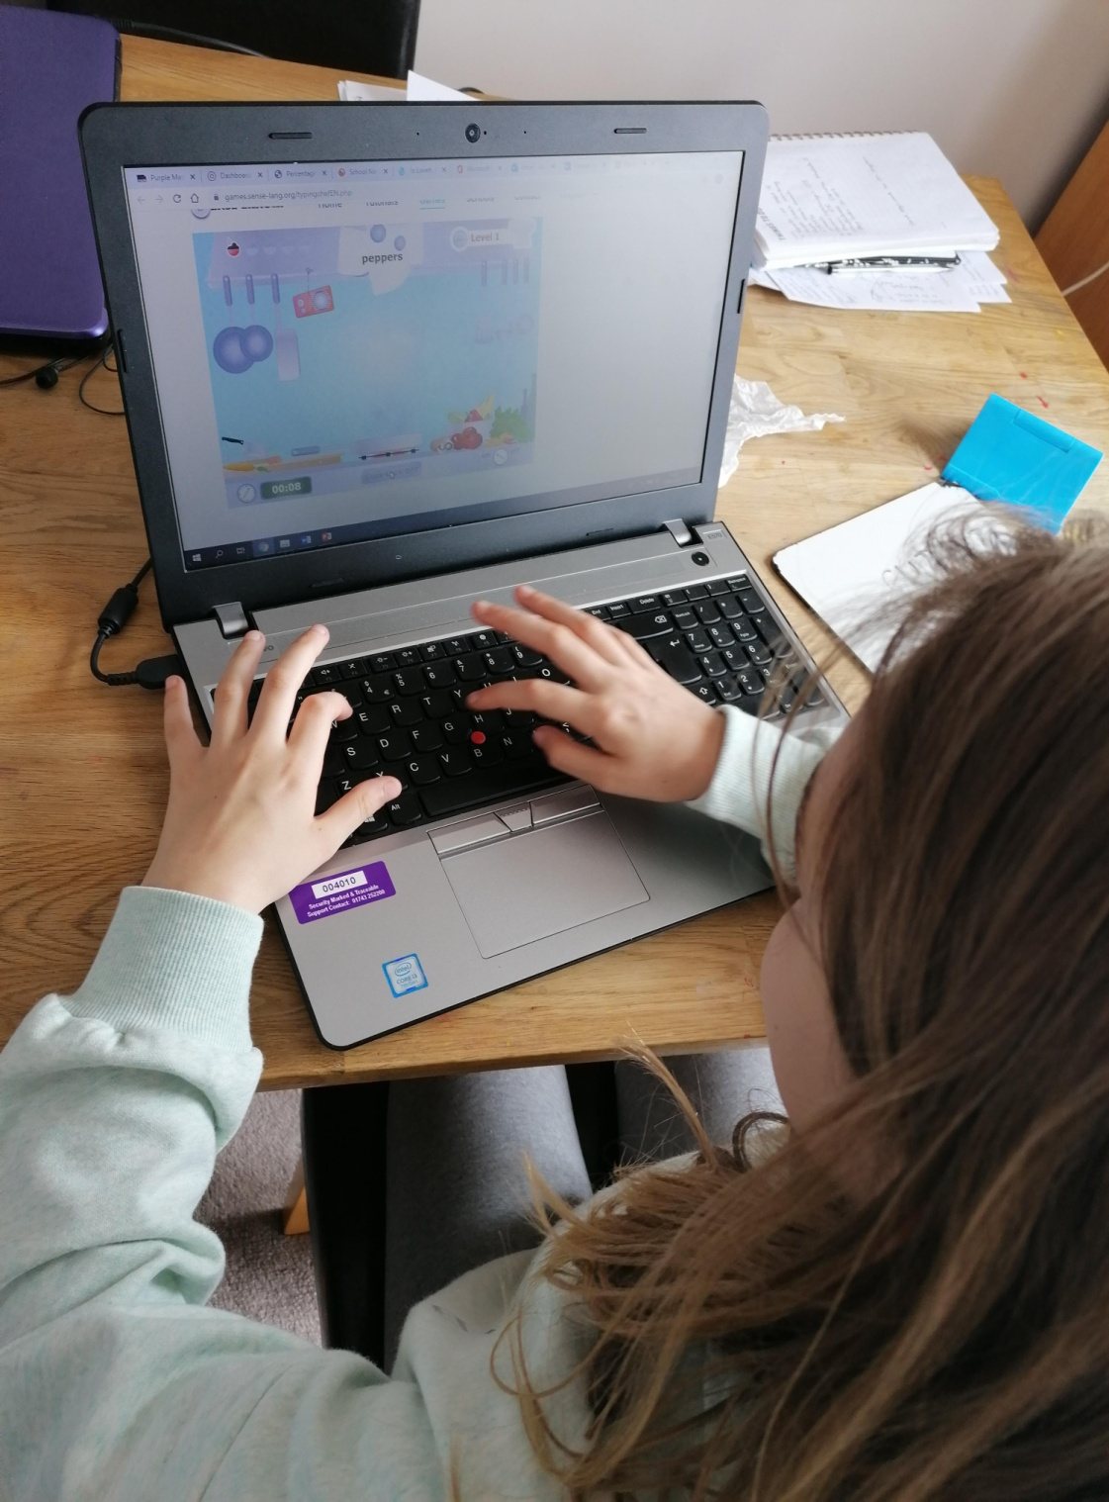
Here’s what Y5&6 have been focusing on at home today.
I’ve been practising the speed of my typing today.

Slide 42
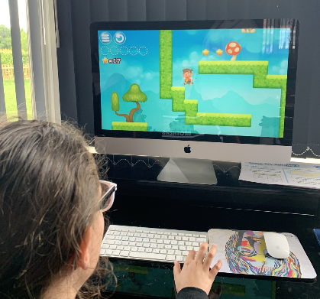
Here’s what Y5&6 have been focusing on at home today.
I’ve been enjoying my computing skills today.

Slide 43
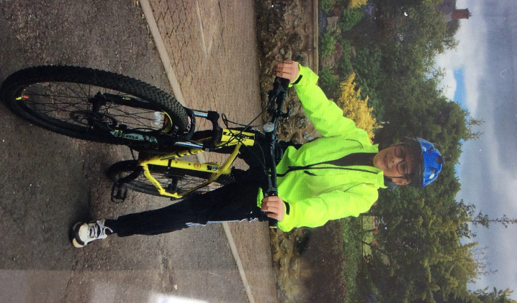
Here’s what Y5&6 have been focusing on at home today.
I’m all ready for my bikeability test in my high-visibility jacket and helmet.

Slide 44
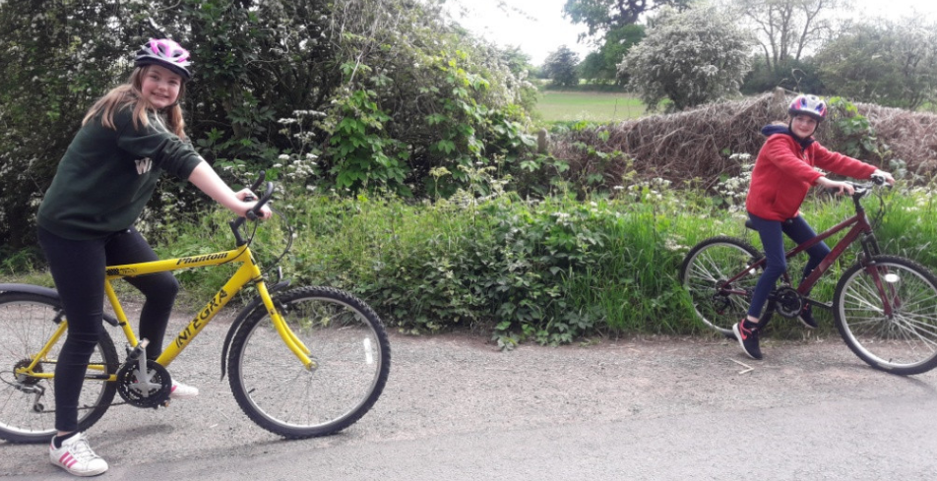
Here’s what Y5&6 have been focusing on at home today.
We’re enjoying our bike ride but following the rules too!

Slide 45
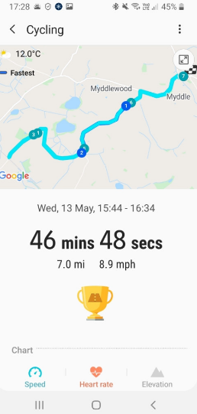
Here’s what Y5&6 have been focusing on at home today.
Bethany enjoyed another evening bike ride too.

Slide 46
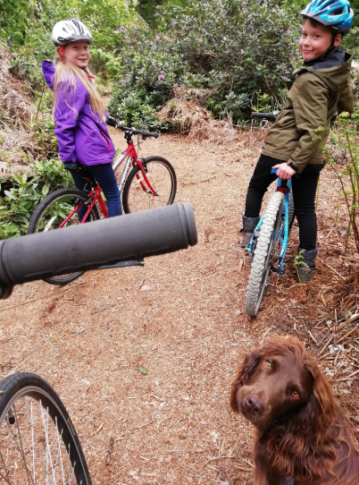
Here’s what Y5&6 have been focusing on at home today.
We’ve all enjoyed a bike ride (dog walk) this afternoon…….

Slide 47
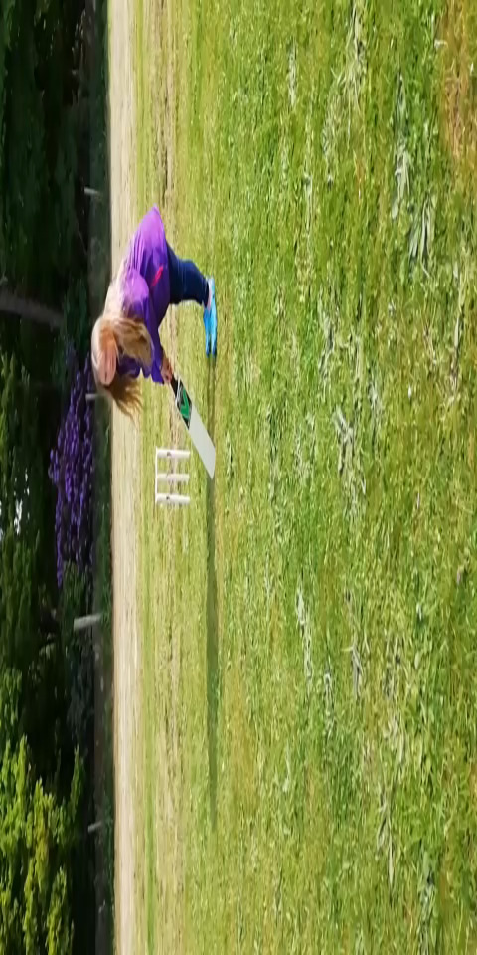
What else have we been doing at home today?
….and we also stopped off for a quick game of kwik cricket.

Slide 48
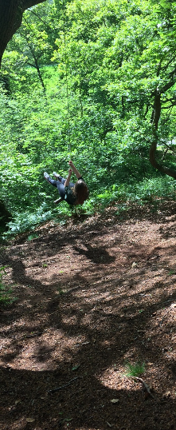
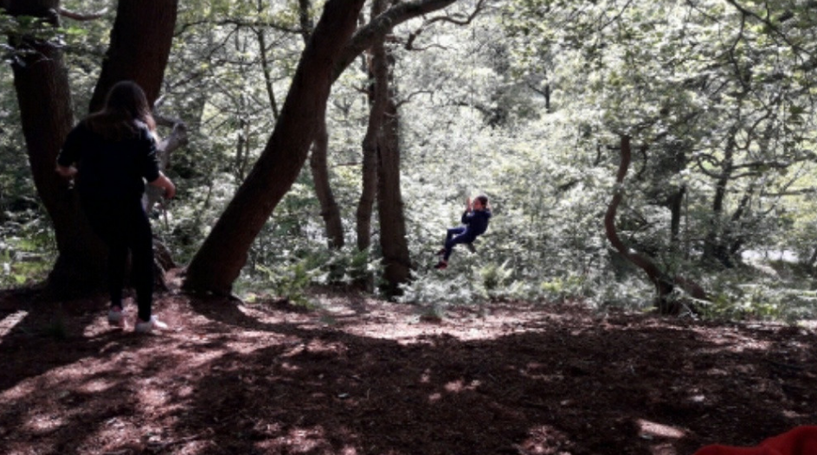
What else have we been doing at home today?
Megan and Chloe enjoying their time on the swing rope / log

Slide 49
What else have we been doing at home today?
Isobel has been busy in the kitchen baking this afternoon.

Slide 50
What else have we been doing at home today?
I went on a long walk yesterday and ended up in Reabrook so that the dog could enjoy a paddle.

Slide 51
What else have we been doing at home today?
Today, I baked a cake and delivered it to my great auntie.

Slide 52
What else have we been doing at home today?
Amy found an old broken terracotta pot, painted it and used the Greek alphabet to spell 'The Cookies' her name and Ben's.

Slide 53
What else have we been doing at home today?
An old broken jug, turned into an ancient Greek artefact!

Slide 54
What else have we been doing at home today?
I’ve been helping to move sandstone boulders.

Slide 55
What else have we been doing at home today?
We’ve been practising our spellings on Spelling Shed

Slide 56
What else have we been doing at home today?
Cassie has been researching the gestation periods of different animals and comparing them to humans

Slide 57
What else have we been doing at home today?
Cassie identifying the difference between the Athenians and the Spartans
Cassie has been solving her maths ‘square numbers’ investigations, as well as taking part in the Kahoot Maths quizzes

Slide 58
What else have we been doing at home today?
A collection of Cassie’s English throughout the week so far

