Slide 1
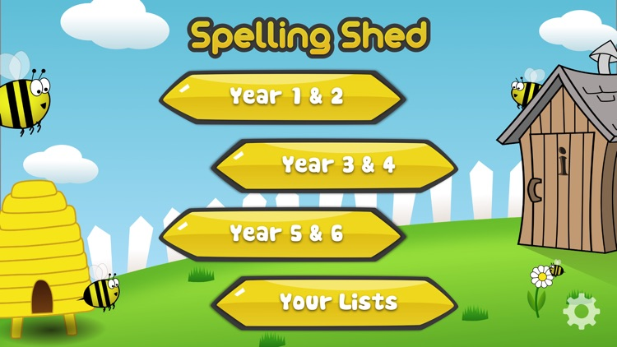
Y5&6 TOP SPELLERS TODAY
1st = Henry 52 points
2nd = Nelly 39 points
3rd = Heidi 35 points
4th = Zoe 27 points
5th = Jack 24 points
6th = Ruby 19 points
7th = Amy 17 points
8th = Dante 10 points
9th = Rhys 9 points
These are the amount of dojos you have received for your efforts today!
Everybody else earns 1 dojo for practising their spellings today!

Slide 2
Here’s what Y5&6 have been
focusing on at home today.

Slide 3
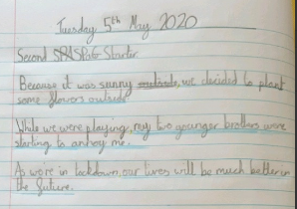
Here’s what Y5&6 have been focusing on at home today.
Bethany has opened her sentences with subordinate clauses, including commas.

Slide 4
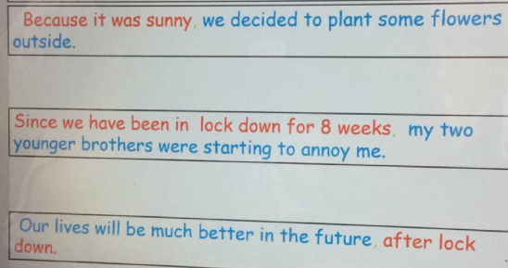
Here’s what Y5&6 have been focusing on at home today.
Reuben has opened his sentences with subordinate clauses, including commas.

Slide 5
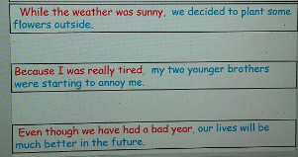
Here’s what Y5&6 have been focusing on at home today.
Toby has opened his sentences with subordinate clauses, including commas.

Slide 6
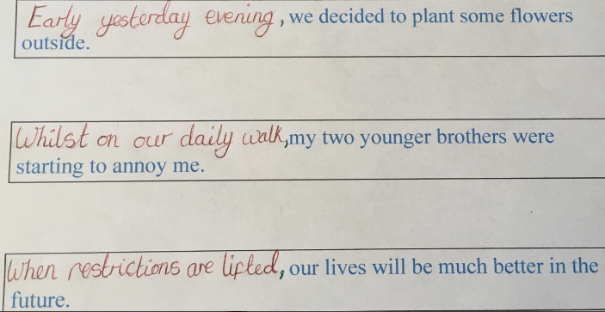
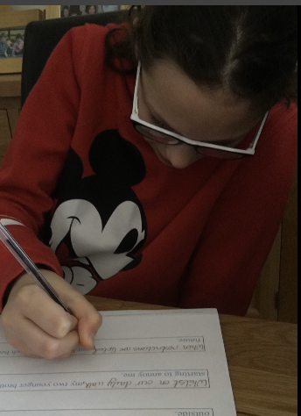
Here’s what Y5&6 have been focusing on at home today.
Nelly has opened his sentences with subordinate clauses, including commas.

Slide 7
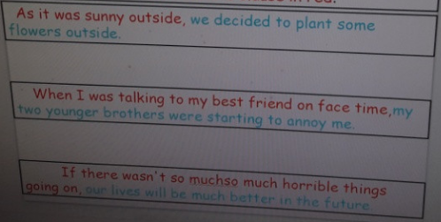
Here’s what Y5&6 have been focusing on at home today.
Chloe has opened her sentences with subordinate clauses, including commas.

Slide 8
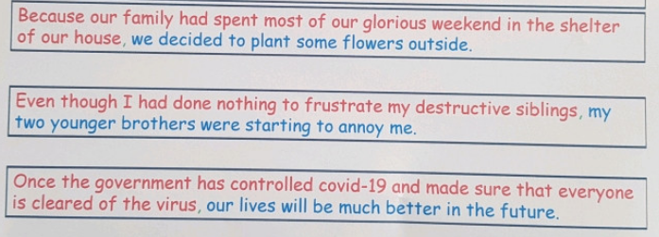
Here’s what Y5&6 have been focusing on at home today.
Cameron has opened his sentences with subordinate clauses, including commas.

Slide 9
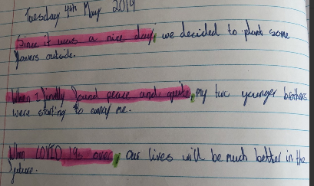
Here’s what Y5&6 have been focusing on at home today.
Harvey has opened his sentences with subordinate clauses, including commas.

Slide 10
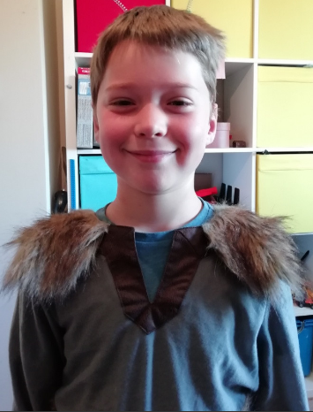
Here’s what Y5&6 have been focusing on at home today.
Amy’s chosen minotaur!

Slide 11
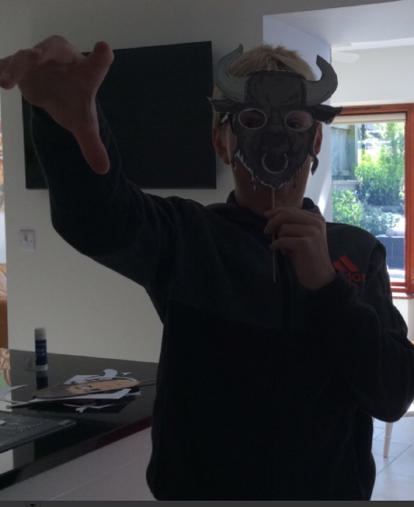
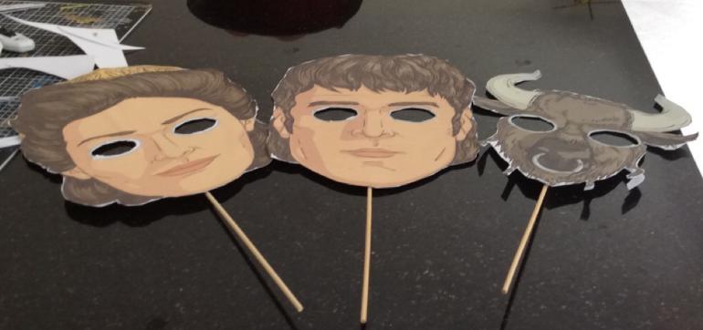
Here’s what Y5&6 have been focusing on at home today.
Roooaaarrrr!!

Slide 12
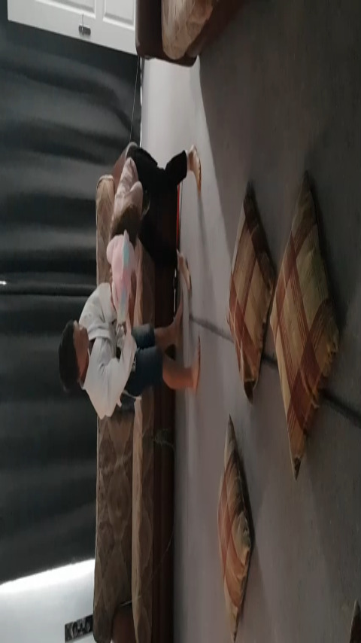
Here’s what Y5&6 have been focusing on at home today.
Theseus and the Minotaur – The Fight Scene

Slide 13
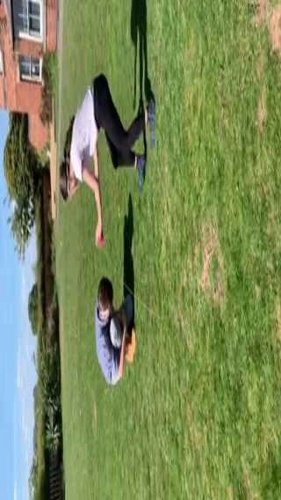
Here’s what Y5&6 have been focusing on at home today.
Theseus and the Minotaur – The Fight Scene

Slide 14
Here’s what Y5&6 have been
focusing on at home today.

Slide 15
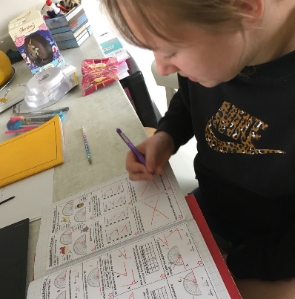
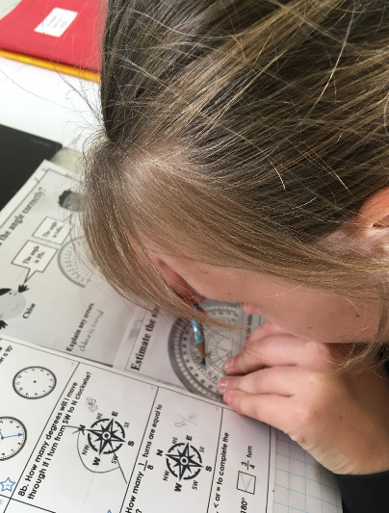
What else have we been doing at home today?
Here’s what Y5&6 have been focusing on at home today.
Using my protractor to help me to measure the angles in maths.

Slide 16
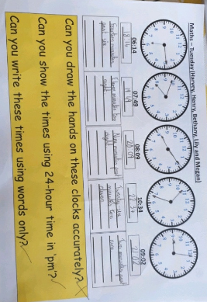
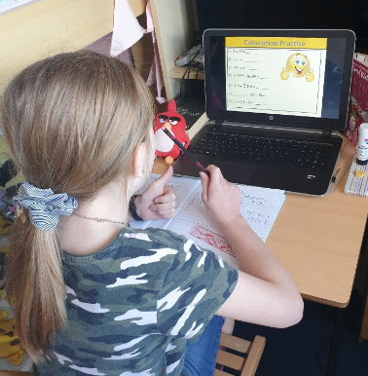
Here’s what Y5&6 have been focusing on at home today.
Drawing, recognising and writing digital and analogue time.

Slide 17
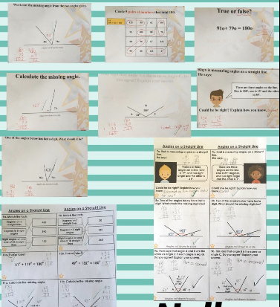
Here’s what Y5&6 have been focusing on at home today.
Nelly has thought carefully about her angles on a straight line totalling 180°.

Slide 18
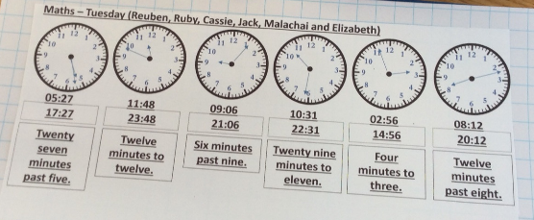
Here’s what Y5&6 have been focusing on at home today.
Reuben has been drawing, recognising and writing digital and analogue time.

Slide 19
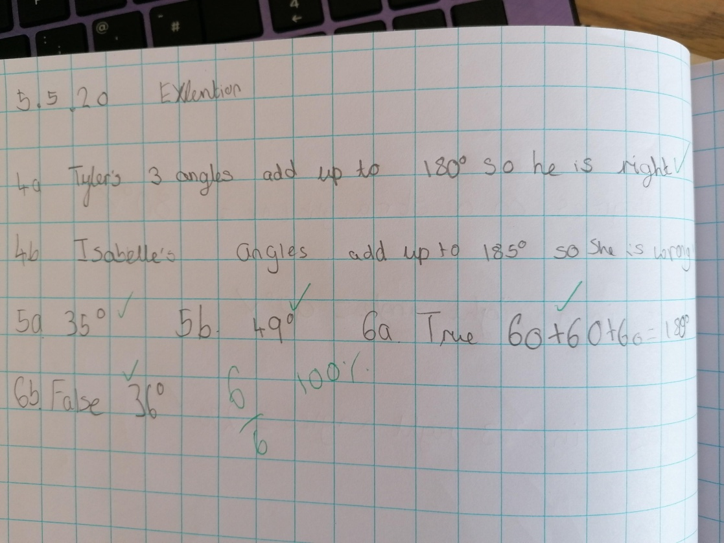
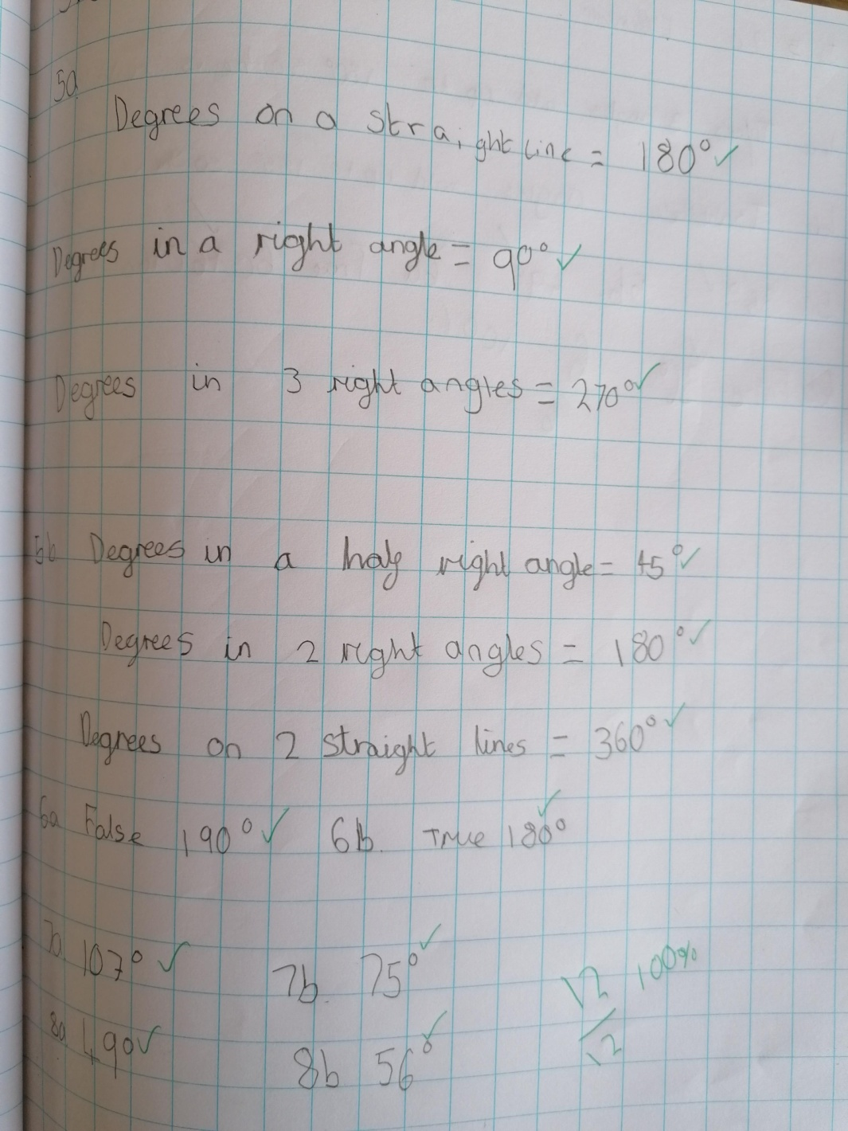
Here’s what Y5&6 have been focusing on at home today.
Isobel has thought carefully about her angles on a straight line totalling 180°.

Slide 20
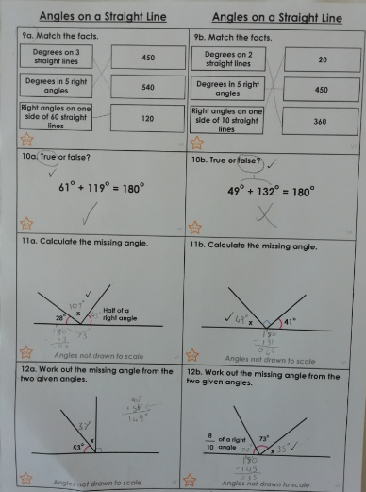
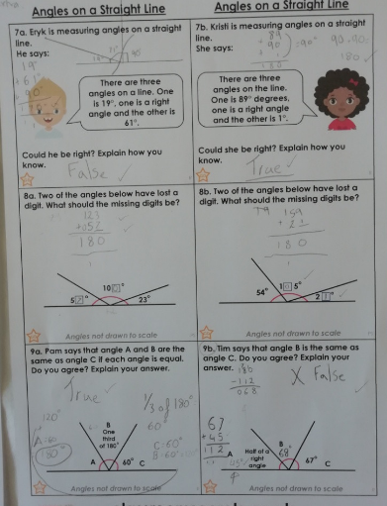
Here’s what Y5&6 have been focusing on at home today.
Amy has thought carefully about her angles on a straight line totalling 180°.

Slide 21
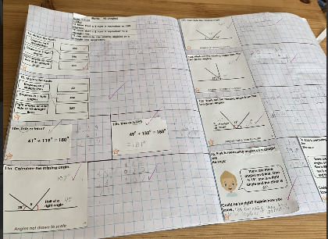
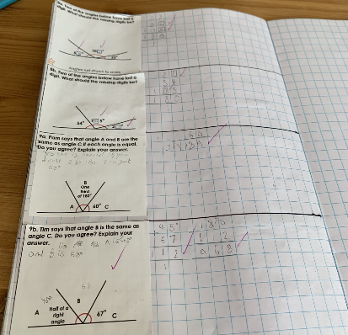
Here’s what Y5&6 have been focusing on at home today.
Zoe has thought carefully about her angles on a straight line totalling 180°. Lovely presentation too!

Slide 22
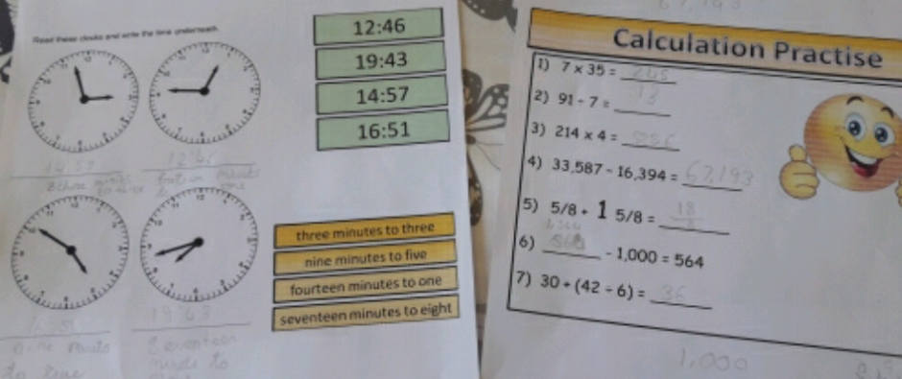
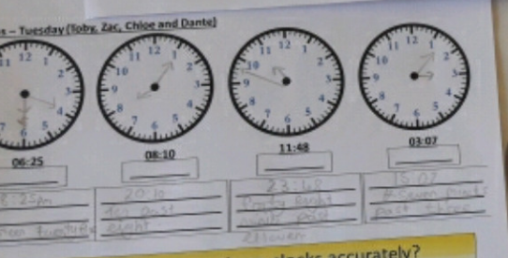
Here’s what Y5&6 have been focusing on at home today.
Chloe has been practising her calculation skills before drawing, recognising and writing digital and analogue time.

Slide 23
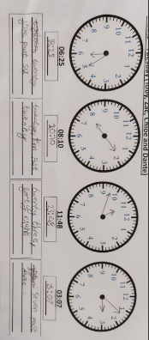
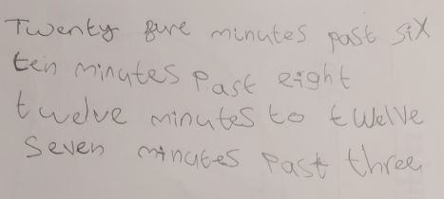
Here’s what Y5&6 have been focusing on at home today.
Dante has been practising his calculation skills before drawing, recognising and writing digital and analogue time.

Slide 24
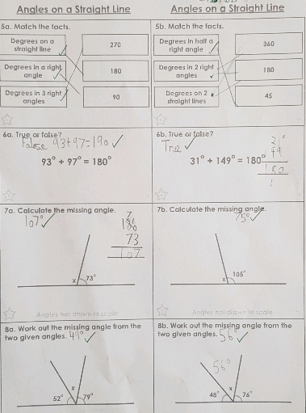
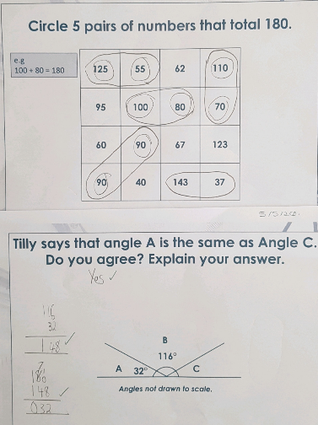
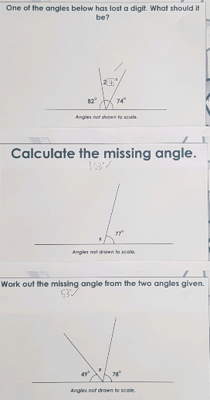
Here’s what Y5&6 have been focusing on at home today.
Cameron has thought carefully about his angles on a straight line totalling 180°.

Slide 25
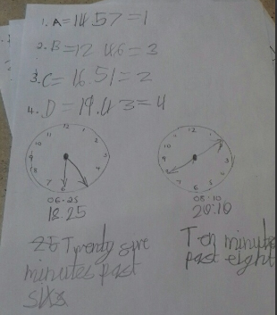
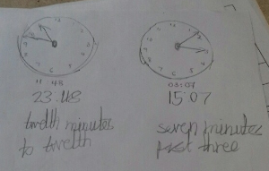
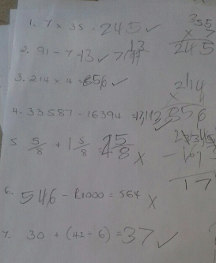
Here’s what Y5&6 have been focusing on at home today.
Toby has been practising his calculation skills before drawing, recognising and writing digital and analogue time.

Slide 26
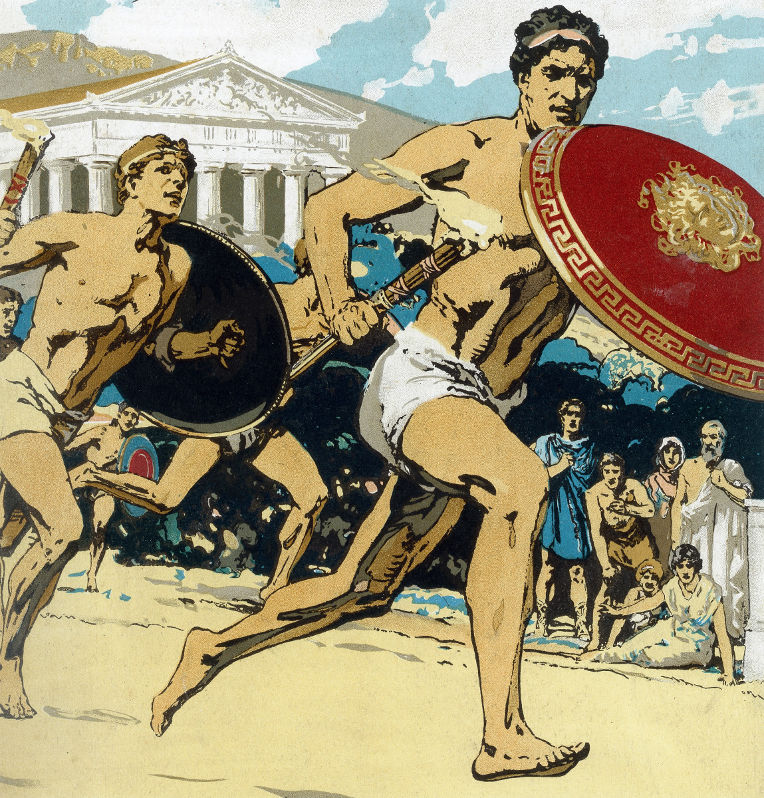
Here’s what Y5&6 have been
focusing on in History at home today.

Slide 27
History - Ancient Greek Olympics
Isobel has categorised the modern and ancient Olympic events.

Slide 28
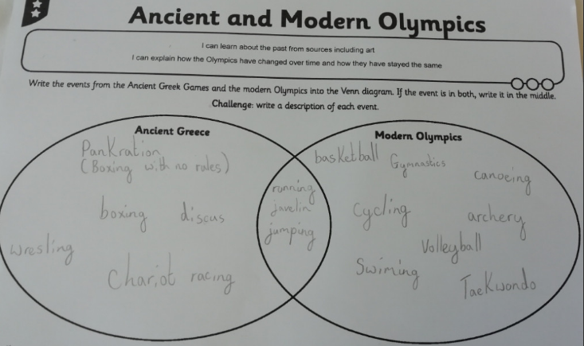
History - Ancient Greek Olympics
Amy has categorised the modern and ancient Olympic events.

Slide 29
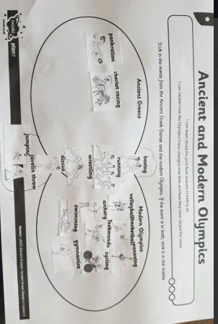
History - Ancient Greek Olympics
Bethany has categorised the modern and ancient Olympic events.

Slide 30
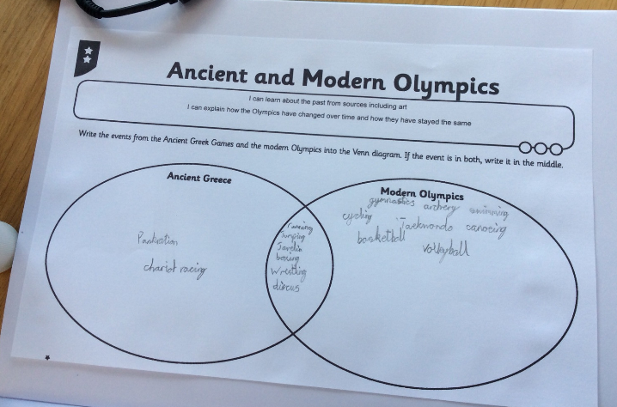
History - Ancient Greek Olympics
Reuben has categorised the modern and ancient Olympic events.

Slide 31
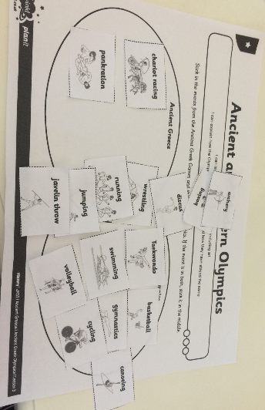
History - Ancient Greek Olympics
Megan has categorised the modern and ancient Olympic events.

Slide 32
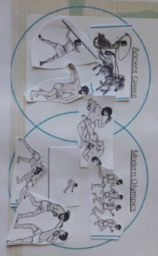
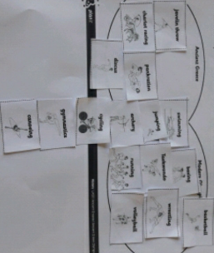
History - Ancient Greek Olympics
Chloe is aiming to categorise the modern and ancient Olympic events.

Slide 33
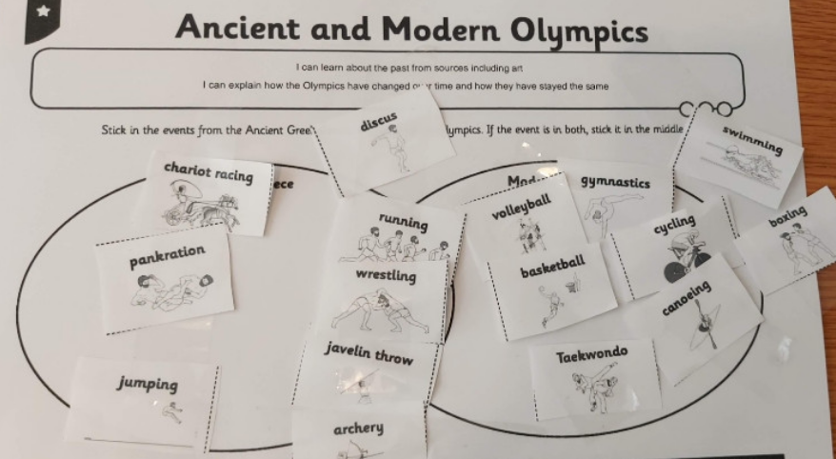
History - Ancient Greek Olympics
Dante is attempting to categorise the modern and ancient Olympic events.

Slide 34
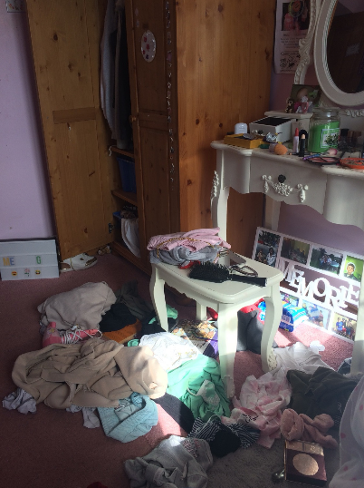
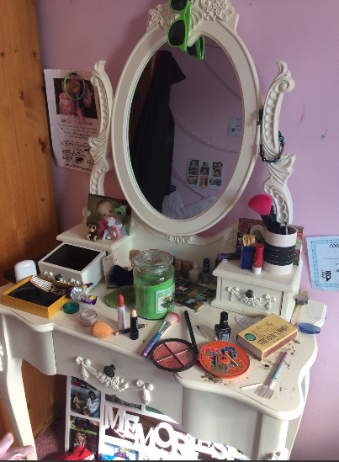
What else have we been doing at home today?
Megan has been tidying her bedroom today – from this…….

Slide 35
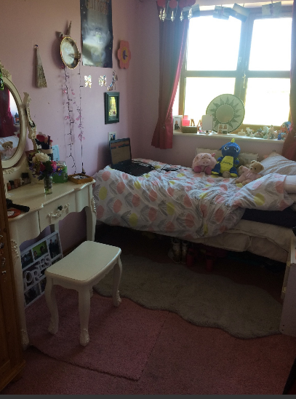
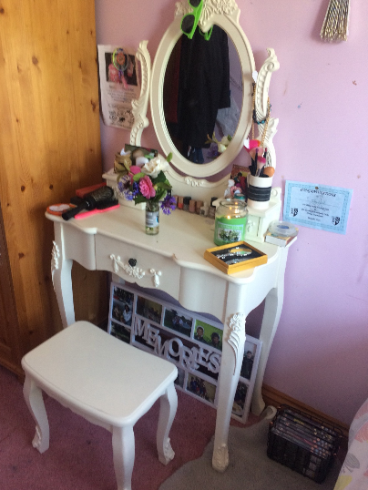
What else have we been doing at home today?
……….to this

Slide 36
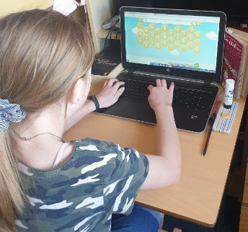
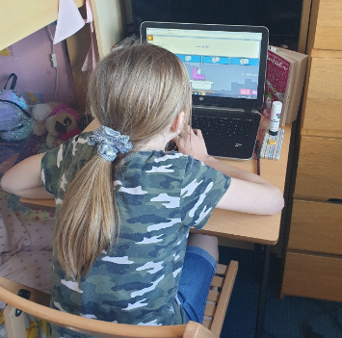
What else have we been doing at home today?
Spelling Shed and Sumdog to start the day.

Slide 37
What else have we been doing at home today?
More jewellery creations today.

Slide 38
What else have we been doing at home today?
Indoor camping is the way to go in the future.
Zoe has proved this!

Slide 39
What else have we been doing at home today?
More magic maths!

Slide 40
What else have we been doing at home today?
That red velvet cake looks delicious!

Slide 41
What else have we been doing at home today?
My feet can nearly touch the floor even though I’ve just climbed this tree!

Slide 42
What else have we been doing at home today?
Story time
Day 9

