Slide 1
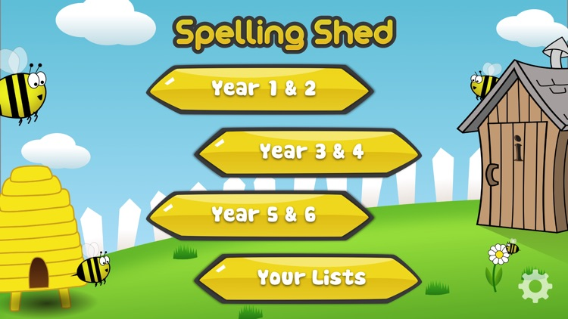
Y5&6 TOP SPELLERS TODAY
1st = Amy 23+ points
2nd = Izzy 22 points
3rd = Holly H 20 points
4th = Nia 17 points
5th = Jack 16 points
6th = Ruby 13 points
7th = Henry 11 points
^{8th} = Megan 8 points
9th = Reuben 6 points
These are the amount of dojos you have received for your efforts today!
Everybody else earns 1 dojo for practising their spellings today!

Slide 2
Here’s what Y5&6 have been
focusing on at home today.

Slide 3
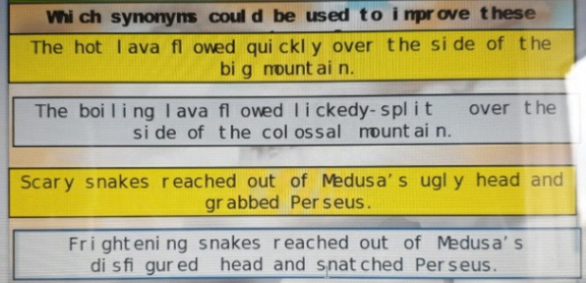
Here’s what Y5&6 have been
focusing on at home today.
Bethany is improving her sentences by choosing more quality synonyms.

Slide 4
Here’s what Y5&6 have been
focusing on at home today.
Reuben is improving his sentences by choosing more quality synonyms.

Slide 5
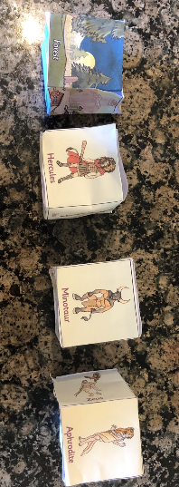
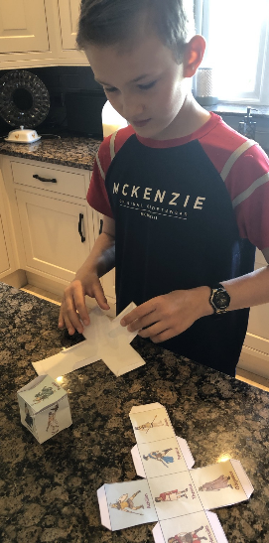
Here’s what Y5&6 have been
focusing on at home today.
I’ve made by story dice and now I need to roll them to see what choices I have made for my Greek myth.

Slide 6
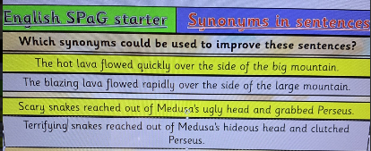
Here’s what Y5&6 have been
focusing on at home today.
Henry is improving his sentences by choosing more quality synonyms.

Slide 7
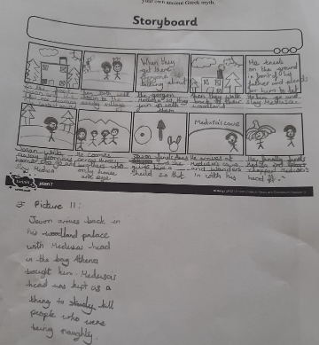
Here’s what Y5&6 have been
focusing on at home today.
Ruby has planned the main events in her ancient Greek myth story.

Slide 8
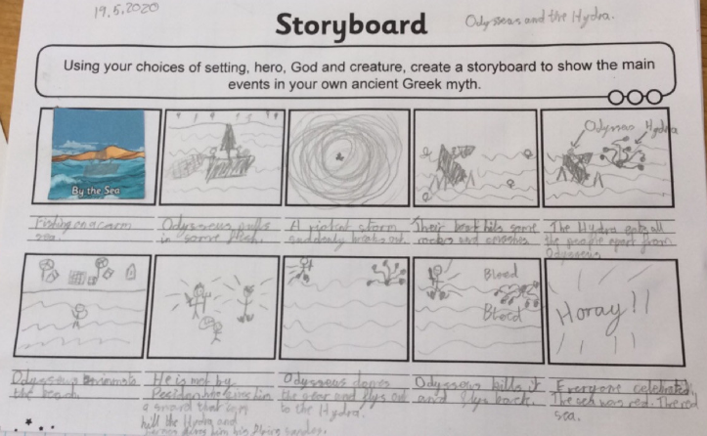
Here’s what Y5&6 have been
focusing on at home today.
Reuben has planned the main events in his ancient Greek myth story.

Slide 9
Here’s what Y5&6 have been
focusing on at home today.
Cameron is improving his sentences by choosing more quality synonyms.

Slide 10
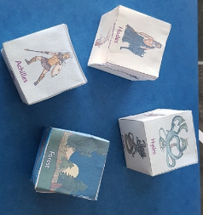
Here’s what Y5&6 have been
focusing on at home today.
Cameron has made the story dice to help him to plan his ancient Greek myth.

Slide 11
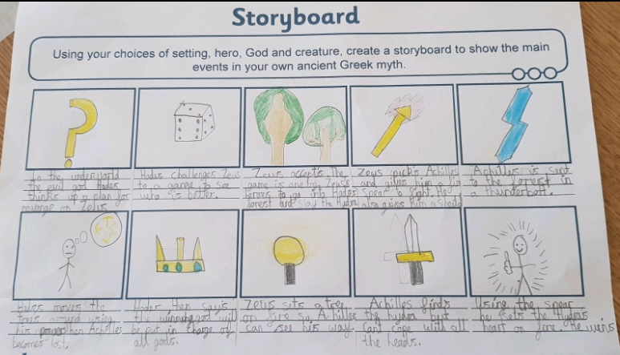
Here’s what Y5&6 have been
focusing on at home today.
Cameron has planned the main events in his ancient Greek myth story.

Slide 12
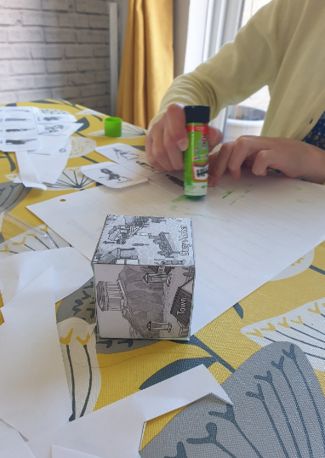
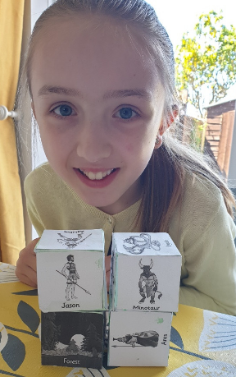
Here’s what Y5&6 have been
focusing on at home today.
I’ve made the story dice to help me to plan my ancient Greek myth.

Slide 13
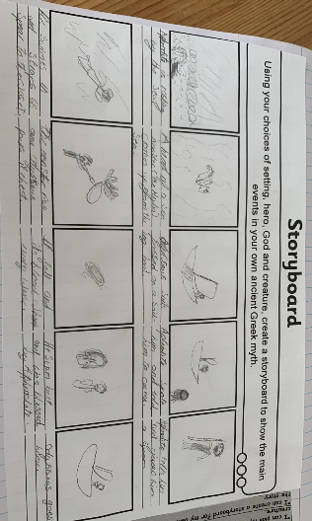
Here’s what Y5&6 have been
focusing on at home today.
Zoe has planned the main events in her ancient Greek myth story.

Slide 14
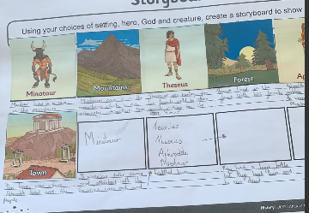
Here’s what Y5&6 have been
focusing on at home today.
Cassie has planned the main events in her ancient Greek myth story.

Slide 15
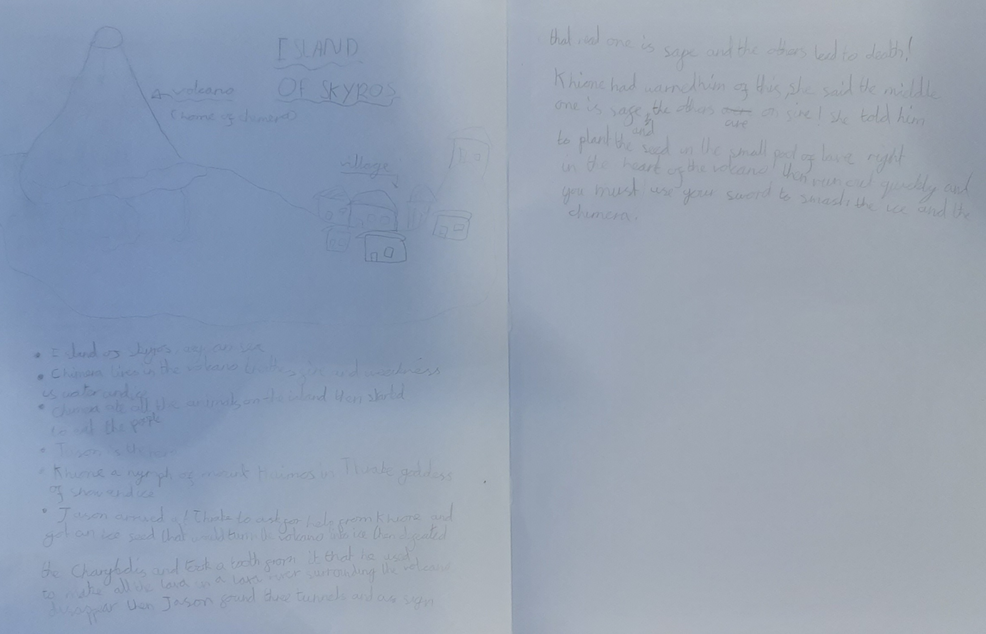
Here’s what Y5&6 have been
focusing on at home today.
Lucy has planned the main events in her ancient Greek myth story.

Slide 16
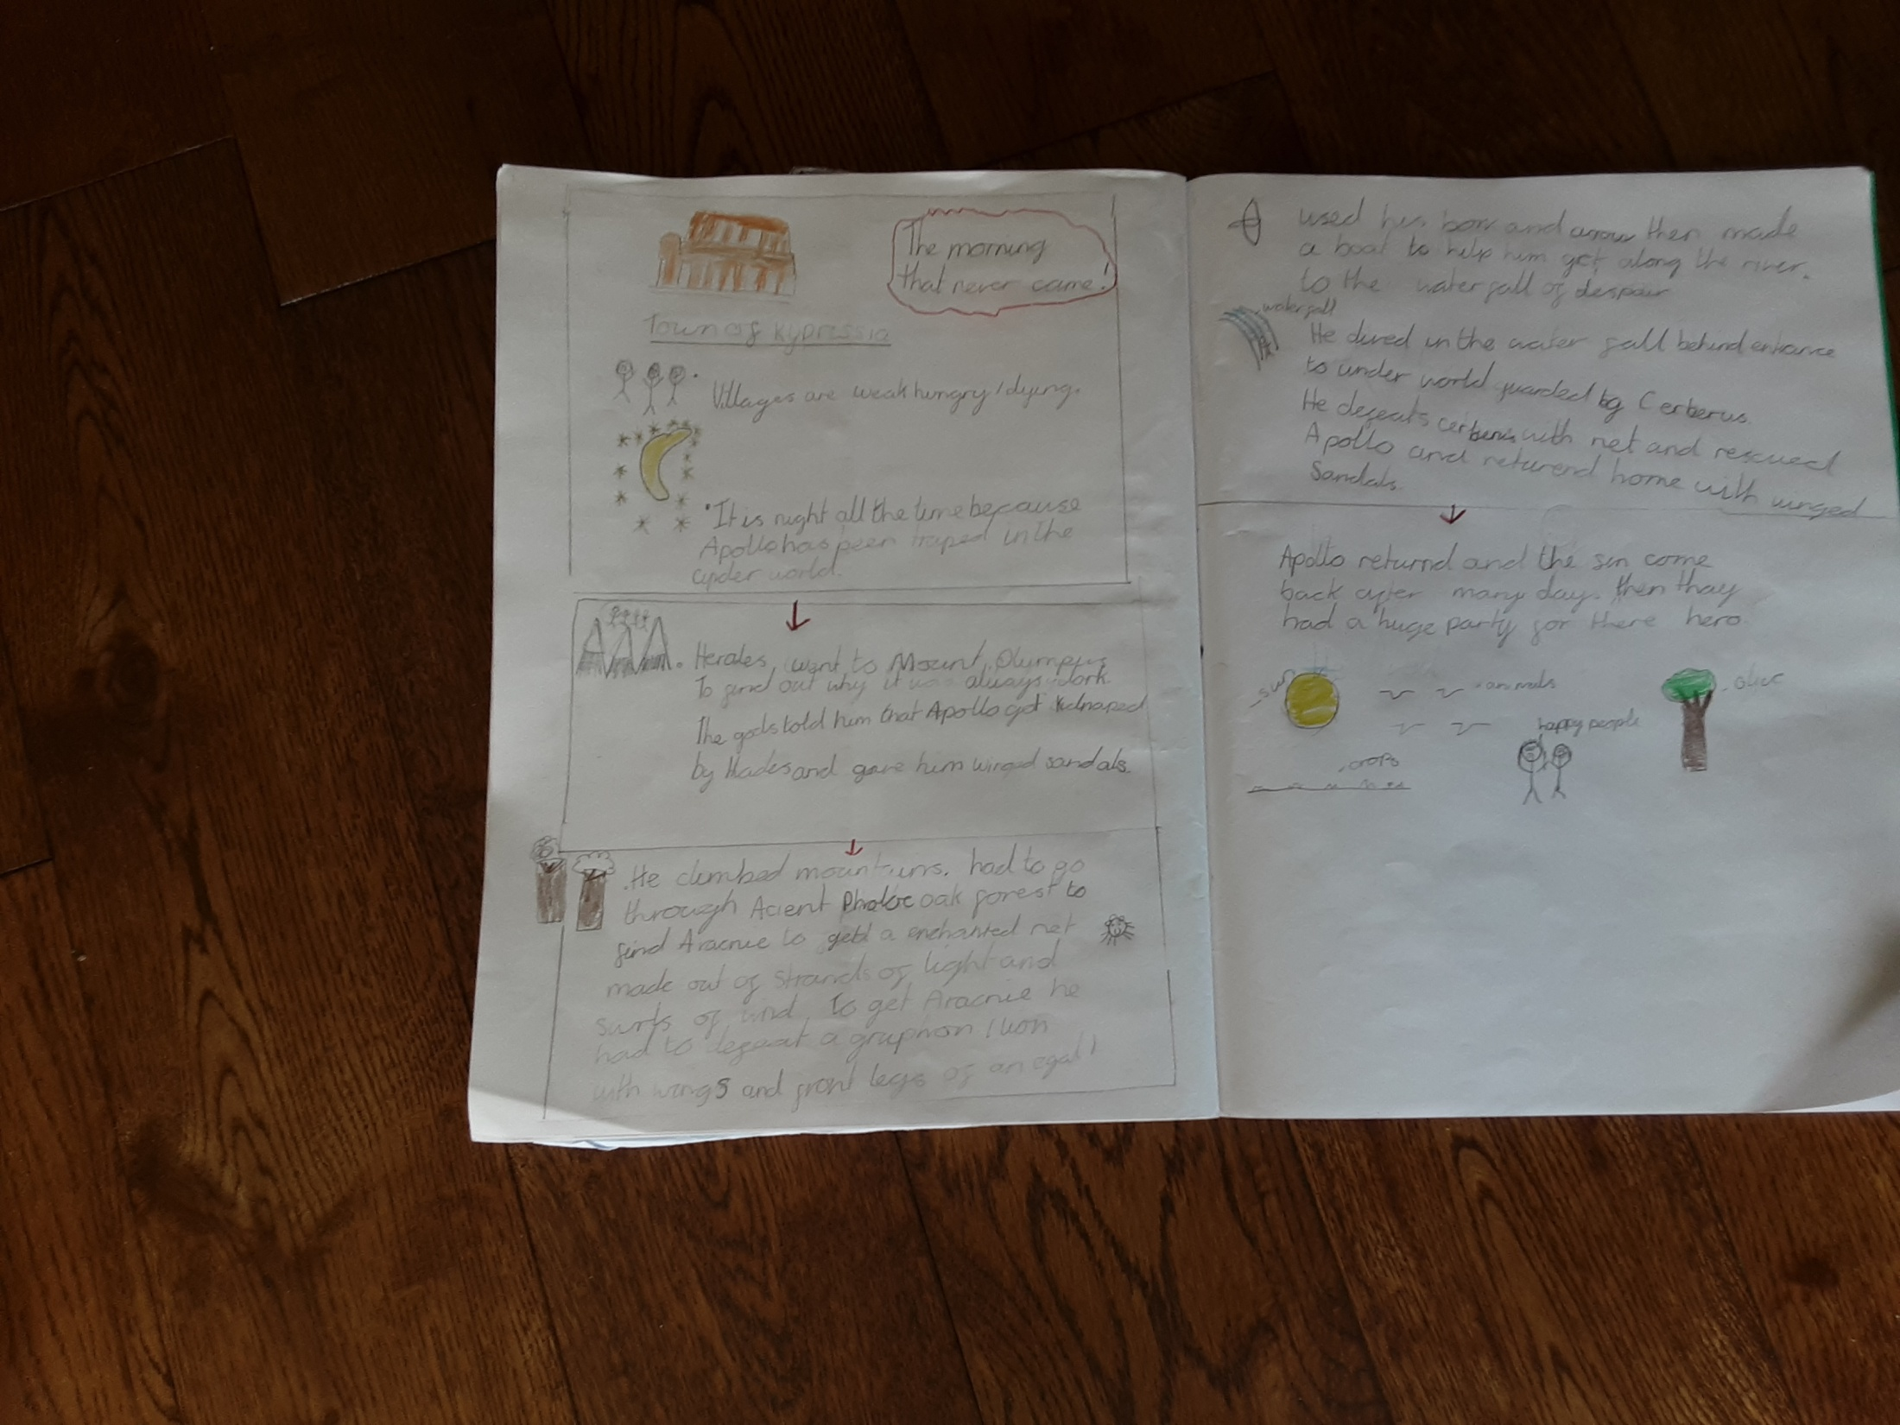
Here’s what Y5&6 have been
focusing on at home today.
Katie has planned the main events in her ancient Greek myth story.

Slide 17
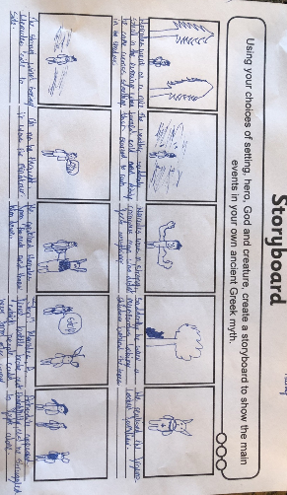
Here’s what Y5&6 have been
focusing on at home today.
Harvey has planned the main events in his ancient Greek myth story.

Slide 18
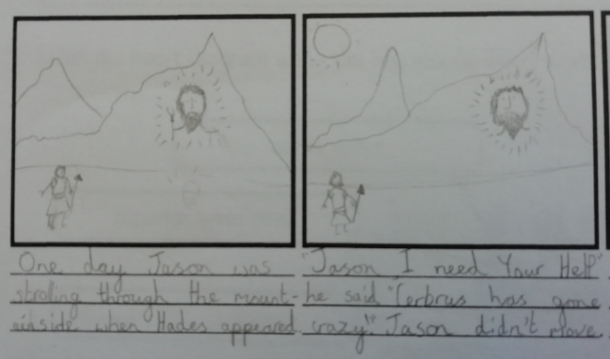
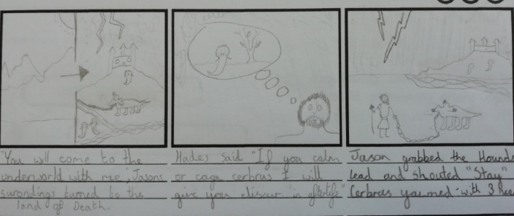
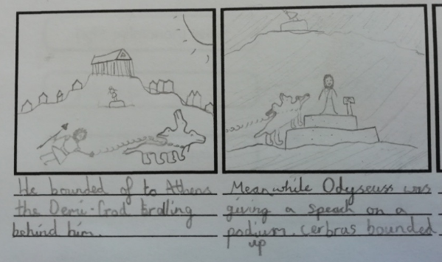
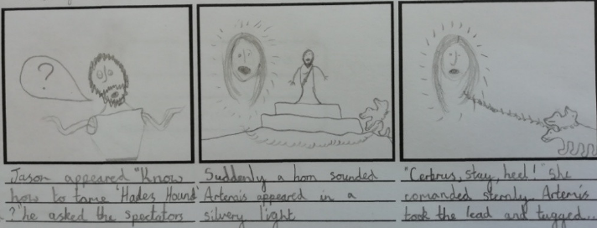
Here’s what Y5&6 have been
focusing on at home today.
Amy has planned the main events in her ancient Greek myth story.

Slide 19
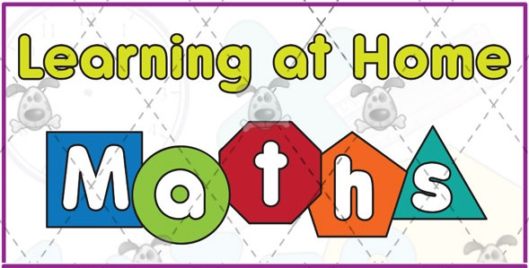
Here’s what Y5&6 have been
focusing on at home today.

Slide 20
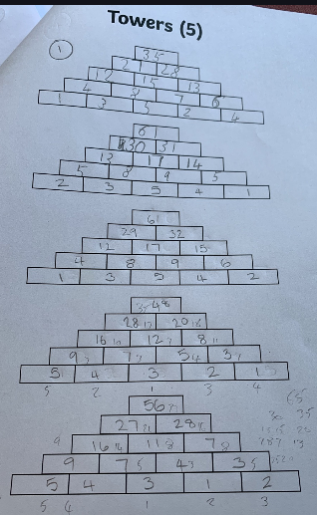
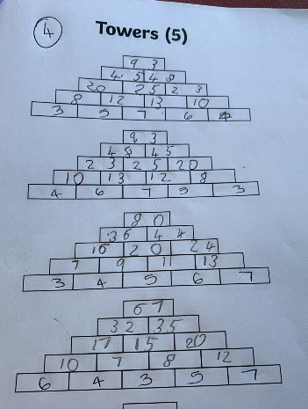
Here’s what Y5&6 have been
focusing on at home today.
Henry has been investigating the towers of numbers in maths.

Slide 21
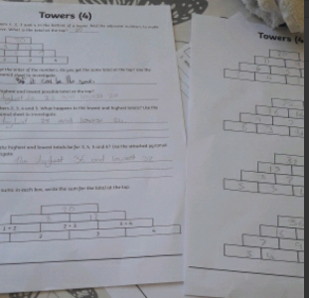
Here’s what Y5&6 have been
focusing on at home today.
Chloe has been investigating the towers of numbers in maths.

Slide 22
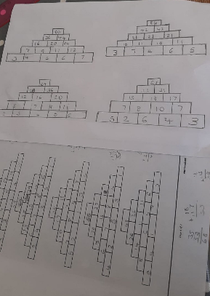
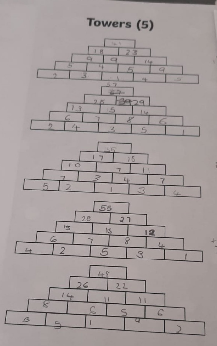
Here’s what Y5&6 have been focusing on at home today.
Ruby has been investigating the towers of numbers in maths.

Slide 23
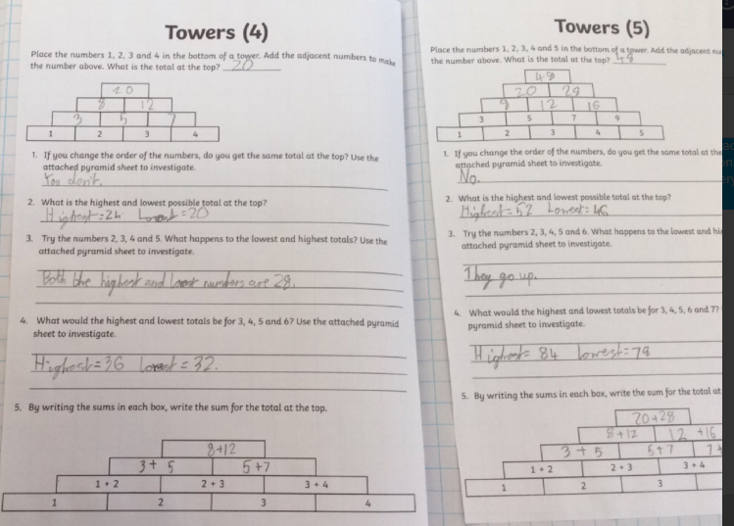
Here’s what Y5&6 have been focusing on at home today.
Reuben has been investigating the towers of numbers in maths.

Slide 24
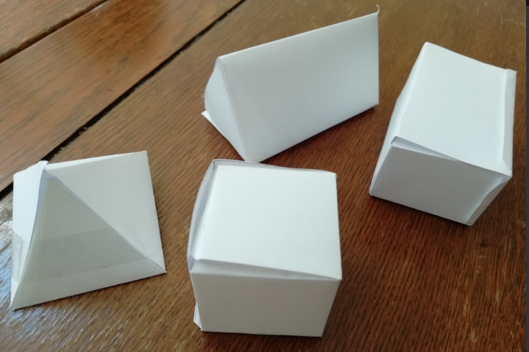
Here’s what Y5&6 have been
focusing on at home today.
Amy has been constructing her 3D shapes using her nets.

Slide 25
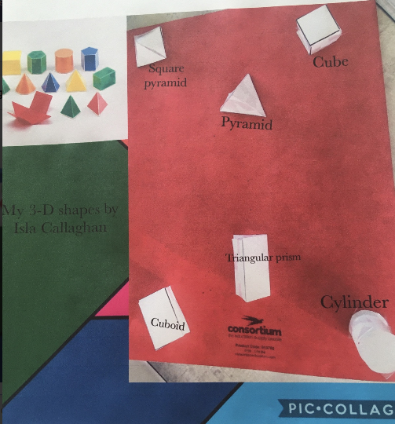
Here’s what Y5&6 have been
focusing on at home today.
Isla has created a pic-collage to show her recognition of these 3D shapes.

Slide 26
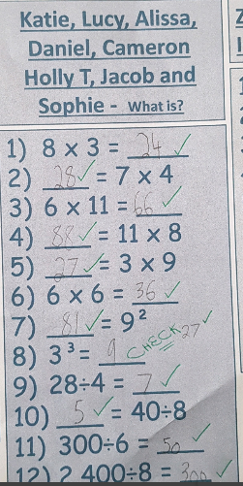
Here’s what Y5&6 have been
focusing on at home today.
Cameron has been practising his calculations for his maths starter

Slide 27
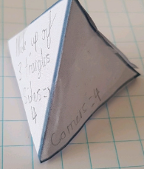
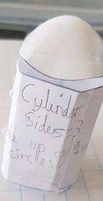
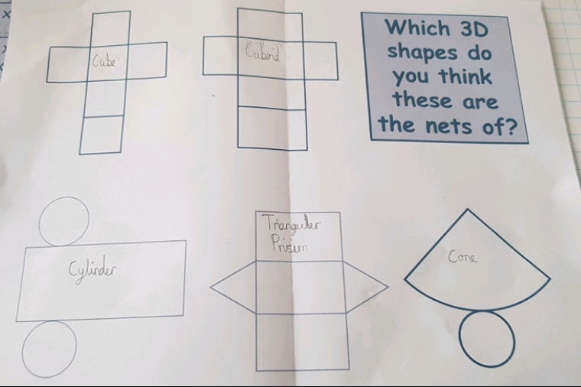
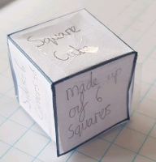
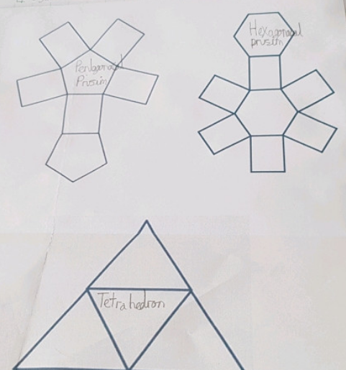
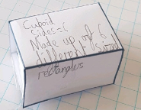
Here’s what Y5&6 have been
focusing on at home today.
Cameron has been constructing and recognising 3D shapes from their nets.

Slide 28
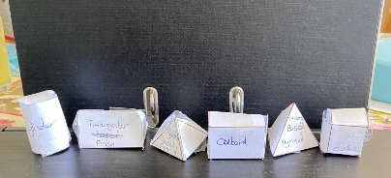
Here’s what Y5&6 have been
focusing on at home today.
Daniel has been constructing and recognising 3D shapes from their nets.

Slide 29
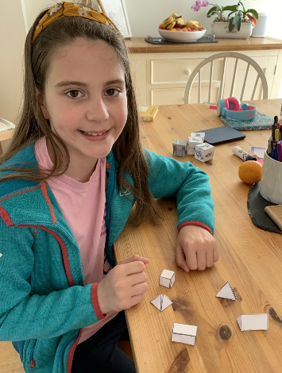
Here’s what Y5&6 have been
focusing on at home today.
I’ve been constructing and recognising 3D shapes from their nets.

Slide 30
Here’s what Y5&6 have been
focusing on at home today.

Slide 31
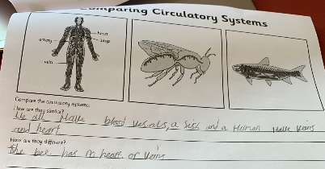
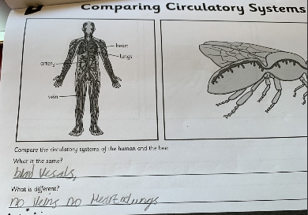
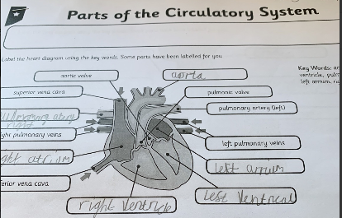
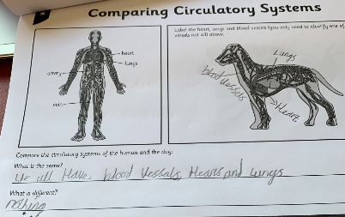
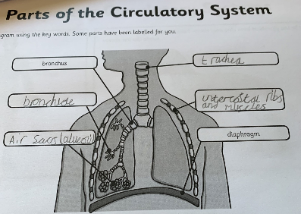
Here’s what Y5&6 have been
focusing on at home today.
Henry has been studying and comparing the circulatory system of humans and other animals.

Slide 32
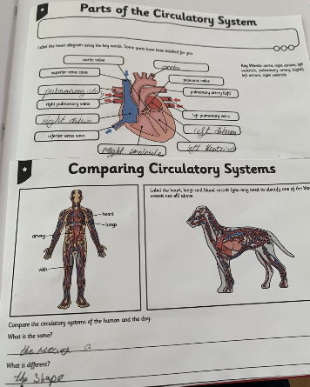
Here’s what Y5&6 have been
focusing on at home today.
Zoe has been studying and comparing the circulatory system of humans and other animals.

Slide 33
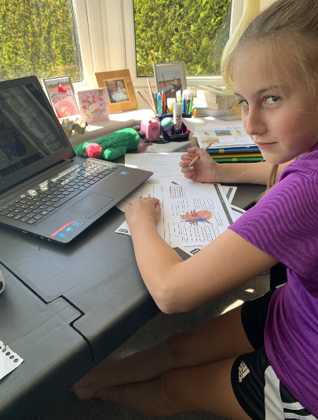
Here’s what Y5&6 have been
focusing on at home today.
I’ve been studying and comparing the circulatory system of humans and other animals.
Can you tell that I’d much rather be outside?

Slide 34
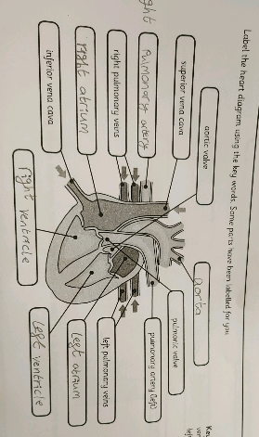
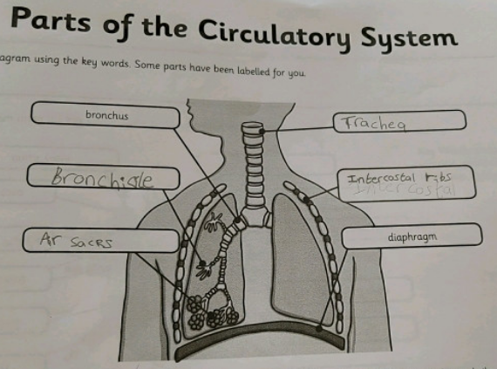
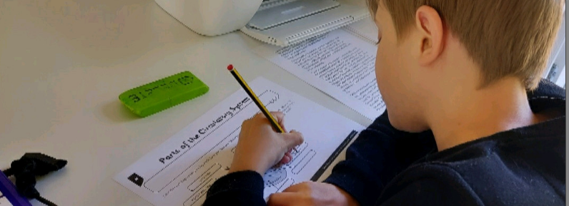
Here’s what Y5&6 have been
focusing on at home today.
Dante has been studying and comparing the circulatory system of humans and other animals.
A future heart surgeon?

Slide 35
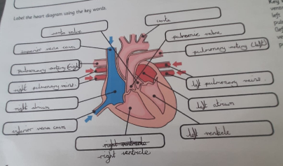
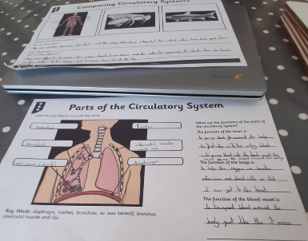
Here’s what Y5&6 have been
focusing on at home today.
Ruby has been studying and comparing the circulatory system of humans and other animals.
A future heart surgeon?

Slide 36
Here’s what Y5&6 have been
focusing on at home today.
Chloe has been studying and comparing the circulatory system of humans and other animals.

Slide 37
Here’s what Y5&6 have been
focusing on at home today.
Reuben has been studying and comparing the circulatory system of humans and other animals.

Slide 38
Here’s what Y5&6 have been
focusing on at home today.
I used my books to help me with my Science

Slide 39
Here’s what Y5&6 have been
focusing on at home today.
Amy has been studying and comparing the circulatory system of humans and other animals.

Slide 40
What else have we been doing at home today?
Reuben cooked his own lunch on the fire that he made.

Slide 41
What else have we been doing at home today?
Henry taking advantage of the weather to enjoy a dip in the pool.

Slide 42
What else have we been doing at home today?
I’ve been creating a wall hanging for my bedroom………..

Slide 43
What else have we been doing at home today?
…..before enjoying a cool-off in the pool.

Slide 44
What else have we been doing at home today?
I’ve been practising my catching skills.

Slide 45
Here’s some of what we missed viewing yesterday.

Slide 46
Lucy’s been studying the ancient Greek gods
Zeus was the god of the sky and king of mount Olympus. Zeus was also the most powerful of all gods! He was married to Hera, queen of the gods.
His temper controlled the weather, If he was angry there would be a huge storm however if he was happy it would be sunny all day!
Did you know?
Zeus’s father thought that his children would betray him so he ate them!
Zeus!
Poseidon!
Poseidon was God of the sea, known to make earthquakes when he was angry and was second most powerful.
He lived in a beautiful palace( you guessed it ) under the sea. Poseidon was the responsible god of the delay of Odysseus’s return home from the Trojan war by shipwrecking his ship.
Did you know?
Poseidon rode a chariot pulled by giant seahorses!
Hades
Hades was god of the dead. He ruled the underworld where all dead bodies ended up. Many people were afraid of him which isn’t very surprising as Hades was god of the dead!
Many people sacrificed things because they wanted something bad to happen to someone else!
Did you know?
Hades was also god of wealth because he found many rare gems down in the underworld!

Slide 47
Lucy’s been studying the ancient Greek gods
Ares
Ares was god of war, son of Zeus and Hera although neither his mother nor his father liked him very much. He defeated the giant Ekhidnades, a fierce monster and enemy of the gods! Ares was both cruel and a coward.
Did you know?
Ares’s throne was upholstered in human skin.
Aphrodite was goddess of love, beauty and protector of sailors. She was loved by many people. She was born when Uranus’s blood fell into the sea, she emerged from the froth
Her skin was whiter than ivory, her hair as golden as the setting sun and her eyes as blue as the summer sky!
Did you know?
Aphrodite made a statue become a human so someone could marry it!
Aphrodite
Hermes was god of travel and trade. He was very fast on his feet and very clever, so Zeus decided to make him a messenger.
He always knew everything about the mythical world and he was trusted by the other gods as he was very loyal.
Did you know?
Many Ancient Greeks believed that Hermes was responsible for the invention of the alphabet, boxing and gymnastics.
Hermes!

Slide 48
Katie’s been studying the ancient Greek gods

Slide 49
Isla’s been recognising the properties of 3D shapes

Slide 50
Isla’s been studying the ancient Greek gods

