Slide 1
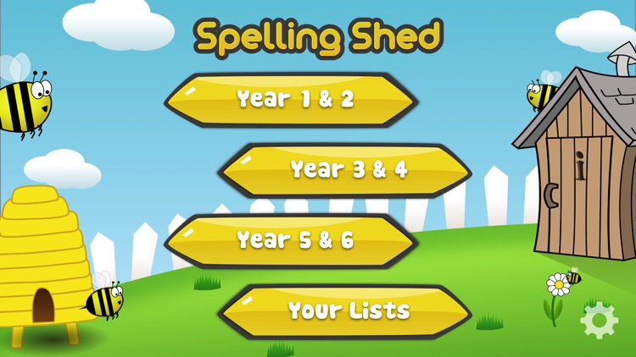
Y5&6 TOP SPELLERS TODAY
1st = points
2nd = points
3rd = points
4th = points
5th = points
6th = points
7th = points
8th = points
9th = point
These are the amount of dojos you have received for your efforts today!
Everybody else earns 1 dojo for practising their spellings today!

Slide 2
Here’s what Y5&6 have been
focusing on at home today.

Slide 3
Here’s what Y5&6 have been
focusing on at home today.

Slide 4
Here’s what Y5&6 have been
focusing on at home today.

Slide 5
Here’s what Y5&6 have been
focusing on at home today.

Slide 6
Here’s what Y5&6 have been
focusing on at home today.

Slide 7
Here’s what Y5&6 have been
focusing on at home today.

Slide 8
Here’s what Y5&6 have been
focusing on at home today.

Slide 9
Here’s what Y5&6 have been
focusing on at home today.

Slide 10
Here’s what Y5&6 have been
focusing on at home today.

Slide 11
Here’s what Y5&6 have been
focusing on at home today.

Slide 12
Here’s what Y5&6 have been
focusing on at home today.

Slide 13
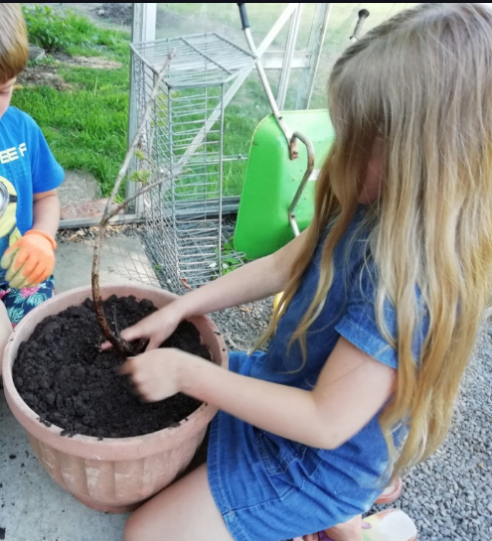
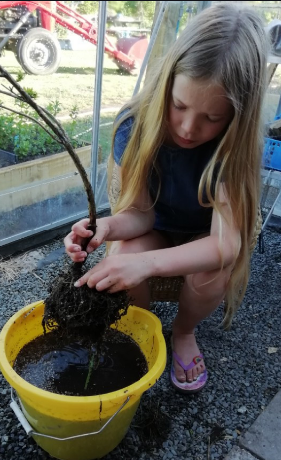
What else have I been doing at home today?
I’ve been rescuing a blueberry plant by washing the roots and getting rid of grass roots before potting it up.

