Slide 1
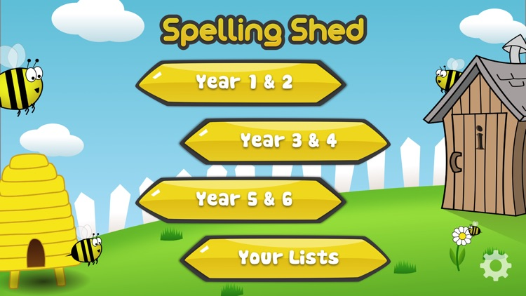
Y5&6 TOP SPELLERS TODAY
1st = Chanel 70 points
2nd = Jack 28 points
3rd = Henry 24 points
4th = Amy 19 points
5th = Holly H 17 points
6th = Sophie 11 points
7th = Lily 10 points
8th = Ruby 9 points
9th = Reuben 8 points
These are the amount of dojos you have received for your efforts today!
Everybody else earns 1 dojo for practising their spellings today!

Slide 2
Here’s what Y5&6 have been
focusing on at home today.

Slide 3
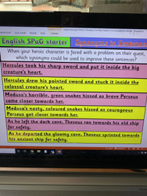
Here’s what Y5&6 have been
focusing on at home today.
Henry has improved these sentences using better choices of synonyms.

Slide 4
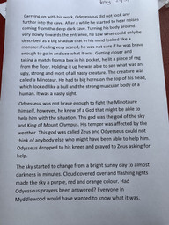
Here’s what Y5&6 have been
focusing on at home today.
Henry continued his Greek myth until he reached a problem in the story

Slide 5
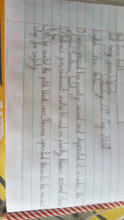
Here’s what Y5&6 have been
focusing on at home today.
Bethany has improved these sentences using better choices of synonyms.

Slide 6
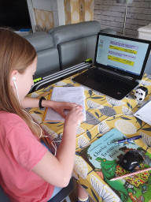
Here’s what Y5&6 have been
focusing on at home today.
I’ve been working on developing and continuing my Greek myth.

Slide 7
A continuation of Bethany’s myth
“GET THEEEEEEEEEMMMMMMMMMMMM!” It was a soldier. Either side of Perseus stood an army. They began charging at each other at full speed. That was quite fast considering they were in full armour and were carrying a sword and shield each.
“NOOOOOOOOOOOOOOOOOO!”screamed Perseus. He could NOT get stuck in the middle of a fight.
“God of war, Ares please stop this war for me to get out. I have a journey to get through.” Suddenly the war stopped.
1
“This...is...so...tiring!” Perseus was by now halfway up the mountain. There was a
huge ledge that he stopped on to rest. Suddenly there was a deafening call,
“I thank you Ares,” said Perseus. He then started to climb the mountain which took him another half an hour. Then he had to climb down the other side. He did not moan or groan but carried on. As he clambered down the other side of the hill he praised all the gods, hoping they’d keep him safe. As he got to the bottom of the mountain he spotted a large monster. A three headed monster.
2

Slide 8
Cameron’s myth so far
Hades underworld game
In the murky, evil underworld the sinister God Hades was plotting yet another destructive plan to get rid of Zeus so he could rule Mount Olympus. In his dark castle sitting on a throne he stroked his triple headed dog Cerebus before the God of evil had a light bulb moment, “I know,” he said his voice echoing around the room “ I will challenge Zeus to a game to see who deserves the right to rule Olympus”.
That night Hades travelled to the world of the living. There he went to nine different forests and in each one Hades captured a single snake and chopped the head off. After he completed this task the God of the Underworld combined all of the furious reptiles to make a replica of the terrifying, great mutant, The Hydra. Hades then wrote a letter. Dear Zeus I am writing to ask you to prove how powerful you really are, so I am challenging you to face me in a new shadow game I have created. Pick your strongest mortal hero and you will guide him or her and help them to beat one of my monsters in the Amazonian rain forest. Hope you lose, Hades (the very best god).
It was now the next day in Zeus’s great palace. “So what do you have for me today Hermes?” boomed the strongest God, Zeus. “ Today you have a letter from Hades and a parcel from Apollo” replied Hermes cheerily. “ What has my brother got to say today, probably challenging me to another game I’m going to win” bellowed Zeus tearing the letter open. “ Ho ho” chuckled the god looking at the letter “I am actually right”
“ When are you ever wrong ?” asked Hermes sarcastically.
“Tell Hades that I’ll do his game” demanded Zeus to Hermes sitting on his golden throne.
When Hermes delivered the answer Hades laughed with joy “ finally I can beat Zeus at his own game”.
Zeus was discussing which hero to chose with Ares (the god of war) finally, they came to a decision. Zeus made a dice it had their best mortal hero’s on it and the dice would decide on their strength and power.

Slide 9
Cameron’s myth so far
Ares rolled the dice, it turned and hummed, before landing on the hero Achilles.
“So Achilles is to go inside the forest” grumbled Zeus with a sound of disappointment in his voice,
“ yes” replied Ares “ not who I was hoping to represent the great gods”.
The very next day Zeus went to Achilles in the form of a lightning bolt. “ Arghhhha” screamed Achilles as the lightning rod smashed onto the patch of field beside him, the long dry grass caught fire. The fire took the image of Zeus and burned the colour of velvet.
“Achilles” boomed the God of lightning mysteriously.
“Y-y-yes” replied the terrified Achilles
“You may be the best of all of the mortal hero's but how will I know if you don’t prove it, you are going to face Hades in a shadow game, meet me in the Amazon forest in a weeks time” bellowed Zeus
“if you do this I will reward you with riches beyond your wildest dreams” he finished. Lost for words Achilles opened his mouth but no sound came out.
“Is that a yes or a no?” asked Zeus looking confused
“yes sorry” replied Achilles.
As soon as Achilles reached his cramped cottage he packed a small bag and started walking towards the forest. For seven days and seven nights he walked and walked. A week went by and Zeus was standing in front of the Amazon rainforest waiting for Achilles and Hades. After what felt like an age the leader of gods finally saw Achilles approaching him wearing a tattered old T-shirt and ripped shorts.
“Why haven’t you come wearing something a bit more suitable for battle?” questioned Zeus looking displeased. Achilles shot him an angry look, the mighty god corrected himself “well lets get you armored up then shall we”. Zeus picked up a stone and it magically transformed into a solid piece of armor. Achilles was stunned, the mighty god then picked up two sticks and rubbed them together to make fire, he then put this flame on a small rock, this combination made a fire sword. The god gave Achilles these pieces of equipment.
“Wow thanks” replied Achilles. Zeus and Achilles suddenly felt a cold breeze, then darkness surrounded the usually bright green forest.
“That would be my brother” boomed Zeus. Sure enough Hades was leaning on a tree, it immediately withered and died, slowly the rest of the trees started dying as well.
“Come on I haven’t got all day” shouted Hades angrily
“go in the forest and slay the Hydra before he gets angry” grumbled Zeus wearily.
As Achilles (wearing his armor and carrying his fire sword) walked into the forest
Zeus called “the end is closer if you slay the heart the end is further if you slay the head” that was odd thought Achilles as he entered the forest.

Slide 10
What else have I been doing at home today?
Here’s what Y5&6 have been
focusing on at home today.
Jack’s myth so far
Hercules & The Return of The Hydra
The marketplace in Thebes, Greece was a very happy place for many, many years. Usually, the market was jam packed with the citizens of the town. You couldn’t see the cobbled streets because it was so full. But it all changed on the chilly November morning, where this tale begins…
It was like any other day in Thebes; the market was full; people were bustling around the cobbled streets next to the meadow. Hercules, the prince of Thebes, went out to fetch some water from the stream that ran past the edge of the market. A little bridge went over the stream so that the shoppers could go into the meadow after to get flowers and fresh water. However, a big rock stood towering over the lush grass and the daisies. This was the entrance to the Underworld. Hercules had never been told about the grand carved rock that would fade when the Underworld was opened. It had several carvings that had been made in its face, and a little crack in the front towards the bottom. Then, just as Hercules turned to go, the sun went away, it became cloudy, it drizzled slightly, and the market slowly emptied. Then Hercules turned to go.
Lightning flashed threateningly out of the ash grey sky. Thunder echoed around the town and screams suddenly filled the meadow. The big carved rock started to crack, and several transparent ghosts flew out of the entrance to the Underworld and started cowering and shivering under the rain sodden trees, charred oak trees. One of the cobbled streets suddenly cracked like a fire that just got wood pushed into it. Hercules was watching all of this sudden storm and was very confused.

Slide 11
Here’s what Y5&6 have been focusing on at home today.
Jack’s myth so far
When twilight fell, Hercules snuck out of the palace and called for Hades, God of the Dead and King of the Underworld.
‘Hades, what is going on?’
‘I am not sure; however, I am sure that there is something down there that is bringing the ghosts up here’ Hades said quietly and coldly.
‘We cannot let this continue, it must stop, but the weirdest thing about it was, see that crack in the pavement’
‘Yes’ Hades said uncertain, ‘What does that have to do with anything?’
‘When all of the ghosts came out of the rock, the pavement cracked over there’ Hercules said
‘Well, would you go down there, in the Underworld and, well, maybe see what’s down there and go and kill it, or trap it or something?’
‘Of course, I- ‘
‘Well here’s some armour, a sword and a shield. Thanks lad. If you kill what’s down there, I will give you several chests full of treasure, and declare you King of Thebes.’ Hades interrupted before Hercules had time to reply, and after 5 minutes, Hercules was off down into the Underworld…
It was quite dark, and only lit by occasional torch attached to the wall. The place was quiet and empty and there were several seating areas with food and wine where ghosts of perished Greeks were having feasts with each other. As he trenched further down the rocky floor, it became darker and the walls felt scaly. But Hercules wasn’t feeling the walls of the Underworld, he was feeling the weird, slimy cyan scales of the Hydra. There were several pools of blood and skulls and, obviously, the Hydra sat in the middle of the mess.

Slide 12
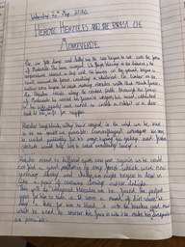
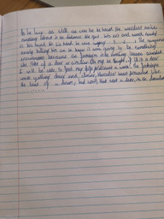
Here’s what Y5&6 have been
focusing on at home today.
Harvey’s myth so far

Slide 13
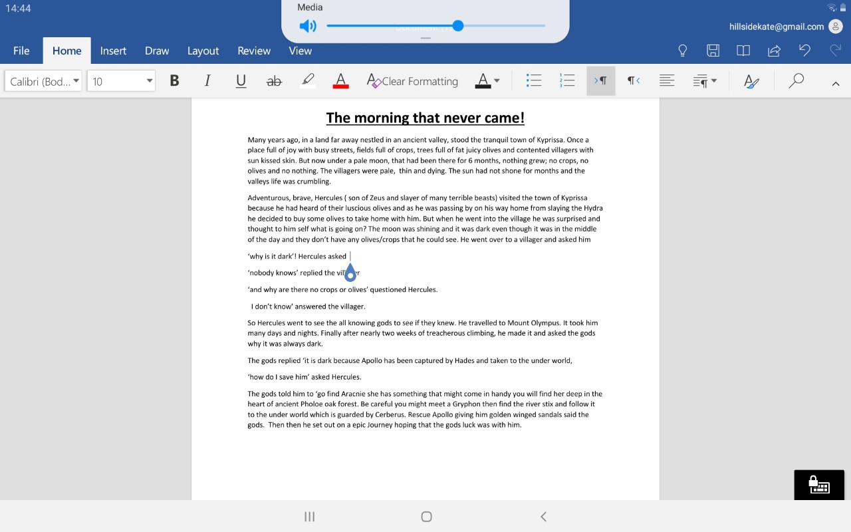
Here’s what Y5&6 have been
focusing on at home today.
Katie’s myth so far

Slide 14
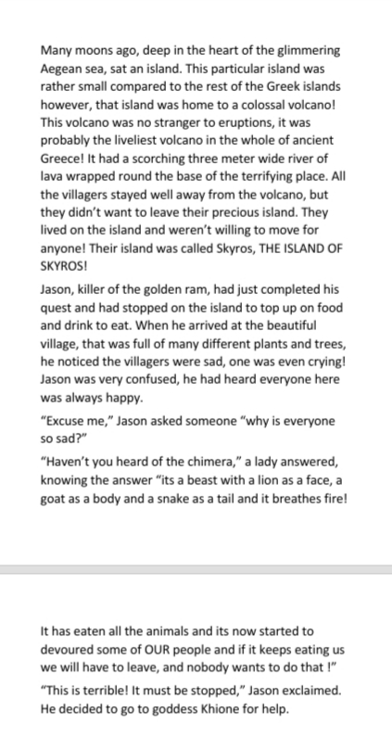
Here’s what Y5&6 have been
focusing on at home today.
Lucy’s myth so far

Slide 15
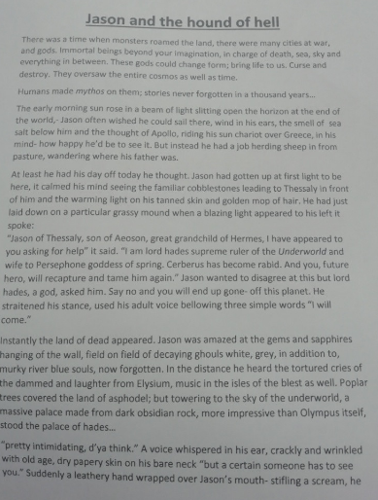
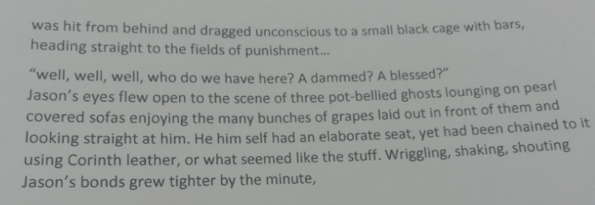
Here’s what Y5&6 have been
focusing on at home today.
Amy’s myth so far

Slide 16
Heidi’s myth so far
Perseus And TheUnderWorld Switch Up
Cassandra grew up her whole life, not aware of the others surrounding her. She lived alone and isolated in a world with no meaning. No one loved her; no-one ever would. She spent her days wondering what it would be like to have a ‘​real’ family, a life where everyone around her actually cared for her and took her in as one of their own. Who was she kidding, a ‘​real’​ family, what a joke.
Perseus was praised for his bravery and compassion, when all he really wanted was a normal life. No attention or being told what to do, he wanted freedom where he could lead a life of his own. He had made the wrong decision when he asked Andromeda to marry him. He didn’t love her, and would have rathered someone who loved him for who he was and not because he was of higher royalty.
A strange man appeared in front of Cassandra‘. Princess Cassandra of-’ Started the man,‘Princess? I’m not a princess,’ She said firmly.‘ But it says you are, I mean but, if you aren’t then, Ummm, I mean, who is, but it says........., He never lies, this must be one big misunderstanding’ He said walking round in circles confused. ‘Who do you mean by ‘He’?’‘Oh, nobody. So, let me get this straight, you're not Princess Cassandra?’Cassandra realised that this might be her only chance to escape this awful place. ‘No, I said I am Princess Cassandra,’ She replied‘ But you said you weren’t’ ‘No, I thought you said Prince, not Princess. So, as you were saying’ She attempted in her poshest voice. Clearly bewildered, the man started again,’ Princess Cassandra of.....; we’ll skip that part, I am Hermes, messenger of the Gods, Hades has requested your appearance at the ball of the undead.’‘ Me?’ Cassandra asked ‘But I’m not important.’‘ You’re a Princess, clearly, that is some level of importance’ Hermes explained, not completely believing the whole ‘I’m not a Princess, but I am’ story.’

Slide 17
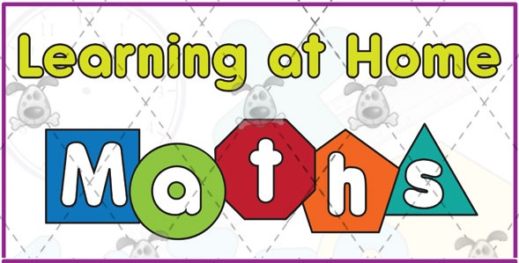
Here’s what Y5&6 have been
focusing on at home today.

Slide 18
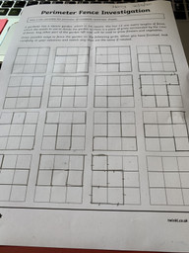
Here’s what Y5&6 have been
focusing on at home today.
Henry found all of these ways of making a perimeter of the garden of 12m.

Slide 19
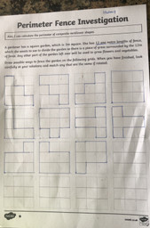
Here’s what Y5&6 have been
focusing on at home today.
Harvey found all of these ways of making a perimeter of the garden of 12m.

Slide 20
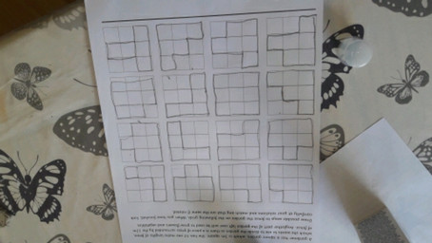
Here’s what Y5&6 have been
focusing on at home today.
Chloe found all of these ways of making a perimeter of the garden of 12m.

Slide 21
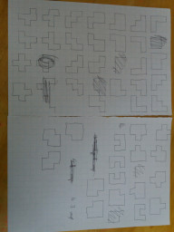
Here’s what Y5&6 have been
focusing on at home today.
Jack found 43 different ways of making his perimeter garden fencing of 16m.

Slide 22
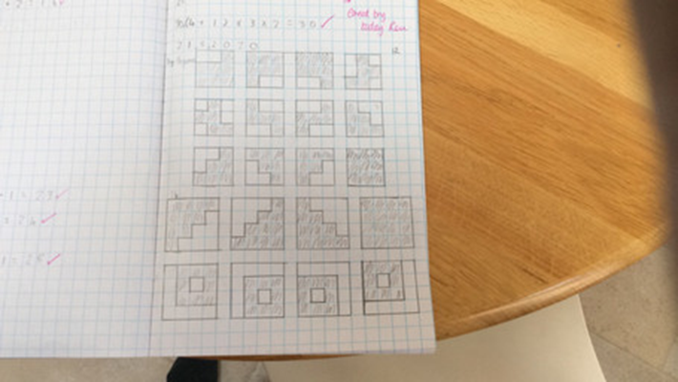
Here’s what Y5&6 have been
focusing on at home today.
Reuben found 23 different ways to solve his perimeter garden fencing of 16m.

Slide 23
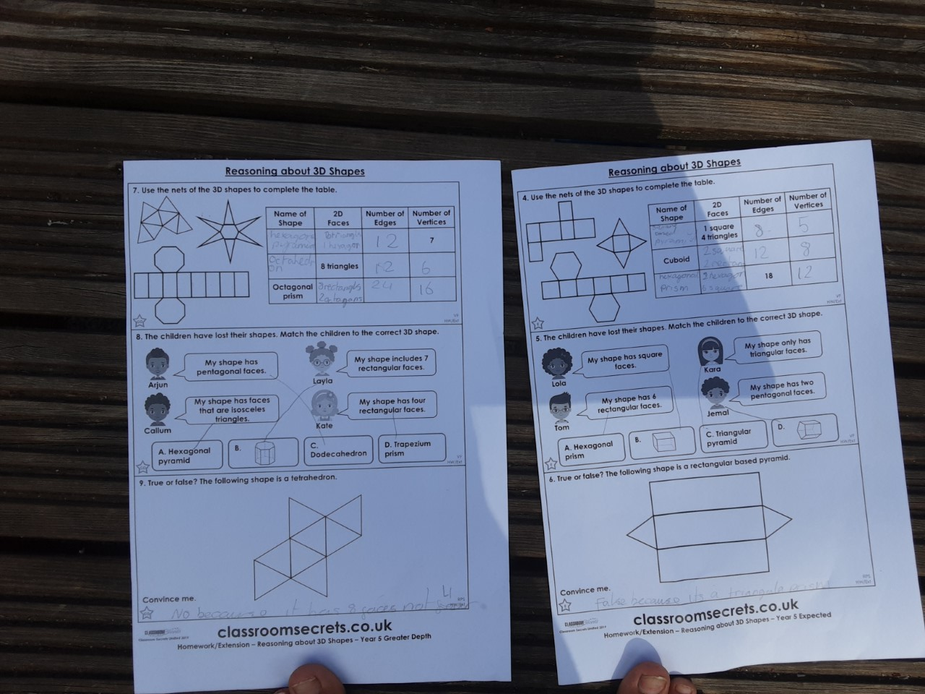
Here’s what Y5&6 have been
focusing on at home today.
Katie’s study of the properties of the 3D shapes

Slide 24
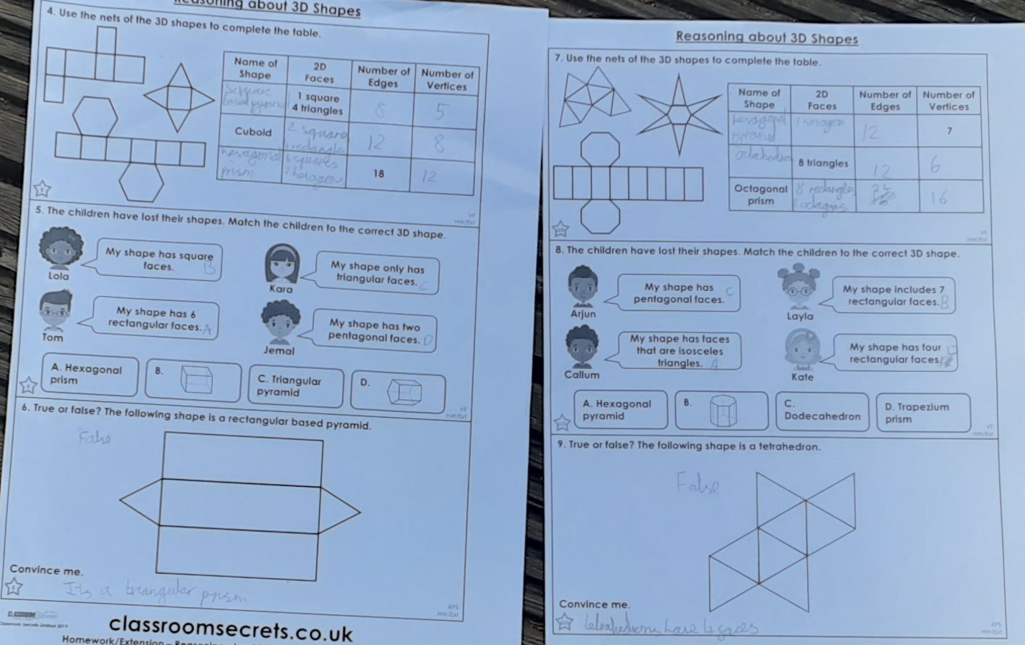
Here’s what Y5&6 have been
focusing on at home today.
Lucy’s study of the properties of the 3D shapes

Slide 25
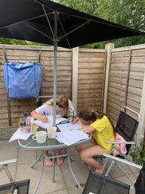
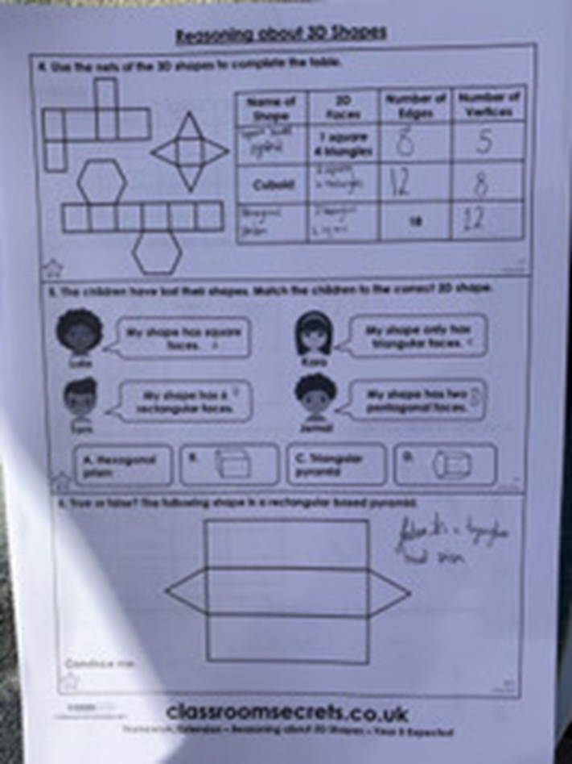
Here’s what Y5&6 have been
focusing on at home today.
I worked on my maths outdoors this morning.

Slide 26
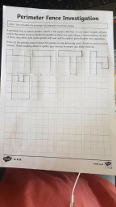
Here’s what Y5&6 have been
focusing on at home today.
Bethany found different ways of making a 16m perimeter fence for the garden.

Slide 27
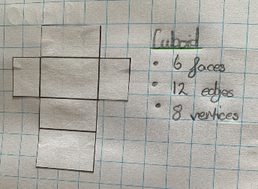
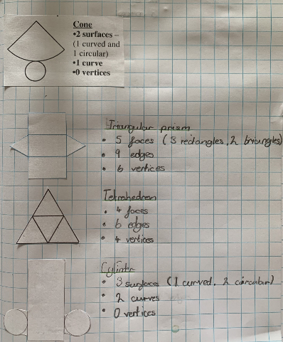
Here’s what Y5&6 have been
focusing on at home today.
Nelly has understood these 3D shape properties really well.

Slide 28
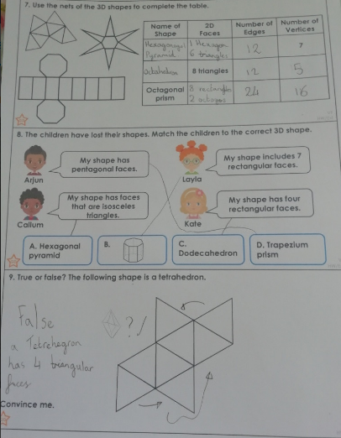
Here’s what Y5&6 have been
focusing on at home today.
Amy has matched these more advanced 3D shapes to their properties very well.

Slide 29
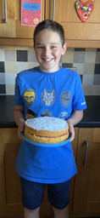
What else have I been doing at home today?
I’ve been baking a cake today all by myself.

Slide 30
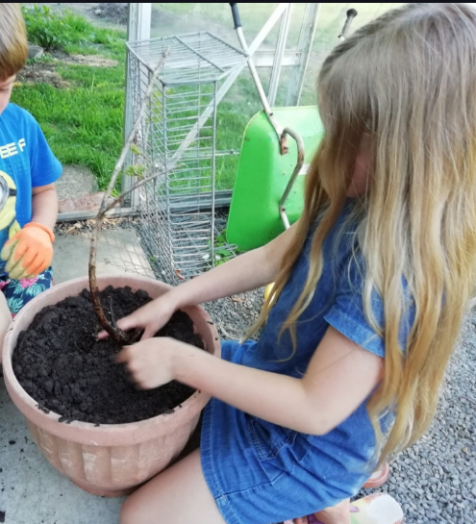
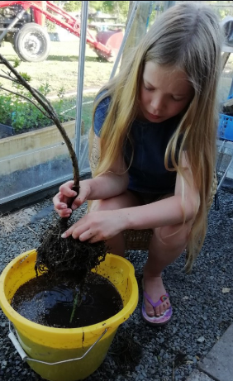
What else have I been doing at home today?
I’ve been rescuing a blueberry plant by washing the roots and getting rid of grass roots before potting it up.

Slide 31
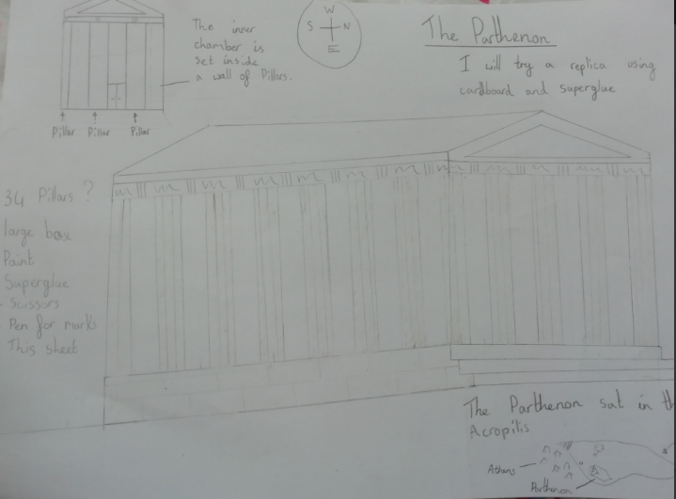
What else have I been doing at home today?

Slide 32
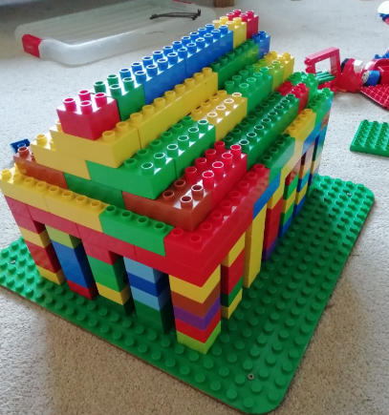
What else have I been doing at home today?
Amy’s test model of Parthenon out of lego, which has an inner door that leads to the inner chamber. This contains a half ivory half gold statue of Athena.

Slide 33
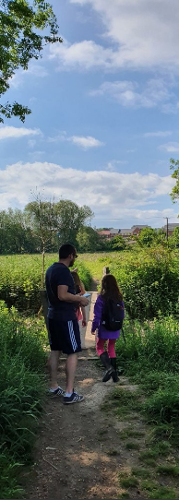
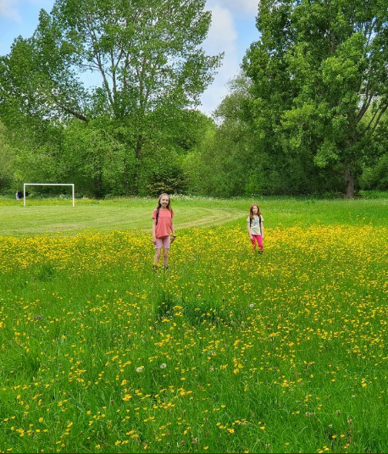
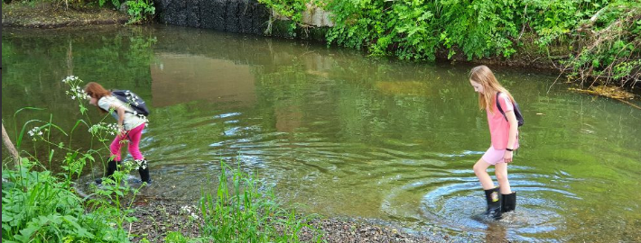
What else have I been doing at home today?
Me too!

Slide 34
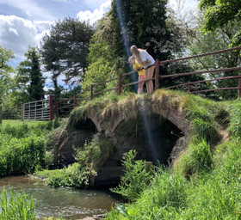
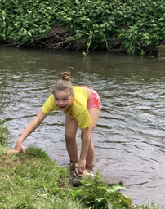
What else have I been doing at home today?
I went for a lovely paddle this afternoon!

Slide 35
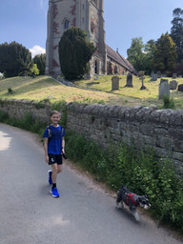
What else have I been doing at home today?
I’ve been having some morning exercise. Can you recognise where we are?

Slide 36
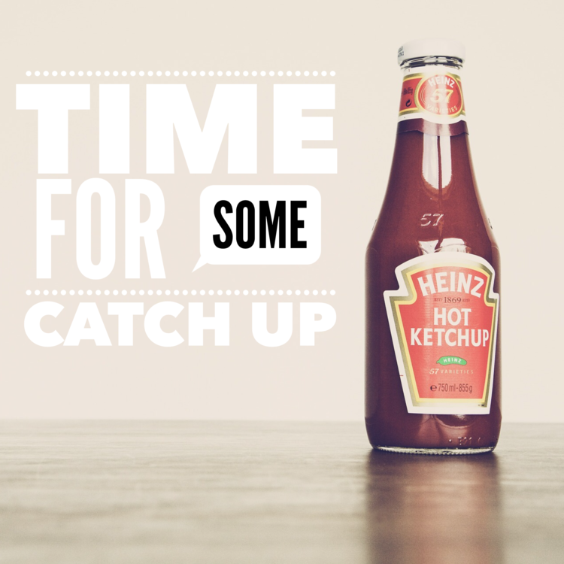
Here’s some more of the work at home that’s just been handed in…….

Slide 37
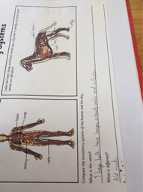
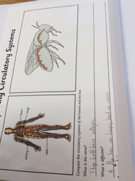
What else have I been doing at home?
Reuben has been catching up with his science from Tuesday.

Slide 38
What else have I been doing at home?
Zeus
Zeus was the God of the Sky and the king of Mount Olympus. He was the most powerful of all the gods. Zeus had 5 children and they were called Ares, Athena, Apollo, Hermes and Artemis.
His temper affected the weather, and when he was angry he threw thunderbolts.
He was married to Hera, but he had many other lovers. Hera was the Queen of the gods.
Zeus was seen as the most powerful god on Mount Olympus.
Did you know?
Zeus’ brothers were Poseidon and Hades.
Poseidon
Poseidon was the God of the sea.
He was the most powerful god except for his brother, Zeus.
He lived in a beautiful palace under the sea.
When he was angry he caused earthquakes to happen.
Hades
Hades was the god of the Dead. He ruled the underworld were people went when they died.
Ancient Greeks were afraid of him because he was a sign of death.
Did you know?
He was also the God of Wealth because of all the precious metals that were mined from the earth.
Ares
Ares was the God of War.
He was the son of Zeus and Hera, but they did not like him.
His symbols are his helmet and his spear.
Did you know?
His throne was upholstered in human skin.
Aphrodite
Aphrodite was the goddess of love, beauty and the protector of sailors.
She was the daughter of Zeus.
Did you know?
Aphrodite changed a statue into a human so that one of her loyal followers could have the statue as his wife.
Hermes
Hermes was Zeus’s youngest son and was very fast on his feet and was also very clever.
He wore some winged sandals and a cap which gave him super speed, he also carried a special staff called a Caduceus which had wings at the top.
Did you know?
Hermes invented the alphabet, boxing and gymnastics.
Sophie’s study of the Greek gods

Slide 39
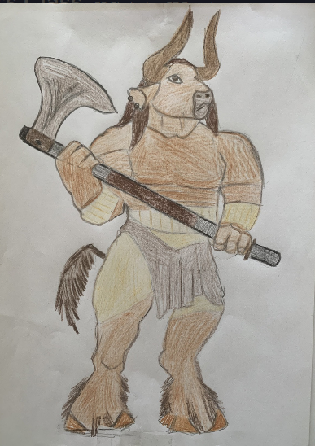
What else have I been doing at home?
Nelly has produced an excellent piece of ‘Minotaur’ art work.

