Slide 1
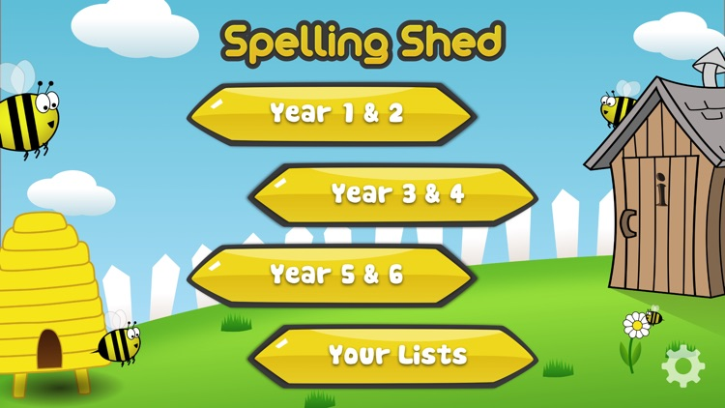
Y5&6 TOP SPELLERS TODAY
1st = Nelly 69 points
2nd = Cameron 31 points
3rd = Ruby 28 points
4th = Heidi 17 points
5th= Henry 14 points
6th = Jack 10 points
7th = Chloe and Bethany 8 points
8th = Reuben 7 points
9th = Zoe and Daniel 6 points
These are the amount of dojos you have received for your efforts today!
Everybody else earns 1 dojo for practising their spellings today!

Slide 2
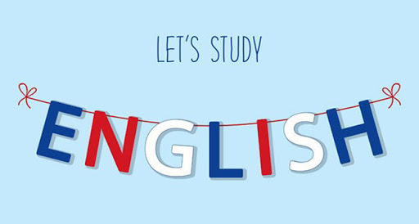
Here’s what Y5&6 have been
focusing on at home today.

Slide 3
Here’s what Y5&6 have been focusing on at home today.
Cameron has been adding main clauses to the end of his subordinate clauses to create these complex sentences.

Slide 4
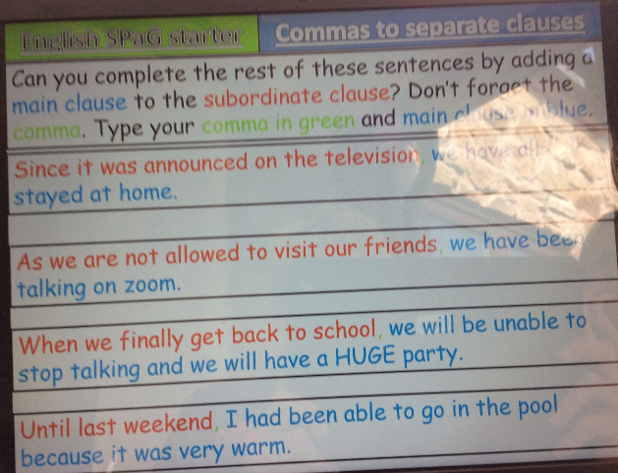
Here’s what Y5&6 have been focusing on at home today.
Reuben has been adding main clauses to the end of his subordinate clauses to create these complex sentences.

Slide 5
English SPaG starter
Commas to separate clauses
Since it was announced on the television, the covid 19 lockdown has to go for a bit longer
As we are not allowed to visit our friends, I speak to them on my Xbox
When we finally get back to school, it will crazy because we are not used it because of lockdown.
Until last weekend, we didn’t know what was happening with covid 19 and Donald trump wanted to insert bleach into everyone.
Toby’s main clauses added to his sentences.

Slide 6
Since it was announced on the television, everybody was staying indoors.
As we are not allowed to visit our friends, we can still talk to them over the fence.
When we finally get back to school, I will look forward to seeing my friends again.
Until last weekend, I had played outside everyday.
Isobel’s main clauses added to his sentences.

Slide 7
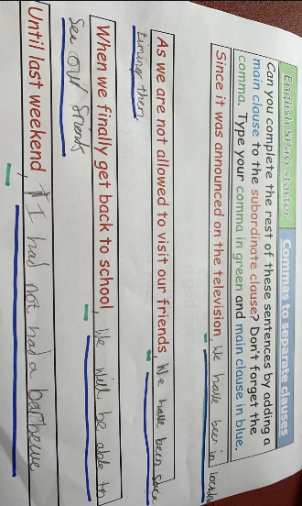
Here’s what Y5&6 have been focusing on at home today.
Henry has been completing his complex sentences by adding in the main clauses.

Slide 8
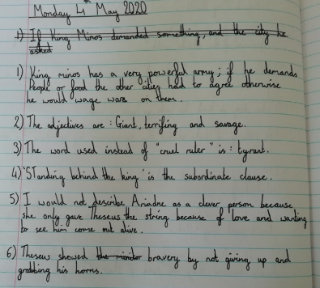
Here’s what Y5&6 have been focusing on at home today.
Amy showing her understanding of Theseus and the Minotaur.

Slide 9
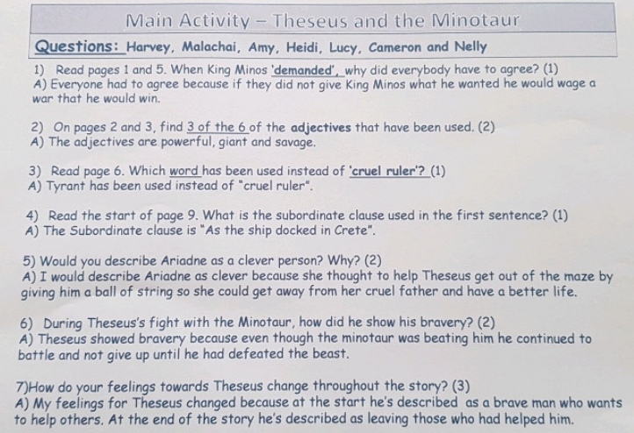
Here’s what Y5&6 have been focusing on at home today.
Excellent presentation from Cameron to show his understanding of the story ‘Theseus and the Minotaur’.

Slide 10
Here’s what Y5&6 have been focusing on at home today.
Isobel’s understanding of the story ‘Theseus and the Minotaur’.
Read page 1. What evidence is there that everybody was frightened of the power of King Minos of Crete? He was a powerful man, they felt they had to agree with him he demanded tributes to honour him.
On page 3, which two adjectives have been used to describe the creature? Powerful and savage.
Why did King Aegeus of Athens have to send 7 men and 7 women to King Minos? Because if they didn’t send them then Minos would wage war on them.
Read page 7. Which word has been used instead of ‘kill’? The word that has been used instead of kill is sacrifice.
Read the start of page 9. What is the subordinate clause used in the first sentence? As the ship docked in Crete.
How did Ariadne show her love for Theseus before he entered the labyrinth? By calling softly to him and giving him a large ball of string.
During Theseus’ fight with the Minotaur, how did he show his bravery? By turning his horns both ways from side to side and leading to them eventually falling off.

Slide 11
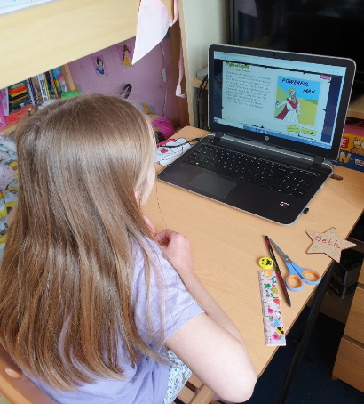
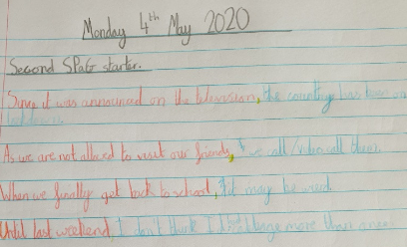
Here’s what Y5&6 have been focusing on at home today.
Completing my sentences, before reading and listening to the story of ‘Theseus and the Minotaur’

Slide 12
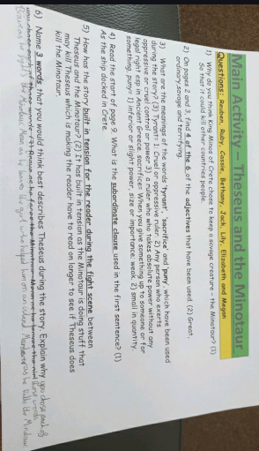
Here’s what Y5&6 have been focusing on at home today.
Bethany’s answers to show her understanding of Theseus and the Minotaur.

Slide 13
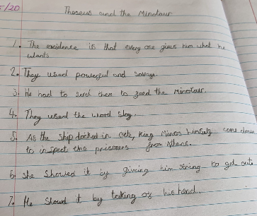
Here’s what Y5&6 have been focusing on at home today.
Zoe has been answering her questions about Theseus and the Minotaur.

Slide 14
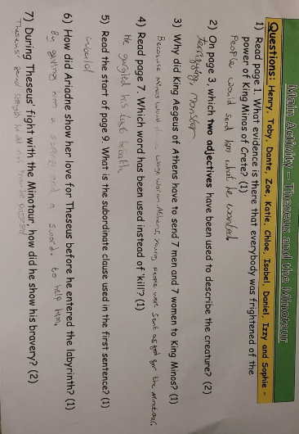
Here’s what Y5&6 have been focusing on at home today.
Dante’s understanding of Theseus and the Minotaur

Slide 15
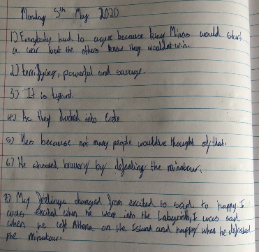
Here’s what Y5&6 have been focusing on at home today.
Harvey’s understanding of Theseus and the Minotaur

Slide 16
Toby’s understanding of Theseus and the Minotaur
Read page 1. What evidence is there that everybody was frightened of the power of King Minos of Crete? He had a famous inventor who could invent weapons that could knock down city walls.
On page 3, which two adjectives have been used to describe the creature?
Noisy and “The Beast”
3) Why did King Aegeus of Athens have to send 7 men and 7 women to King Minos? To feed the minotaur
Read page 7. Which word has been used instead of ‘kill’? Slain
5) Read the start of page 9. What is the subordinate clause used in the first sentence? You’ll know as soon as our ship appears
6) How did Ariadne show her love for Theseus before he entered the labyrinth? She gave him and a sword and thread so he could stay alive.
7) During Theseus’ fight with the Minotaur, how did he show his bravery?
He walked towards him instead of running away and killed him.

Slide 17
Here’s what Y5&6 have been focusing on at home today.
Katie’s sentences in English and then showing her understanding of the story Theseus and the Minotaur.

Slide 18
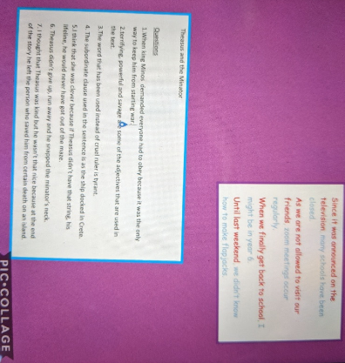
Here’s what Y5&6 have been focusing on at home today.
Lucy’s sentences in English and then showing her understanding of the story Theseus and the Minotaur.

Slide 19
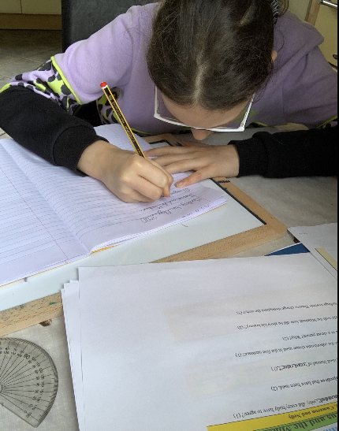
Here’s what Y5&6 have been focusing on at home today.
Her sentences in English to show understanding of the story Theseus and the Minotaur.

Slide 20
Here’s what Y5&6 have been
focusing on at home today.

Slide 21
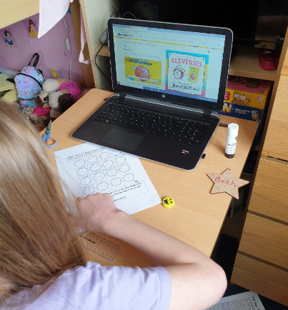
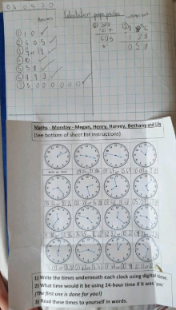
Here’s what Y5&6 have been focusing on at home today.
Hard at work in maths today

Slide 22
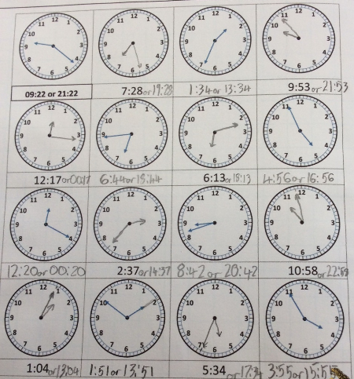
Here’s what Y5&6 have been focusing on at home today.
Reuben has been recognising or drawing the times on the clocks accurately.

Slide 23
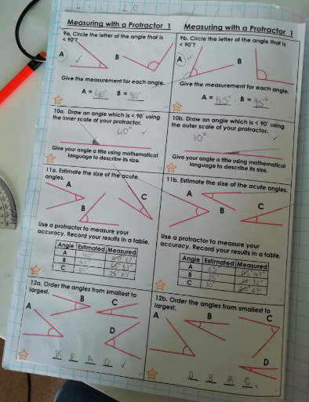
Here’s what Y5&6 have been focusing on at home today.
Amy has been using her protractor to help to recognise, measure or order these angles.

Slide 24
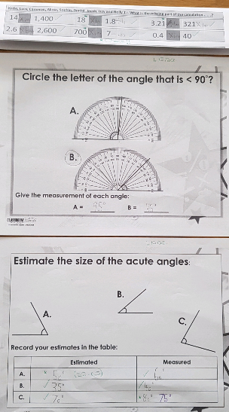
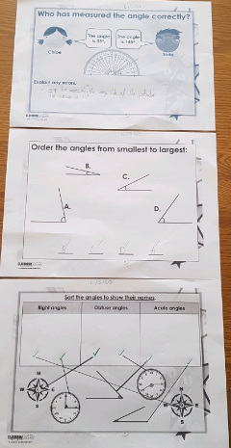
Here’s what Y5&6 have been focusing on at home today.
Cameron has been using his protractor to help to recognise, measure or order these angles.

Slide 25
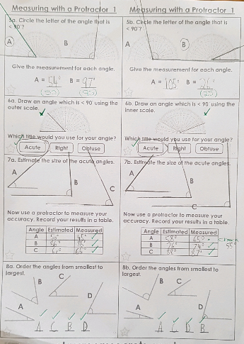
Here’s what Y5&6 have been focusing on at home today.
Cameron has been using his protractor to help to recognise, measure or order these angles.

Slide 26
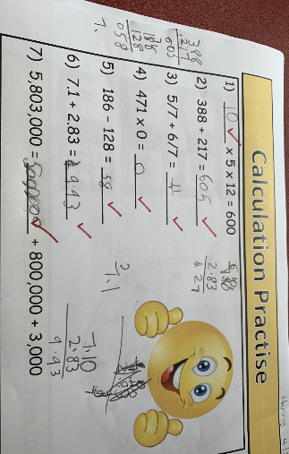
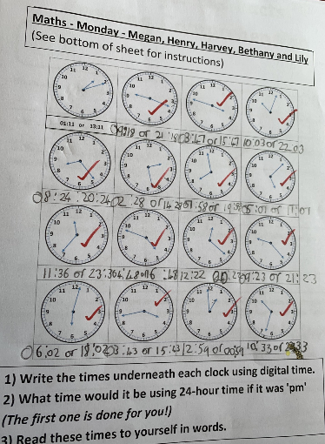
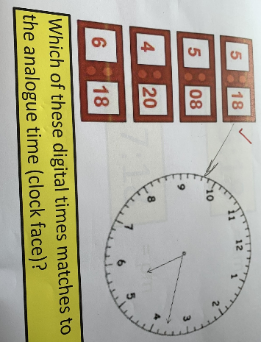
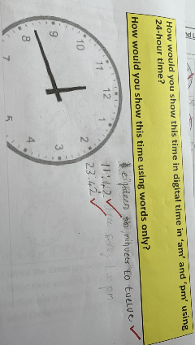
Here’s what Y5&6 have been focusing on at home today.
Henry has been hard at work in maths today.

Slide 27
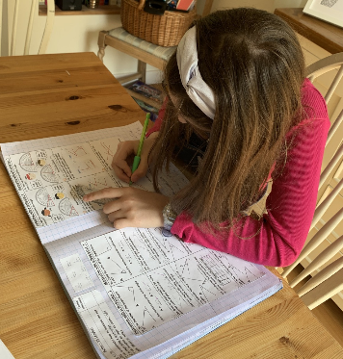
Here’s what Y5&6 have been focusing on at home today.
Hard at work in maths today studying angles using a protractor

Slide 28
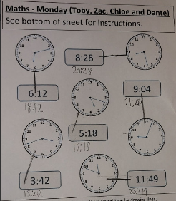
Here’s what Y5&6 have been focusing on at home today.
Dante has been matching the digital and analogue times together.

Slide 29
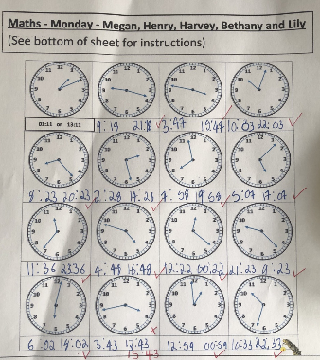
Here’s what Y5&6 have been focusing on at home today.
Harvey has been matching the digital and analogue times together.

Slide 30
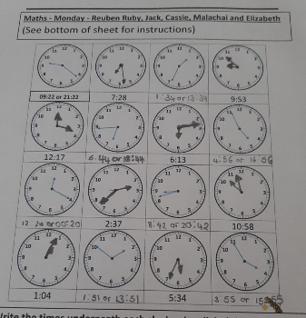
Here’s what Y5&6 have been focusing on at home today.
Ruby has been matching the digital and analogue times together.

Slide 31
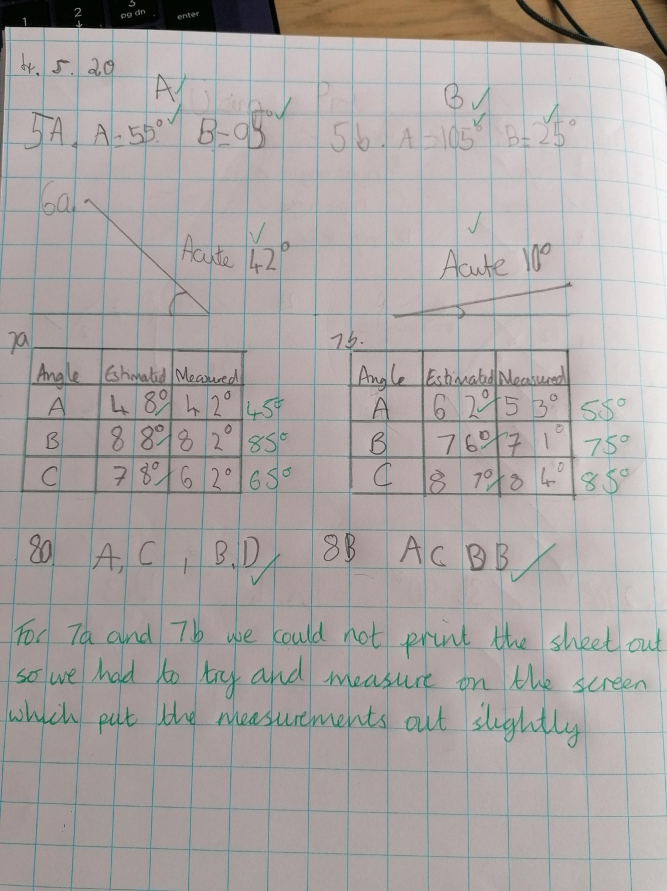
Here’s what Y5&6 have been focusing on at home today.
Isobel has been using her protractor and looking closely at the angles.

Slide 32
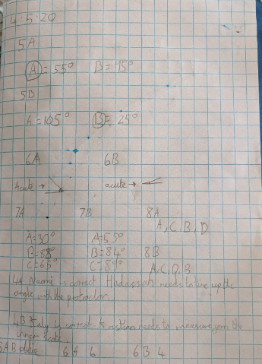
Here’s what Y5&6 have been focusing on at home today.
Lucy has been using her protractor and looking closely at the angles.

Slide 33
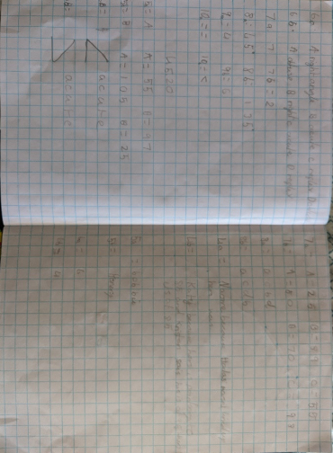
Here’s what Y5&6 have been focusing on at home today.
Katie has been using her protractor and looking closely at the angles.

Slide 34
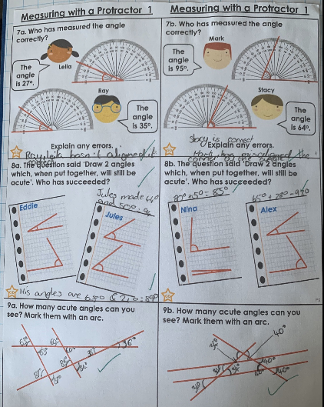
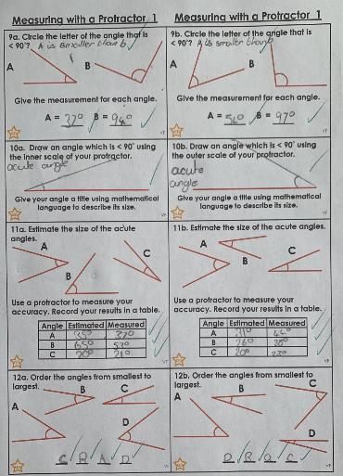
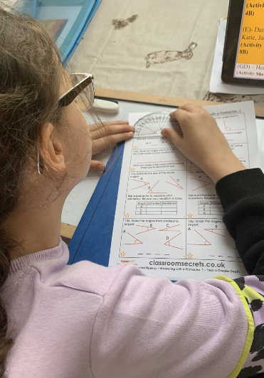
Here’s what Y5&6 have been focusing on at home today.
Using her protractor and looking closely at the angles.

Slide 35
Here’s what Y5&6 have been
focusing on at home today.

Slide 36
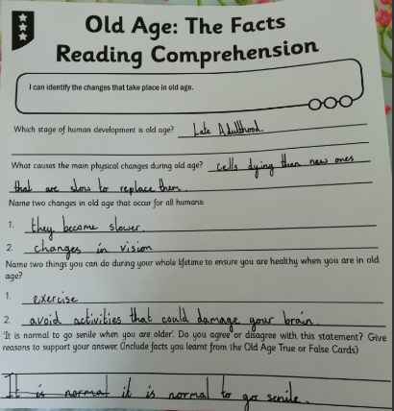
Here’s what Y5&6 have been focusing on at home today.
Amy showing her understanding of how getting older affects your body.

Slide 37
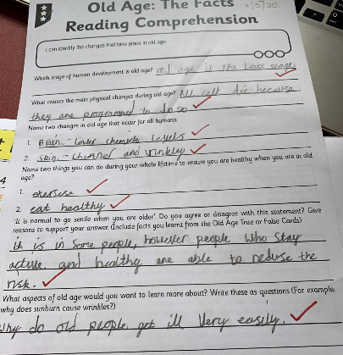
Here’s what Y5&6 have been focusing on at home today.
Henry showing his understanding of how getting older affects your body.

Slide 38
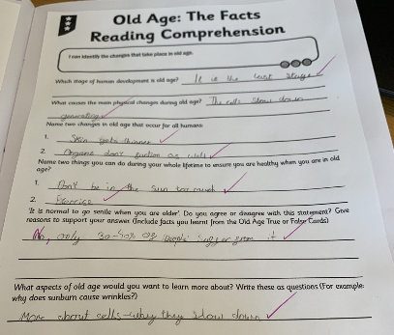
Here’s what Y5&6 have been focusing on at home today.
Zoe showing her understanding of how getting older affects your body.

Slide 39
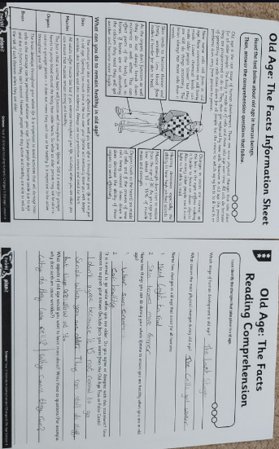
Here’s what Y5&6 have been focusing on at home today.
Dante showing his understanding of how getting older affects your body.

Slide 40
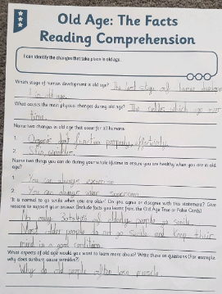
Here’s what Y5&6 have been focusing on at home today.
Cameron showing his understanding of how getting older affects your body.

Slide 41
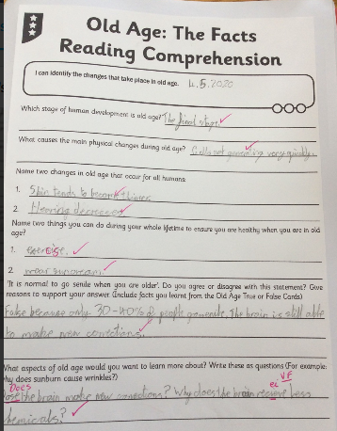
Here’s what Y5&6 have been focusing on at home today.
Reuben showing his understanding of how getting older affects your body.

Slide 42
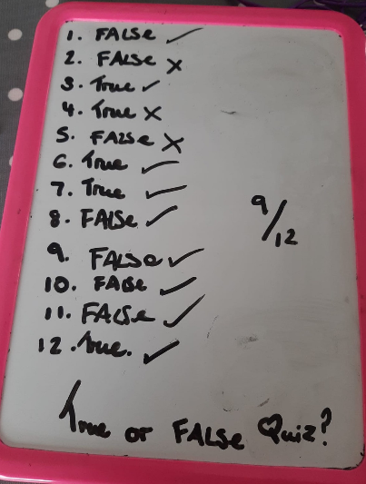
Here’s what Y5&6 have been focusing on at home today.
Ruby got 75% of her questions about her ‘Science’ correct.

Slide 43
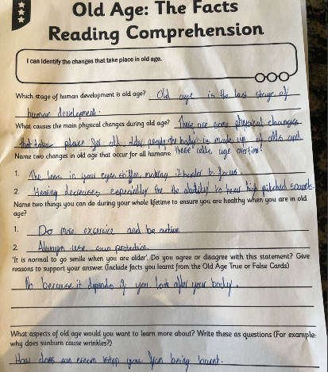
Here’s what Y5&6 have been focusing on at home today.
Harvey showing his understanding of how getting older affects your body.

Slide 44
Here’s what Y5&6 have been focusing on at home today.
Old Age
Old age is the last stage of human development.
The process of regenerating new cells starts to slow down.
Muscle strength starts to reduce from the age of thirty and hearing decreases.
Always use sun cream to avoid sunburn and exercise throughout your life.
I disagree that it is normal to go senile when you are older because only 30-40% of the elderly population suffer severe memory loss.
What food do elderly people need to eat?
Isobel showing her understanding of how getting older affects your body.

Slide 45
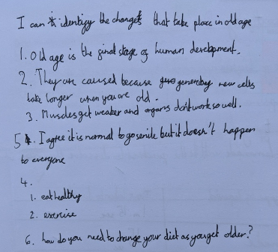
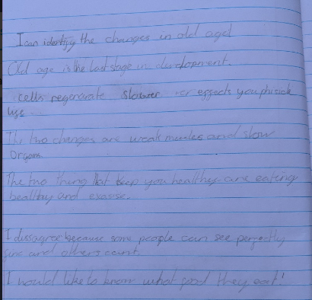
Here’s what Y5&6 have been focusing on at home today.
Lucy and Katie showing their understanding of how getting older affects your body.

Slide 46
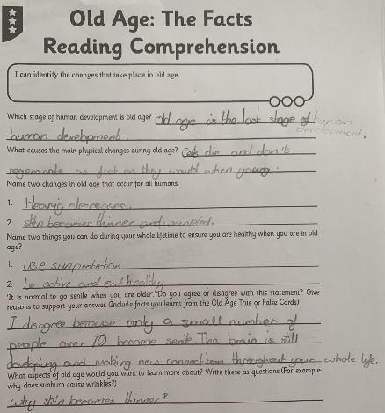
Here’s what Y5&6 have been focusing on at home today.
Nelly showing her understanding of how getting older affects your body.

Slide 47
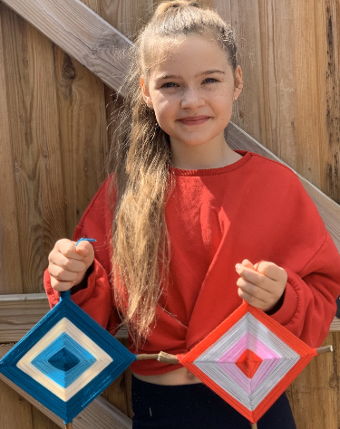
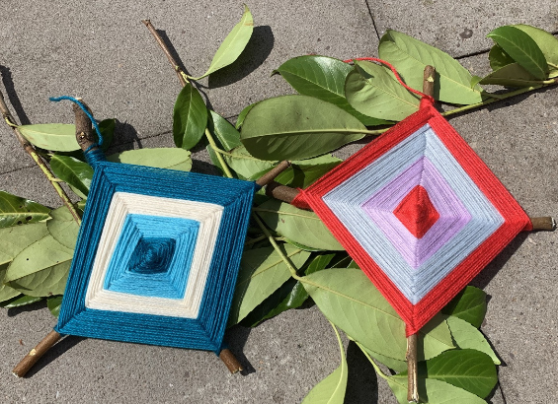
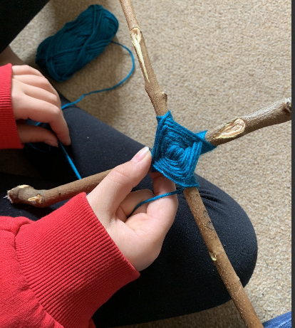
What else have we been doing at home today?
Sophie’s been making some art work to display in school when we return.

Slide 48
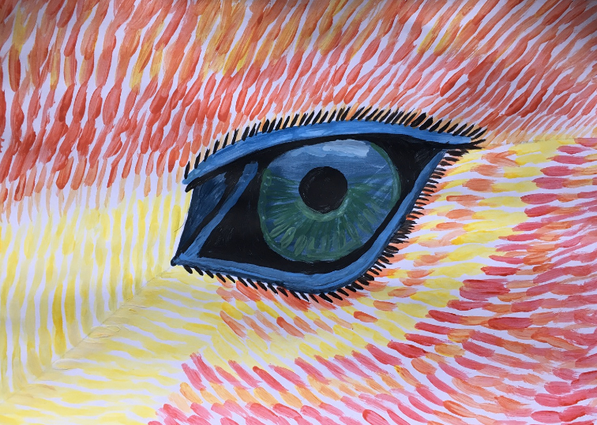
What else have we been doing at home today?
Nelly has been painting her ‘phoenix eye’ over the weekend.

Slide 49
What else have we been doing at home today?
Here’s my morning exercise – Over 10 miles!

Slide 50
What else have we been doing at home today?
Here’s my lunch for today!
The word on my t-shirt says it all!

Slide 51
What else have we been doing at home today?
Practising my spellings for this week on Spelling Shed

Slide 52
What else have we been doing at home today?
I enjoyed Theseus and the Minotaur so I decided to draw the vicious beast.

Slide 53
What else have we been doing at home today?
Dante has been learning about healthy eating……..

Slide 54
What else have we been doing at home today?
……before he munched his way through this gift from his auntie and uncle.

Slide 55
What else have we been doing at home today?
Reuben has regularly been completing his reading record

Slide 56
What else have we been doing at home today?
I’ve been making jewellery this afternoon.

Slide 57
What else have we been doing at home today?
Isobel has been making pita bread during the weekend.

Slide 58
What else have we been doing at home today?
Megan has been reading a book about King Minos’ palace ‘Knossos’.

Slide 59
What else have we been doing at home today?
Practising her tennis skills

Slide 60
What else have we been doing at home today?
Story time
Day 8

