Slide 1
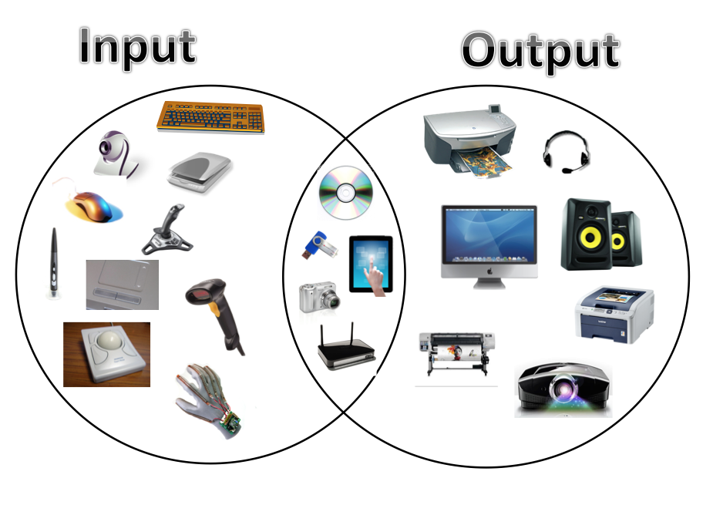
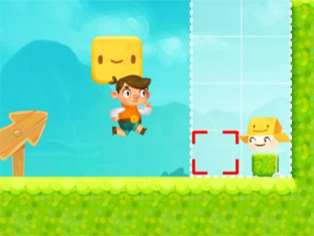
What I’m learning in Computing today
Computing Date: Wednesday 6th May 2020
L.Obj: *I can improve the speed and accuracy of my word processing (typing) skills.
*I can control a ‘sprite’ through a game.

Slide 2
What I’m learning in Computing today
Improving Word Processing Skills
Click on this hyperlink here to take you to the website ‘Dance Mat Typing’.
Then, practise the speed and accuracy of your word processing (typing) skills.

Slide 3
What I’m learning in Computing today
Click on the link here to program the boy through the game.
Click on ‘Adobe play’ and ‘allow’.
Sprite Box
On the first page, you can change your ‘sprite’ before you click on the green button to start.
Arrow Keys : Move Left / Right, Jump, Climb
Mouse/Trackpad : Code & Interact

