Slide 1
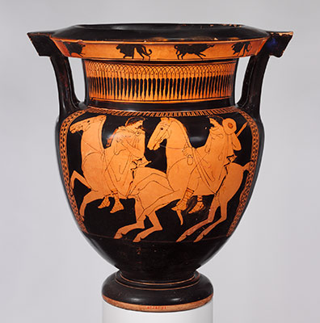
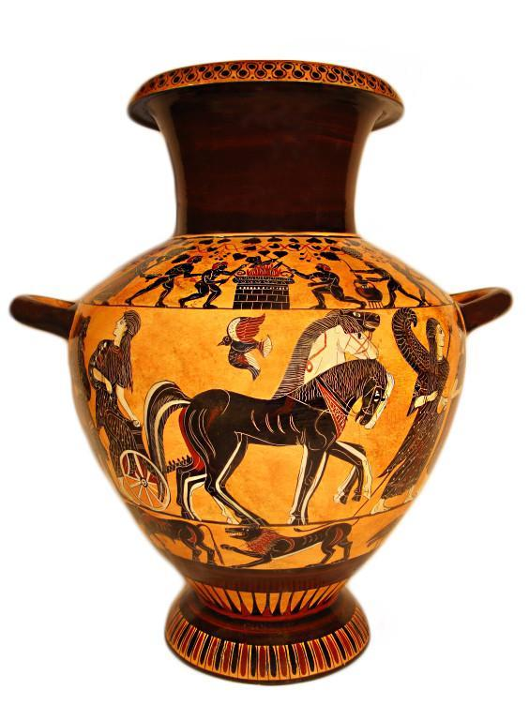
What I have been learning in ART
PREVIOUS LESSONS (ART – Lessons 1 & 2)
L.Obj: *I can paint the eye of an Ancient Greek creature, the phoenix
*I can draw Ancient Greek vases with accuracy and attention to detail.
These are the pieces of Ancient Greek art work that you’ve produced during the last two weeks. If you’ve not yet had the opportunity to complete these, here are the links you will need. Just click on the words below.
phoenix eye
Ancient Greek vases

Slide 2
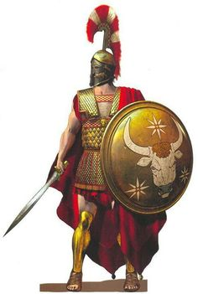
What I’m learning in ART today
(ART – Lesson 3) Thursday 7th May 2020
L.Obj: *I can sketch / paint Ancient Greek armour and weapons.

Slide 3
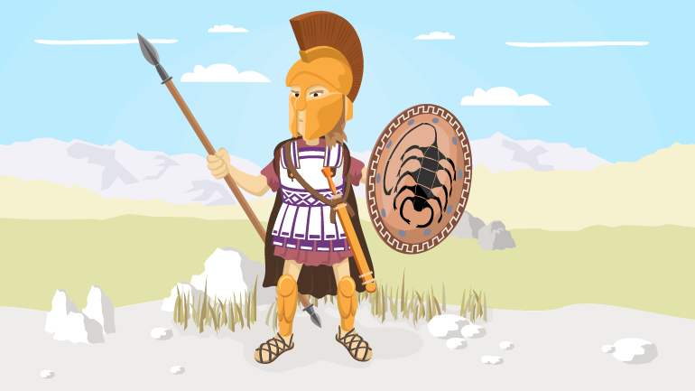
What I’m learning in Art today
I was
called a
‘hoplite’.
Click on the picture, then scroll down to find me on the website.
Study the weapons that I used and what the role of a hoplite was.

Slide 4
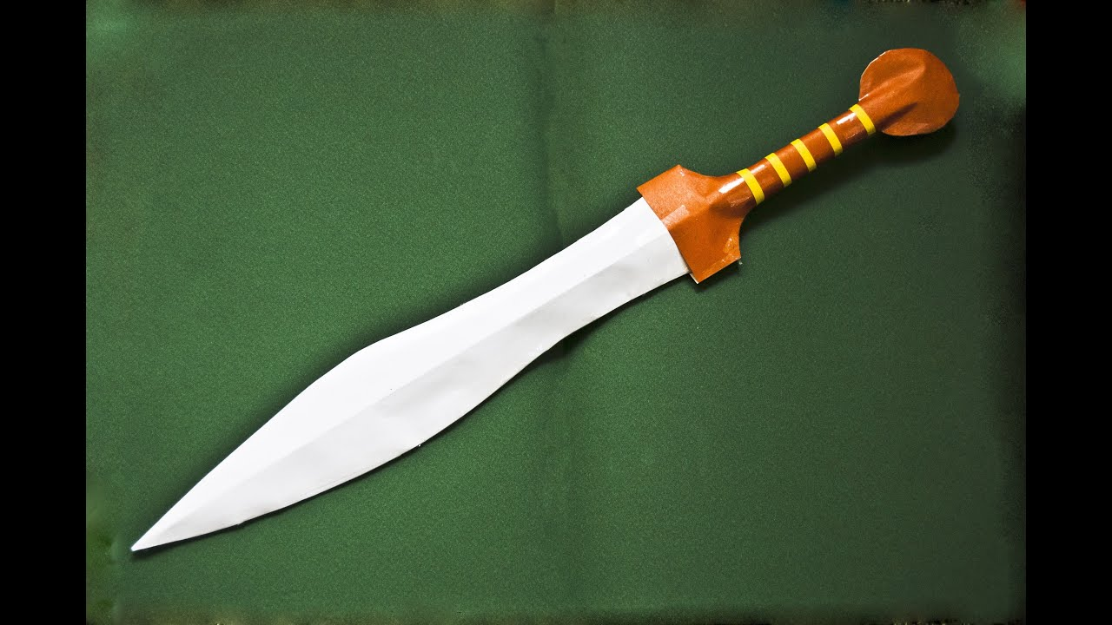
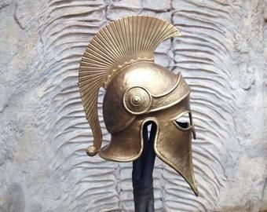
What I’m learning in Art today
xiphos
(pronounced ‘ziphos’)
a hoplite’s helmet
Click on these hyperlinks!

