Slide 1
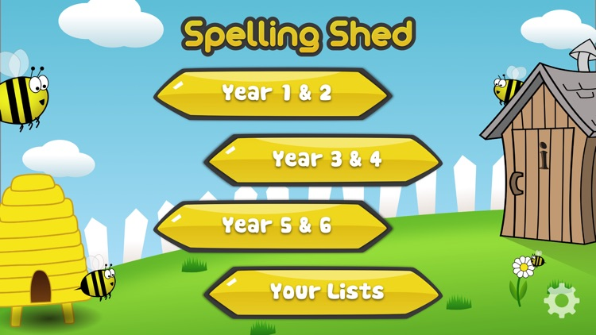
Y5&6 TOP SPELLERS TODAY
1st = Izzy 49 points
2nd = Amy 15 points
3rd = Heidi 12 points
4th = Nelly and Jack 10 points
5th = Lily 9 points
6th = Cassie 8 points
7th = Ruby 5 points
8th = Elizabeth 3 points
9th = Rhys 2 points
These are the amount of dojos you have received for your efforts today!
Everybody else earns 1 dojo for practising their spellings today!

Slide 2
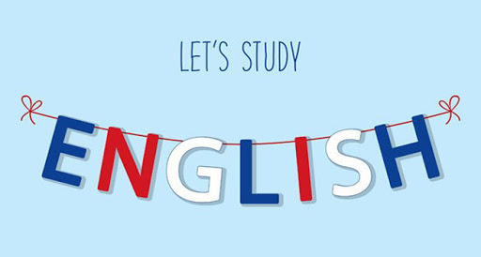
Here’s what Y5&6 have been
focusing on at home today.

Slide 3
Here’s what Y5&6 have been
focusing on at home today.
Henry has improved these sentences with better synonyms.

Slide 4
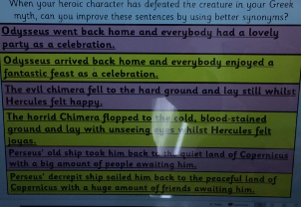
Here’s what Y5&6 have been
focusing on at home today.
Reuben has improved these sentences with better synonyms.

Slide 5
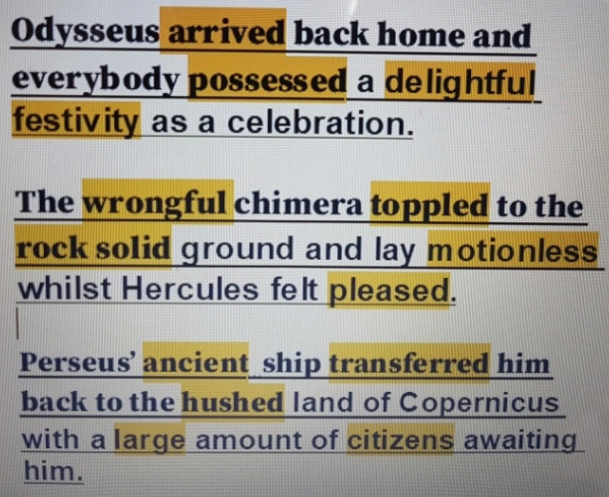
Here’s what Y5&6 have been
focusing on at home today.
Bethany has improved these sentences with better synonyms.

Slide 6
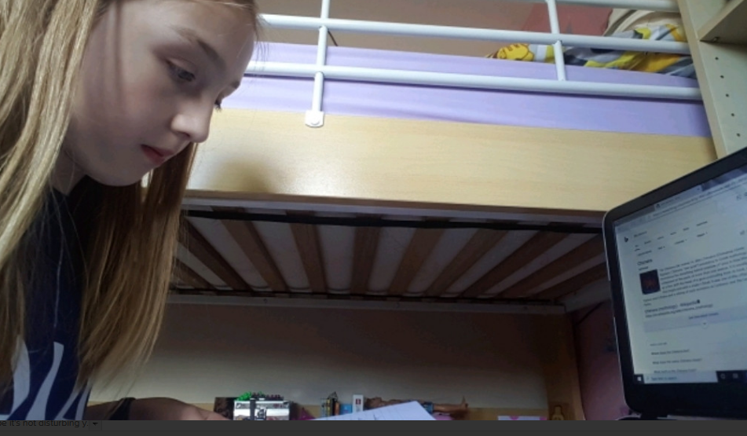
Here’s what Y5&6 have been
focusing on at home today.
I’m now now concentrating on my Greek myth

Slide 7
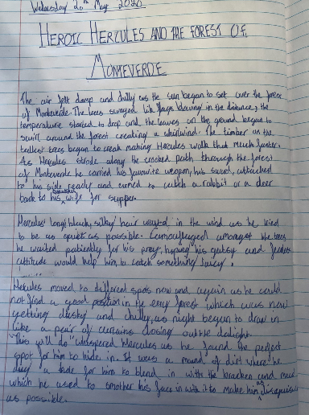
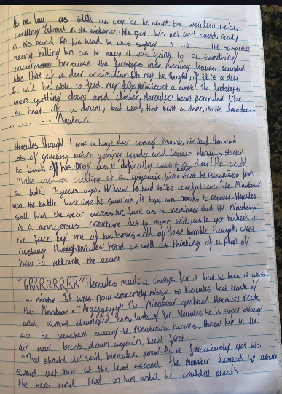
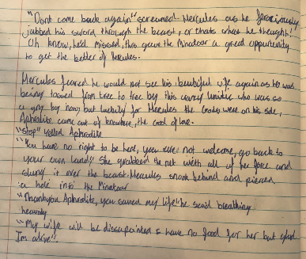
Here’s what Y5&6 have been
focusing on at home today.
Harvey has continued his Greek myth today and will finish it off next week.

Slide 8
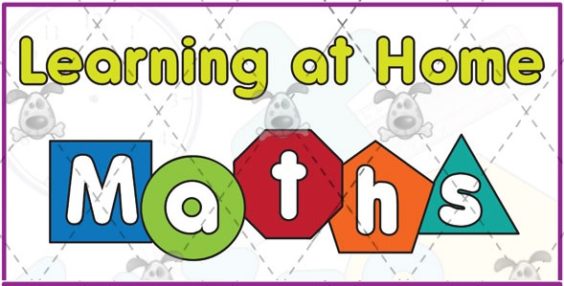
Here’s what Y5&6 have been
focusing on at home today.

Slide 9
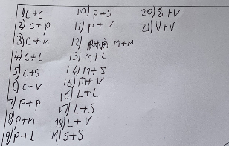
Here’s what Y5&6 have been
focusing on at home today.
Henry found all 21 possible combinations of ice-cream flavour.

Slide 10
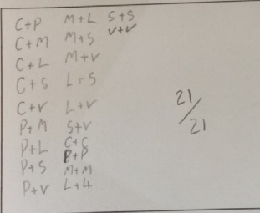
Here’s what Y5&6 have been
focusing on at home today.
Reuben also used an effective system to find all 21 possible combinations of ice-cream flavour too.

Slide 11
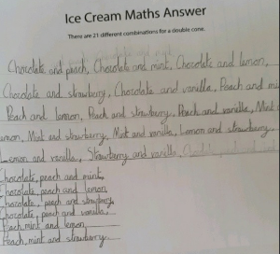
Here’s what Y5&6 have been
focusing on at home today.
Bethany also used an effective system to find all 21 possible combinations of ice-cream flavour too.

Slide 12
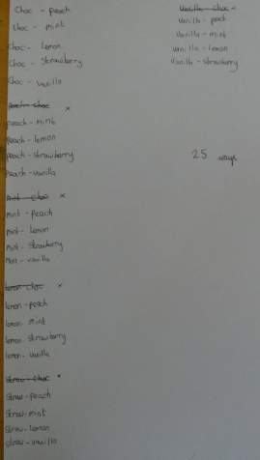
Here’s what Y5&6 have been
focusing on at home today.
Jack found 25 possible combinations but then realised he had repeated some of the combinations but written them in reverse.

Slide 13
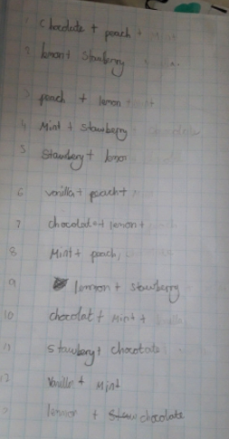
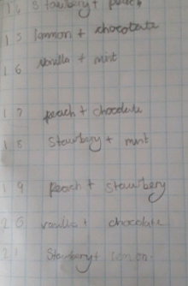
Here’s what Y5&6 have been
focusing on at home today.
Chloe found all 21 too.

Slide 14
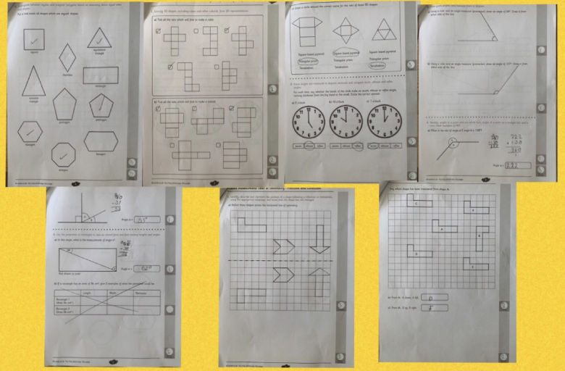
Here’s what Y5&6 have been
focusing on at home today.
Nelly has completed her ‘Geometry’ assessment really well.

Slide 15
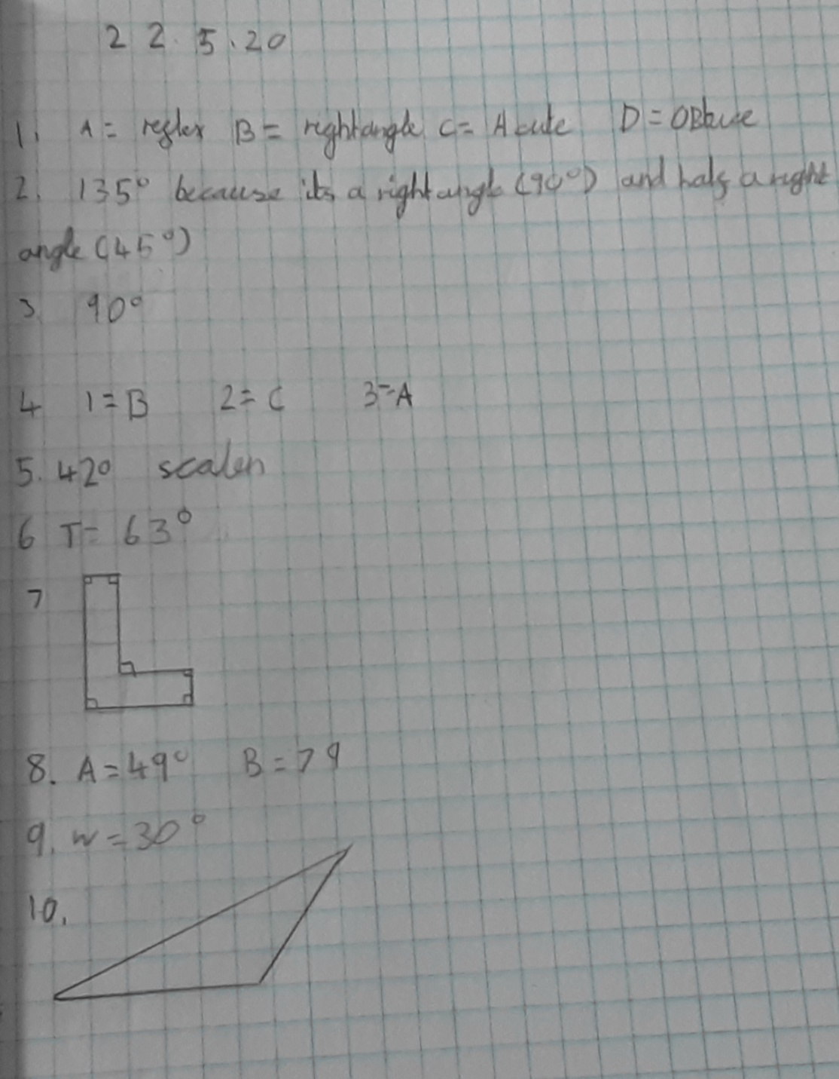
Here’s what Y5&6 have been
focusing on at home today.
Lucy has answered her angles and shape questions effectively today.

Slide 16
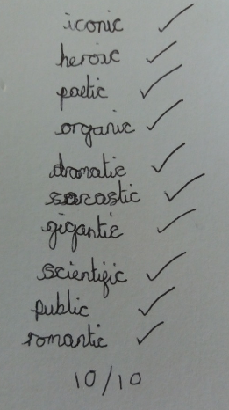
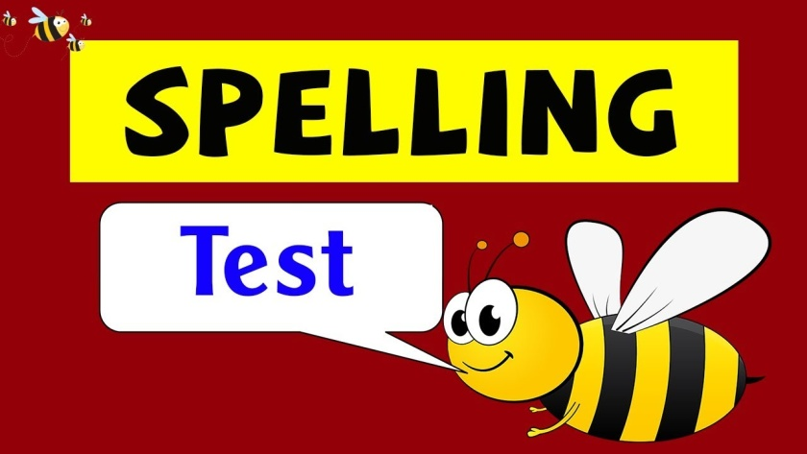
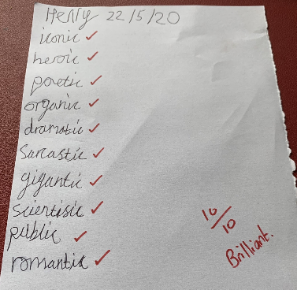
What else have I done at home today?
Elizabeth scored 10/10 for her spellings
So did Jack!
And Henry too!

Slide 17
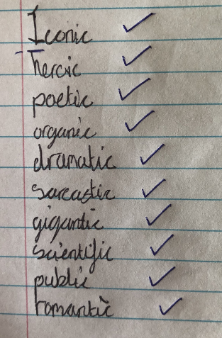
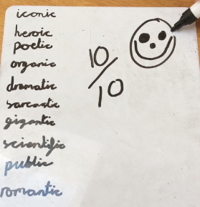
What else have I done at home today?
Harvey scored 10/10 for his spellings.
So did Amy!
And Reuben and Rhys did too!

Slide 18
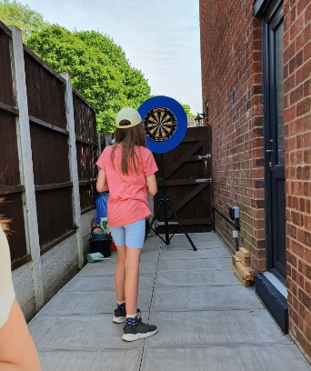
What else have I done at home today?
I enjoyed a game of darts yesterday evening.

Slide 19
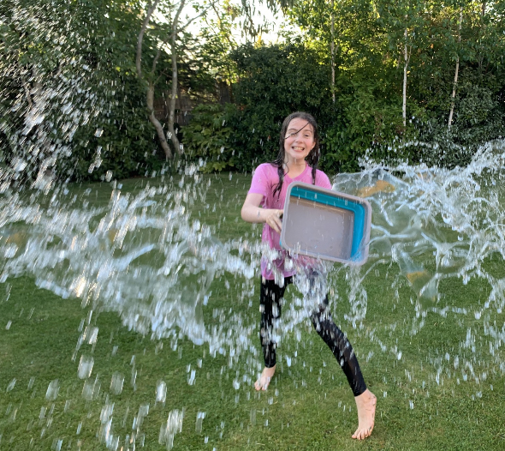
What else have I done at home today?
I’ve been loving water fights with my mum.

Slide 20
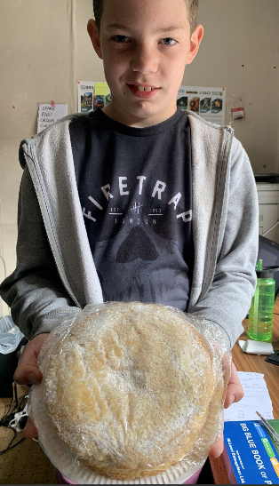
What else have I done at home today?
I’ve been busy baking a cake.

Slide 21
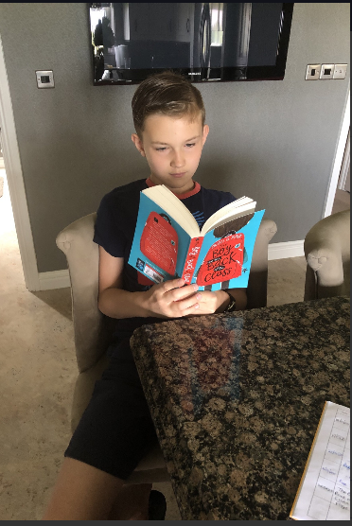
What else have I done at home today?
I’m really loving ‘The Boy at the Back of the Class’ by Onjali Q. Raúf

Slide 22
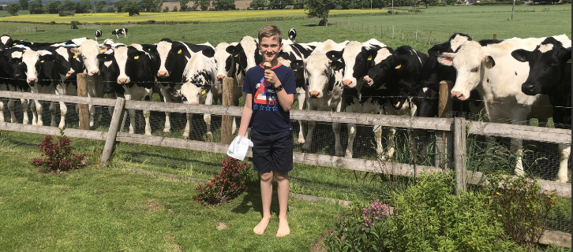
What else have I done at home today?
I enjoyed an ice-cream after my maths investigation – and had some nosey guests too!

Slide 23
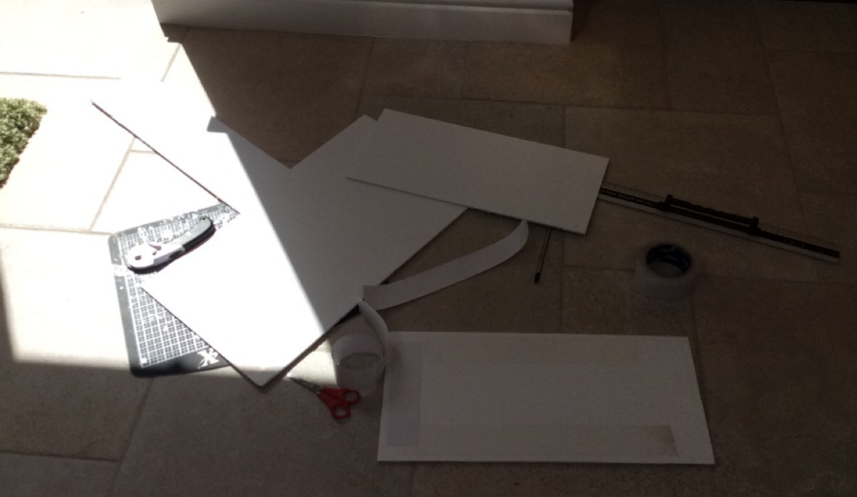
What else have I done at home today?
Reuben has started to think about his Parthenon creation…………..

Slide 24
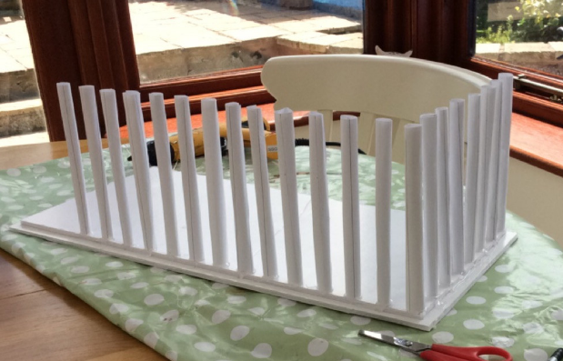
What else have I done at home today?
..and now the construction begins…

Slide 25
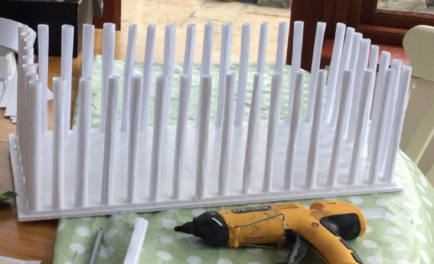
What else have I done at home today?
…..until I’ve completed the columns.

Slide 26
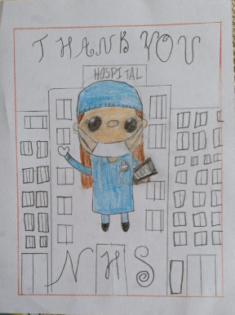
What else have I done at home today?
Bethany has been sketching to say ‘Thank you’ to the NHS workers

Slide 27
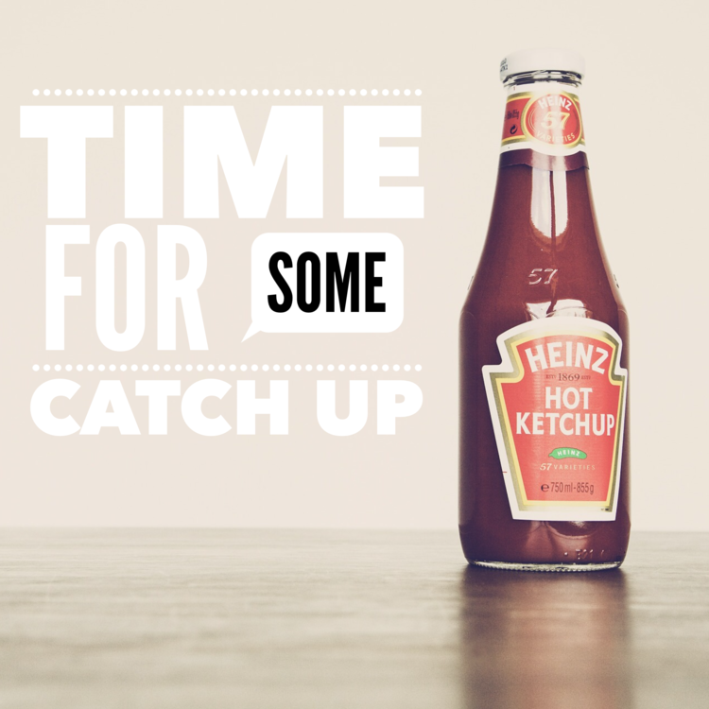
Here’s some more of the work at home that’s just been handed in…….

Slide 28
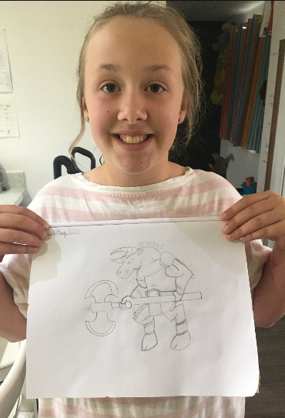
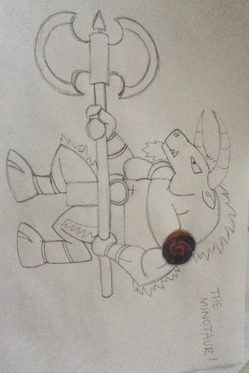
I’ve got more to show you
My mum and I have been following the tutorial to sketch the minotaur

Slide 29
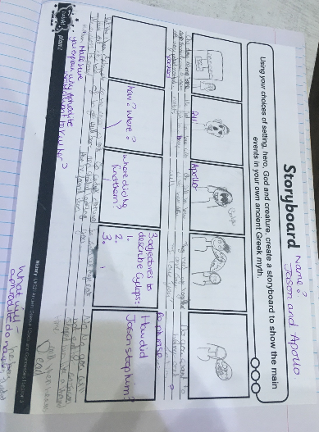
I’ve got more to show you
Isla’s story plan for her Greek myth

Slide 30
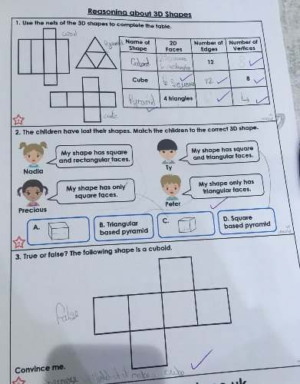
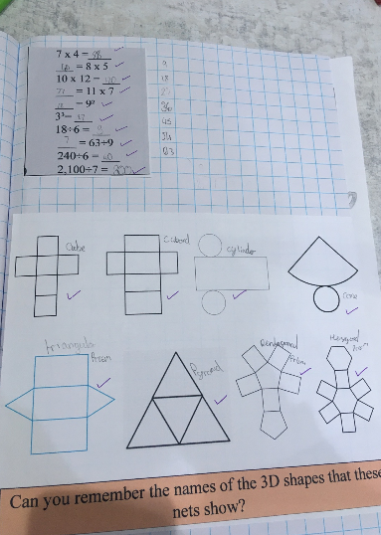
I’ve got more to show you
Isla has been studying the properties of the 3D shapes

Slide 31
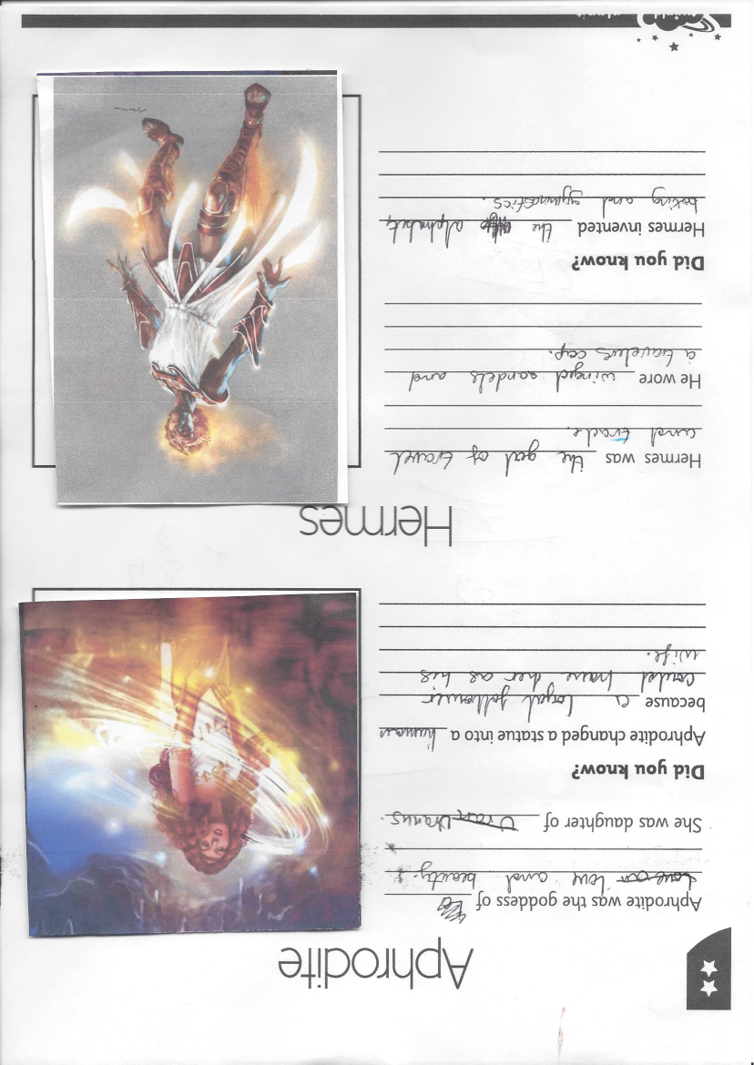
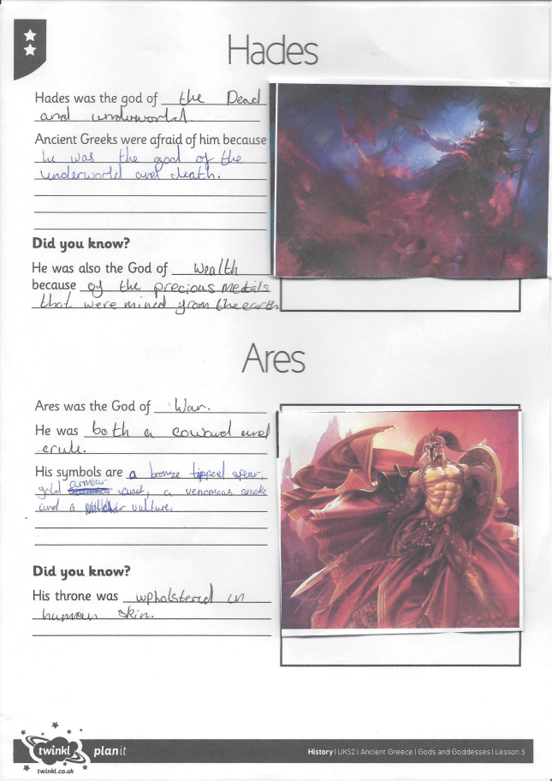
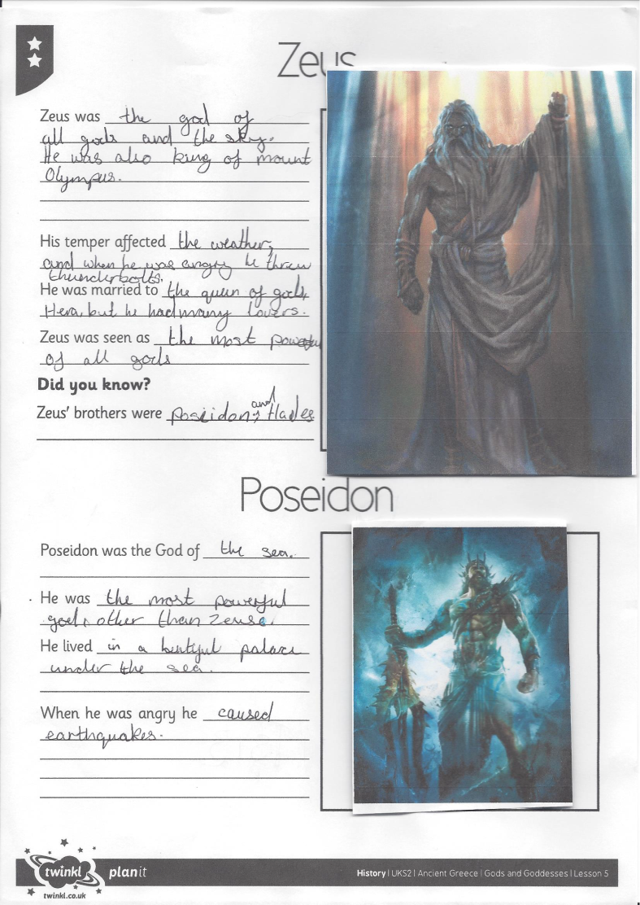
I’ve got more to show you
Megan was studying the Greek gods and goddesses

Slide 32
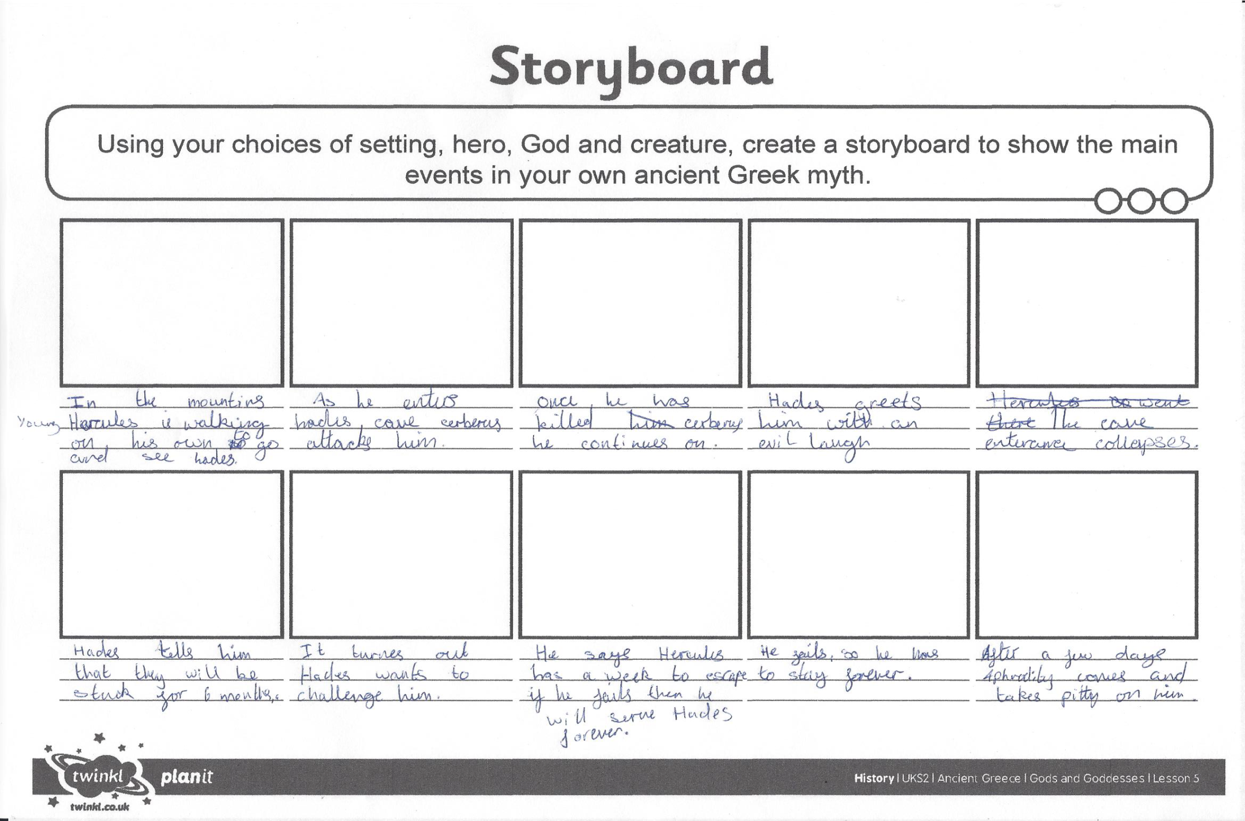
I’ve got more to show you
Megan created the main events for her Greek myth

Slide 33
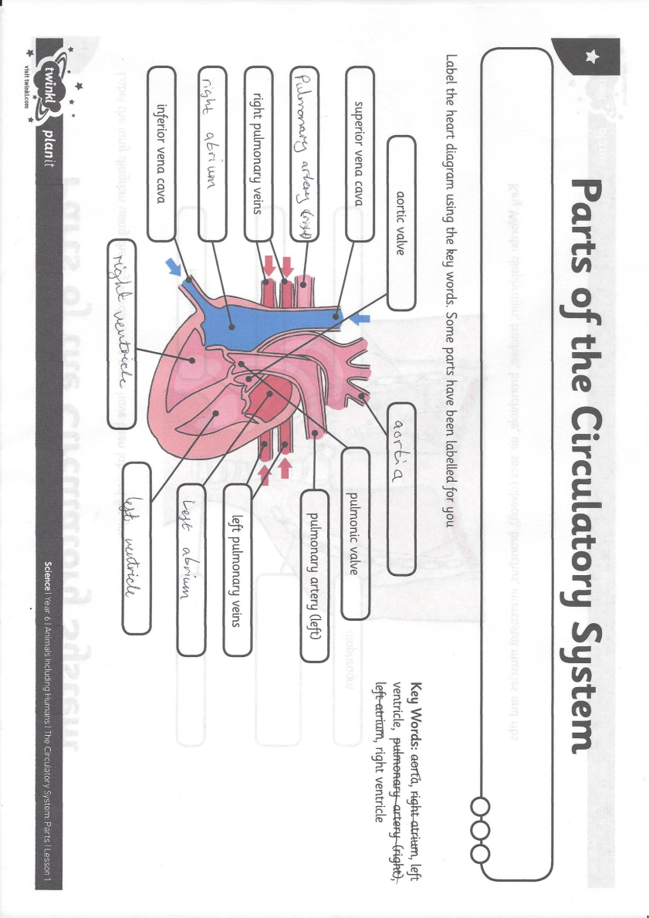
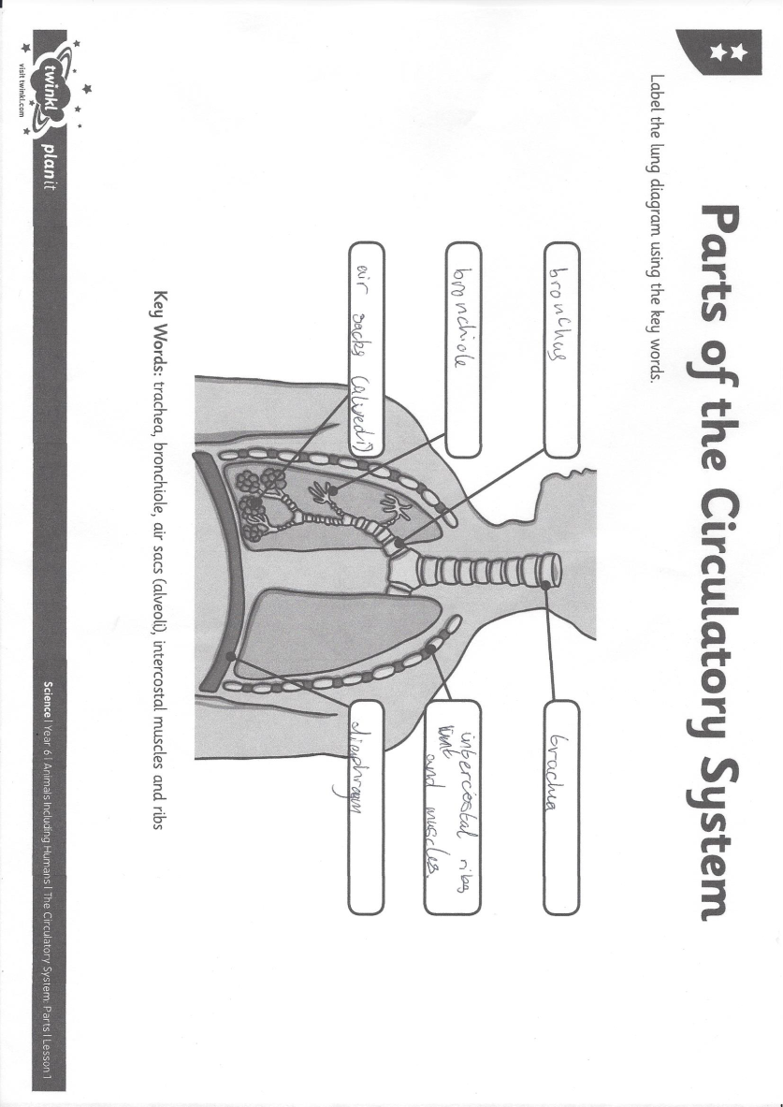
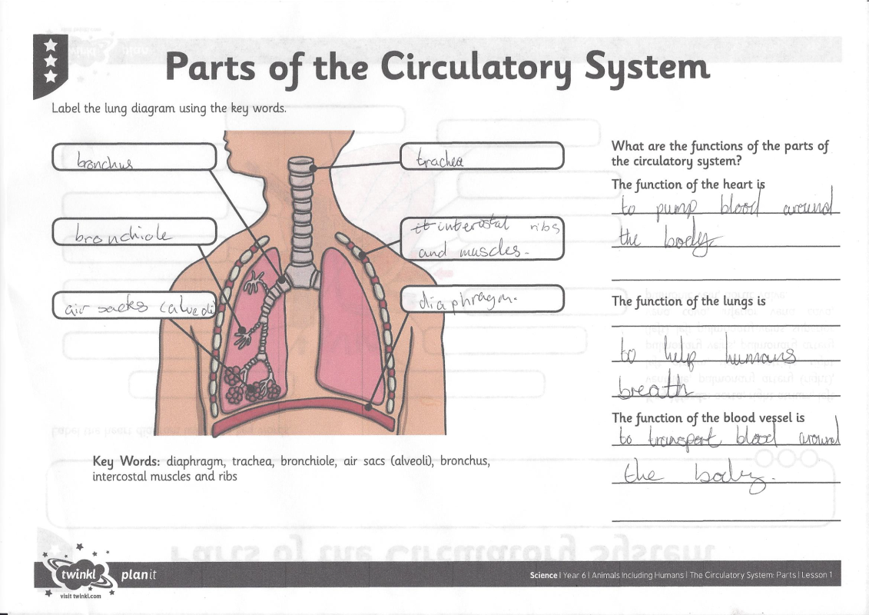
I’ve got more to show you
Megan identified the parts of the heart and lungs

Slide 34
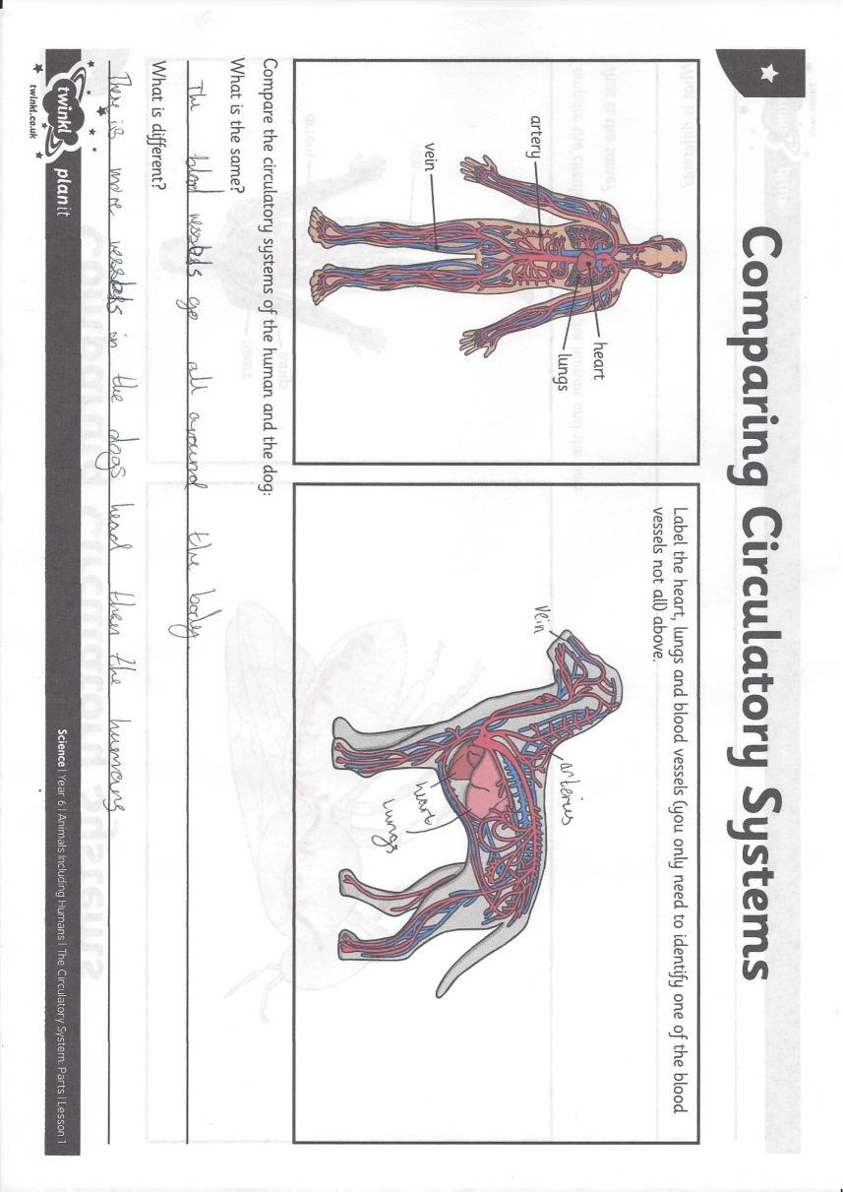
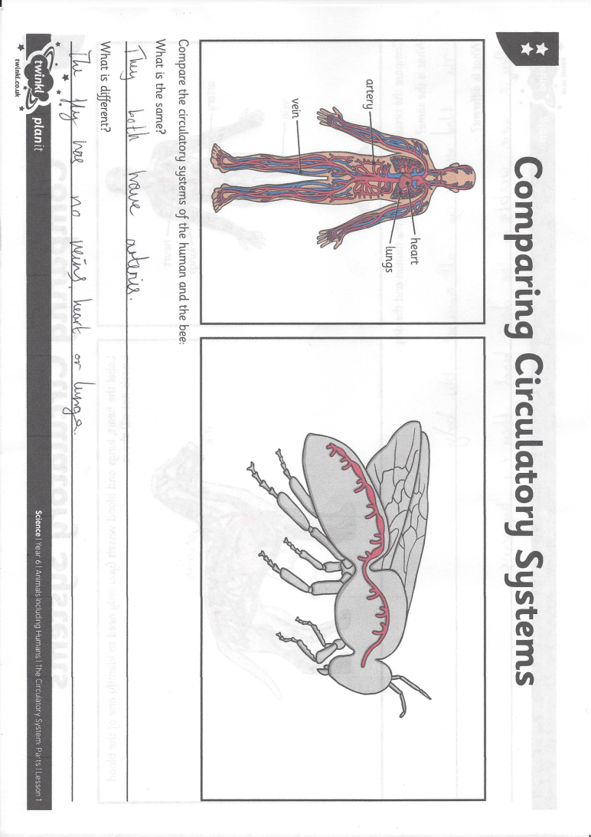
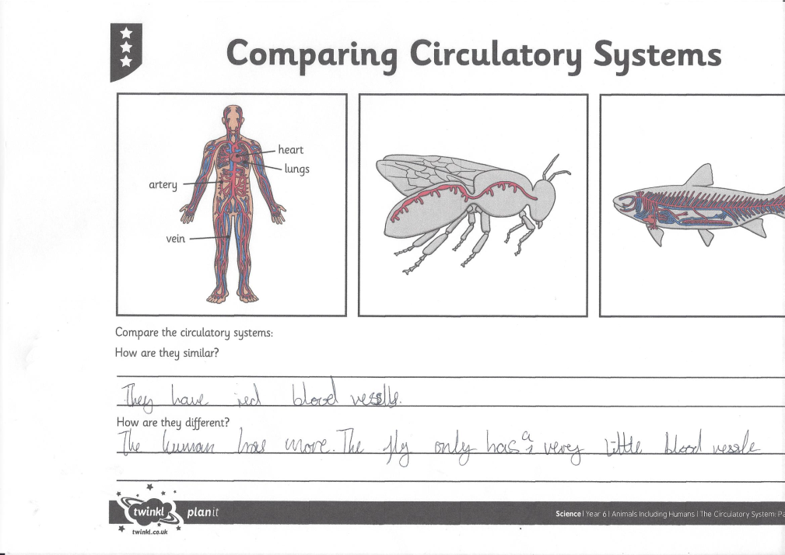
I’ve got more to show you
Megan compared human and animal circulatory systems

Slide 35
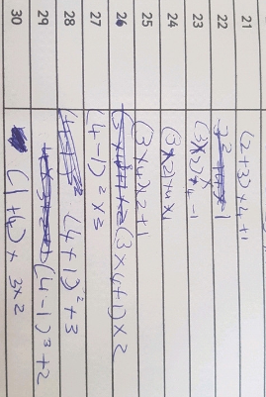
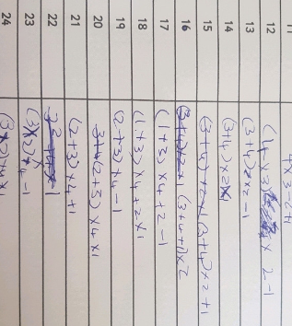
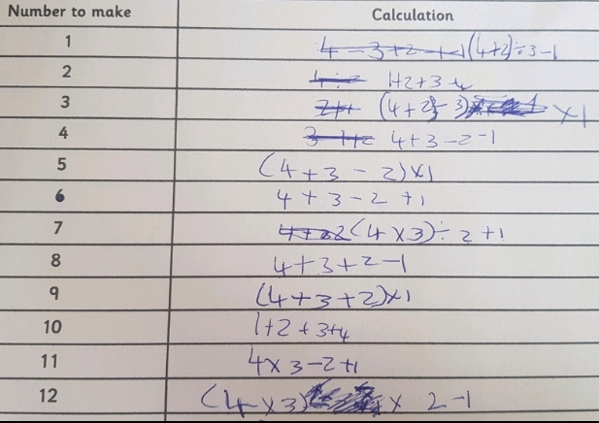
I’ve got more to show you
Elizabeth used the digits 1,2,3 and 4 to make the different totals 1-30.

Slide 36
AND FINALLY!
Happy 11th birthday to Henry for Monday

