Slide 1
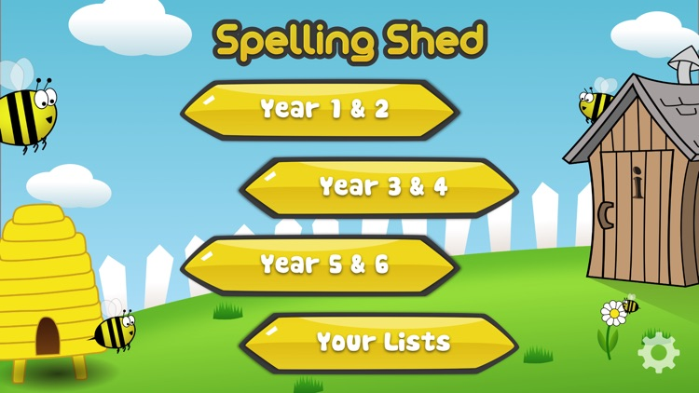
Y5&6 TOP SPELLERS TODAY
1st = Nelly 143 points
2nd = Jack 94 points
3rd = Heidi 28 points
4th = Holly H 20 points
5th = Dante 14 points
6th = Amy 12 points
7th = Megan 11 points
8th = Lily 9 points
9th = Toby, Zac and Nia 8 points
These are the amount of dojos you have received for your efforts today!
Everybody else earns 1 dojo for practising their spellings today!

Slide 2
Here’s what Y5&6 have been
focusing on at home today.

Slide 3
Here’s what Y5&6 have been focusing on at home today.
Cassie’s extract from yesterday

Slide 4
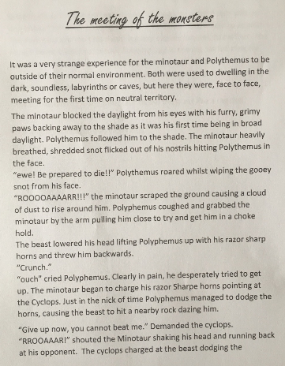
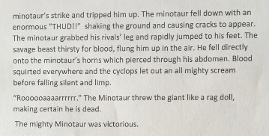
Here’s what Y5&6 have been focusing on at home today.
Nelly’s extract from yesterday

Slide 5
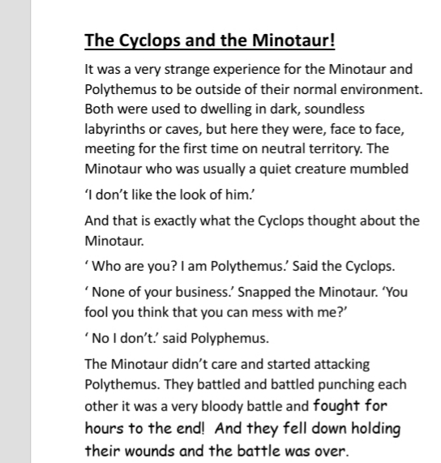
Here’s what Y5&6 have been focusing on at home today.
Katie’s extract from yesterday

Slide 6
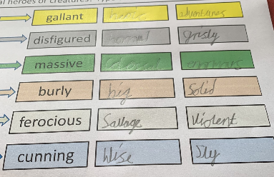
Here’s what Y5&6 have been focusing on at home today.
Henry’s synonyms

Slide 7
Here’s what Y5&6 have been focusing on at home today.
Toby’s synonyms
brave
gallant
handsome
heroic
ugly
disfigured
gross
monstrous
huge
massive
large
humongous
strong
burly
muscly
towering
vicious
ferocious
scary
angry
clever
cunning
intelligent
smart

Slide 8
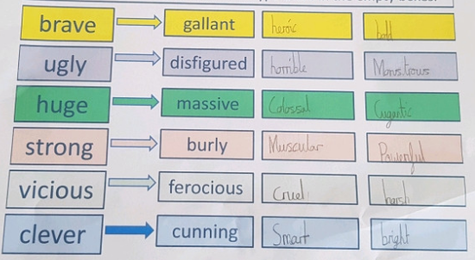
Here’s what Y5&6 have been focusing on at home today.
Cameron’s synonyms

Slide 9
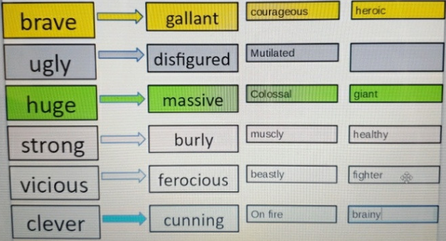
Here’s what Y5&6 have been focusing on at home today.
Bethany’s synonyms

Slide 10
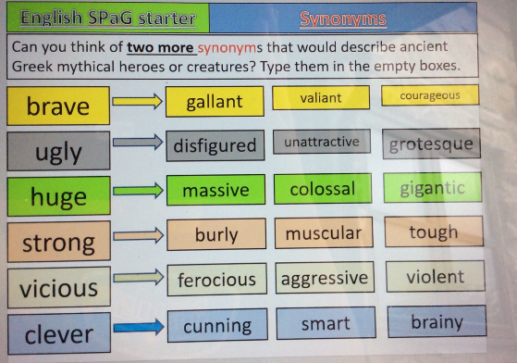
Here’s what Y5&6 have been focusing on at home today.
Reuben’s synonyms

Slide 11
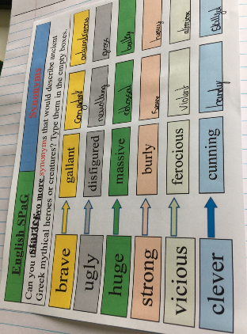
Here’s what Y5&6 have been focusing on at home today.
Isla’s synonyms

Slide 12
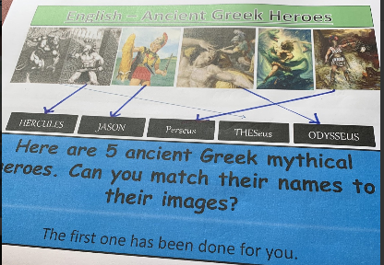
Here’s what Y5&6 have been focusing on at home today.
Henry’s matched the ancient Greek heroes to their images

Slide 13
Here’s what Y5&6 have been focusing on at home today.
Reuben’s matched the ancient Greek heroes to their images

Slide 14
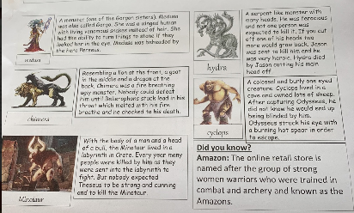
Here’s what Y5&6 have been focusing on at home today.
Henry has produced a non-chronological report about some of the ancient Greek mythical creatures

Slide 15
Katie has produced a non-chronological report about some of the ancient Greek mythical creatures

Slide 16
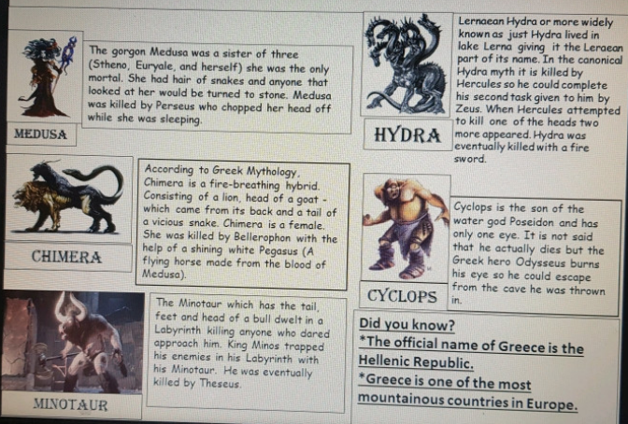
Cameron has produced a non-chronological report about some of the ancient Greek mythical creatures

Slide 17
Reuben has produced a non-chronological report about some of the ancient Greek mythical creatures, including a super introduction

Slide 18
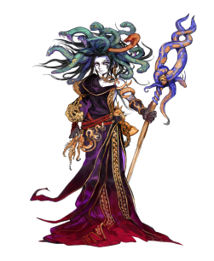
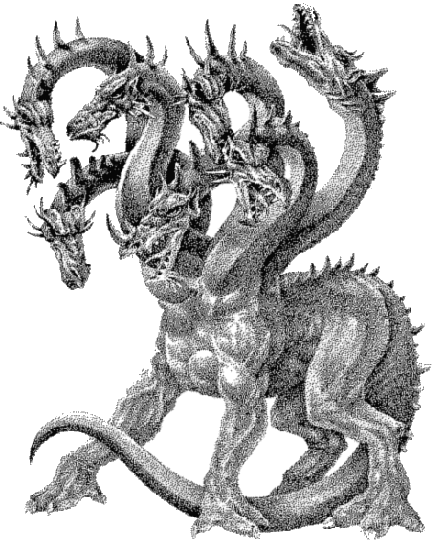
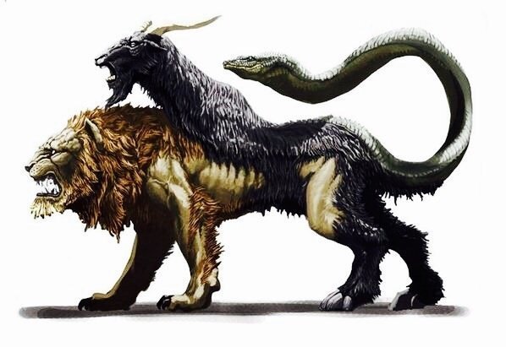
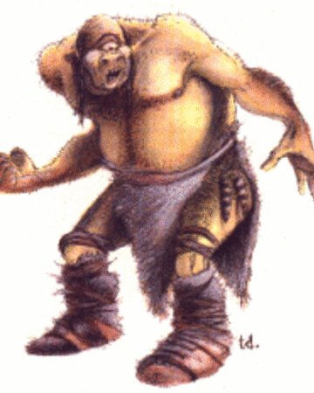
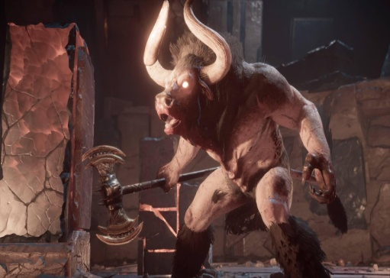
Toby has produced a non-chronological report about some of the ancient Greek mythical creatures
Medusa was vicious and a brutal lady. She turned people to stone, just for looking at her. She was very ugly and had snakes in her hair.
Hyrda was a giant swamp snake with many heads. He was killed by Hercules who chopped off his heads and stopped them growing back.
medusa
hydra
Chimera is a fire breathing lion, with a goat on her back and a tail of a dragon. She was shot by Belleprophon and Pegasus who could fly.
These giant one eyed creatures, they lived on an island, eating sheep and farming them. Polyphemus was killed by a hot, sharp spike in his eye.
chimera
cyclops
Minotaur was originally a snow white bull. He was kept by Minos in a labyrinth and would eat anyone who came in there. He was killed by Theseus with the help of Ariadne who was the daughter of King Minos
Did you know?
The amount of heads Hyrda is supposed to have is somewhere between 5 and more than 100.
Minotaur

Slide 19
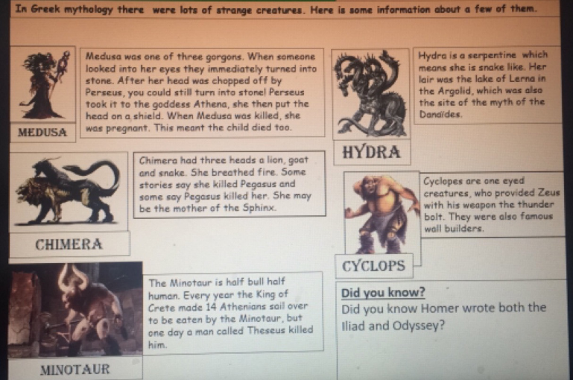
Megan has produced a non-chronological report about some of the ancient Greek mythical creatures

Slide 20
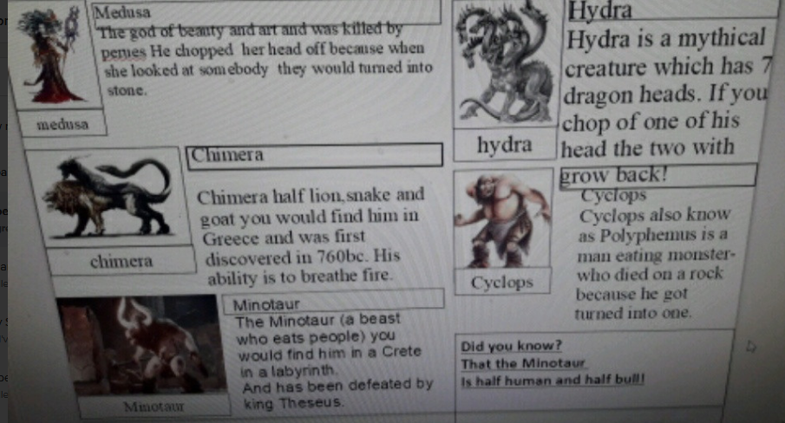
Chloe has produced a non-chronological report about some of the ancient Greek mythical creatures

Slide 21
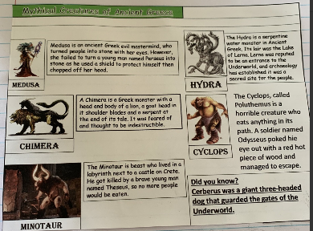
Zoe has produced a non-chronological report about some of the ancient Greek mythical creatures

Slide 22
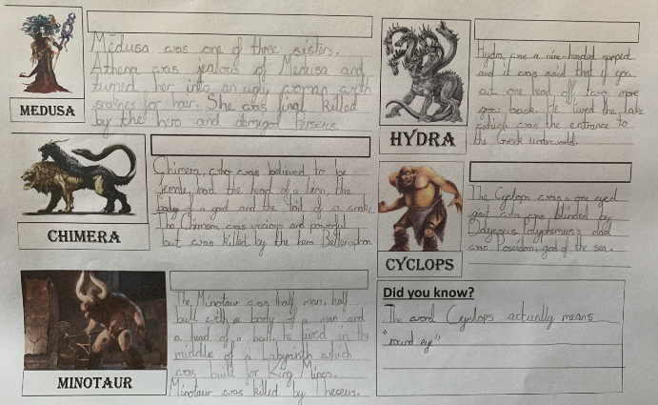
Sophie has produced a non-chronological report about some of the ancient Greek mythical creatures

Slide 23
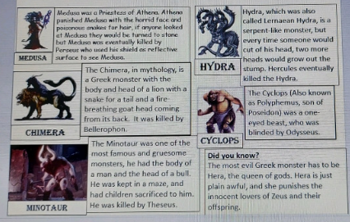
Dante has produced a non-chronological report about some of the ancient Greek mythical creatures

Slide 24
Lucy produced a non-chronological report about some of the ancient Greek mythical creatures

Slide 25
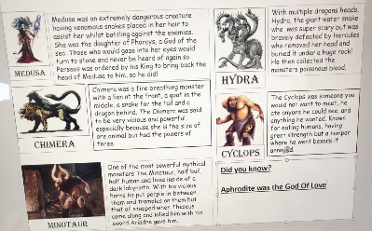
Harvey has produced a non-chronological report about some of the ancient Greek mythical creatures, including a super introduction

Slide 26
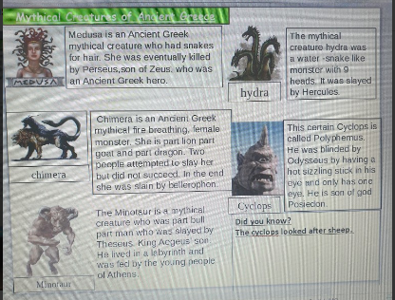
Bethany has produced a non-chronological report about some of the ancient Greek mythical creatures, including a super introduction

Slide 27
Here’s what Y5&6 have been
focusing on at home today.

Slide 28
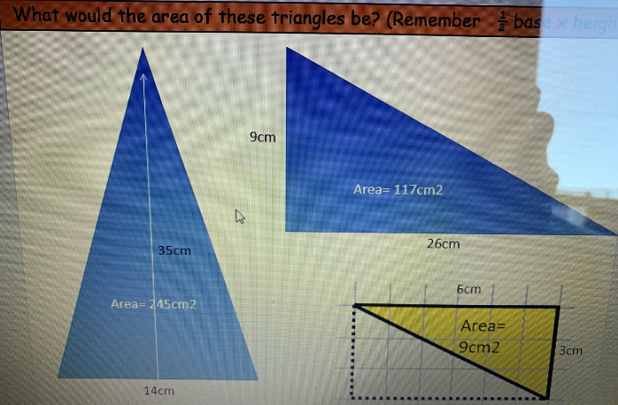
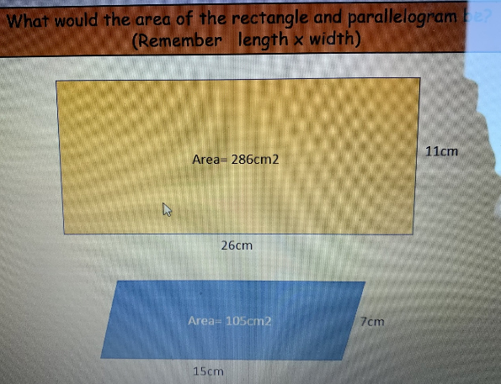
Here’s what Y5&6 have been focusing on at home today.
Cassie was calculating the area of these triangles, rectangles and parallelograms yesterday.

Slide 29
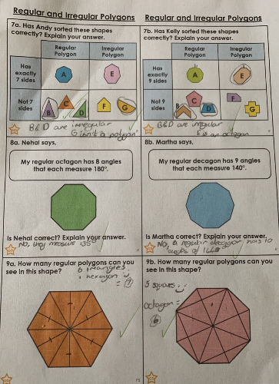
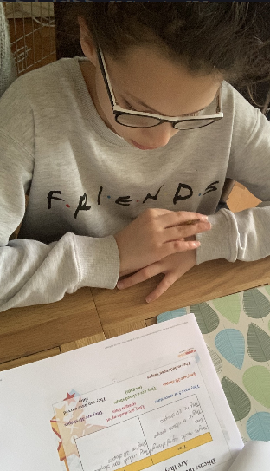
Here’s what Y5&6 have been focusing on at home today.
I’m catching up on my understanding of polygons in maths from yesterday………..

Slide 30
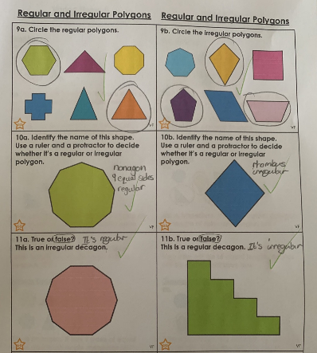
Here’s what Y5&6 have been focusing on at home today.
…….and now I’m recognising the difference between the regular and irregular shapes, and naming them too.

Slide 31
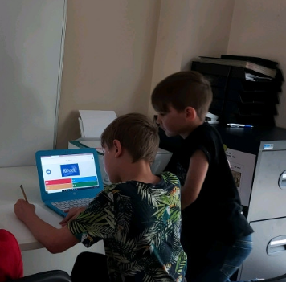
Here’s what Y5&6 have been focusing on at home today.
Dante has got his pencil and paper to help him with any jottings on his Kahoot maths calculation quiz.

Slide 32
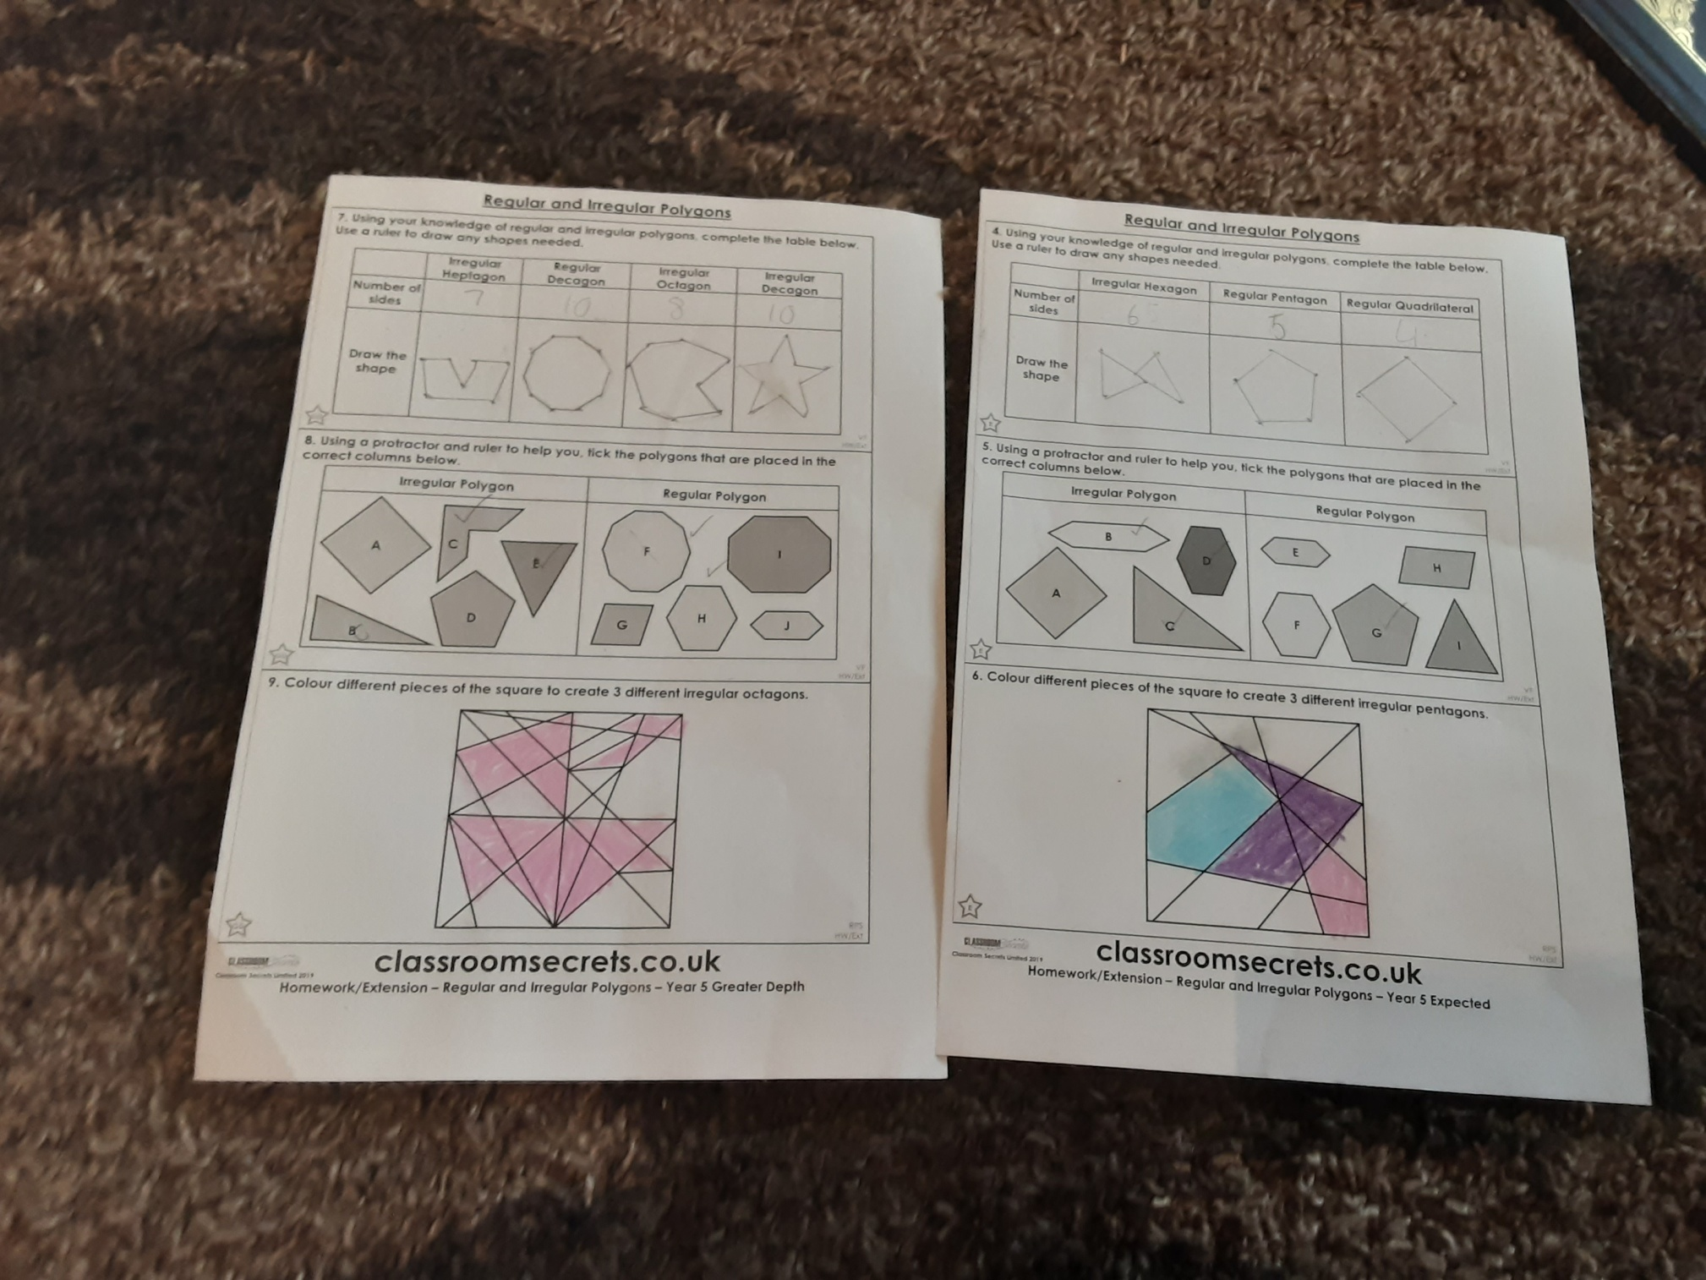
Here’s what Y5&6 have been focusing on at home today.
Katie has recognised the difference between the regular and irregular shapes, and naming them too.

Slide 33
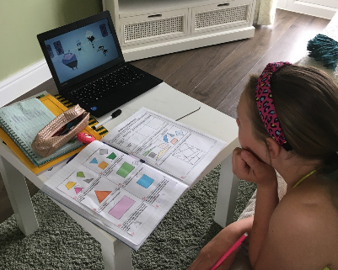
Here’s what Y5&6 have been focusing on at home today.
I’ve been watching the video link to learn more about regular and irregular polygons in maths

Slide 34
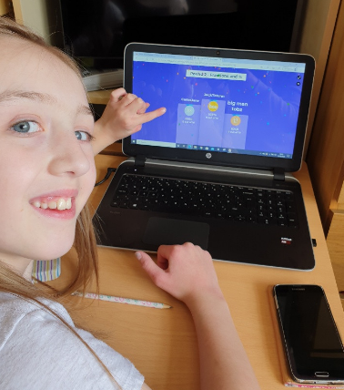
Here’s what Y5&6 have been focusing on at home today.
I’m delighted to have finished 2nd in Round 1 and Round 2 of the maths quiz today.

Slide 35
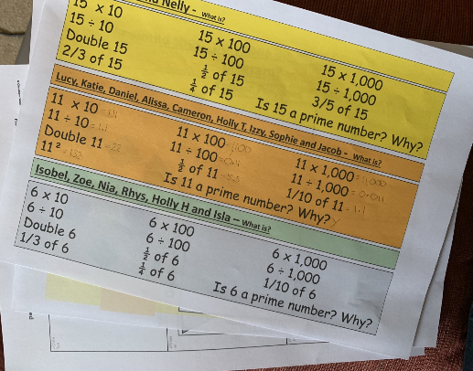
Here’s what Y5&6 have been focusing on at home today.
Sophie has been working hard in all of her maths work today.

Slide 36
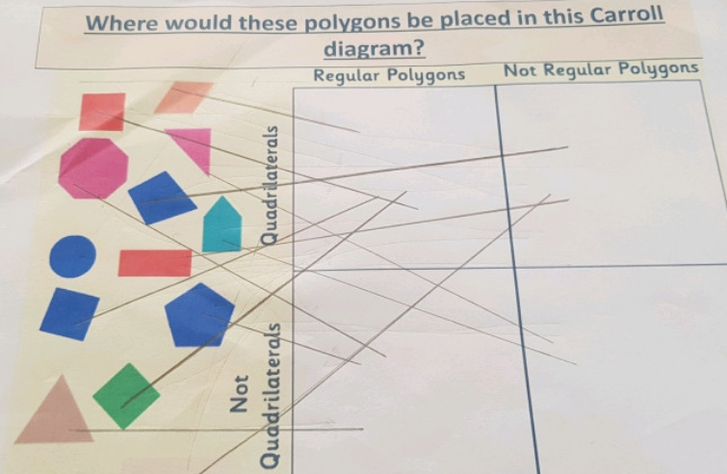
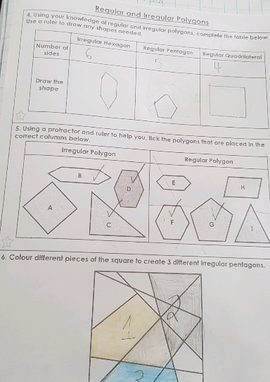
Here’s what Y5&6 have been focusing on at home today.
Cameron’s been learning more about regular and irregular polygons in maths

Slide 37
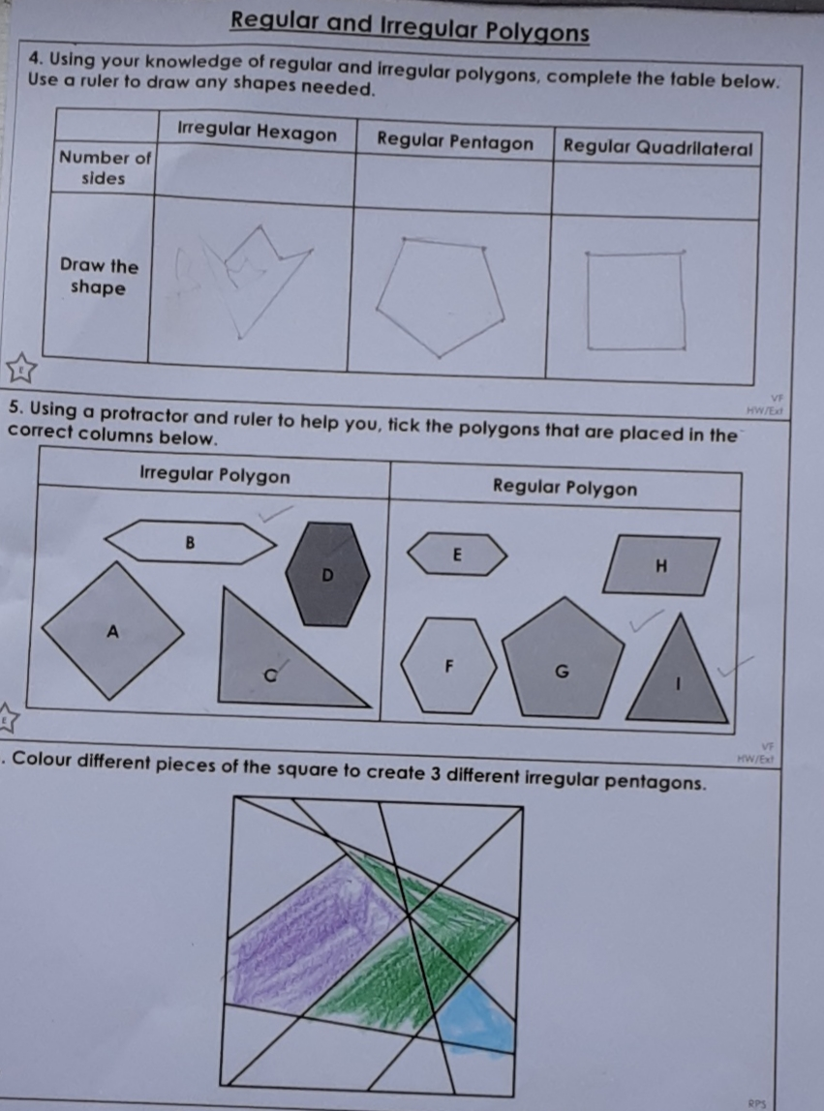
Here’s what Y5&6 have been focusing on at home today.
Lucy’s been learning more about regular and irregular polygons in maths

Slide 38
Here’s what Y5&6 have produced at home today.
Excellent research to understand more about the Hindu Gods and Goddesses from Reuben

Slide 39
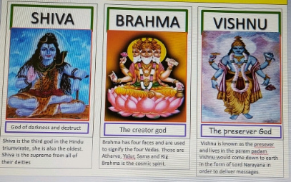
Here’s what Y5&6 have produced at home today.
Dante has been researching the Hindu Gods also.

Slide 40
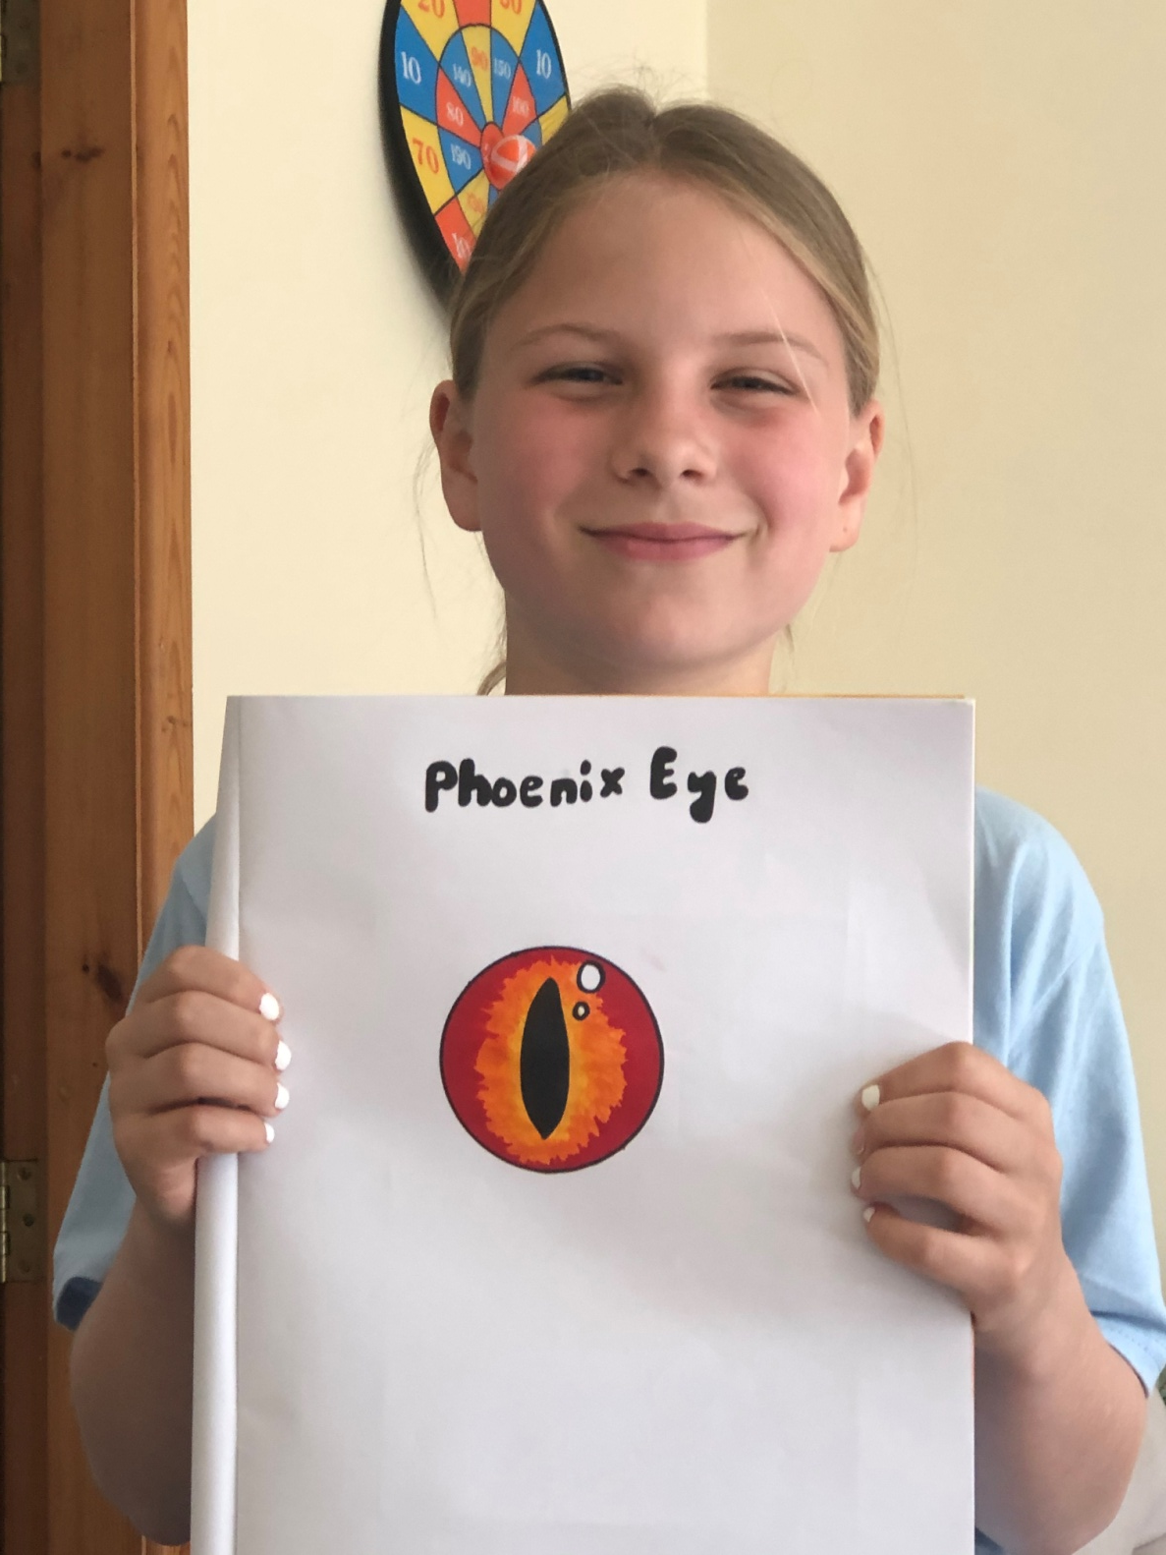
This is what I’ve also been doing at home today…
I’ve been focusing on my ‘phoenix eye’ artwork

Slide 41
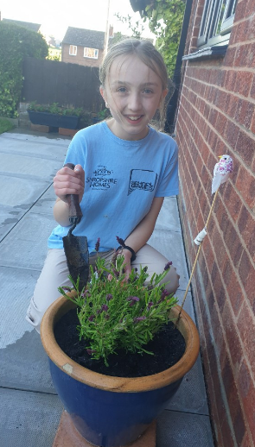
This is what I’ve also been doing at home today…
I’ve been helping my dad with the gardening

Slide 42
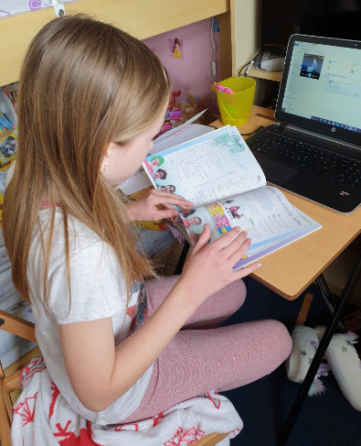
This is what I’ve also been doing at home today…
It’s reading time in my house now.

Slide 43
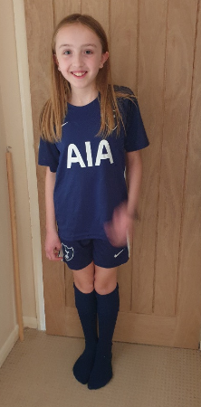
This is what I’ve also been doing at home today…
I’m going to play football now with my big brother and show off my Harry Kane skills.

Slide 44
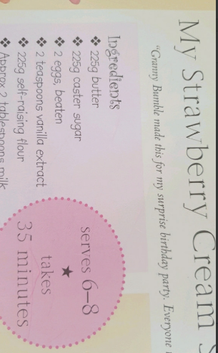
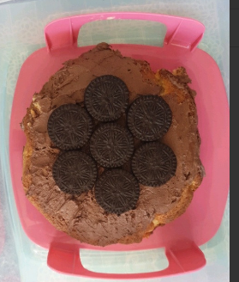
This is what I’ve also been doing at home today…
Bethany’s cake ingredients from yesterday

Slide 45
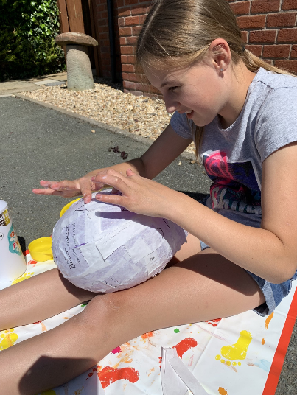
This is what I’ve also been doing at home today…
I started to make my hoplite helmet yesterday

Slide 46
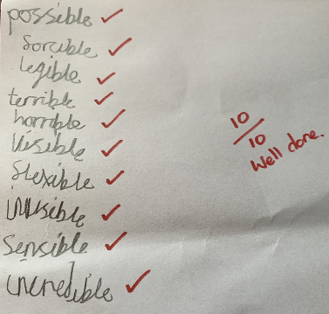
This is what I’ve also been doing at home today…
Henry scored 10/10 in his spellings.

Slide 47
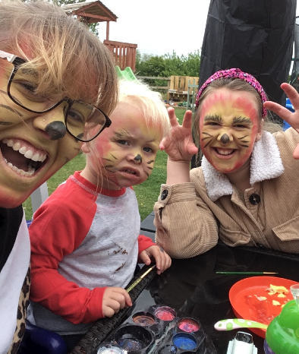
This is what I’ve also been doing at home today…
I got my face painted for my Zoom chat earlier today.

Slide 48
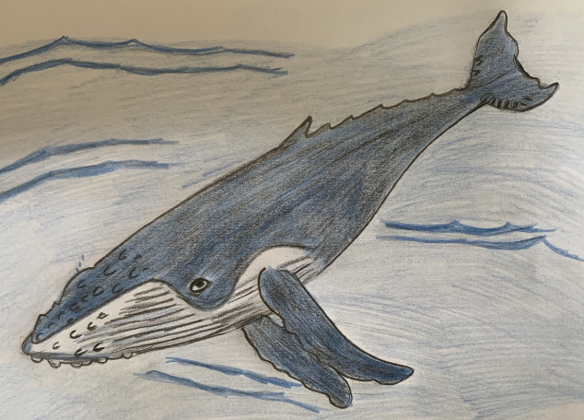
This is what I’ve also been doing at home today…
Nelly’s humpback whale

Slide 49
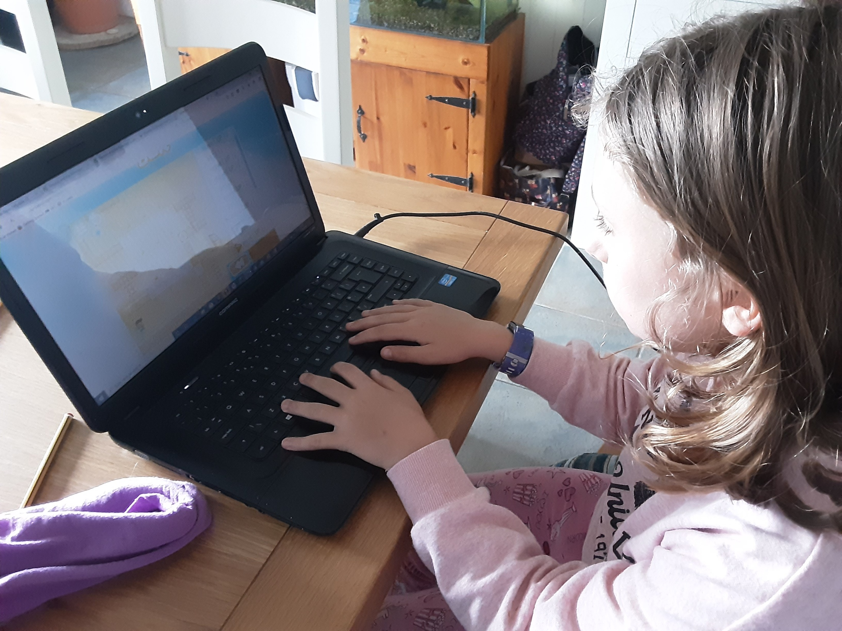
This is what I’ve also been doing at home today…
I’ve been practising my typing skills whilst working today.

Slide 50
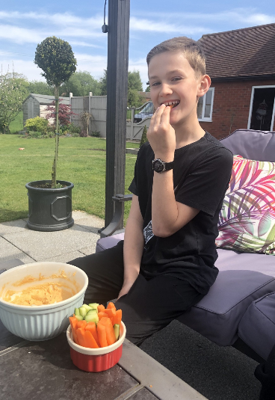
And finally…….
It’s my 11th birthday tomorrow and I’m missing you all. I’d love to see you on a Zoom chat if you would like to call me.

