Slide 1
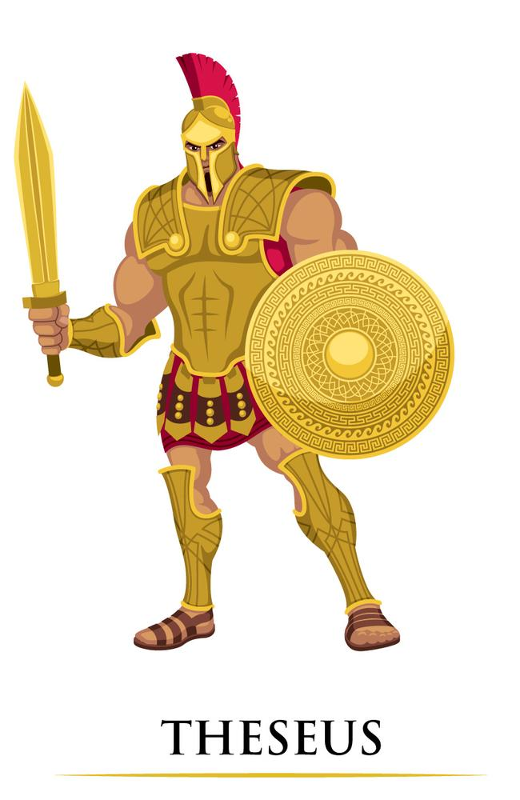
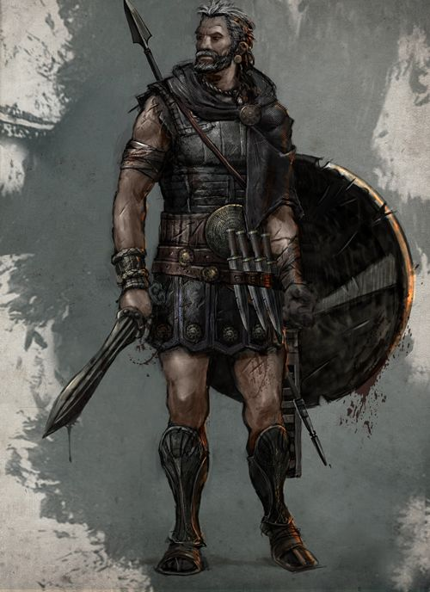
What I’m learning in English today
English – (Ancient Greek script – Theseus and Odysseus) Date: Wednesday 13th May 2020
L.Obj: (SPaG) – Speech and dialogue *I can convert direct speech sentences into dialogue for a script using correct punctuation.
*I can write / type an extract from a script with accuracy, using the correct features.
ODYSSEUS

Slide 2
English SPaG starter
Speech Dialogue
Look at this direct speech sentence.
“Tell me little man, what is your name?” the Cyclops questioned, whilst looking down.
When writing a direct speech sentence, the speech punctuation surrounds the words that are spoken by the character.
You also need to explain who the words were spoken by.
Let’s turn it into a piece of dialogue from a script.
Polyphemus: (looking down) Tell me little man, what is your name?
When writing dialogue for a script, speech punctuation is not needed.
The name of the person speaking is written at the side.
The part in brackets tell you how to act or speak.

Slide 3
English SPaG starter
Speech Dialogue
Look at this direct speech sentence.
“Well I am neither your friend nor do I fear you,” announced the Cyclops confidently.
Can you turn it into a piece of dialogue from a script.

Slide 4
English SPaG starter
Speech Dialogue
Look at this direct speech sentence.
“Princess, how can I thank you?” said Theseus, with arms out wide. “Without your help, I would never have found my way out of that terrible place.”
Can you turn it into a piece of dialogue from a script.

Slide 5
English – Main Activity
What would’ve happened if these two had ever met?
Would they have been friends or rivals?
What conversation would they have had?
ODYSSEUS
KING OF ATHENS
KING OF ITHACA

Slide 6
English – Main Activity
Write / type an extract of the conversation they would’ve had as A SCRIPT!
(Odysseus marches into King Theseus’ palace in Athens and they stand in front of each other)

