Slide 1
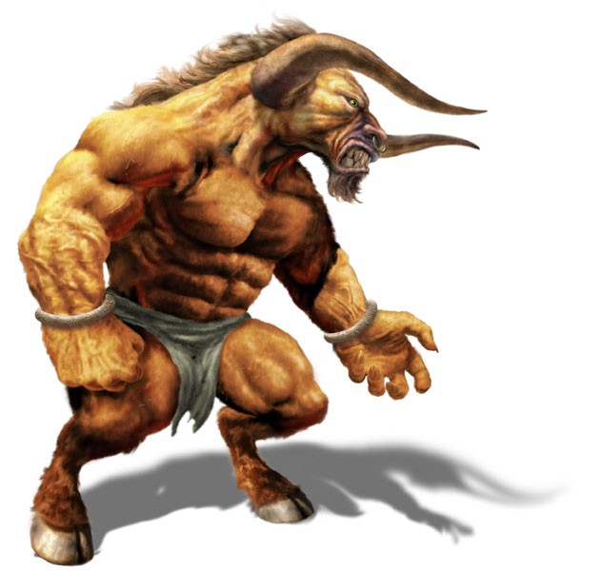
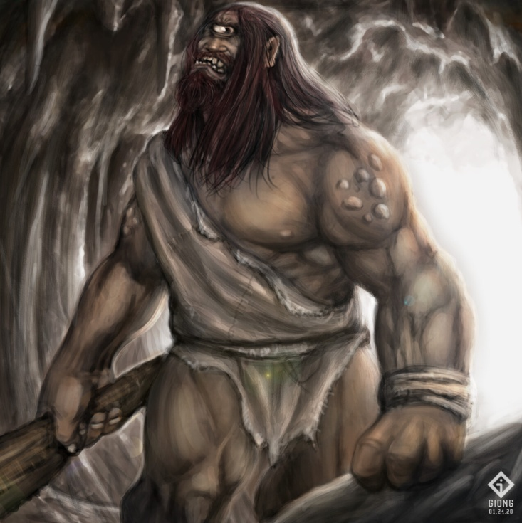
What I’m learning in English today
English – Ancient Greek mythical creatures – Minotaur and Polythemus (Cyclops) Date: Thursday 14th May 2020
L.Obj: (SPaG) – Speech and dialogue *I can convert dialogue for a script into speech sentences using correct punctuation.
*I can write an extract from a story, using a wide range of sentence structure, descriptive vocabulary and punctuation.
Minotaur
Polythemus (Cyclops)

Slide 2
English SPaG starter
Dialogue Speech
Look at this piece of dialogue from a script.
Odysseus: (pointing) Land! I see land ahead!
When writing dialogue for a script, speech punctuation is not needed.
The name of the person speaking is written at the side.
The part in brackets tell you how to act or speak.
Let’s turn it into a direct speech sentence.
“Land! I see land ahead!” Odysseus announced loudly on board the ship, whilst pointing in the distance.
When writing a direct speech sentence, the speech punctuation surrounds the words that are spoken by the character.
You also need to explain who the words were spoken by.

Slide 3
English SPaG starter
Dialogue Speech
Look at this piece of dialogue from a script.
Odysseus: (excitedly) A cave! Let’s go and see inside it.
Can you turn it into a direct speech sentence.

Slide 4
English SPaG starter
Speech Dialogue
Dialogue Speech
Look at this piece of dialogue from a script.
Polythemus: (angrily) Who’s lit this fire? And who’s been eating my sheep?
Can you turn it into a direct speech sentence.

Slide 5
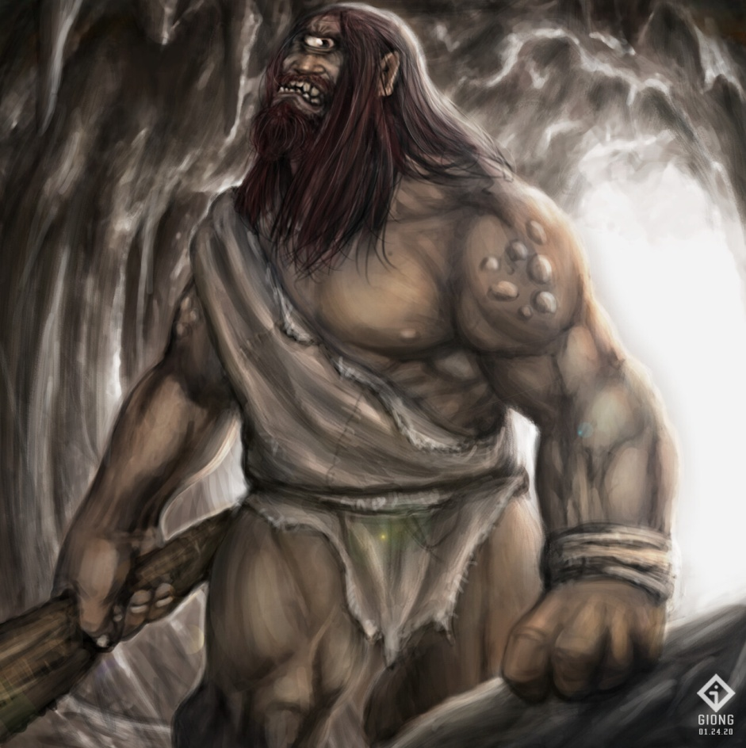
English – Main Activity
Minotaur
Polythemus (Cyclops)
These two Ancient Greek mythical creatures were both defeated by Theseus and Odysseus.
But…….what if they fought each other?

Slide 6
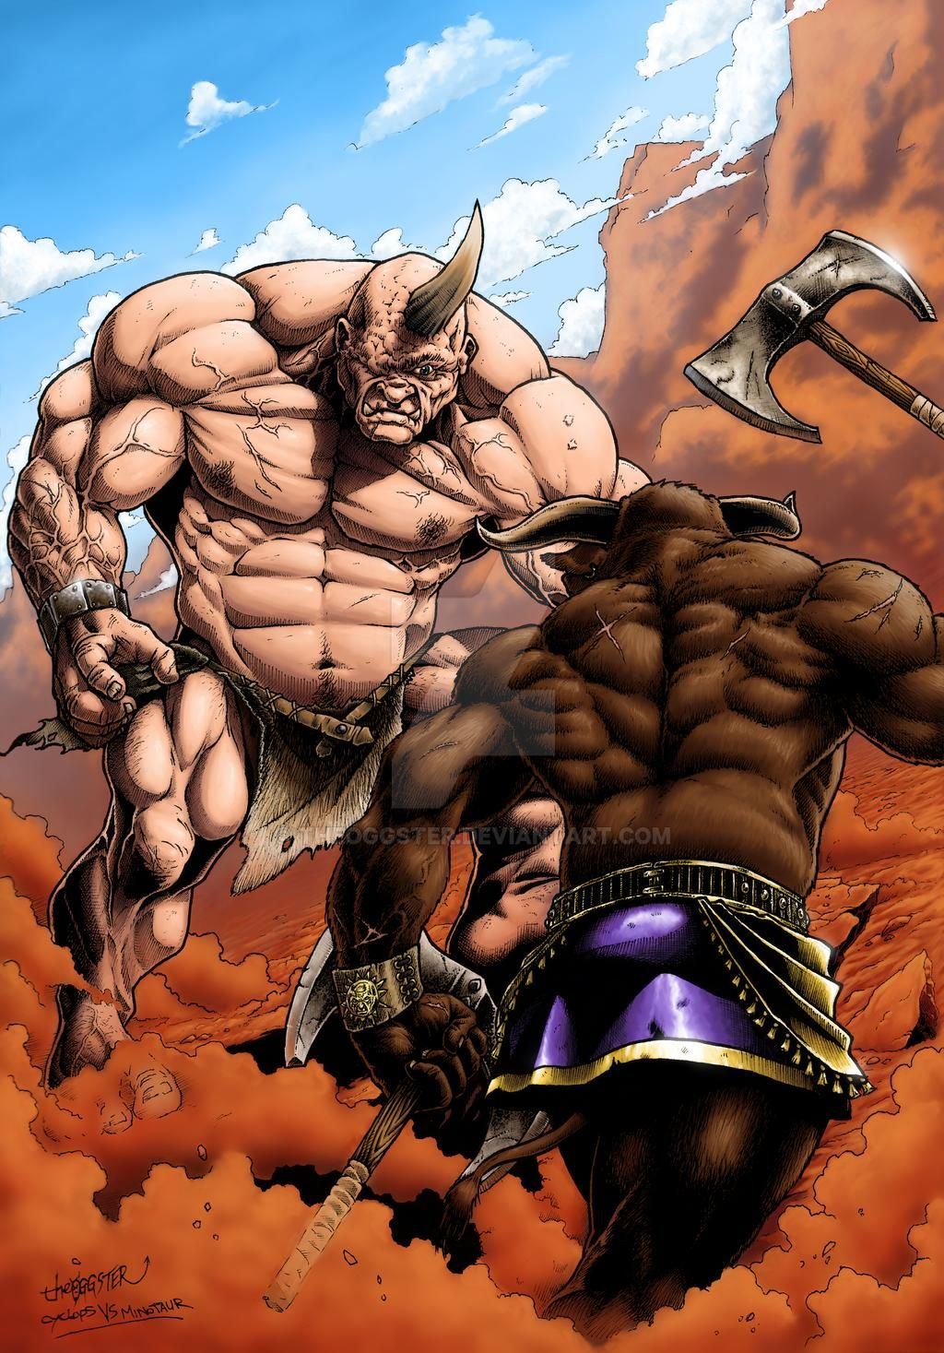
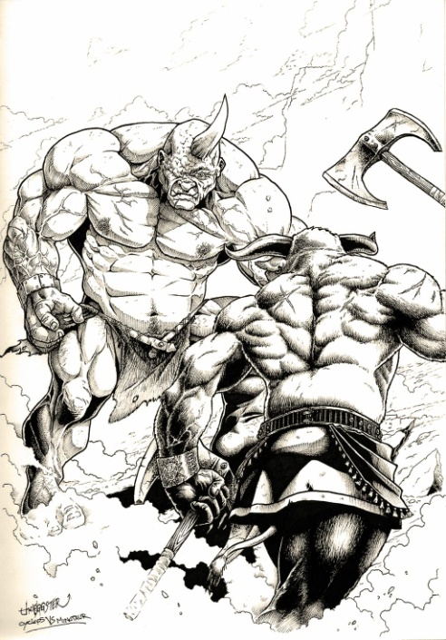
English – Main Activity
Your challenge today is to continue to write/type the fight scene between the Minotaur and Polythemus (cyclops) as an extract from a story. (The first part has been written for you.)
Make sure that you include some direct speech but not too much.
Top Tips:
*Start each speech sentence from a different speaker on a new line.
*Use synonyms for ‘said’
*Lots of descriptive vocabulary (adjectives, adverbs, similes, metaphors)

Slide 7
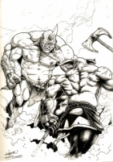
The Meeting of the Monsters
It was a very strange experience for the Minotaur and Polythemus to be outside of their normal environment. Both were used to dwelling in dark, soundless labyrinths or caves, but here they were, face to face, meeting for the first time on neutral territory.

