Slide 1
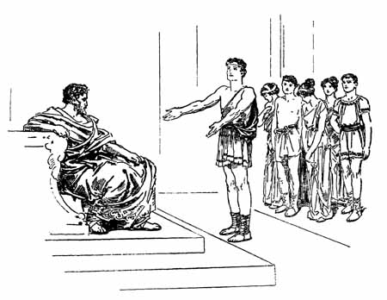
What I’m learning in English today
English – (Ancient Greek Myth - Playscripts) Date: Wednesday 6th May 2020
L.Obj: (SPaG starter) – Commas to separate clauses *I can use commas to separate subordinate clauses and main clauses correctly.
*I can recognise and name features of a script.
*I can create and act a short script based on the Ancient Greek myth ‘Theseus and the Minotaur’.
*I can use the correct features as part of my playscript.

Slide 2
English SPaG starter
Commas to separate clauses
Look at these subordinating conjunctions………...
as
although
before
whenever
They can be used at the start of a sentence to add a subordinate clause. But, where should the comma go?
Whenever I miss my friends I give them a call to cheer myself up.

Slide 3
English SPaG starter
Commas to separate clauses
Whenever I miss my friends, I give them a call to cheer myself up.
This comma separates the subordinate clause from the main clause.

Slide 4
English SPaG starter
Commas to separate clauses
Can you spot where the missing comma should appear in the sentence to separate the subordinate clause from the main clause?
Although it’s been tough I’ve kept myself busy by focusing hard on my school work.
When the weather was lovely we were able to spend a lot of time outdoors.
Even though my best friends lives only three doors away I’ve still not been able to spend time at their house.
As the weeks are passing by so strangely I don’t really know what day of the week it is anymore.
Before I go to bed I always watch the ‘Highlights from Home’ page on the school website.

Slide 5
Main Activity

Slide 6
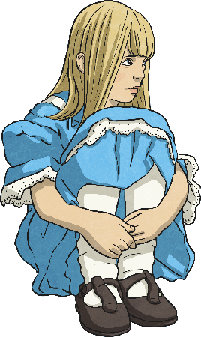
Features of a Play Script: Character List
Characters Alice In Wonderland
Alice
The main character – A young girl who is lost in Wonderland. Has a great imagination.
The Mad Hatter
As the name suggests, he is ‘crazy’. He gives out riddles, dresses fashionably and likes tea.
Hare
A friend of the Mad Hatter, thinks it is always time for afternoon tea, is also mad.
Dormouse
Incredibly sleepy friend of the Mad Hatter.
At the beginning of a play script, you’ll find a list of all the characters that are in the play.
Sometimes they will have a short description with them.

Slide 7
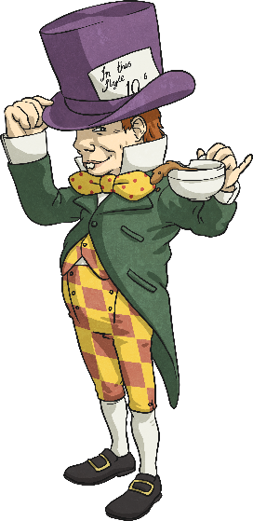
Features of a Play Script: Scene Number, Title and Setting Description
A bit like chapters in a book, the sections of a script are broken down into ‘scenes’. A new scene usually means a new setting.
Scene 7 – A Mad Tea Party
The Mad Hatter, Dormouse and Hare are sitting at a table having afternoon tea.
Just after the scene number and title is a short description of the setting. This tells you what the stage looks like.

Slide 8
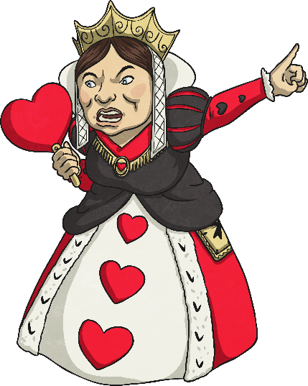
Features of a Play Script: Speaker Name, Colon and Dialogue
A colon always comes after the name.
Queen of Hearts:
Guards! Get her! Off with her head! Off with her head!
In a script, the name of the character who is speaking goes on the left.
After the colon is the dialogue (the words the character says).
How is this different to writing speech in a story?
No inverted commas!

Slide 9
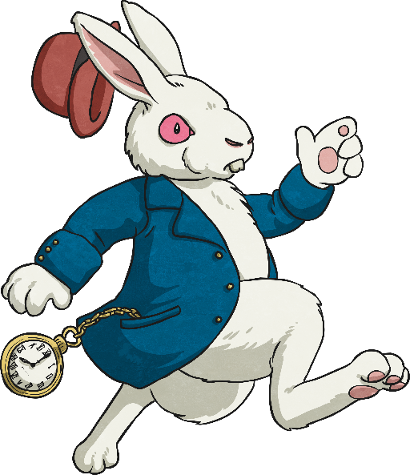
Features of a Play Script: Stage Directions
Words in brackets are stage directions. These are instructions to the actors so they know what their character should be doing.
White Rabbit:
Alice:
(anxiously, whilst rushing across the stage) I’m late! I’m late!
(confused) A talking rabbit? It can’t be…
Sometimes they tell the actor how to say their words.
The actors don’t say the stage directions.

Slide 10
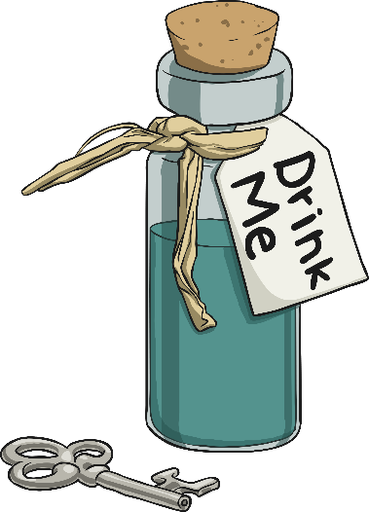
Features of a Play Script: Stage Directions and Narrators
Some plays have a narrator to help set the scene for the audience, but lots of plays don’t.
Narrator:
Alice found herself in a strange room, inside was a small table. On top of it, sat a small, peculiar-looking bottle with a label on.
(Alice looks around, confused, then goes over to the table and studies the bottle.)
Stage directions can be given to any character, not just the ones speaking. They are always written in present tense.

Slide 11
Can you find the play script features in the text here?
Scene number and title
Scene 7 – A Mad Tea Party
The Mad Hatter, Dormouse and Hare are sitting at a table having afternoon tea.
Lost and lonely, Alice continued towards the sound. She didn’t know what to expect when she reached a clearing…
(Alice enters the scene, stage left)
(starts for a moment, pauses and a broad grin appears across his face. He gets up out of his chair and walks across the table towards Alice)
(exasperated)
(gasps and throws his hands against his head)
You’re absolutely Alice, I’d know you anywhere.
(to the rest of the characters at the table)
I’d know him anywhere!
(Dormouse and Hare laugh manically)
Well, as you can see we’re still having tea.
You’re terribly late you know… naughty.
I’m incredibly intrigued.
Setting description
Narrator:
Mad Hatter:
Dormouse:
Hare:
Mad hatter:
Alice:
Speaker’s name, followed by a colon (:)
It’s you.
No it’s not! Hare brought us the wrong Alice!
It’s the wrong Alice!
Stage directions in brackets
Speech – without inverted commas!
click the different features to show the answers

Slide 12
Main Activity – Playscript
Today’s task: Using the extract on the next slide from the Greek myth Theseus and the Minotaur, can you turn it into a script using the correct features?
*When you write your script, use the dialogue that has been included in the story BUT, you can also add in your own speech too.
(You only need the 2 characters – Theseus and King Aegeus)
*When you have finished your script, can you act the script?

Slide 13
"Why do we send these young people to Crete every year?" Theseus asked his father, the King of Athens. "And why is it that none of them ever return?" "Because if we did not send them, Minos would wage war on us and it is a war that we would not win," said King Aegeus. "And they do not return because they do not go to Crete as slaves. They go as food for the Minotaur." "Father, this is terrible," shouted Theseus, "we cannot let this go on. We cannot sacrifice any more of our young citizens to this tyrant. When it is time to send the next tribute, I will go as one of them and I vow that it is the last time the Minotaur will be fed with the flesh of any of our people." Try as he might, his father could not persuade him to change his mind. Aegeus reminded him that every year, other young men had sworn to slay this terrible beast and they had never been seen again. Theseus insisted that he understood the dangers but would succeed. "I will return to you, father," cried Theseus, as the ship left the harbour wall, "and you will be proud of your son." "Then I wish you good luck, my son," cried his father, "I shall keep watch for you every day. If you are successful, take down these black sails and replace them with white ones. That way I will know you are coming home safe to me."

Slide 14
Cast: Theseus
King Aegeus
Theseus and the Minotaur
Scene 1 (King Aegeus stands with his son Theseus at his palace in Athens)

