Slide 1
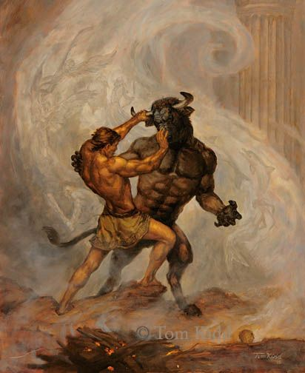
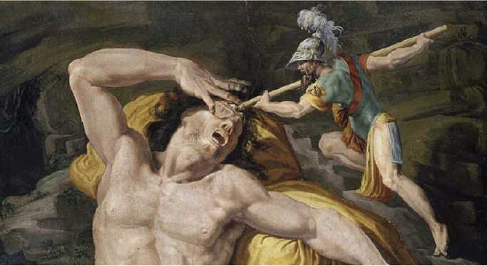
What I’m learning in English today
English – (Ancient Greek Mythical Heroes – Odysseus and Theseus) Date: Tuesday 12th May 2020
L.Obj: (SPaG) – Speech and dialogue *I can convert direct speech sentences into dialogue for a script using correct punctuation.
*I can show and gather understanding of two ancient Greek mythical heroes – Odysseus and Theseus.
*I can write persuasively using effectively vocabulary.
Theseus
Odysseus

Slide 2
English SPaG starter
Speech Dialogue
Look at this direct speech sentence.
“What if he wakes up?” announced Eurylochus in panic.
When writing a direct speech sentence, you need to use the speech punctuation around the spoken part.
*Use different synonyms for ‘said’.
Let’s turn it into a piece of dialogue from a script.
Eurylochus: (panicking) What if he wakes up?
When writing a piece of dialogue for a script, we DON’T need to use speech punctuation.
*The words in brackets tell us how the words were spoken or the actions of that person

Slide 3
English SPaG starter
Dialogue Speech
Look at this direct speech sentence.
“Mmmm – lovely!” Polyphemus stated, licking his lips. “Be even nicer cooked.”
Can you turn it into a piece of dialogue from a script?

Slide 4
English SPaG starter
Dialogue Speech
Look at this direct speech sentence.
Odysseus shouted back loudly. “Stop! You monster!”
Can you turn it into a piece of dialogue from a script?

Slide 5
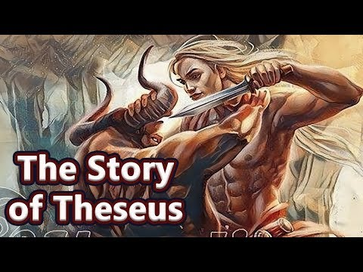
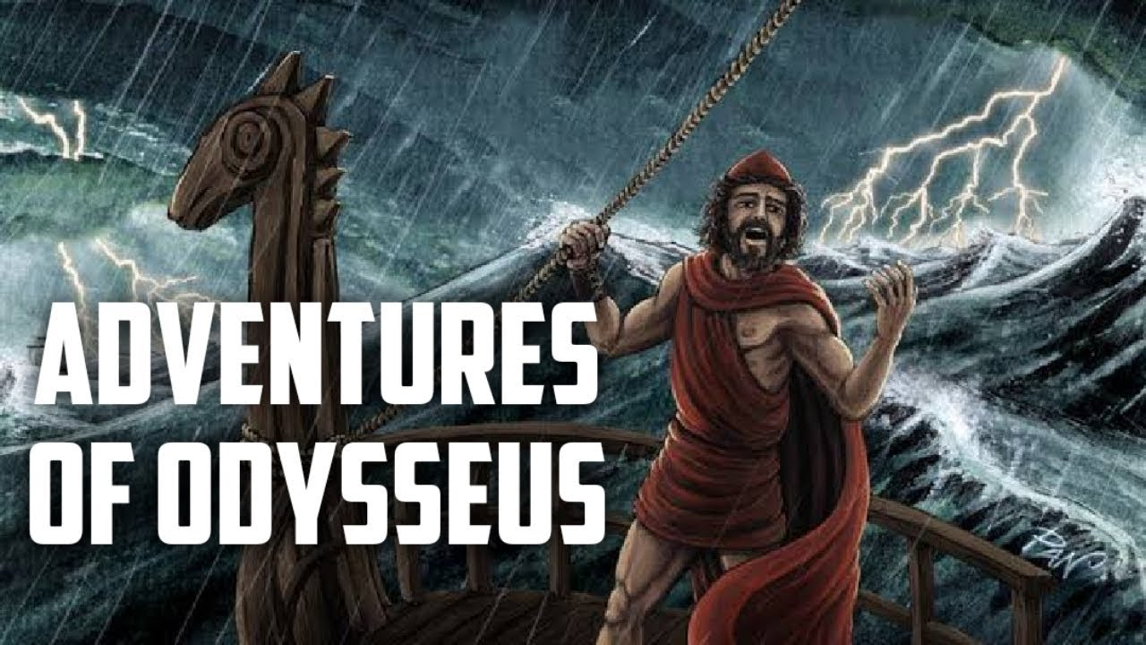
Ancient Greek mythical heroes
What do you know about these 2 ancient Greek mythical heroes?
_________________________________
_________________________________
_________________________________
_________________________________
_________________________________
__________________________________
__________________________________
__________________________________
__________________________________
__________________________________
Click on the two images above to learn more about these two heroic characters.

Slide 6
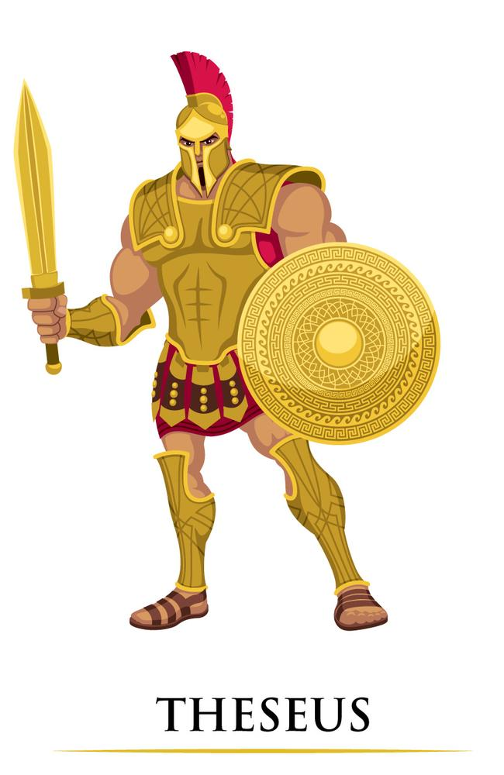
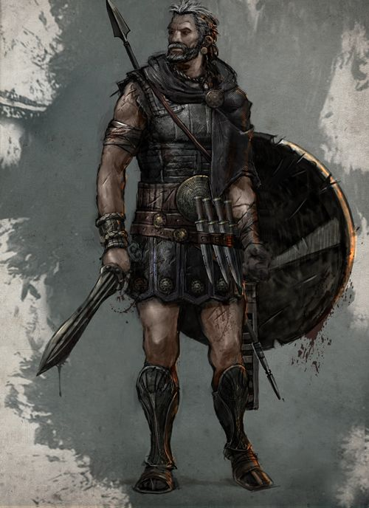
Who do you think was the most heroic?
Why?
ODYSSEUS

Slide 7
Are you Theseus or Odysseus?
PERSUADE the judges that YOU were the most heroic Ancient Greek hero.
*What made you the most heroic? Why were you better than the other hero?
Click inside the box to start to type.
Image of my chosen ancient Greek hero
(Theseus or Odysseus)

