Slide 1
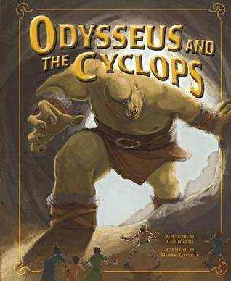
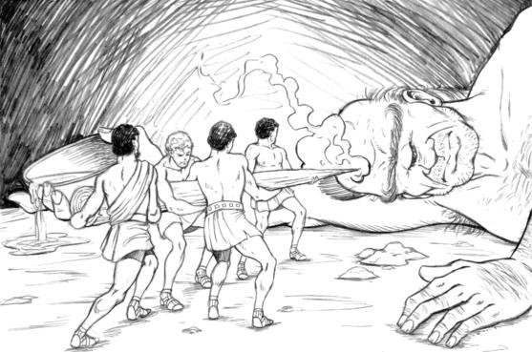
What I’m learning in English today
English – (Ancient Greek Mythical Hero – Odysseus) Date: Monday 11th May 2020
L.Obj: (SPaG) – Speech and dialogue *I can convert dialogue into direct speech sentences using correct punctuation.
*I can explain the heroic actions of the ancient Greek mythical hero Odysseus.

Slide 2
English SPaG starter
Dialogue Speech
Look at this sentence taken from a script.
Theseus: (urgently) Quick, let’s get out of here and back to Athens.
When writing a script, there is NO need for speech punctuation (“ “).
Why do you think this is?
The adverb in brackets explains how the actor needs to speak.
Let’s turn it into a direct speech sentence from a story.
“Quick, let’s get out of here and back to Athens,” Theseus announced urgently.
When writing a story, we need to use speech punctuation to show the words that have been spoken.
Notice how the comma has appeared at the end of the speech.
Why do you think that is?

Slide 3
English SPaG starter
Dialogue Speech
Look at this sentence taken from a script.
Ariadne: (pleading) Please take me with you Theseus. I love you!
Can you turn it into a direct speech sentence from a story?
(Type in the yellow box)

Slide 4
English SPaG starter
Dialogue Speech
Look at this sentence taken from a script.
King Minos: (laughing) You think that you can defeat my Minotaur? You must be mad!
Can you turn it into a direct speech sentence from a story? (Type in the yellow box)

Slide 5
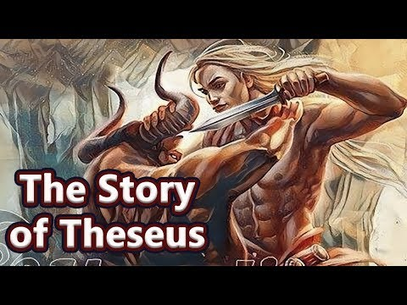
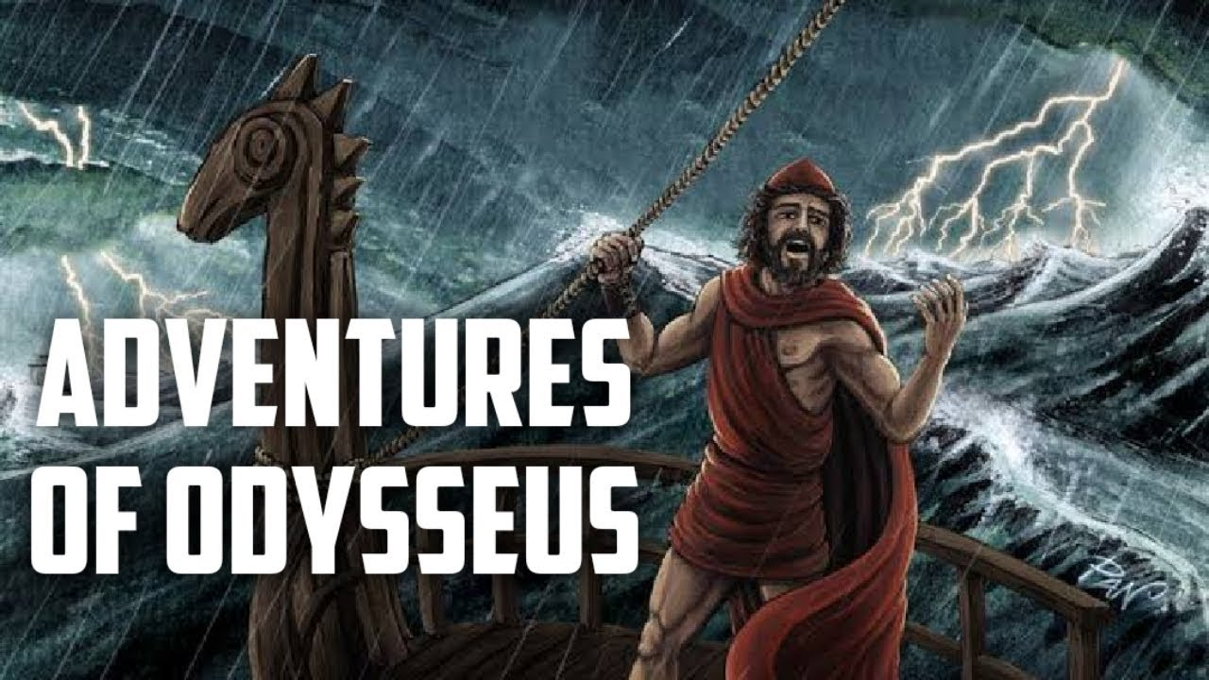
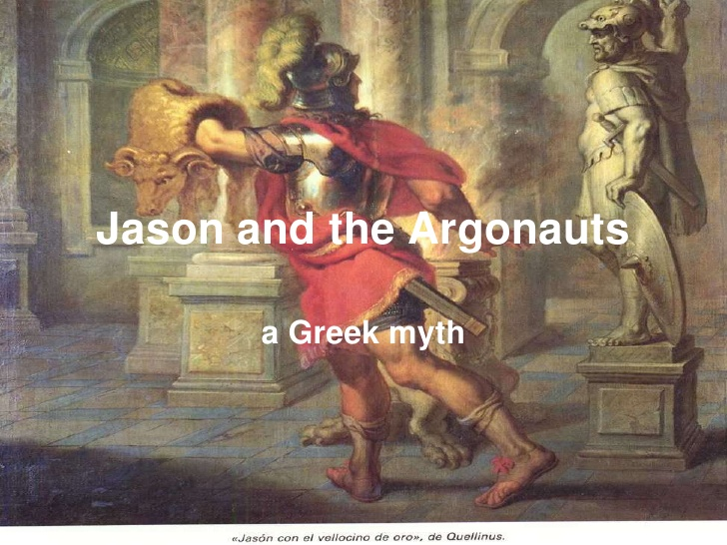
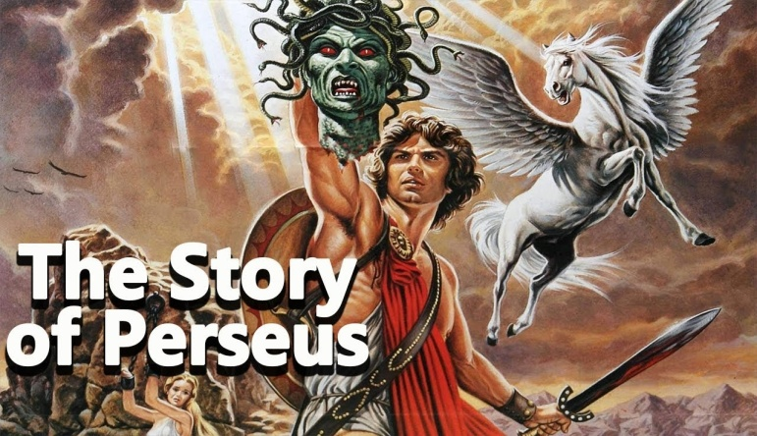
Ancient Greek
mythical heroes
The story of Jason
Odysseus was brave and strong but mostly got by because of his intelligence.

Slide 6
Main Activity – Odysseus and the Cyclops
Click on the image to listen to the story ‘Odysseus and the Cyclops’.
You may wish to follow the script as you are listening to it.

Slide 7
Task – Dialogue Direct speech
On the next slides, there are some sentences from the script ‘Odysseus and the Cyclops’.
Can you convert them into direct speech? Check your punctuation carefully.
(*You could type each direct speech sentence or write them out neatly in your books.)
Odysseus and
the Cyclops

Slide 8
Isla, Nia, Toby, Chloe, Henry, Rhys, Zac, Zoe, Isobel and Holly T
Polyphemus: (loudly) Let’s be havin’ you!
Odysseus: (handing Polyphemus a drink) Cyclops - you might like to wash your meal down with wine.
Polyphemus: (grabbing the drink) Don’t mind if I do. Cheers!
Odysseus: So you’ve never tasted wine before?

Slide 9
Jacob, Alissa, Holly H, Harvey, Malachai, Dante, Katie, Daniel, Izzy and Sophie
Polyphemus: (loudly) Let’s be havin’ you!
Odysseus: (handing Polyphemus a drink) Cyclops - you might like to wash your meal down with wine.
Polyphemus: (grabbing the drink) Don’t mind if I do. Cheers!
Odysseus: So you’ve never tasted wine before?
Polyphemus: (angrily) I’ll get you! Arrrgghhh!

Slide 10
Nelly, Cameron, Lucy, Elizabeth, Cassie and Megan
Polyphemus: (loudly) Let’s be havin’ you!
Odysseus: (handing Polyphemus a drink) Cyclops - you might like to wash your meal down with wine.
Polyphemus: (grabbing the drink) Don’t mind if I do. Cheers!
Odysseus: So you’ve never tasted wine before?
Polyphemus: (angrily) I’ll get you! Arrrgghhh!
Odysseus: (looking up) Goddess Athena. Will you guide me home to my wife and son?

Slide 11
Heidi, Amy, Reuben, Ruby, Jack, Bethany and Lily
Polyphemus: (loudly) Let’s be havin’ you!
Odysseus: (handing Polyphemus a drink) Cyclops - you might like to wash your meal down with wine.
Polyphemus: (grabbing the drink) Don’t mind if I do. Cheers!
Odysseus: So you’ve never tasted wine before?
Polyphemus: (angrily) I’ll get you! Arrrgghhh!
Eurylochus: (in amazement) Odysseus, you’re a genius!
Odysseus: (looking up) Goddess Athena. Will you guide me home to my wife and son?

