Slide 1
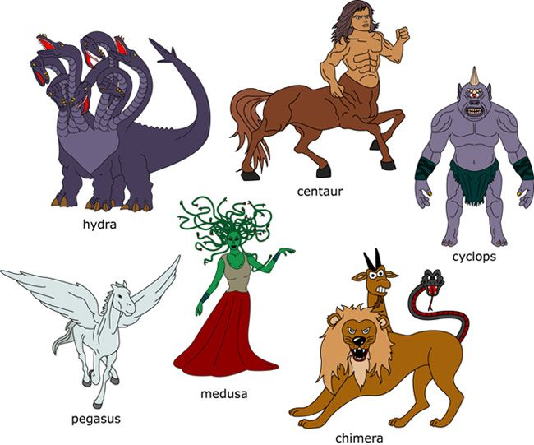
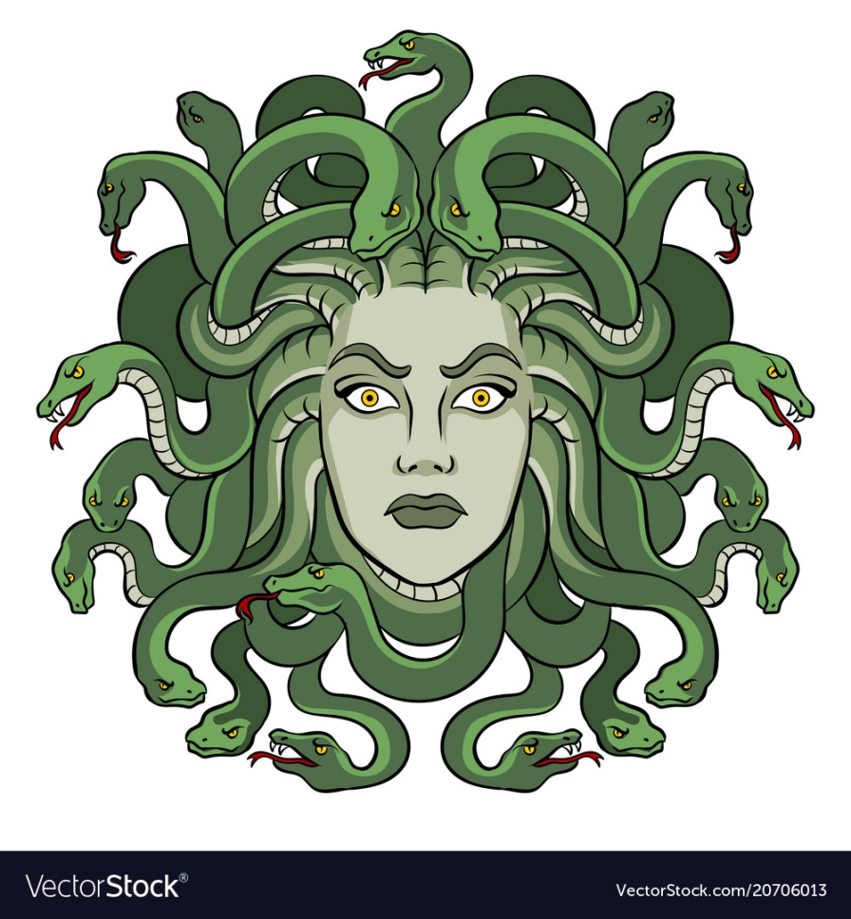
What I’m learning in English today
English – (Ancient Greek mythical creatures and heroes) Date: Friday 15th May 2020
L.Obj: (SPaG) – Synonyms *I can find and use a range of synonyms.
*I can write an effective non-chronological report about Ancient Greek mythical creatures.

Slide 2
English SPaG starter
Synonyms
Can you think of two more synonyms that would describe ancient Greek mythical heroes or creatures? Type them in the empty boxes.
brave
gallant
ugly
disfigured
huge
massive
strong
burly
vicious
ferocious
clever
cunning

Slide 3
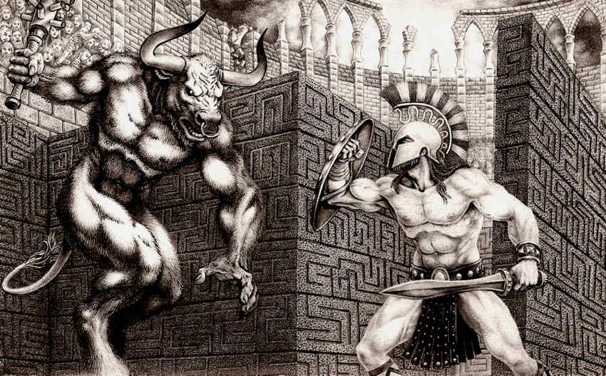
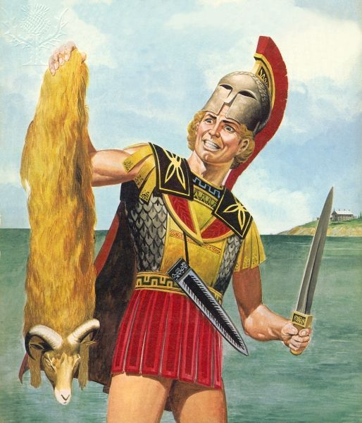
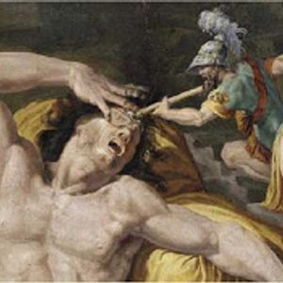
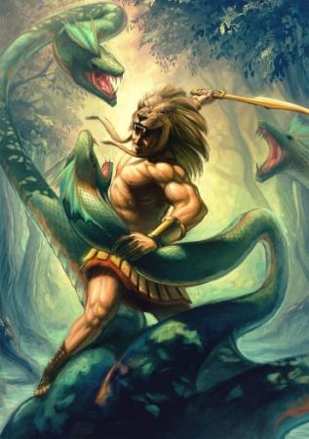
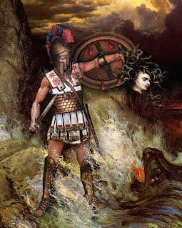
English – Ancient Greek Heroes
HERCULES
JASON
Perseus
THESeus
ODYSSEUS
Here are 5 ancient Greek mythical heroes. Can you match their names to their images?
The first one has been done for you.

Slide 4
English – Ancient Greek Heroes
THESeus
JASON
ODYSSEUS
HERCULES
Perseus
Now, look at how information about these mythical heroes can be given to the reader as a non-chronological report…..

Slide 5
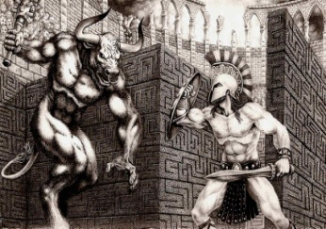
Heroes of Ancient Greece
In ancient Greek tradition, a hero was a human, male or female, who was endowed with superhuman abilities by being descended from an immortal god. Read on to learn about some of the most well-known ancient Greek heroes……..
Jason was the leader of the Argonauts, the 50 heroes who sailed in search of the Golden Fleece—the wool from the magical winged ram. On their journey, Jason and the Argonauts faced such dangers as the deadly singing Sirens. He ultimately captured the fleece with the help of Medea, who became Jason's wife.
Many have considered Theseus (son of either Poseidon or King Aegeus) to be the greatest Athenian hero. He volunteered to be one of 14 slaves to be sent to the vicious Minotaur inside his labyrinth, where he successfully killed the beast. Theseus later became the King of Athens and his list of achievements was very lengthy.
THESeus
JASON
Odysseus was a celebrate warrior who helped the Greeks triumph in the Trojan War. Afterwards, he journeyed nearly ten years to return home to his homeland Ithaca and his wife Penelope. Along the way Odysseus's courage and cleverness saved him from such monsters as the Cyclops (Polyphemus) and the Sirens. Back in Ithaca, Odysseus proved his identity to Penelope and being King.
Perseus – the son of Zeus - completed dangerous feats with his quick thinking and talents as a warrior. Most famous was his slaying of the Gorgon Medusa. He kept her head in his satchel and later, he pulled it out to save the princess Andromeda from being eaten by a sea monster by turning the creature to stone.
ODYSSEUS
Brave and powerful Hercules was the son of Zeus and Alcmene (a granddaughter of Perseus), Hercules grew up to become a famed warrior, however Zeus's jealous wife, Hera, made him temporarily insane, and he killed his wife and children. As punishment, Hercules had to perform twelve seemingly impossible tasks. Hercules is often depicted wearing a lion skin and wielding a club.
Perseus
Did you know?
The largest moon in our solar system is Ganymede (Jupiter), which was named after the Trojan prince.
HERCULES

Slide 6
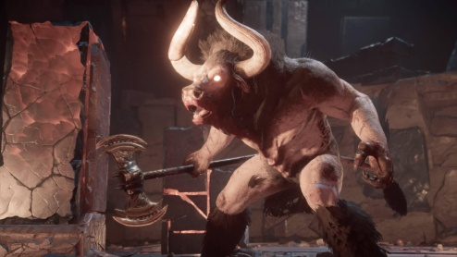
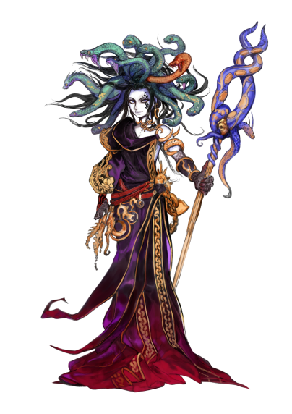
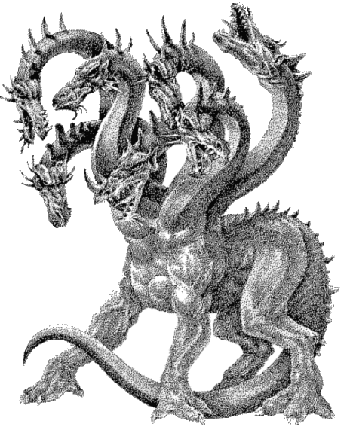
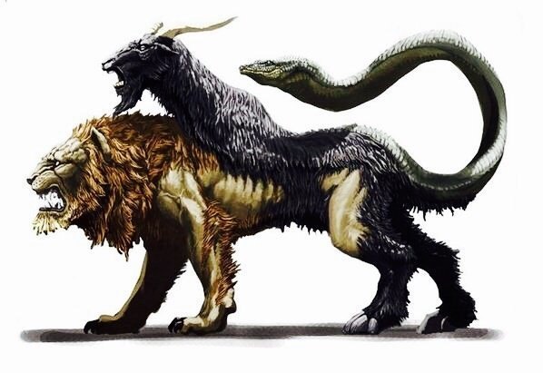
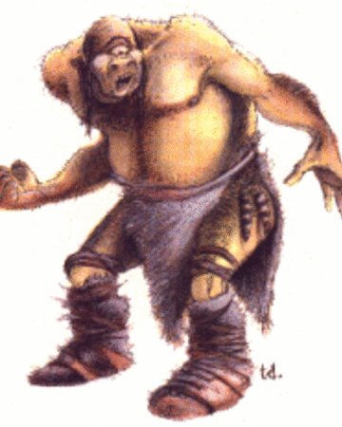
Main Activity – Ancient Greek Mythical Creatures
MINOTAUR
CHIMERA
POLYTHEMUS
HYDRA
MEDUSA
Here are 5 ancient Greek mythical creatures.
Can you create your own non-chronological report on to provide the reader with information about these creatures?
*You can click in the boxes and use the next slide, or create your own layout.

Slide 7
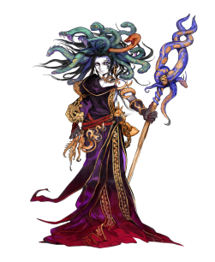
Mythical Creatures of Ancient Greece
medusa
hydra
chimera
cyclops
Did you know?
Minotaur

