Slide 1
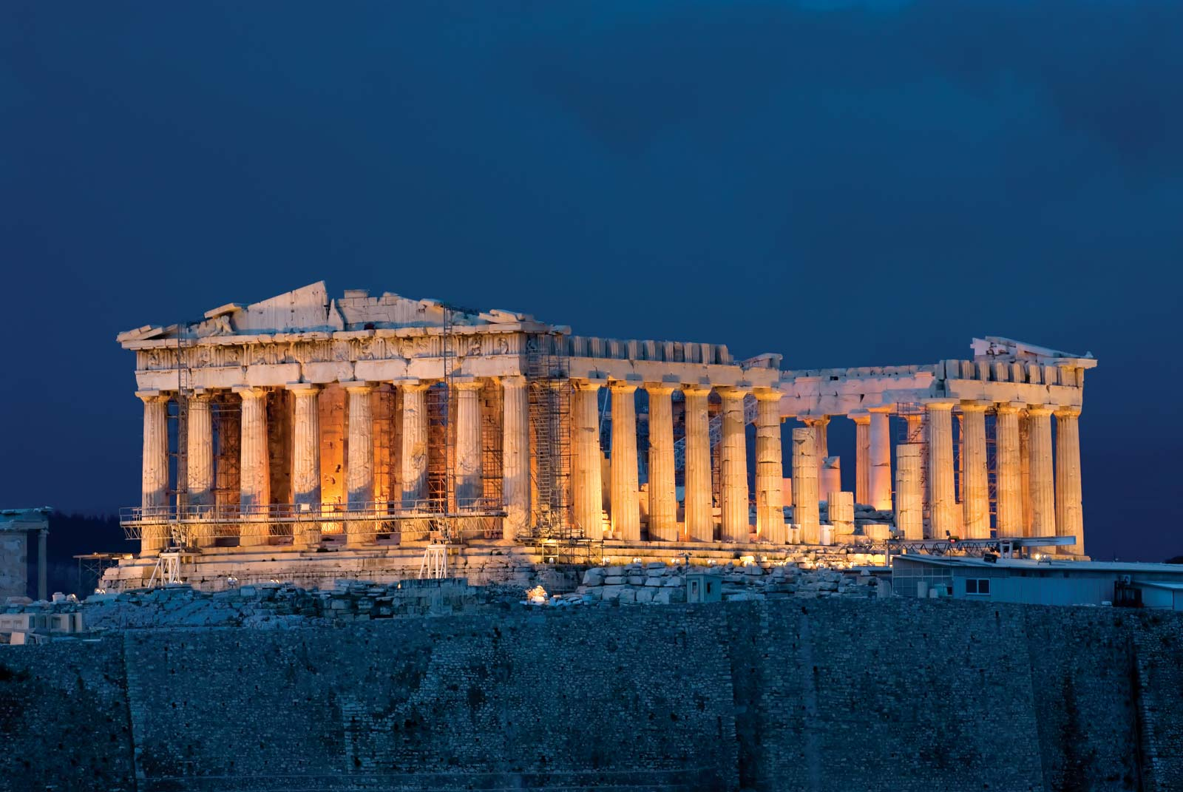
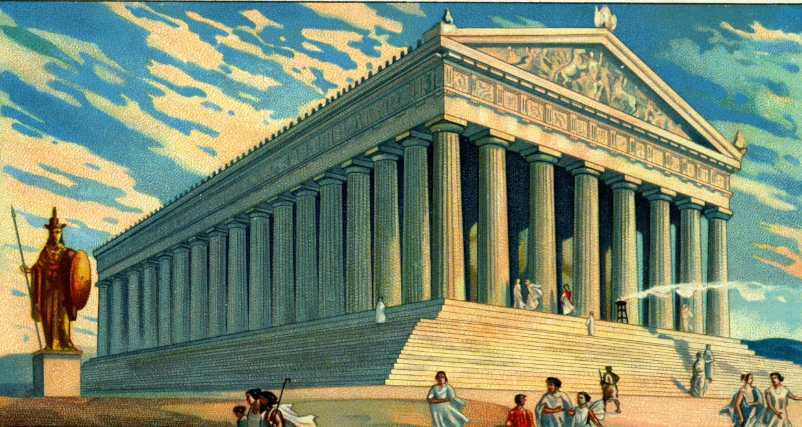
What I could learn in D&T today
(Technology) Thursday 21st May onwards 2020
L.Obj: *I can construct a model Parthenon building from ancient Greece.
Your challenge (starting today but continuing over half term) is to produce a model Parthenon building from ancient Greece. How you do it is entirely up to you!
Click on both of the images below to watch the videos, which will help you to learn about The Parthenon.

