Slide 1
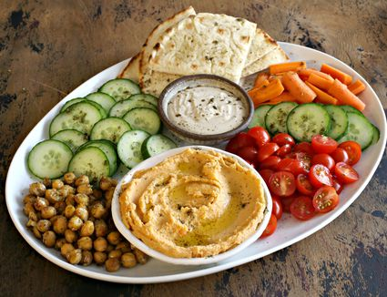
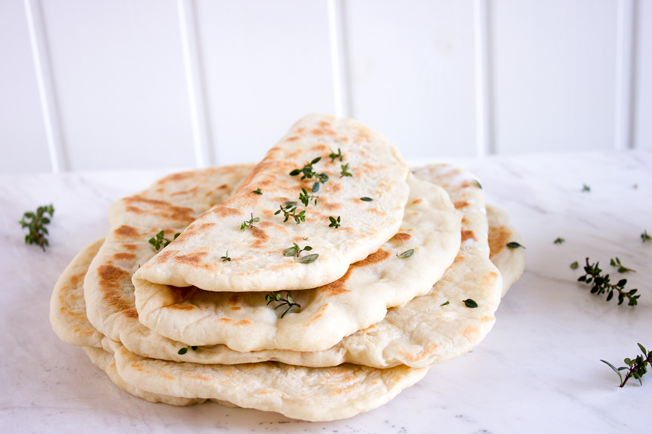
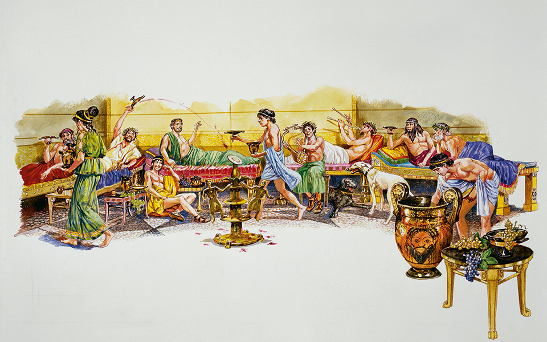
What I have been learning in D&T
PREVIOUS LESSONS (Food Technology)
L.Obj: *I can follow a recipe to make Ancient Greek ‘hummus’.
*I can follow a recipe to make Ancient Greek pita bread.
*I can choose, combine or make an Ancient Greek meal.
TASK 3:
Now that you’ve understood the eating habits of an Ancient Greek, can you decide, plan and create a meal that you think would be appreciated by an Ancient Greek?
How to make Greek hummus
How to make Greek pita bread

Slide 2
Breakfast
Most ancient Greeks had the same thing for breakfast—bread dipped in wine.
The Greeks also ate something called a teganites, which resembles a pancake. These were made with wheat flour, olive oil, honey, and curdled milk, and usually topped with honey or cheese.
Lunch
Bread and wine made an appearance at this midday meal as well, but the Greeks would drink a bit more of the wine versus simply dunking bread into it.
Lunch was considered a midday snack, so it was common for the Greeks to dine on relatively light foods like figs, salted fish, cheeses, olives, and more bread.
Dinner (Evening meal)
Dinner was and still is the most important meal of the day in Greece. In ancient times, it was when everyone would gather with friends—not family—and discuss things like philosophy or maybe just daily events.
Men and women normally ate separately. If a family had slaves, the slaves would serve the men dinner first, then the women, then themselves. If the family didn't have slaves, the women of the house served the men first, and then they ate when the men were finished.
Dinner was when most of the foods were consumed. The ancient Greeks would eat eggs from quail and hens, fish, legumes, olives, cheeses, bread, figs, and any vegetables they could grow, which might include arugula, asparagus, cabbage, carrots, and cucumbers. Meats were reserved for the wealthy.

Slide 3
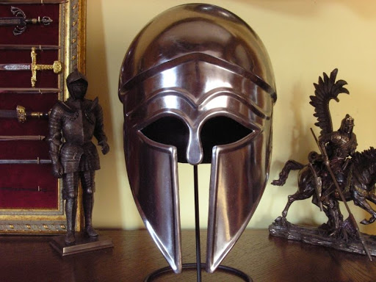
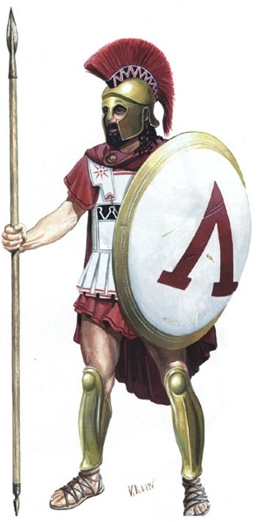
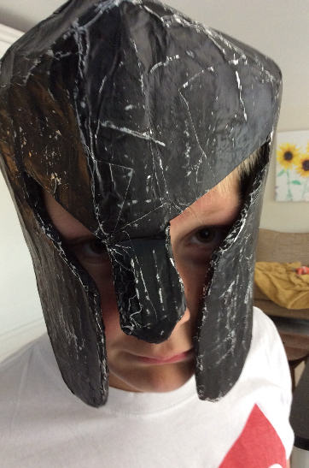
What I could learn in D&T today
(Technology) Thursday 14th May 2020
L.Obj: *I can follow simple-step instructions to create an ancient Greek ‘hoplite’ helmet.
Click on any of the images below to follow the same instructions that Reuben did to make his Ancient Greek hoplite helmet.

