Slide 1
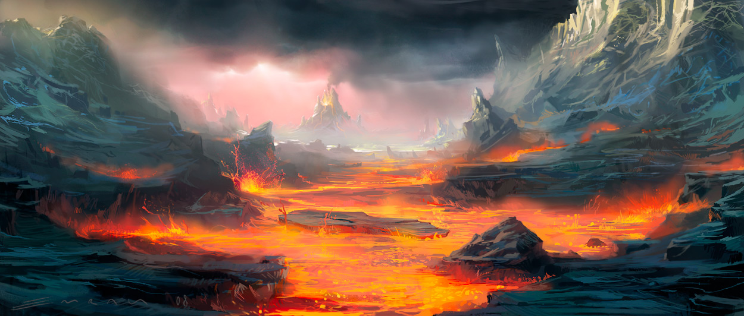
Hades
Underworld
Game

Slide 2
In the murky, evil underworld, the sinister God Hades was plotting yet another destructive plan to get rid of Zeus, so he could rule Mount Olympus. In his dark castle sitting on a throne, he stroked his triple headed dog Cerebus before the God of evil had a light bulb moment, “I know,” he said his voice echoing around the room “I will challenge Zeus to a game to see who deserves the right to rule Olympus.”
That night Hades travelled to the world of the living. There he went to nine different forests and in each one Hades captured a single snake and chopped the head off. After he completed this task, the God of the Underworld combined all of the furious reptiles to make a terrifying, great mutant, The Hydra. Hades then wrote a letter. Dear Zeus, I am writing to ask you to prove how powerful you really are, so I am challenging you to face me in a new shadow game I have created. Pick your strongest mortal hero and you will guide him or her and help them to beat one of my dark souls in the Amazonian rain forest. Hope you lose, Hades (the very best god).
It was now the next day in Zeus’s great palace.
“So what do you have for me today Hermes?” boomed the strongest God, Zeus.
“ Today you have a letter from Hades and a parcel from Apollo,” replied Hermes cheerily.
“ What has my brother got to say today? Probably challenging me to another game I’m going to win!” bellowed Zeus tearing the letter open. “ Hahaha,” chuckled the god looking at the letter. “I am actually right.”
“ When are you ever wrong?” asked Hermes sarcastically.
“Tell Hades that I’ll do his game,” demanded Zeus to Hermes sitting on his golden throne.
When Hermes delivered the answer, Hades laughed with joy
“ Finally I can beat Zeus at his own game.”
Zeus was discussing which hero to chose with Ares (the god of war); finally they came to a decision. Zeus made a dice. It had their best mortal heroes on it and the dice would decide on their strength and power.

Slide 3
Ares rolled the dice, it turned and hummed, before landing on the hero Achilles.
“So Achilles is to go inside the forest,” grumbled Zeus with a sound of disappointment in his voice.
“ Yes” replied Ares. “Not who I was hoping to represent the great gods.”
The very next day, Zeus went to Achilles in the form of a lightning bolt.
“ Arghhhha!” screamed Achilles as the lightning rod smashed onto the patch of field beside him, the long dry grass catching fire. The fire took the image of Zeus and burned the colour of velvet.
“Achilles” boomed the God of lightning mysteriously.
“Y-y-yes” replied the terrified Achilles, who was sleeping on the grass.
“You may be the best of all of the mortal hero's but how will I know if you don’t prove it, you are going to face Hades in a shadow game, meet me in the Amazon forest in a weeks time,” bellowed Zeus.
“If you do this I will reward you with riches beyond your wildest dreams” he finished. Lost for words Achilles opened his mouth but no sound came out.
“Is that a yes or a no?” asked Zeus looking confused.
“Yes” replied Achilles.
As soon as Achilles reached his cramped cottage, he packed a small bag and started walking towards the forest. For seven days and seven nights he walked and walked. A week went by and Zeus was standing in front of the Amazon rainforest waiting for Achilles and Hades. After what felt like an age the leader of gods finally saw Achilles approaching him wearing a tattered old T-shirt and ripped shorts.
“Why haven’t you come wearing something a bit more suitable for battle?” questioned Zeus looking displeased. Achilles shot him an angry look, the mighty god corrected himself
“Well lets get you armored up then shall we”. Zeus picked up a stone and it magically transformed into a solid piece of armor. Achilles was stunned, the mighty god then picked up two sticks and rubbed them together to make fire, he then put this flame on a small rock, this combination made a fire sword. The god gave Achilles these pieces of equipment.
“Wow thanks” replied Achilles. Zeus and Achilles suddenly felt a cold breeze, then darkness surrounded the usually bright green forest.
“That would be my brother” boomed Zeus. Sure enough Hades was leaning on a tree, it immediately withered and died, slowly the rest of the trees started dying as well.
“Come on I haven’t got all day!” shouted Hades angrily
“Go in the forest and slay the dark soul before he gets angry” grumbled Zeus wearily.
As Achilles (wearing his armor and carrying his fire sword) walked into the forest
Zeus called “the end is closer if you slay the heart the end is further if you slay the head and flame likes the monster” that was odd thought Achilles as he entered the forest.

Slide 4
Achilles swayed through the uneven ground and uncut grass, but he started to realise he was seeing the exact same tree again and again. He was not sure if it was just a similar one so he drew his flaming fire sword and burnt a deep cut on all the trees he had already seen. Now knowing where he had already been he started to progress through the forest. Looking over the woodland Hades was realising he had mistaken Zeus’s power once again, but he would not let the lightning god defeat the him once more, so using his magic Hades put the tree’s in different places so Achilles would soon be lost. Zeus did not like this at all.
“ Brother this was not a part of the game you agreed to play” bellowed Zeus angrily.
“ Zeus did you not pay attention to what the letter said? This is a shadow game, who made the shadow games? Me! The rules don’t state that I can’t do that!” shouted Hades with joy
“ Oh and also I think to make this a bit more fun, the winner gets the right to rule Olympus” he added.
“If gods can use their powers, then take this for size!” replied Zeus angrily.
Zeus looked at the sun and shouted “Apollo bring down your light on this cursed forest and bring the warrior here to victory”
Apollo beamed the radiant sun down on the lost hero. Achilles sword of flame burned more brightly and it dragged Achilles further and further towards the center of the forest until he was a few meters away from a snarling vicious Hydra.
“ So that’s what Zeus means by flame likes the monster” thought Achilles once he had successfully hidden himself away behind a rock. Achilles climbed a tree and snatched five pineapple’s. He was planning to grab the best fruits and mix them together to use it as bait to lure the Hydra into a hole, and once the Hydra was in the hole he would kill it with his fire sword. Next he swiped eight melons, then four pawpaws, finally he chopped down the biggest leaf he could find to use as a bowl. Using at thick stick he mixed the fruits together to make a delicious combination. To finish his task of catching the Hydra, Achilles grabbed a stone to use as a shovel, he used it to dig a colossal hole and put leaves over the top.
“ Nearly done” thought Achilles placing the fruit behind the hole.
“Over here you beast” shouted Achilles to the Hydra, who was sleeping in the calm waters. The Hydra did not like being called a beast at all and it ran at Achilles all heads snarling. Quickly he hid behind a rock waiting for the Hydra to fall in the hole, eventually it did. Achilles proudly went to inspect his catch. The warrior looked at the nine headed beast and raised his sword to kill it but he felt a change of heart ,why was he destroying a creature because someone told him to; if he didn’t kill it he wouldn’t get paid. Achilles had an idea, quietly he whispered to the hydra.
“Will you help me escape? If you do I won’t kill you I’ll free you,” with that the Hydra made its heads form into a tick, to show agreeance.
Then using another head the creature flung Achilles onto its back.
“ Woo hoo!” shouted Achilles as the Hydra passed tree after tree eventually reaching the edge of the forest. The Hydra got to Hades who was with Zeus.
“ I win brother, your hero didn’t have the guts to defeat my dark monster!” shouted Hades in an arrogant tone.
“ That Hades is where you are wrong” replied Achilles smirking
“ you made a creature with no evil soul so this is not a dark monster, all this Hydra wants is revenge on you, so at the very start of the game Zeus had already won and you had already lost”.

Slide 5
“ Hades you are cruel and mean to make a creature for it to die, its even worse that it hadn’t done anything wrong” bellowed Zeus angrily
“Have a taste of your own games, you will spend all of your days without the privilege to come to the living world.To make matters worse you will only be allowed in the world of the living once a year, 31st of October. No living mortal will be able to see you, and on that day you cannot use your powers” started Zeus
“Penalty game! banishment!” shouted Zeus pointing his finger at Hades head.
“ Nooooooooooooooooooooooo!!!!!!!!!!!!!!!!!!!!” screamed Hades and a black portal opened underneath his feat, he fell in.
“It would be best if this is erased from your memory” said Zeus gliding back to Olympus with light shining behind him.
Epilogue
Once Achilles woke up he wondered why his body was so tired. He stood up and on the grass there was a large basket filled with bags and bags of money.
“Why is that there?” he thought. Then he noticed a sword with a flickering flame on it mounted on a display rack followed by a suit of armor.
“What in the world?” thought Achilles going back to the deerskin and falling asleep instantly.
Back at Olympus Zeus decided to celebrate the one day a year that Hades and the underworld spirits could come to the world of the living, that special day is what we now think of as Halloween.
Most people believe the tradition of Halloween originated from the ancient Celtic festival of Samhain, when people would light bonfires and wear costumes to ward off ghosts but the shocking truth is that it is really the day where Zeus celebrates the day he gets to see his brother Hades as he roams the earth.

