Slide 1
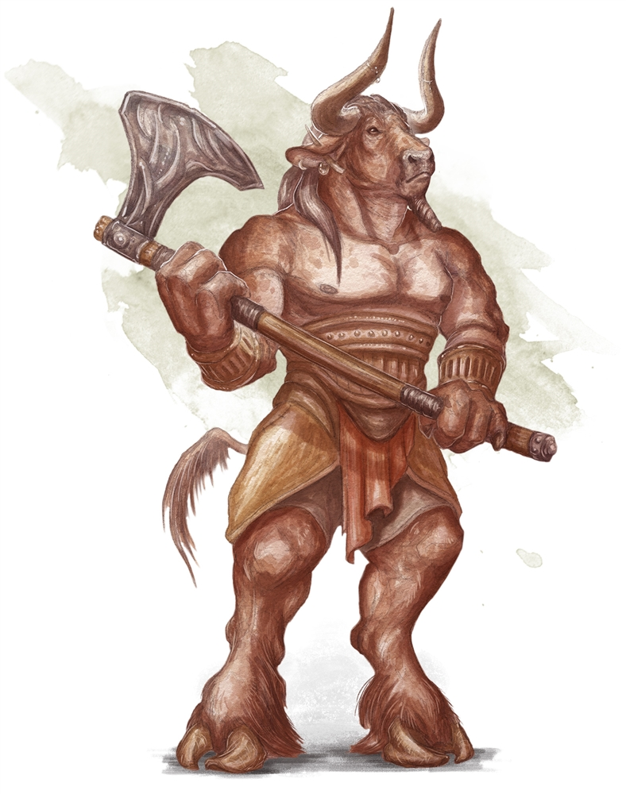
What I have been learning in ART
(ART – Lesson 5) Wednesday 20th May 2020
L.Obj: *I can show close pencil control and hand-to-eye coordination to sketch a minotaur’s body.
Click on the image of the Minotaur to watch the tutorial.

Slide 2
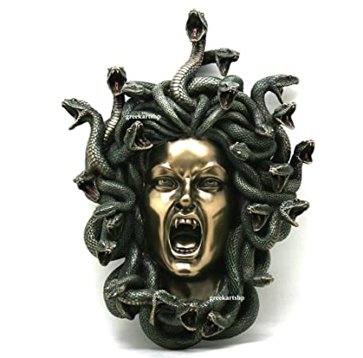
What I have been learning in ART
(ART – Lesson 5) Wednesday 20th May 2020
L.Obj: *I can show close pencil control and hand-to-eye coordination to sketch Medusa’s head.
Click on the image of Medusa to watch the tutorial.

