Slide 1
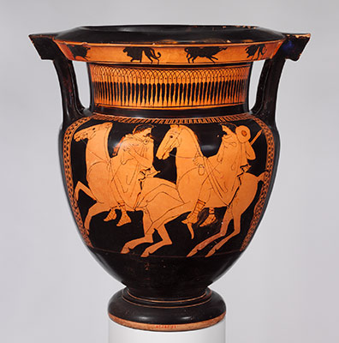
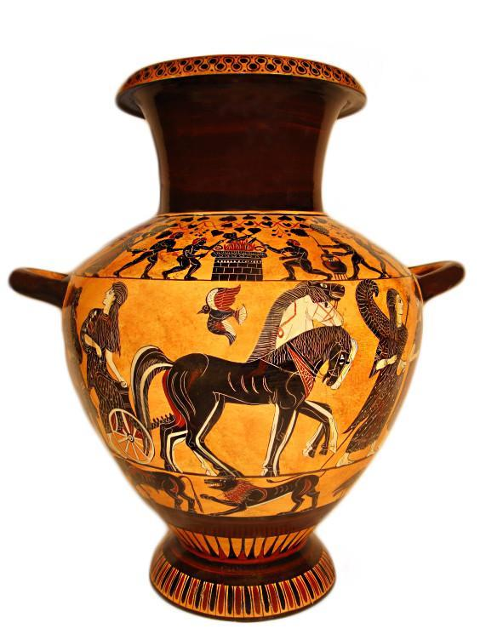
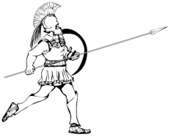
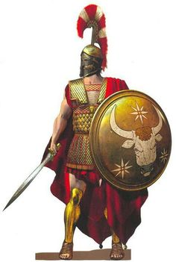
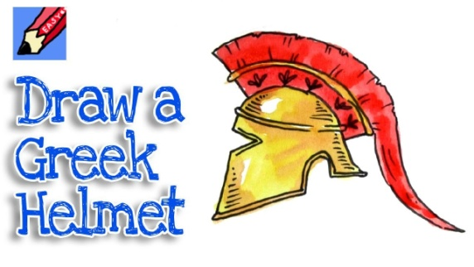
What I have been learning in ART
PREVIOUS LESSONS (ART – Lessons 1, 2 & 3)
L.Obj: *I can paint the eye of an Ancient Greek creature, the phoenix
*I can draw Ancient Greek vases with accuracy and attention to detail.
*I can sketch / paint Ancient Greek armour and weapons. (xiphos / hoplite’s clothing)
These are the pieces of Ancient Greek art work that you’ve produced during the last three weeks. If you’ve not yet had the opportunity to complete these, here are the links you will need. Just click on the words/ pictures below.
phoenix eye
Ancient
Greek vases

Slide 2
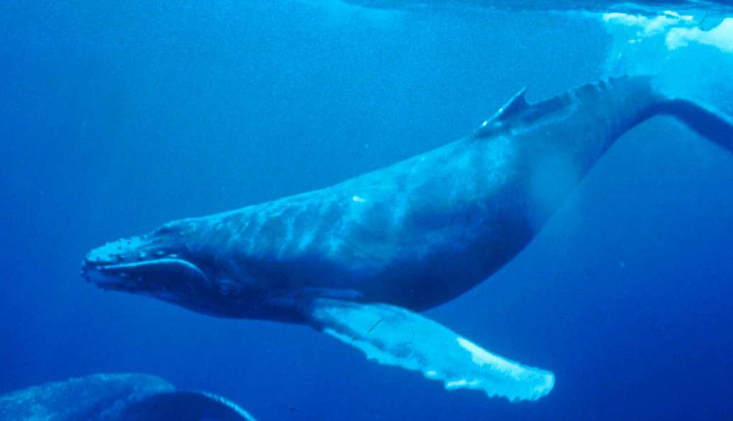
What could I be learning Art today?
(ART) Thursday 14th May 2020
L.Obj: *I can follow steps / instructions to draw / paint a humpback whale.
We learned on Monday in Science that the gestation period of a humpback whale is 11-12 months. Why not learn how to draw / paint a humpback whale?
Click on the image to find the link.

