Slide 1
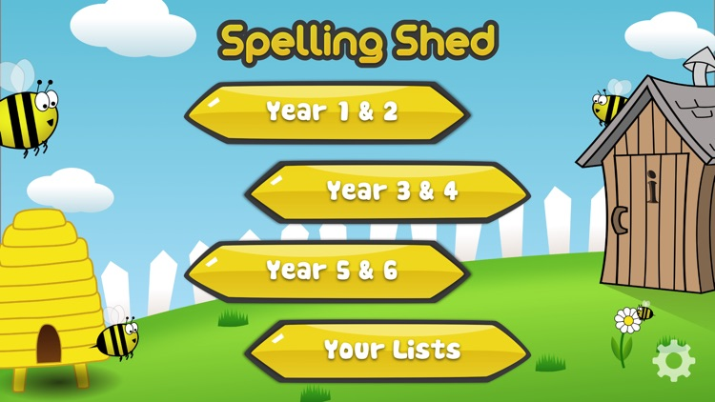
Y5&6 TOP SPELLERS TODAY
1st = Nelly 45 points
2nd = Heidi 32 points
3rd = Jack 31 points
4th = Henry 25 points
5th -= Cassie 18 points
6th = Harvey 15 points
7t^{h} = Isobel 14 points
8th = Alissa 12 points
9th = Lucy 7 points
These are the amount of dojos you have received for your efforts today!
Everybody else earns 1 dojo for practising their spellings today!

Slide 2
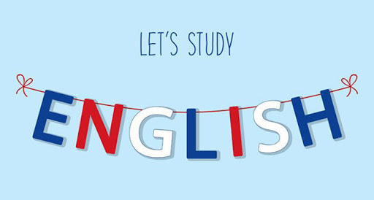
Here’s what Y5&6 have been
focusing on at home today.

Slide 3
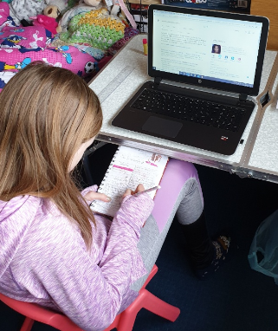
Here’s what Y5&6 have been focusing on at home today.
Bethany continuing to write her biography in English whilst adding extra research.

Slide 4
Here’s what Y5&6 have been focusing on at home today.
Tom Daley Biography
In 1994 a baby called Thomas Robert Daley was born. Today he is known as Tom Daley one of Britain’s best divers. After winning his first medal at the age of 8 he may be representing Britain in the 2020 Olympics for the fourth time at the age of 26. Due to covid-19 the games have be moved back to 2021.
Early life
Tom was born in Plymouth Devon. At the age of 7 he started to dive, and he immediately knew he wanted to be a diver. By 2009 he was ranked number 1 diver his age (14) in the world! He went to Eggbuckland secondary school where he was bullied. He then moved to a private school called Plymouth college which had a good academic record so even if he was training, he would still get plenty of work done.
Family life
Tom’s parents were Debbie and Robert Daley. He also has two younger brothers William and Ben. Sadly, his dad died of brain cancer in 2012 at the age of 40. Tom paid tribute to his father on Twitter, saying: "If I could be half the dad that my Dad was to me then that would be my best achievement! I love you!” In 2013 Tom revealed he was gay. Whilst his mother has been supportive, some of his other family members have 'mixed opinions'. Tom married Dustin Lance Black in 2017 after knowing each other for 6 years. They are still happily married and have a son called Robert Black-Daley aged 2.
What he is best known for
Tom is best known for being a gifted diver in both the men’s 10 meter and synchronised diving events. By age 14 he was Britain’s youngest competitor in the Olympics in Beijing in 2008. Tom didn’t win a medal at Beijing but he had won a European gold medal earlier that year. In 2010 he went to the Common wealth games and won 2 gold medals, also in that year he won the BBC Young Sports Personality of the year for the third time.
In 2012 the Olympics were held in London, where Tom won his first Olympic medal. 2016 was the second time he won an Olympic medal at the Rio Olympics. Again, it was bronze. In 2013 he had become even more well known for being a judge/mentor on the tv programme ‘Splash’ and Tom also had a wax work at Madame Tussaud’s.
Tom is still in the diving business and is living in London with Lance and Robbie (his husband and son). He is sponsored by Mini, Adidas, Speedo, British Swimming, British Gas, The Lottery and Nestle this means he is quite wealthy and likes to spend his free time uploading to his YouTube channel. But his main focus is training for his fourth Olympics -now in 2021- where he may finally win gold.
Megan has been writing a biography of Tom Daley too.

Slide 5
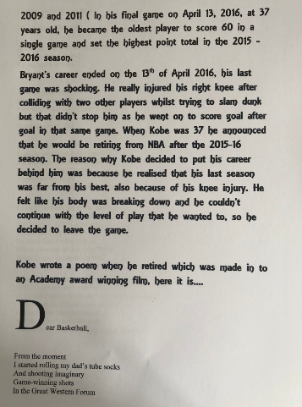
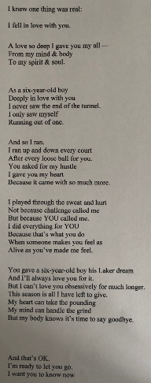
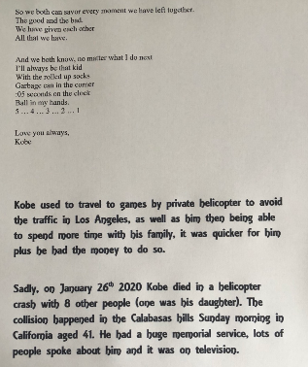
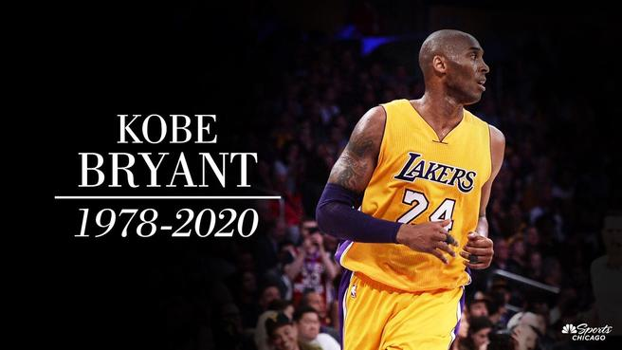
Here’s what Y5&6 have been focusing on at home today.
Harvey focusing on the death of the basketballer Kobe Bryant.

Slide 6
Here’s what Y5&6 have been focusing on at home today.
Andy ‘Wimbledon Winner’ Murray
Sir Andrew Barron Murray OBE (professionally known as Andy Murray) Wimbledon winner 49 times and counting. Andy has one brother named Jamie; they are very close. Andy has been in several tournaments. He has also won Wimbledon several times in his career and has won records because of his achievements. The record holder and brilliant tennis player however has more to his life than playing tennis and winning records and all the usual things that celebrities do. Read on to find out about Andy’s life from his birth, to the current day …
Andy was born on the 15th May 1987 in Glasgow, Scotland to William and Judy Murray. He got into the sport of tennis at the age of 3 when his mother took him regally to local courts to play. That was just the start of his career at this particular sport. Andy and his brother Jamie attended Dunblane Primary School. Unfortunately, it wasn’t the happiest of schooling because in 1996, Andy and Jamie were involved in the Dunblane School Massacre, when Thomas Hamilton ran into a classroom with a gun and shot 16 children and a teacher before shooting himself. Fortunately for Andy and Jamie, they took cover behind a table.
After the horrible event of 1996, Murray scored a major youth championship, when he won Florida’s Orange Bowl at the age of 12 in 1999. When Andy Murray left High School in 2003, he had 0 qualifications and instead, wanted to train in Barcelona for tennis. In 2004, Andy became the world’s number 1 junior after winning the U.S Open Junior title. Later that year, he was named the BBC’s Young Sports Personality of The Year. Shortly after becoming the youngest British player to compete in the Davis Cup, Murray made his professional debut in April 2005. In 2006, with a new coach -Brad Gilbert- Murray beat top ranked Roger Federer in Round 2 of the Cincinnati Masters tournament. Also that year, he defeated Andy Roddick en route to winning the SAP Open for his first ATP title. In 2007, Andrew’s parents Judy and William divorced. Andy Murray himself said that they were just 2 completely different people and hadn’t been getting along for several months. He claimed a second straight SAP Open and also won the St. Petersburg Open to break the top 10 rankings.
When 2008 came around, Murray emerged in the tennis spotlight when he defeated Spanish sensation Rafael Nadal to reach the final of the 2008 U.S. Open before losing to Roger Federer. He ascended down the score board to No. 2 in the world in 2009, and finished runner up at the Australian Open in both 2010 and 2011. In 2012, Murray made it into the Wimbledon Stadium final for the first time in his career with his semi final win over Jo-Wilfried Tsonga. Andy’s victory made Scotland and the whole of the United Kingdom proud – he was the first tennis pro from Great Britain to reach the Wimbledon final since 1938. However, Murray unfortunately lost to Roger Federer again. Andy Murray avenged his Wimbledon loss at the 2012 Summer Olympic Games, held in London, where he beat Federer to take his first Olympic gold medal. That September, he continued to burn up the courts with an impressive run through the grand U.S. Open field. Murray scored a great victory over Novak Djokovic in a tough five sets to clinch his first Grand Slam title, becoming the first player from the UK since 1977 (and the first British man since 1936) to win a Grand Slam singles tournament.
In 2013, after losing to Djokovic at the 2013 Australian Open, Murray made history that summer by defeating the Serbian player to claim the Wimbledon men’s singles championship. He was the first British male to win the tournament in 77 years and the second Scottish-born player to win Wimbledon since Harold Mahony in 1896. Also, that year, Andy underwent back surgery in September following his loss in the quarter finals of the U.S. open His performance was uneven for most of the 2014 season, though he made news by hiring former women’s champion Amelie Mauresmo to be his coach.
The Scottish player seemingly was back on track when he reached his fourth Australian Open final in early 2015. That March, he scored a career victory No. 500 while competing at the Miami Open. Murray followed with an impressive run at the 2015 French Open, battling back from a two set deflect in the semi-finals before succumbing to Djokovic. A few weeks later, he reached the semi finals of Wimbledon, but his hopes of advancing were stopped by the ageless Federer. Murray’s subsequent fourth round loss at the U.S. Open not only thwarted his last opportunity for a major title in 2015, it snapped his streak of consecutive appearances in a Grand Slam quarter final. To put 2015 to a close, Murray got married to Kim Sears on the 11th April that year at the Murray’s Cromlix hotel in central Scotland relaxed for a while.
Andy began the 2016 season on a high, advancing to the Australian Open final before losing to Djokovic. But he gained some payback by defeating him to claim the Italian Open in May, and then maintained his high level of play through the French Open. With his semi final win over defending world champion Stan Wawrinka; Murray became the first British player to reach the French Open since 1937. However, his bid to add another Slam title fell short when he wound up on the losing end of a match between him and Djokovic once again. That following July, Murray stepped into semi finals at Wimbledon once more after defeating J Wilfried-Tsonga. When he reached the glory of the finals, he upended Milos Raonic, the first Canadian man to make it into the Wimbledon final, 6-4, 7-6 (3), 7-6 (2). The victory was Murray’s third Grand Slam title.
The following month, he continued his sterling play by winning against Argentina’s Juan Martin del Potro at the Rio Games, making him the first male tennis player to successfully defend his Olympic singles title.
In 2017, Andy Murray became Sir Andrew Murray as he was knighted in the New Year Honours for services to tennis and charity by Queen Elizabeth II. Also that year, Andy had been affected by a hip injury for the majority of 2017, he wound up withdrawing from the U.S. Open in late summer. He then underwent surgery in January 2018.
He returned to tennis in June 2018, and was back in Grand Slam action at that year’s U.S. Open, but struggled to get into a groove post-operation. Just before the start of the 2019 Australian Open, Murray announced that his hip was still bothering him and he would likely retire by the conclusion of Wimbledon that summer, if not sooner. However, after battling through a first-round match that ended up in defeat, he suggested he may undergo yet another operation in an attempt to regain mobility on the court.
Currently, Andy is self-isolating -like the rest of us- and is on the leadership team of Malaria No More UK, a charity that raises funds and awareness to save lives in Africa, and a global ambassador for the World Wildlife Fund. Murray is also considering coming out of retirement when we are aloud out again. Hopefully he will come back and even if he doesn’t, his name will be remembered for a long time to come.
Jack’s biography of Andy Murray.

Slide 7
Here’s what Y5&6 have been focusing on at home today.
Sprinting To Success
LOOK AT THAT, CATHY FREEMAN WINS AGAIN! Cathy freeman, an Australian 400-meter dash champion and founder of a great educational charity. How did she learn to do that? Run along and get comfy to take a leap in to her life story in her biography.
Early life
Catherine Astrid Salome Freeman, normally known as Cathy Freeman was born 16th of February 1973 in Slade Point, Australia. She was raised in a housing commission (a lower cost housing estate which had social problems) in Australia. Sadly, at young age, her farther left the family and went to live in Woorabinda (also in Australia.) On a happier note, when her mother married again, her stepfather noticed her sporting ability when she was five and encouraged her to train harder and get into the sport of running. She went to many schools, including schools in Mackay and Coppabella and at fourteen went to Kooralbyn international school to be coached professionally but was mostly educated at Fairholme College in Toowoomba, where she attended after getting a sporting scholarship to board at the school.
At a young age, she always wanted to be a runner and had a collection of regional titles. As well as running, she loved to horse ride and dance – she still does today. At age 17 she won a gold medal at the 1990 Commonwealth Games and was named the Young Australian of the year. This was a brilliant start to her career.
Career and Main Life
During the main point in her career, Cathy did many competitions like in 1997, when she won in the 400m at the World Championships in Athens. Then sadly she injured her foot and took some time off the 1998 season. Upon her return to the track in 1999, Freeman did not lose a single 400m race, including at the World Championships. Another great achievement is lighting the torch at the 2000 Olympics in Sydney. Cathy is Aboriginal, (native Australian) and lighting the torch was seen as a positive move in recognising the Aboriginal people of Australia. Freeman went on to win a gold medal in front of her home nation in the 400m. On her victory lap, she carried both the Australian national flag and the native Aboriginal flag.
Throughout her career, Freeman regularly competed in the Victorian Athletic League where she won two 400m races at the Stawell Gift Carnival. Freeman did not compete during the 2001 season but in 2002, she to the track to compete as a member of Australia's victorious 4x 400 m relay team at the 2002 Commonwealth Games.
Freeman retired from professional competition, the realisation had hit her that her gold medal in the Sydney Olympics, carrying the weight of the expectations of 19 million Australians, was a point to which she could not return. "I won't ever have the same fulfilling moment as I already have had," Freeman said. "I don't have the same hunger. I know what it takes to be a champion, to be the best in the world, and I just don't have that feeling right now. I'm tired all of a sudden."
After her retirement in 2007, Freeman founded the Cathy Freeman Foundation. The Foundation works with four remote Indigenous communities to close the gap in education between Indigenous and non-Indigenous Australian children, by offering opportunities for children to attend school.
Zoe’s biography of Cathy Freeman.

Slide 8
Here’s what Y5&6 have been focusing on at home today.
Hot Dogging Into History
Roger Federer is a world-renowned tennis player who is best known for winning Wimbledon 8 times, being the oldest men’s champion in it and entertaining the crowd with his exhibition ‘Hot Dog’ shots. He has been number one for years and years but do you know about his early life and the amazing story of how young he was when he turned pro? Dive
right into the gob smacking life of this amazing man.
Early life.
Roger Federer was born on the 8th of August 1981 in Basel, Switzerland to Swedish Dad Robert Federer and his mother (Lynette Du Rand) who was South African. They had met on a business trip for a pharmaceutical company -where they both worked. He also had an older sister called Diana Federer. Roger started his life-long love for tennis at 8. At this time, he was also playing other sports such as football (soccer). Just 6 years later, he was in the top 3 junior players in Switzerland; he continued to train hard, trying to perfect how Boris Becker (his idol) played.
At 14, he was training 6 hours a week and 3 hours extra conditioning (building up muscle stamina). On top of this, he played 3-4 tournaments per months, consequently making him the national junior champion in Switzerland. Seeing he had a chance to become professional in tennis, he decided to quit all other of his sports. In this same year, Roger chose to train at the Swiss National Tennis Centre in Ecublens.
In July 1996, he joined the International Tennis Federation junior circuit and at 16, he got his first sponsorship. Next, he won the junior Wimbledon and the orange ball shortly after he had turned pro. The ITF then scouted him out and were stunned by his amazing talent. Consequently, they awarded him the ITF World Junior Tennis champion of the year.
Tennis Career: Grand Slams, French Opens, Wimbledon Wins & More
In 1998, Roger won the boys singles and doubles at Wimbledon and turned professional in the same year. 3 years later in 2001, he was at Wimbledon’s 4th round and up against the reigning singles champion, Pete Sampras. Surprisingly, Roger won and knocked Pete out. In 2003, a brilliant season on grass saw Roger become the first Swiss Man to Win a Grand Slam title when he was victorious at Wimbledon.
In early 2004, Roger slid down the world rankings to number 2, however he wasn’t going to stay there for long. In that same year, he won the Australian Open, the U.S. Open, the ATP Masters and last but not least won the Wimbledon’s Men’s Singles. Early in 2005, Roger became number 1 and successfully won the U.S. Open and Wimbledon for a third consecutive year.
Maintaining his number 1 title from 2004-2008, Roger won the singles championships at the Australian Open, Wimbledon and the U.S. Open. Federer was named the Laurus World Spots Man of the year from 2005-2008. In 2008 he beat Andy Murray at the U.S. Open, however he lost to Rafael Nadal at the French Open and at Wimbledon. Also, he lost to another young star named Novak Djokovic at the Australian Open in the same year. For the first time in 4 years, he slid down to number 2 in the world rankings.
2009 was a good year for Federer; he reclaimed the number 1 spot for his amazing all round play. He beat Robin Soderling to win the French Open and completed the career Grand Slam, he also defeated Andy Roddick in a brilliant Wimbledon final. This over took Sampras
Reuben’s biography of Roger Federer Part 1

Slide 9
Here’s what Y5&6 have been focusing on at home today.
for a record 15 Grand Slam singles titles. He reached the finals of two other major tournaments, falling five sets to Nadal at the Australian Open and to Juan Martin del Potro at the U.S. Open.
In 2012 Roger achieved a record breaking 302 weeks at the top of the world rankings and broke another record for most Wimbledon wins (7). Later in 2013, Roger was knocked out in the second round of Wimbledon by Sergiy Stakhovsky who was ranked 116th at the time. Federer admitted that he had ‘struggled through out which wasn’t very satisfying.’ His confidence was shaken by the loss.
2014 was a disappointing year for Roger Federer, he lost to Djokovic in the men’s singles finals at Wimbledon, on the contrary he came back a year later in 2015 to beat Djokovic in the final of the Dubai Championships. Just a month later though, Federer lost to Djokovic in the final of Wimbledon, therefore stopping his quest for an 8th Wimbledon victory. The same thing happened in the U.S. Open the same year. No matter how hard Federer tried, he just couldn’t beat the top-ranked Djokovic.
Early in 2016, Roger was defeated by Novak in the Australian Open again. After this match, Roger got a knee injury and was subsequently side lined. Later still in the season, Federer suffered back problems and had to withdraw from the French Open to avoid further injury.
After six months in recuperation, Roger was back and went on to beat Rafael Nadal in the final of the Australian Open. That was his 18th Grand Slam title and he graciously said after wards “Id like to congratulate Rafael on an amazing comeback, too. I don’t think either of us thought we would be in the final at the Australian Open this year. I am happy for you. I would’ve been happy to lose to you tonight, too, really.”
Roger was back on a roll in 2017, he won Wimbledon for a record-breaking 8th time, beating Martin Cilic 6-3 6-1 6-4. The 35-year-old said “I wasn’t sure if I was ever going to be here again in another final after last year. I’ve had some tough ones here, losing to Novak in 2014 and 2015. But I always believed that maybe I could come back and do it again. And if you believe, you can go really far in life.”
Personal life
In 2003, Roger set up the Roger Federer Foundation that helps provide grants to poor countries for education and sports projects. 2009 saw Federer get married to Mirka Vavrinec -a former professional tennis player. Still in the same year, they were blessed with identical twin girls Myla and Cherlene. 5 years later on May the 6, Mirka gave birth to twin boys Leo and Lenny. They now all live in Bottmingen, Switzerland.
‘If you believe you can go really far in life.’ Roger Federer
Reuben’s biography of Roger Federer Part 2

Slide 10
Here’s what Y5&6 have been focusing on at home today.
An All Rounder
Andrew “Freddie” Flintoff, an all good rounder in cricket. He played for Lancashire and England cricket teams. Do you want to be like him? A cricketer’s dream!
Andrew Flintoff was born in Preston, Lancashire on the 6th December 1977. His dad was a plumber. Freddie (as he is also known as), who has an older brother called Chris, went to Greenland’s Primary School and Ribbleton Hall High School. At school he was a keen chess player. Andrew played in a school lunchtime club and would often beat children much older than him with his fantastic moves.
Freddie played cricket alongside his dad and brother at Harris Park. One day,the under 14’s were short of a player, so Freddie was asked to play. This was his first local match at the age of six. At the age of 11, Freddie played for Lancashire schools team. Freddie’s greatest influence was his dad, who he watched play from a very young age. A coach called “Jim Renyon” changed Freddie from a school boy player to an adult cricketer. He passed nine GCSEs but did want to carry on his education.
Andrew was given the nickname ‘Freddie’ by the captain of Lancashire when he was a teenager, because his name was similar to ‘Fred Flintstone’ from the cartoon. At the age of 16, Freddie was snapped up by David Lloyd, the then Lancashire coach. Freddie trained with the team full time. His first debut for Lancashire came against Hampshire in August 1995, when Freddie was only eighteen. By the age of nineteen, Freddie was the captain of the England under 19’s cricket team. Freddie was a right handed player and a great all-rounder.
Freddie made his test match debut for England in 1998 against South Africa at Trent Bridge, Nottingham. In 2000 Freddie hit 135 not out (whilst playing for Lancashire), in the quarterfinals of the NatWest trophy against Surry. In that same year England’s management were very unhappy about his fitness level and his weight gain Freddie was dropped from playing for England during 2001. He was determined to get into shape to be reselected for his national team. He had to loose 2 stone in weight and with the help of the GB rugby coach Steve Hampson he improved his fitness.
It worked and by 2003 Freddie was back hitting big and bowling really well. Andrew worked hard in 2004 he was ‘Man of the Series’ in England’s 4-0 victory against west Indians and voted player of the year by the Professional Cricket Association. His first daughter was also born.
In 2005 Freddie played for England against Australia in the ashes. In the second test Freddie played outstandingly taking England to a nail –biting victory. England went on to win the ashes and Freddie went on the win the man of the series .that same year Freddie also won the BBC sprot personality of the year.
2006 was a hard year for Freddie. An ankle injury and worries over his fitness were developing. In September 2006; Freddie was named captain for the ashes series being played in Australia. Unfortunatul Australia won it back. his second child (son) was born
Due to Freddie drinking heavily he was sacked from vice-captain for England during 2007 world cup. Lots of injuries followed the next few years not playing. In this time his third child was born
In 2009 Freddie started the ashes near to full fitness, old injury’s came back and on the 15th of July 2009 Freddie decided that he would retire from test cricket. England went on to regain the ashes. 2010 Freddie retired from all cricket .he then moved to broadcasting.
In March 2011 the BBC gave Freddie a job co-presenting a sports show (Radio 5 Live) called Freddie’s World of Sport. Freddie also took up boxing and won points in a heavy weight fight.
During 2017, Freddie hosted a game show called Cannonball. But his new career highlight, has been to host the biggest car TV show called Top Gear with two other people and from this day on he is still doing it. Freddie has also had his fourth child. A highlight of Freddie’s life was him getting awarded with an MBE from the queen for his services to cricket.
Henry’s biography of Andrew ‘Freddie’ Flintoff

Slide 11
Here’s what Y5&6 have been focusing on at home today.
Sir Richard John Hadlee
Who is that amazing person throwing that ball as quick as lightning across the long grassy cricket field? It’s… Sir Richard Hadlee, the cricketing star and, one of the best fast bowlers in history. Let’s take a swing into his life.
Richard John Hadlee was born on the 3rd of July 1951 on a Tuesday; his place of birth was St Albans [Christchurch New-Zealand]. He was fourth born of five sons. Hadlee, who liked cricked, had a cricketing family, his father, Walter Hadlee, captained the New-Zealand cricket team. Two of Richard’s brothers, Barry and Dayle Hadlee, were already in the team by the time Hadlee was 24. Richard had taken a liking into the game at school and began his road to stardom. Read on to know his amazing journey!
Richard John Hadlee spent a lot of his childhood playing cricket. Hadlee attended Christchurch boys high and afterwards he was expected to join Canterbury like his older brothers did but since it was already full of opening bowlers he went to Lancaster Park instead. People only started to recognise Hadlee’s talent when he [and his Kiwi team] defeated the cricketing India in 1976. Richard Hadlee was then recognised for his greatness for this sport and quickly became Nz’s top dog. In 1980 he was the NZ sportsman [an award given to their country’s best sportsperson] of the year three times in a row. Hadlee was so great in just 25 tests he took 100 wickets making him his country’s main strike bowler. In 18 years Richard played 86 test matches. Before Hadlee played test cricket for NZ the team had not won a single match against England, West Indies and Australia [Known as the Big Three]. Hadlee as well as all his awards won the nickname Paddles, due to his over-sized feat. This nickname was given to him at Heaton Street Intermediate School.
Hadlee was a very private man and consciously stayed away from scandal and the public eye. He married Karen Ann Marsh who herself was a professional cricketer for the NZ team. Together they had two sons and after around twenty-two years together they decided to divorce [no Hadlee had ever divorced before]. He later remarried Lady Dianne. In 1980 Hadlee felt he should retire from professional cricket because he was suffering from a range of injures which meant he couldn’t play for most of the season and was underperforming. He was talked back by Nottingham to carrying on playing. For ten years of his career he helped Nottingham, who was low-rated at the time, rise up and become one of the best but at thirty-six with two young sons decided to stop. This was because he was finding the travel hard with a young family, twice a year; he chose to focus on the NZ team instead. Hadlee finally retired from test cricket on the 10th of July 1990 after helping the defeat of Australia, where he took his “100th first class 5 wicket haul in an innings”. Hadlee expressed in an interview that he had started to question continuing with test cricket a few years before retiring when he had heard his ex-coach Glenn Turner describing “the hysterical way wealthy young guns like Chris Cairns and Adam Parole acted when he dished out a bit of criticism”. He felt they were overpaid stars who although they had talent they were not dedicated. He was appalled that these new players felt they didn’t need to listen to someone of Turners experience.
Richard ended his cricket career with 431 wickets from only eighty-six tests and was the highest wicket taker for a long period of time before cricketer Kapil Dev over took this legend. The year John Hadlee retired he created the Sir Richard Hadlee sports trust designed for people from New-Zealand who have difficulties playing their favourite sport due to hardship or special circumstances holding them back. Even though Hadlee had finished his great career of test cricket he was given, by the Queen, a knighthood for his contribution to his favourite sport. New-Zealand recognised Richard as a great and amazing player so once a year they play an O.D.I contest, One Day International contest, called the Chappell Hadlee cup in his name. In 2009 Hadlee went into the I.C.C, International cricket council, hall of fame for his achievements in cricket. In more recent years Sir Richard John Hadlee has been diagnosed with bowel cancer and has had two operations. After having an operation to remove the bowel cancer he was then later diagnosed with liver cancer. In one of Hadlee’s rare public appearances he said ‘’It was purely a freak situation where a routine colonoscopy determined the problem. I was faced with a huge challenge in my life as odds were not in my favour.”
Cameron’s biography of Sir Richard Hadlee

Slide 12
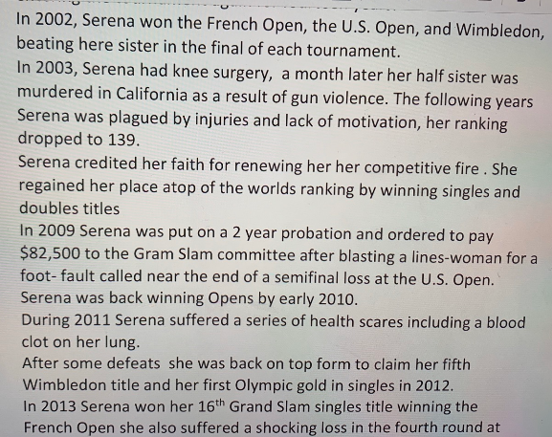
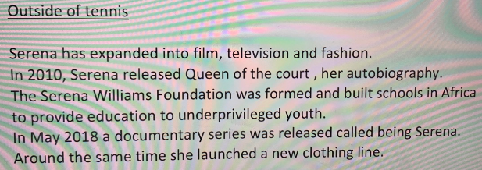
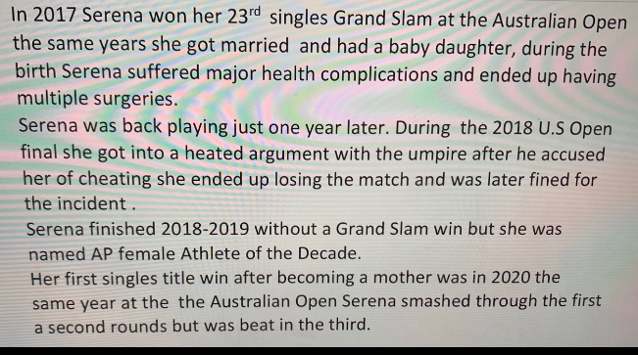
Here’s what Y5&6 have been focusing on at home today.
Nelly’s biography of Serena Williams

Slide 13
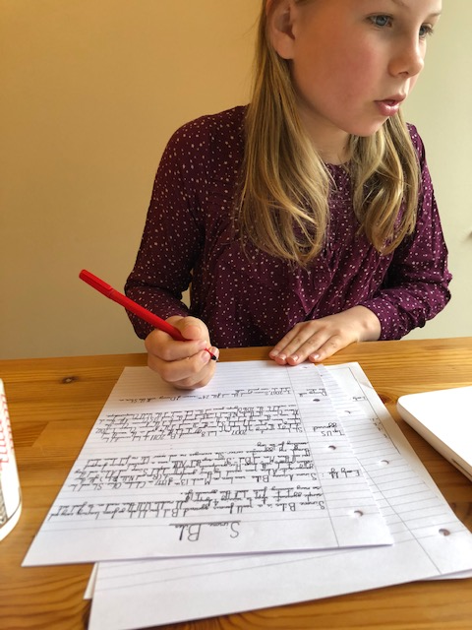
Here’s what Y5&6 have been focusing on at home today.
Lily is continuing to work on her biography of Simone Biles.

Slide 14
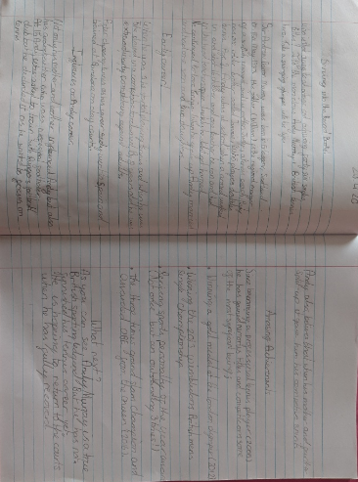
Here’s what Y5&6 have been focusing on at home today.
Katie’s biography of Andy Murray

Slide 15
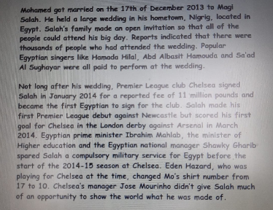
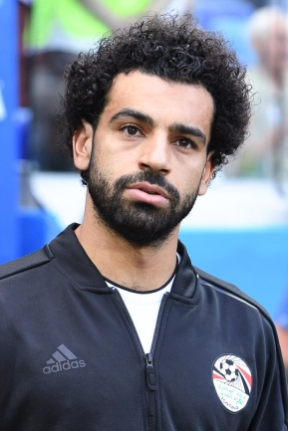
Here’s what Y5&6 have been focusing on at home today.
Ruby’s continued biography of Mo Salah

Slide 16
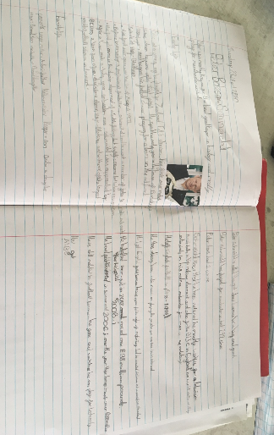
Here’s what Y5&6 have been focusing on at home today.
Isla’s continued biography of Peter Schmeichel

Slide 17
Here’s what Y5&6 have been focusing on at home today.
Sophie locating the possessive pronouns in the sentences.

Slide 18
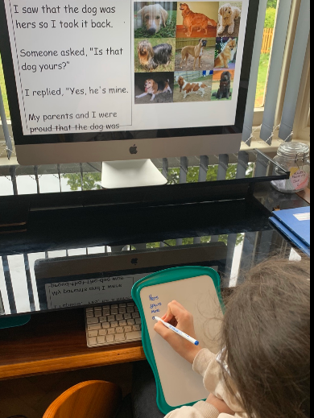
Here’s what Y5&6 have been focusing on at home today.
Nelly locating the possessive pronouns in the sentences.

Slide 19
Here’s what Y5&6 have been focusing on at home today.
Henry locating the possessive pronouns in the sentences.

Slide 20
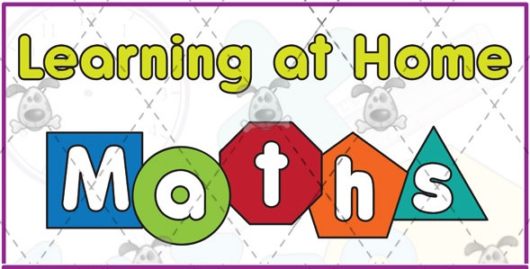
Here’s what Y5&6 have been
focusing on at home today.

Slide 21
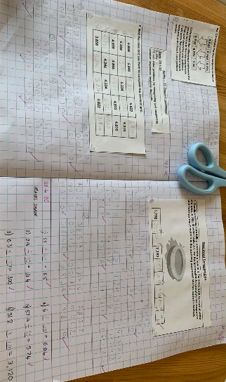
Here’s what Y5&6 have been focusing on at home today.
Zoe whizzing her way through her maths today.

Slide 22
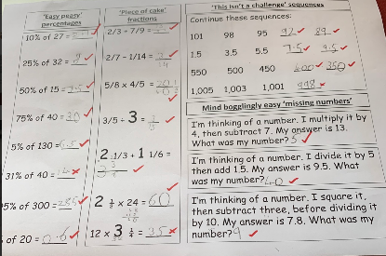
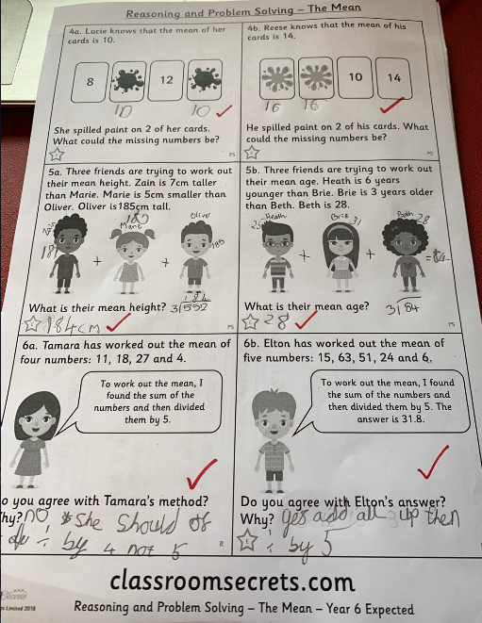
Here’s what Y5&6 have been focusing on at home today.
Henry smashing his calculations and then showing his understanding of ‘mean’ (average).

Slide 23
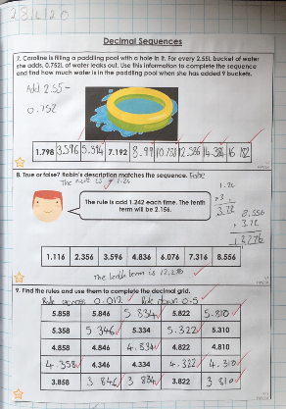
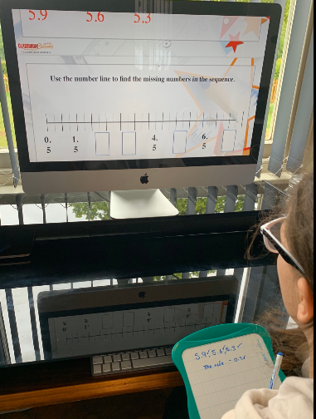
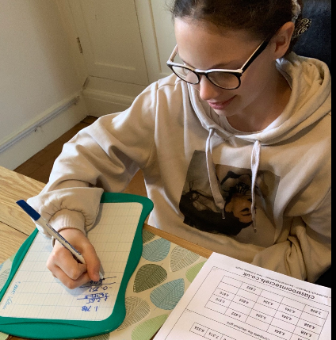
Here’s what Y5&6 have been focusing on at home today.
Nelly completing her understanding of decimal number sequences successfully in maths.

Slide 24
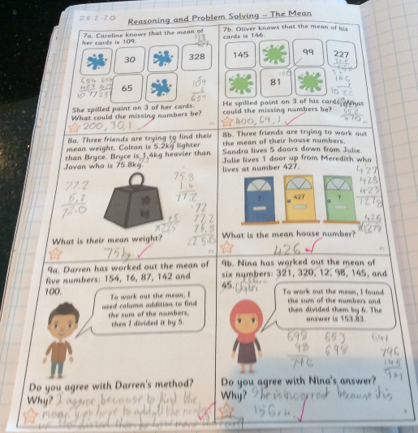
Here’s what Y5&6 have been focusing on at home today.
Reuben showing great workings out / jottings to help to solve these ‘mean’ (average) problems.

Slide 25
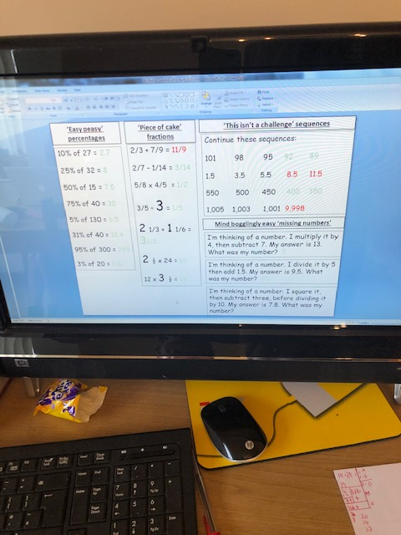
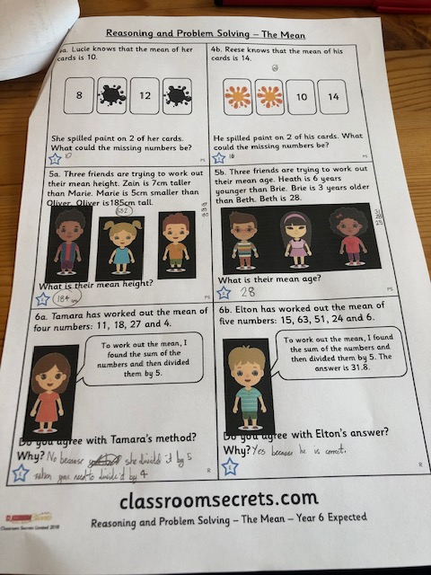
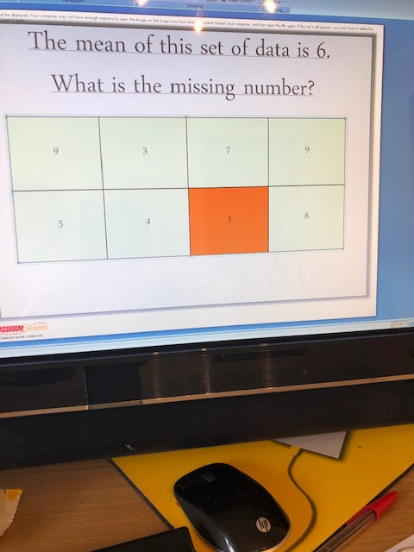
Here’s what Y5&6 have been focusing on at home today.
Lily practising her calculations before moving onto solving these ‘mean’ (average) problems.

Slide 26
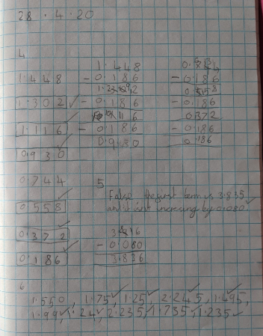
Here’s what Y5&6 have been focusing on at home today.
Lucy completing her understanding of decimal number sequences successfully in maths.

Slide 27
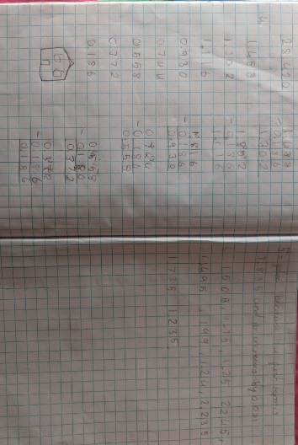
Here’s what Y5&6 have been focusing on at home today.
Katie completing her understanding of decimal number sequences successfully in maths.

Slide 28
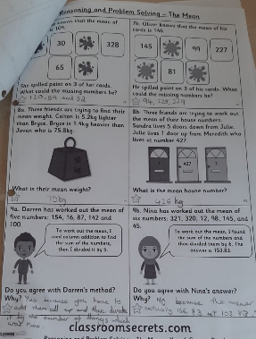
Here’s what Y5&6 have been focusing on at home today.
Ruby showing great workings out / jottings to help to solve these ‘mean’ (average) problems.

Slide 29
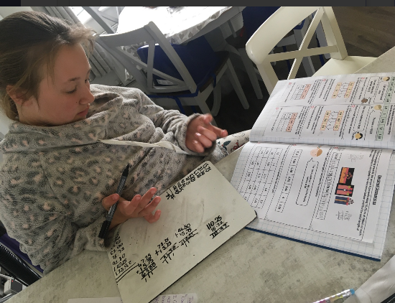
Here’s what Y5&6 have been focusing on at home today.
Isla completing her understanding of decimal number sequences successfully in maths.

Slide 30
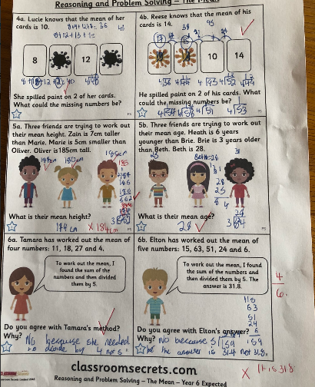
Here’s what Y5&6 have been focusing on at home today.
Harvey attempting to solve these ‘mean’ (average) problems.

Slide 31
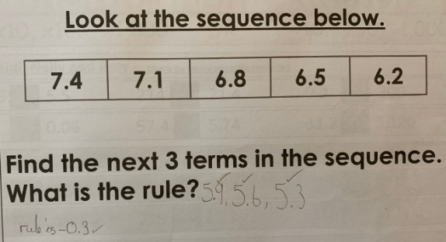
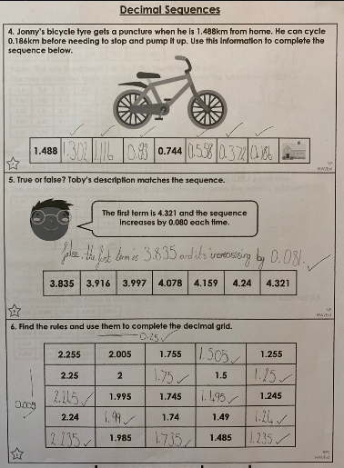
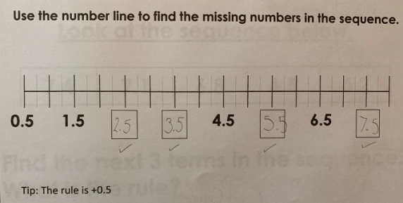
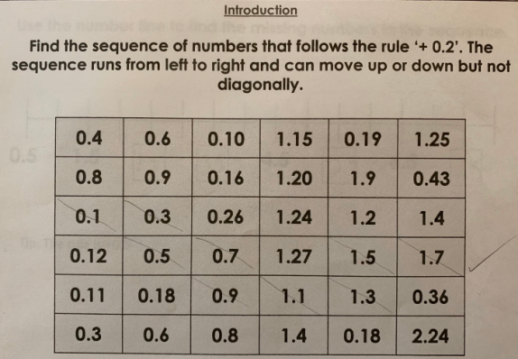
Here’s what Y5&6 have been focusing on at home today.
Sophie’s really good thinking to solve these decimal sequence problems.

Slide 32
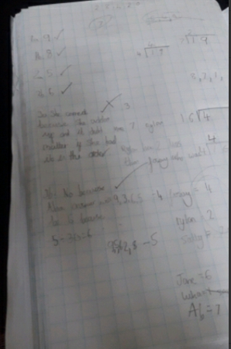
Here’s what Y5&6 have been focusing on at home today.
Chloe’s jottings have helped her to try to calculate the answers to these ‘mean’ (average) problems.

Slide 33
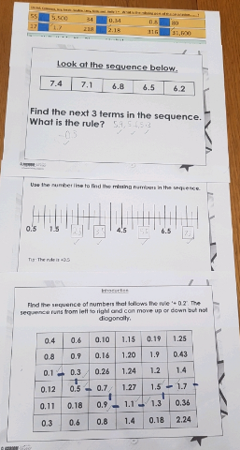
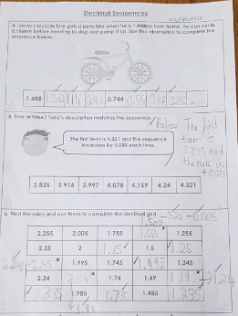
Here’s what Y5&6 have been focusing on at home today.
Cameron’s decimal sequences in maths today.

Slide 34
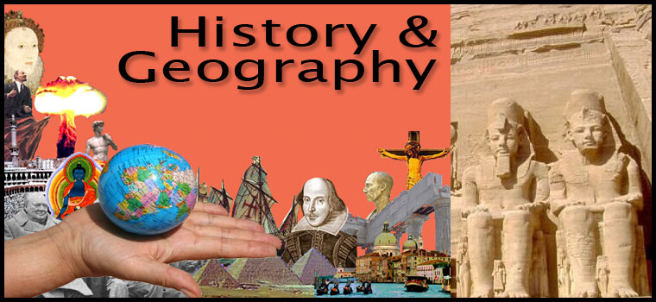
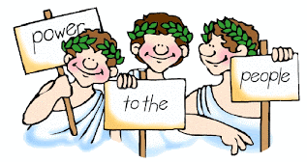
Here’s what Y5&6 have been focusing on at home today.
DEMOCRACY

Slide 35
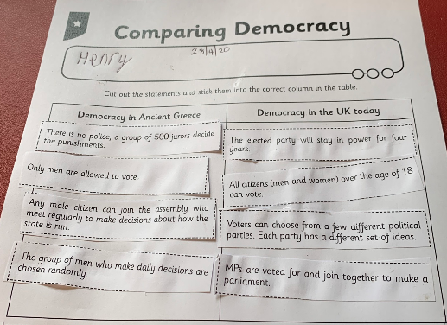
History - Ancient Greek Democracy
Henry comparing democracy in the UK and Ancient Greece.

Slide 36
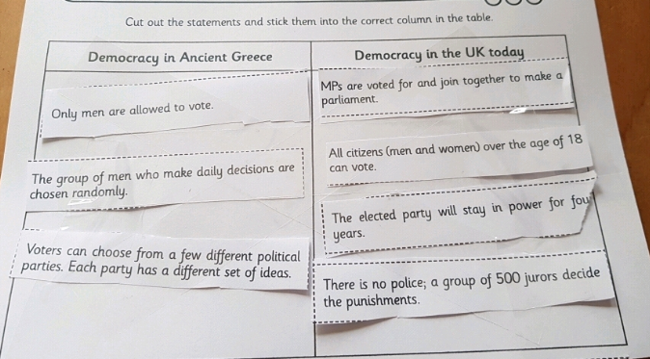
History - Ancient Greek Democracy
Elizabeth attempting to compare democracy in the UK and Ancient Greece.

Slide 37
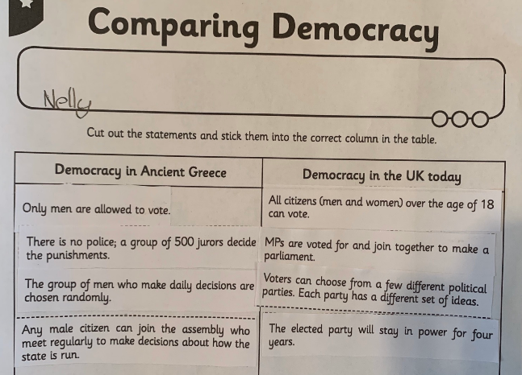
History - Ancient Greek Democracy
Nelly comparing democracy in the UK and Ancient Greece.

Slide 38
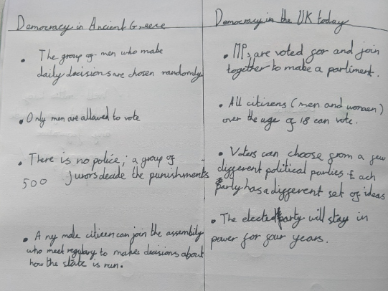
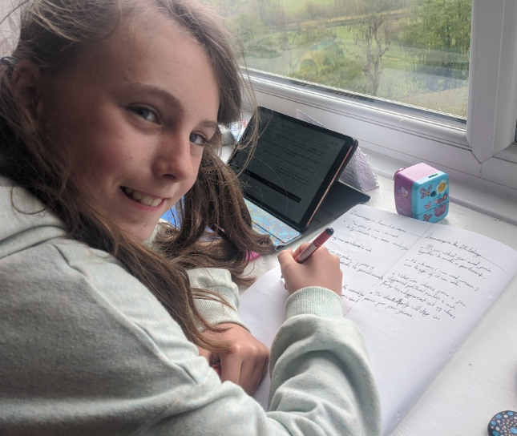
History - Ancient Greek Democracy
Lucy comparing democracy in the UK and Ancient Greece.

Slide 39
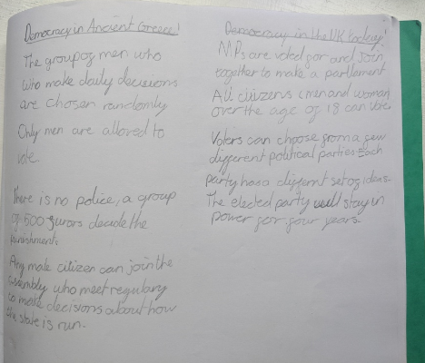
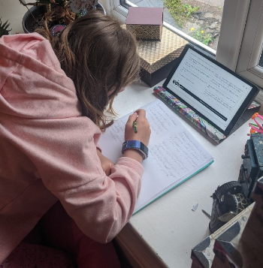
History - Ancient Greek Democracy
Katie comparing democracy in the UK and Ancient Greece.

Slide 40
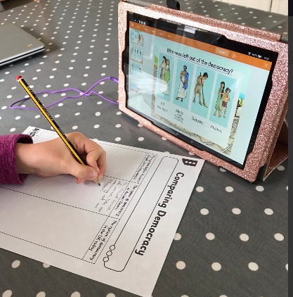
History - Ancient Greek Democracy
Ruby comparing democracy in the UK and Ancient Greece.

Slide 41
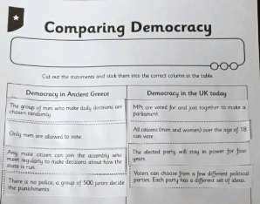
History - Ancient Greek Democracy
Bethany comparing democracy in modern day UK and Ancient Greece.

Slide 42
History - Ancient Greek Democracy
Isla comparing democracy in modern day UK and Ancient Greece.

Slide 43
History - Ancient Greek Democracy
Chloe comparing democracy in modern day UK and Ancient Greece.

Slide 44
History - Ancient Greek Democracy
Harvey is really organised when comparing democracy in modern day UK and Ancient Greece.

Slide 45
History - Ancient Greek Democracy
Sophie’s comparing of the democracy in modern day UK and Ancient Greece.

Slide 46
What else have we been doing at home today?
Isla has been
finishing off her
phoenix eye

Slide 47
What else have we been doing at home today?
Just Dance and reading to start the day for Bethany.

Slide 48
What else have we been doing at home today?
Henry reading and listening to his Ancient Greek Myth.

Slide 49
What else have we been doing at home today?
What else have we been doing at home today?
Elizabeth matching and ordering the stages of human development.

Slide 50
What else have we been doing at home today?
Zoe has been extending herself by practising her sentence structure and spellings.

Slide 51
What else have we been doing at home today?
Reuben hard at work…………

Slide 52
What else have we been doing at home today?
…..before working on his model helicopter.

Slide 53
What else have we been doing at home today?
Katie and Lucy making dad a birthday cake.

Slide 54
What else have we been doing at home today?
Preparing the vegetables for a birthday celebration roast dinner this evening.

Slide 55
What else have we been doing at home today?
Story time with Nelly – Day Five
Will you answer her question correctly today?

