Slide 1
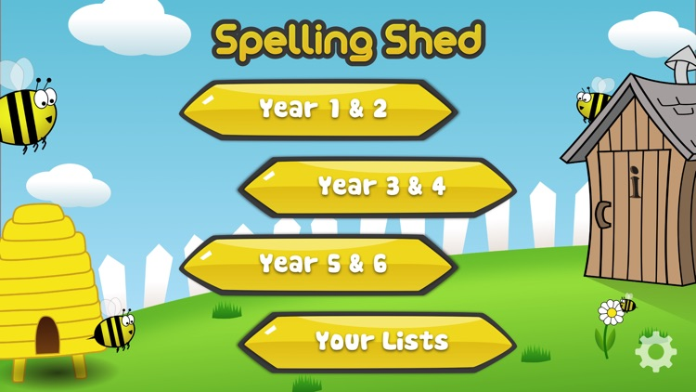
Y5&6 TOP SPELLERS TODAY
1st = Nelly 46 points
2nd = Heidi 44 points
3rd = Cameron 33 points
4th = Henry 21 points
5th = Isobel 19 points
6th = Lily 15 points
7th = Dante 14 points
8th = Jack 13 points
9th = Ruby and Rhys 10 points
These are the amount of dojos you have received for your efforts today!
Everybody else earns 1 dojo for practising their spellings today!

Slide 2
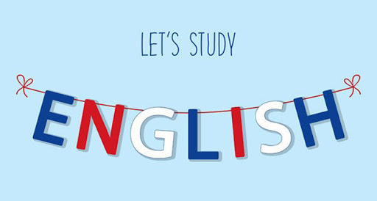
Here’s what Y5&6 have been
focusing on at home today.

Slide 3
Here’s what Y5&6 have been focusing on at home today.
Andy ‘Wimbledon Winner’ Murray
Sir Andrew Barron Murray OBE (professionally known as Andy Murray) Wimbledon winner 49 times and counting. Andy has one brother named Jamie; they are very close. Andy has been in several tournaments. He has also won Wimbledon several times in his career and has won records because of his achievements. The record holder and brilliant tennis player however has more to his life than playing tennis and winning records and all the usual things that celebrities do. Read on to find out about Andy’s life from his birth, to the current day …
Andy was born on the 15th May 1987 in Glasgow, Scotland to William and Judy Murray. He got into the sport of tennis at the age of 3 when his mother took him regally to local courts to play. That was just the start of his career at this particular sport. Andy and his brother Jamie attended Dunblane Primary School. Unfortunately, it wasn’t the happiest of schooling because in 1996, Andy and Jamie were involved in the Dunblane School Massacre, when Thomas Hamilton ran into a classroom with a gun and shot 16 children and a teacher before shooting himself. Fortunately for Andy and Jamie, they took cover behind a table.
After the horrible event of 1996, Murray scored a major youth championship, when he won Florida’s Orange Bowl at the age of 12 in 1999. When Andy Murray left High School in 2003, he had 0 qualifications and instead, wanted to train in Barcelona for tennis. In 2004, Andy became the world’s number 1 junior after winning the U.S Open Junior title. Later that year, he was named the BBC’s Young Sports Personality of The Year. Shortly after becoming the youngest British player to compete in the Davis Cup, Murray made his professional debut in April 2005. In 2006, with a new coach -Brad Gilbert- Murray beat top ranked Roger Federer in Round 2 of the Cincinnati Masters tournament. Also that year, he defeated Andy Roddick en route to winning the SAP Open for his first ATP title. In 2007, Andrew’s parents Judy and William divorced. Andy Murray himself said that they were just 2 completely different people and hadn’t been getting along for several months. He claimed a second straight SAP Open and also won the St. Petersburg Open to break the top 10 rankings.
When 2008 came around, Murray emerged in the tennis spotlight when he defeated Spanish sensation Rafael Nadal to reach the final of the 2008 U.S. Open before losing to Roger Federer. He ascended down the score board to No. 2 in the world in 2009, and finished runner up at the Australian Open in both 2010 and 2011.
In 2012, Murray made it into the Wimbledon Stadium final for the first time in his career with his semi final win over Jo-Wilfried Tsonga. Andy’s victory made Scotland and the whole of the United Kingdom proud – he was the first tennis pro from Great Britain to reach the Wimbledon final since 1938. However, Murray unfortunately lost to Roger Federer again.
Andy Murray avenged his Wimbledon loss at the 2012 Summer Olympic Games, held in London, where he beat Federer to take his first Olympic gold medal. That September, he continued to burn up the courts with an impressive run through the grand U.S. Open field. Murray scored a great victory over Novak Djorkovic in a tough five sets to clinch his first Grand Slam title, becoming the first player from the UK since 1977 (and the first British man since 1936) to win a Grand Slam singles tournament.
In 2013, after losing to Djokovic at the 2013 Australian Open, Murray made history that summer by defeating the Serbian player to claim the Wimbledon men’s singles championship. He was the first British male to win the tournament in 77 years and the second Scottish-born player to win Wimbledon since Harold Mahony in 1896. Also that year, Andy underwent back surgery in September following his loss in the quarter finals of the U.S. open His performance was uneven for most of the 2014 season, though he made news by hiring former women’s champion Amelie Mauresmo to be his coach.
The Scottish player seemingly was back on track when he reached his fourth Australian Open final in early 2015. That March, he scored a career victory No. 500 while competing at the Miami Open. Murray followed with an impressive run at the 2015 French Open, battling back from a two set deflict in the semi finals before succumbing to Djokovic. A few weeks later, he reached the semi finals of Wimbledon, but his hopes of advancing were stopped by the ageless Federer. Murray’s subsequent fourth round loss at the U.S. Open not only thwarted his last opportunity for a major title in 2015, it snapped his streak of consecutive appearances in a Grand Slam quarter final. To put 2015 to a close, Murray got married to Kim Sears and relaxed for a while.

Slide 4
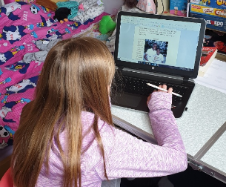
Here’s what Y5&6 have been focusing on at home today.
Bethany focusing
hard on her
biography writing

Slide 5
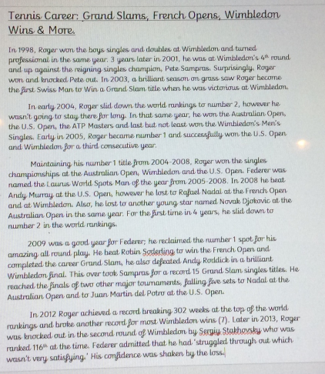
Here’s what Y5&6 have been focusing on at home today.
Reuben’s continuation of the main successes in the career of Roger Federer.

Slide 6
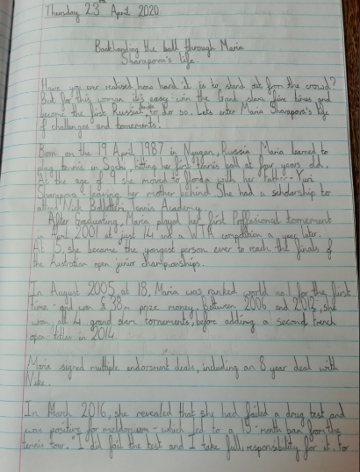
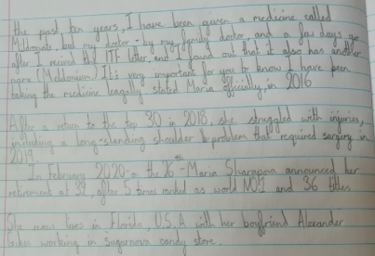
Here’s what Y5&6 have been focusing on at home today.
Amy’s continuation of the main successes in the career of Maria Sharapova.

Slide 7
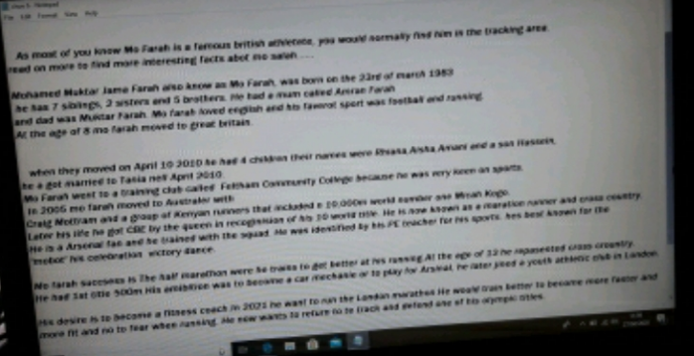
Here’s what Y5&6 have been focusing on at home today.
Chloe’s continuation of the main successes in the career of Mo Farah.

Slide 8
Here’s what Y5&6 have been focusing on at home today.
Sir Richard John Hadlee
Who is that amazing person throwing that ball as quick as lightning across the long grassy cricket field? It’s… Sir Richard Hadlee, the cricketing star and, one of the best fast bowlers in history. Let’s take a swing into his life.
Richard John Hadlee was born on the 3rd of July 1951 on a Tuesday; his place of birth was St Albans [Christchurch New-Zealand]. He was fourth born of five sons. Hadlee, who liked cricked, had a cricketing family, his father, Walter Hadlee, captained the New-Zealand cricket team. Two of Richard’s brothers, Barry and Dayle Hadlee, were already in the team by the time Hadlee was 24. Richard had taken a liking into the game at school and began his road to stardom. Read on to know his amazing journey!
Richard John Hadlee spent a lot of his childhood playing cricket. Hadlee attended Christchurch boys high and afterwards he was expected to join Canterbury like his older brothers did but since it was already full of opening bowlers he went to Lancaster Park instead. People only started to recognise Hadlee’s talent when he [and his Kiwi team] defeated the cricketing India in 1976. Richard Hadlee was then recognised for his greatness for this sport and quickly became Nz’s top dog. In 1980 he was the NZ sportsman [an award given to their country’s best sportsperson] of the year three times in a row. Hadlee was so great in just 25 tests he took 100 wickets making him his country’s main strike bowler. In 18 years Richard played 86 test matches. Before Hadlee played test cricket for NZ the team had not won a single match against England, West Indies and Australia [Known as the Big Three]. Hadlee as well as all his awards won the nickname Paddles, due to his over-sized feat. This nickname was given to him at Heaton Street Intermediate School.
Hadlee was a very private man and consciously stayed away from scandal and the public eye. He married Karen Ann Marsh who herself was a professional cricketer for the NZ team. Together they had two sons and after around twenty-two years together they decided to divorce [no Hadlee had ever divorced before]. He later remarried Lady Dianne.
In 1980 Hadlee felt he should retire from professional cricket because he was suffering from a range of injures which meant he couldn’t play for most of the season and was underperforming. He was talked back by Nottingham to carrying on playing. For ten years of his career he helped Nottingham, who was low-rated at the time, rise up and become one of the best but at thirty-six with two young sons decided to stop. This was because he was finding the travel hard with a young family, twice a year; he chose to focus on the NZ team instead.
Hadlee finally retired from test cricket on the 10th of July 1990 after helping the defeat of Australia, where he took his “100th first class 5 wicket haul in an innings”. Hadlee expressed in an interview that he had started to question continuing with test cricket a few years before retiring when he had heard his ex-coach Glenn Turner describing “the hysterical way wealthy young guns like Chris Cairns and Adam Parole acted when he dished out a bit of criticism”. He felt they were overpaid stars who although they had talent they were not dedicated. He was appalled that these new players felt they didn’t need to listen to someone of Turners experience.
Even though he had finished his life of test cricket the Queen decided to knight him for his contribution to his favourite sport.
Cameron’s continuation of the main successes in the career of Sir Richard Hadlee.

Slide 9
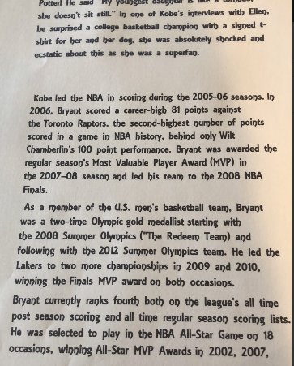
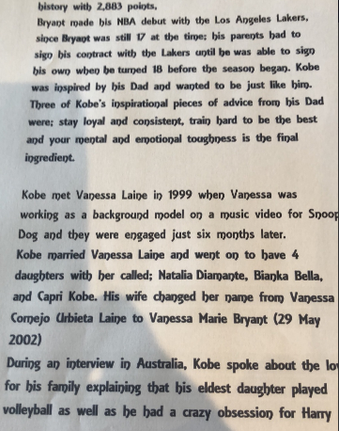
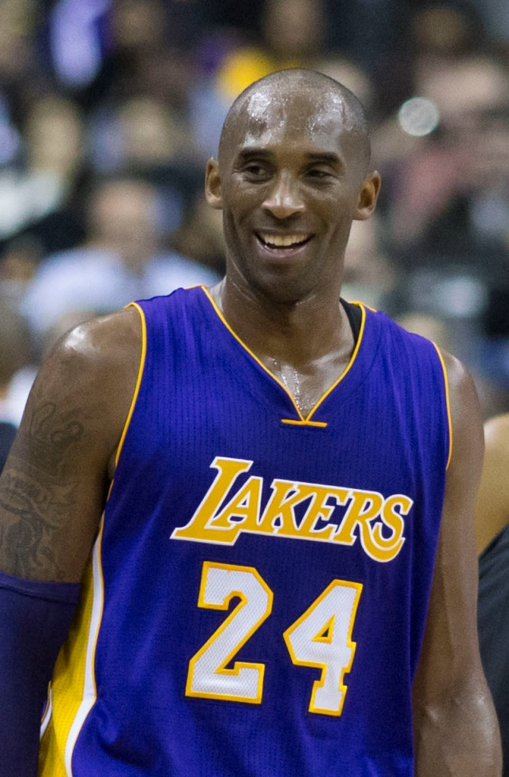
Here’s what Y5&6 have been focusing on at home today.
Harvey’s continuation of the main successes in the career of Kobe Bryant.

Slide 10
Here’s what Y5&6 have been focusing on at home today.
An All Rounder
Andrew “Freddie” Flintoff, an all good rounder in cricket. He played for Lancashire and England cricket teams. Do you want to be like him? A cricketer’s dream!
Andrew Flintoff was born in Preston, Lancashire on the 6th December 1977. His dad was a plumber. Freddie (as he is also known as), who has an older brother called Chris, went to Greenland’s Primary School and Ribbleton Hall High School. At school he was a keen chess player. Andrew played in a school lunchtime club and would often beat children much older than him with his fantastic moves.
Freddie played cricket alongside his dad and brother at Harris Park. One day,the under 14’s were short of a player, so Freddie was asked to play. This was his first local match at the age of six. At the age of 11, Freddie played for Lancashire schools team. Freddie’s greatest influence was his dad, who he watched play from a very young age. A coach called “Jim Renyon” changed Freddie from a school boy player to an adult cricketer. He passed nine GCSEs but did want to carry on his education.
Andrew was given the nickname ‘Freddie’ by the captain of Lancashire when he was a teenager, because his name was similar to ‘Fred Flintstone’ from the cartoon. At the age of 16, Freddie was snapped up by David Lloyd, the then Lancashire coach. Freddie trained with the team full time. His first debut for Lancashire came against Hampshire in August 1995, when Freddie was only eighteen. By the age of nineteen, Freddie was the captain of the England under 19’s cricket team. Freddie was a right handed player and a great all-rounder.
Freddie made his test match debut for England in 1998 against South Africa at Trent Bridge, Nottingham. In 2000 Freddie hit 135 not out (whilst playing for Lancashire), in the quarterfinals of the NatWest trophy against Surry. In that same year England’s management were very unhappy about his fitness level and his weight gain
Freddie was dropped from playing for England during 2001. He was determined to get into shape to be reselected for his national team. He had to lose 2 stone in weight and with the help of the GB rugby coach Steve Hampson he improved his fitness.
It worked and by 2003 Freddie was back hitting big and bowling really well. Andrew worked hard in 2004 he was ‘Man of the Series’ in England’s 4-0 victory against west Indians and voted player of the year by the Professional Cricket Association. His first daughter was also born.
In 2005 Freddie played for England against Australia in the ashes. In the second test Freddie played outstandingly taking England to a nail –biting victory. England went on to win the ashes and Freddie went on the win the man of the series .that same year Freddie also won the BBC sport personality of the year.
2006 was a hard year for Freddie. An ankle injury and worries over his fitness were developing. In September 2006; Freddie was named captain for the ashes series being played in Australia. Unfortunately Australia won it back. his second child (son) was born
Due to Freddie drinking heavily he was sacked from vice-captain for England during 2007 world cup. Lots of injuries followed the next few years not playing. In this time his third child was born
In 2009 Freddie started the ashes near to full fitness, old injury’s came back and on the 15th of July 2009 Freddie decided that he would retire from test cricket. England went on to regain the ashes. In, 2010 Freddie retired from all cricket and he then moved to broadcasting .
Henry’s continuation of the main successes in the career of Andrew Flintoff.

Slide 11
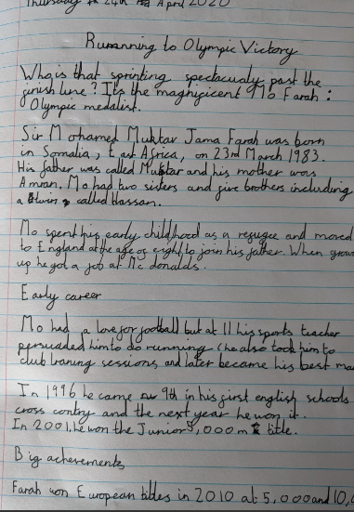
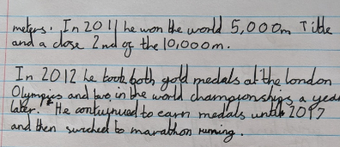
Here’s what Y5&6 have been focusing on at home today.
Lucy’s continuation of the main successes in the career of Mo Farah.

Slide 12
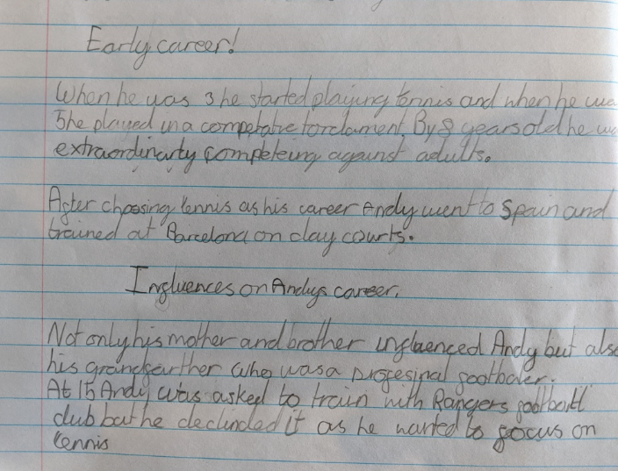
Here’s what Y5&6 have been focusing on at home today.
Katie’s continuation of the main successes in the career of Andy Murray.

Slide 13
Here’s what Y5&6 have been focusing on at home today.
Sprinting To Success
LOOK AT THAT, CATHY FREEMAN WINS AGAIN! Cathy freeman, an Australian 400-meter dash champion and founder of a great educational charity. How did she learn to do that? Run along and get comfy to take a leap in to her life story in her biography.
Early life
Catherine Astrid Salome Freeman, normally known as Cathy Freeman was born 16th of February 1973 in Slade Point, Australia. She was raised in a housing commission (a lower cost housing estate which had social problems) in Australia. Sadly, at young age, her farther left the family and went to live in Woorabinda (also in Australia.) On a happier note, when her mother married again, her stepfather noticed her sporting ability when she was five and encouraged her to train harder and get into the sport of running. She went to many schools, including schools in Mackay and Coppabella and at fourteen went to Kooralbyn international school to be coached professionally but was mostly educated at Fairholme College in Toowoomba, where she attended after getting a sporting scholarship to board at the school.
At a young age, she always wanted to be a runner and had a collection of regional titles. As well as running, she loved to horse ride and dance – she still does today. At age 17 she won a gold medal at the 1990 Commonwealth Games and was named the Young Australian of the year. This was a brilliant start to her career.
Career and Main Life
During the main point in her career, Cathy did many competitions like in 1997, when she won in the 400m at the World Championships in Athens. Then sadly she injured her foot and took some time off the 1998 season. Upon her return to the track in 1999, Freeman did not lose a single 400m race, including at the World Championships. Another great achievement is lighting the torch at the 2000 Olympics in Sydney. Cathy is Aboriginal, (native Australian) and lighting the torch was seen as a positive move in recognising the Aboriginal people of Australia. Freeman went on to win a gold medal in front of her home nation in the 400m. On her victory lap, she carried both the Australian national flag and the native Aboriginal flag.
Throughout her career, Freeman regularly competed in the Victorian Athletic League where she won two 400m races at the Stawell Gift Carnival. Freeman did not compete during the 2001 season but in 2002, she returned to the track to compete as a member of Australia's victorious 4x 400 m relay team at the 2002 Commonwealth Games. Freeman retired from professional competition in 2003.
Zoe’s continuation of the main successes in the career of Cathy Freeman.

Slide 14
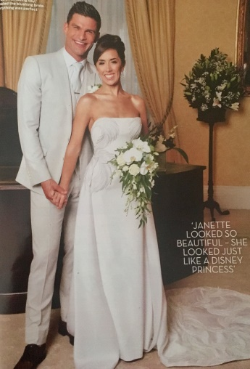
Here’s what Y5&6 have been focusing on at home today.
Major achievements
Janette first joined strictly in 2013 and was soon nicknamed the pocket rocket! She made it all the way to the semi-final in 2014 with Jake Wood partly thanks to a body-bending Salsa. She has partnered some famous people over the years including Peter Andre, Melvin Odoom, Aston Merrygold, Dr Ranj Singh and most recently in 2019 she teamed up with Paralympian Will Bayley. The start of 2020 has seen Janette win Strictly come dancing the live tour with 2019 winner Kelvin Fletcher. Her appearances in strictly have led to her becoming a household name. Janette’s favourite dances are the Rhumba, which she loves incorporating contemporary moves into, and the more traditional Quickstep.
Family life
In 2015 Janette got engaged to her long-time partner, Strictly Come Dancing and Burn The Floor co-star, Aljaz Skorjanec. They then got married in July 2017. They do not yet have any children, but are excited to start a family one day!
Isobel’s continuation of the main successes in the career of Janette Manrara.

Slide 15
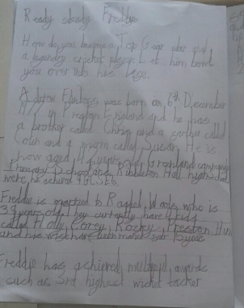
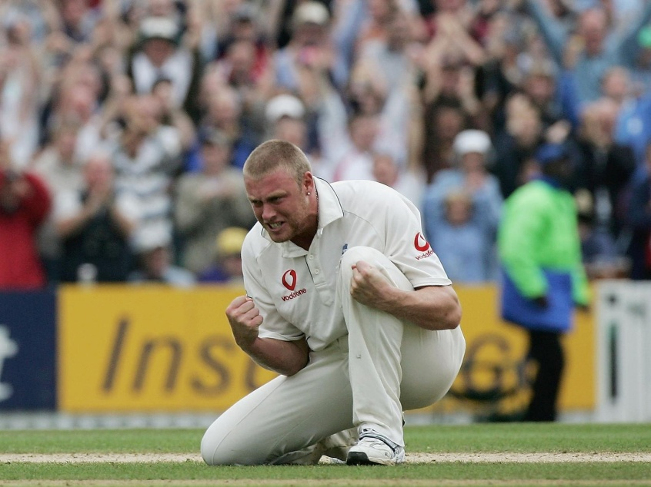
Here’s what Y5&6 have been focusing on at home today.
Toby’s continuation of the main successes in the career of Freddie Flintoff.

Slide 16
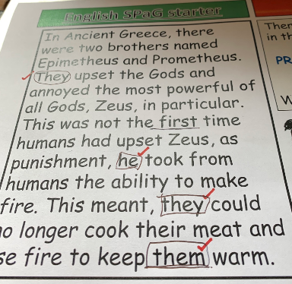
Here’s what Y5&6 have been focusing on at home today.
Henry identifying the personal pronouns in the text.

Slide 17
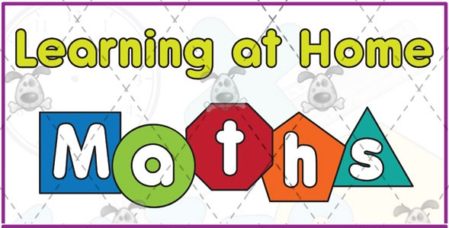
Here’s what Y5&6 have been
focusing on at home today.

Slide 18
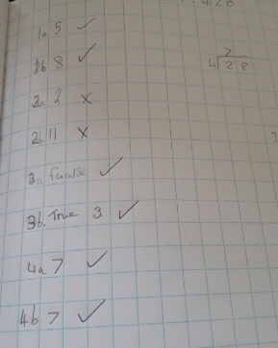
Here’s what Y5&6 have been focusing on at home today.
Chloe has been completing her maths this morning.

Slide 19
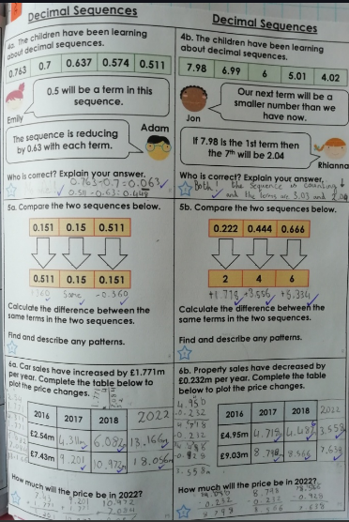
Here’s what Y5&6 have been focusing on at home today.
Amy has been carefully counting forwards and backwards with these tricky decimals.

Slide 20
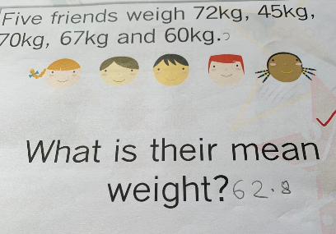
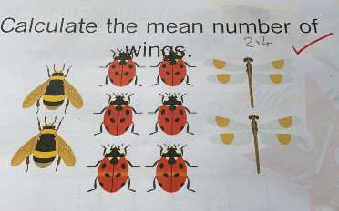
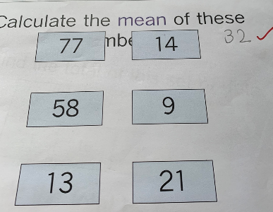
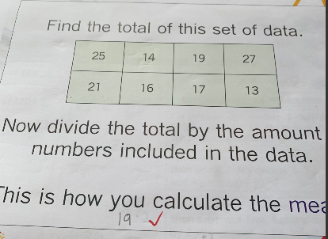
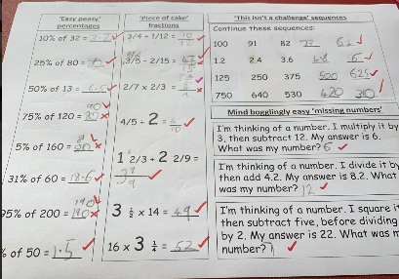
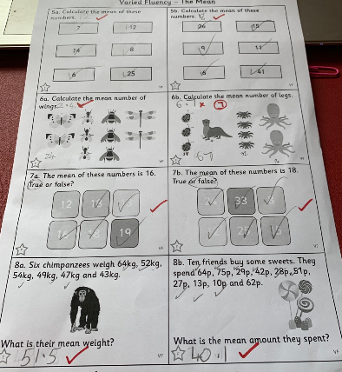
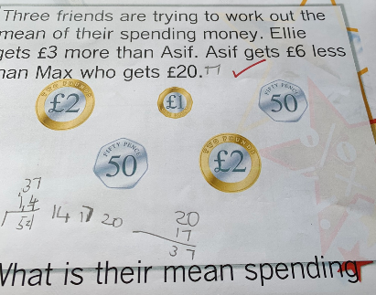
Here’s what Y5&6 have been focusing on at home today.
Henry focusing hard on the ‘mean’ in maths.

Slide 21
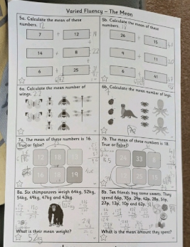
Here’s what Y5&6 have been focusing on at home today.
Bethany focusing hard on the ‘mean’ in maths.

Slide 22
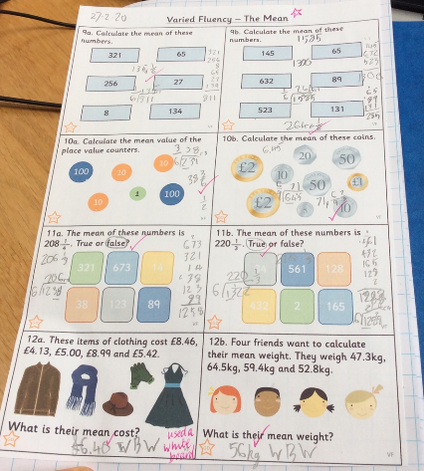
Here’s what Y5&6 have been focusing on at home today.
Reuben focusing hard on the ‘mean’ in maths.

Slide 23
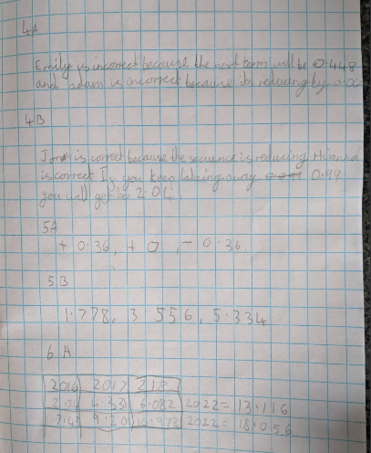
Here’s what Y5&6 have been focusing on at home today.
Lucy has been carefully counting forwards and backwards with these tricky decimals.

Slide 24
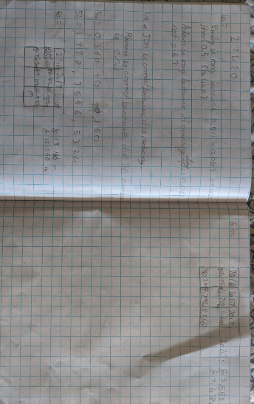
Here’s what Y5&6 have been focusing on at home today.
Katie has been carefully counting forwards and backwards with these tricky decimals.

Slide 25
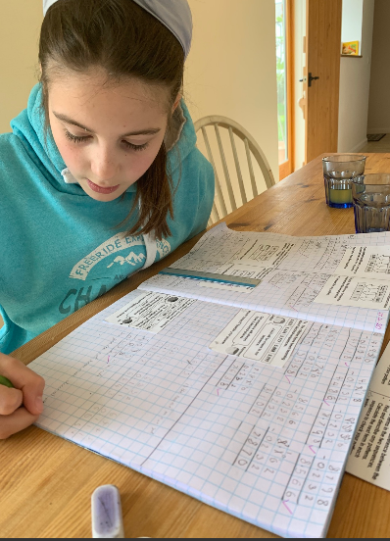
Here’s what Y5&6 have been focusing on at home today.
Zoe presenting her maths work beautifully today when solving these decimal sequences.

Slide 26
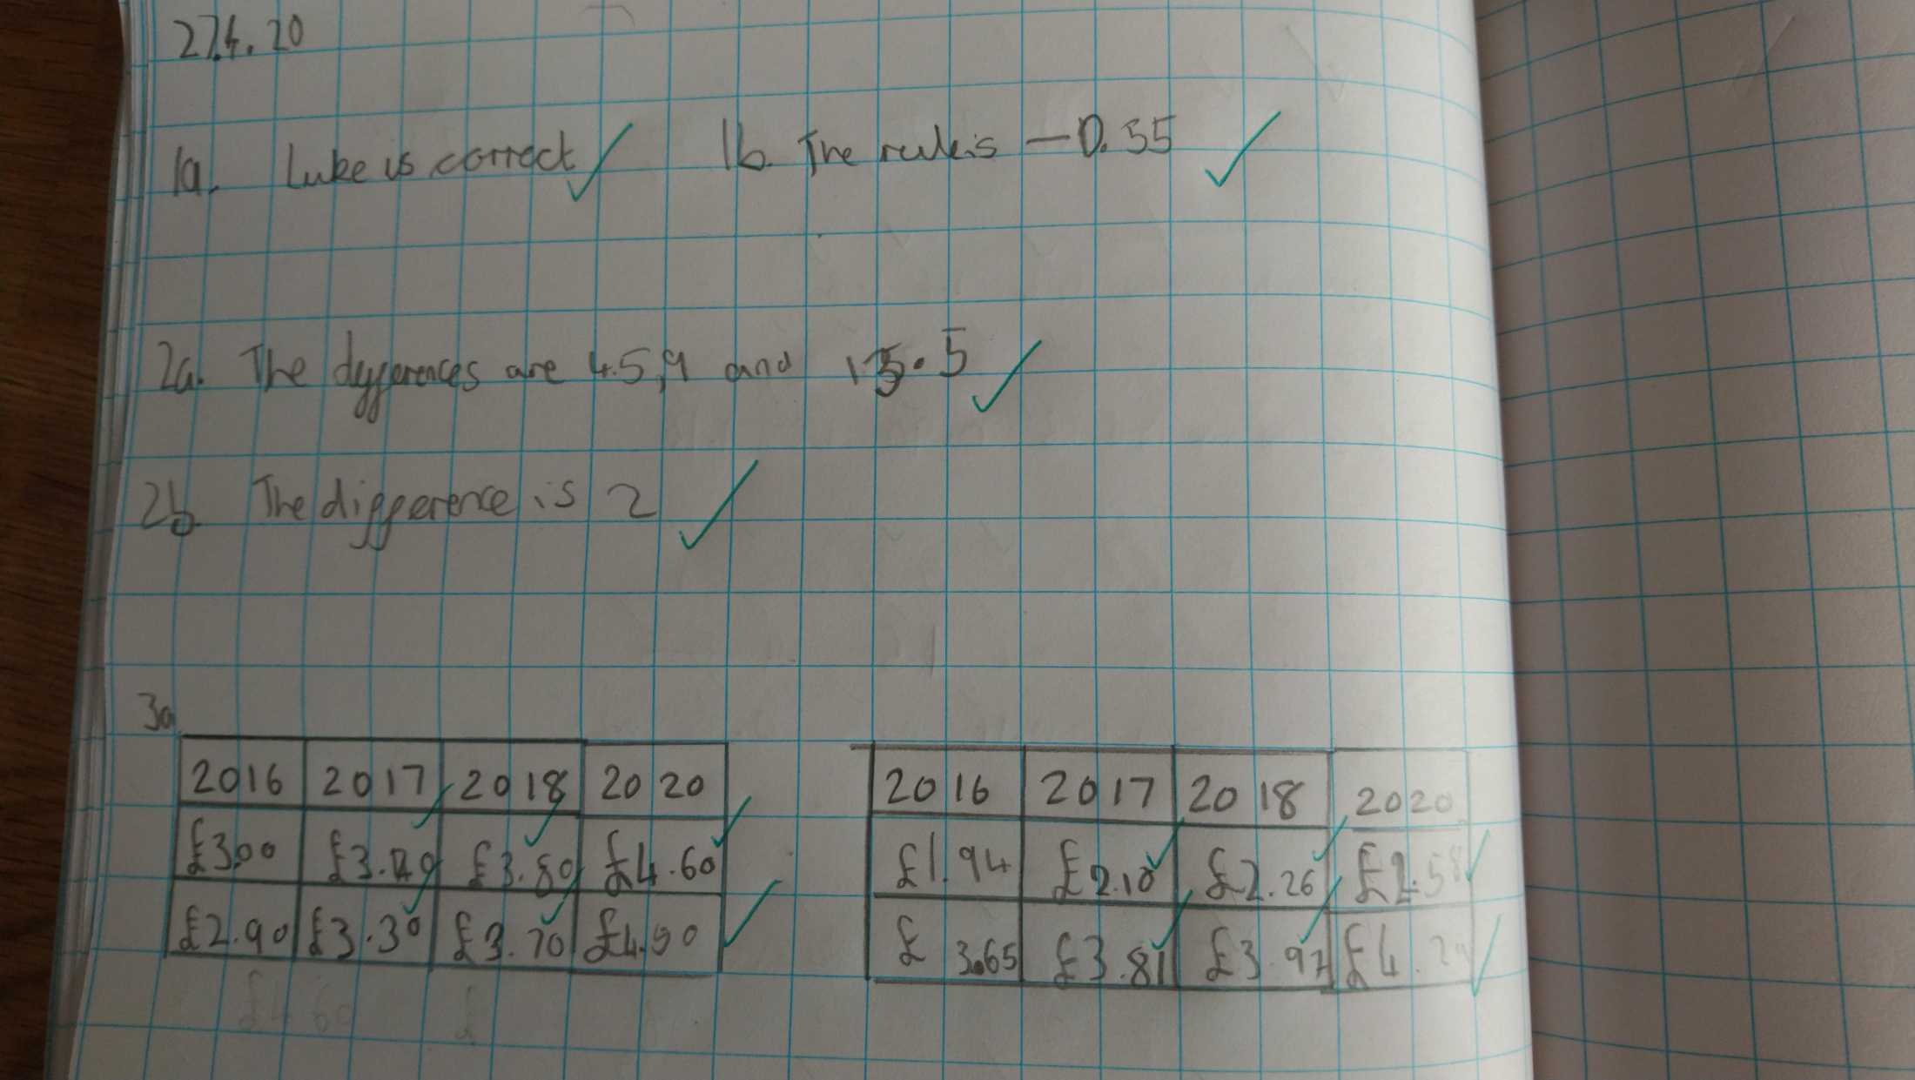
Here’s what Y5&6 have been focusing on at home today.
Here’s what Y5&6 have been focusing on at home today.
Isobel presenting her maths work beautifully today when solving these decimal sequences.

Slide 27
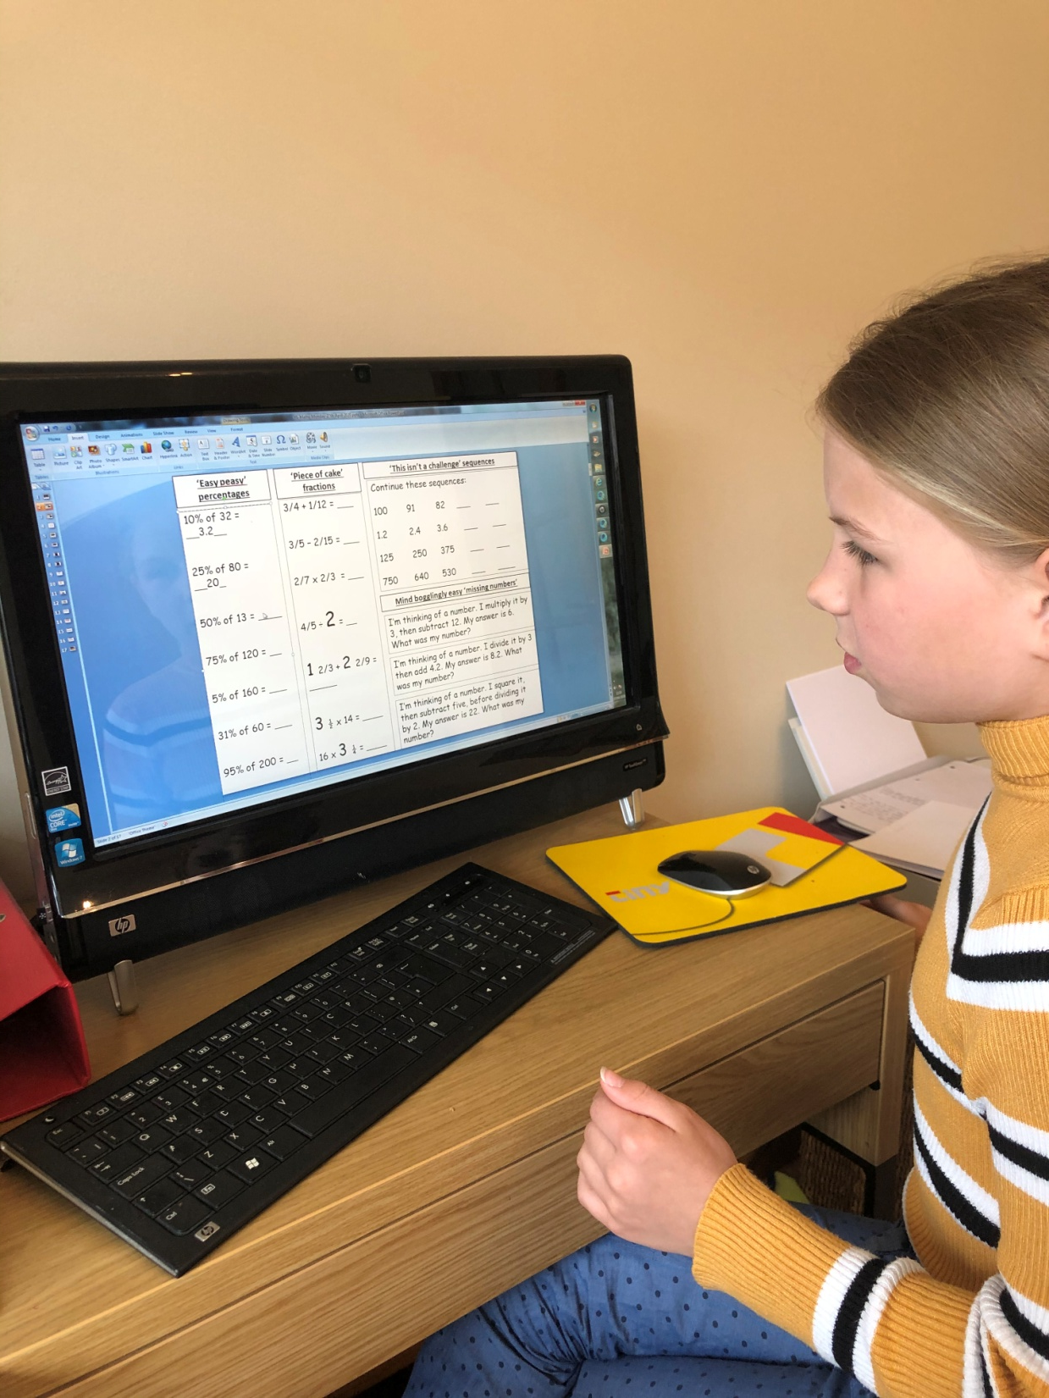
Here’s what Y5&6 have been focusing on at home today.
Lily has been practising her calculations in maths.

Slide 28
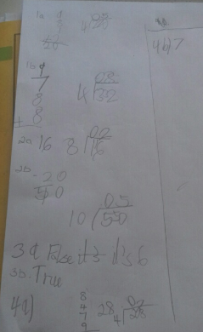
Here’s what Y5&6 have been focusing on at home today.
Toby has been practising his calculations in maths.

Slide 29
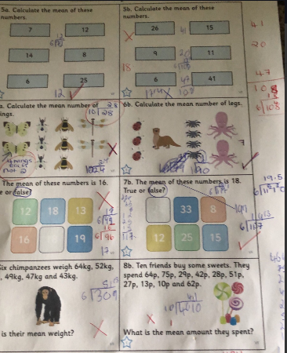
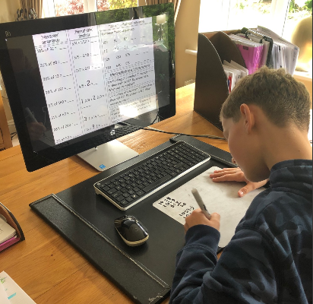
Here’s what Y5&6 have been focusing on at home today.
Harvey has been thinking hard about how to calculate the ‘mean’ in maths.

Slide 30
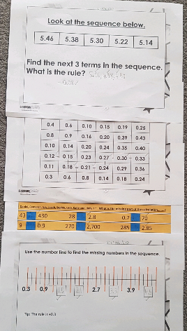
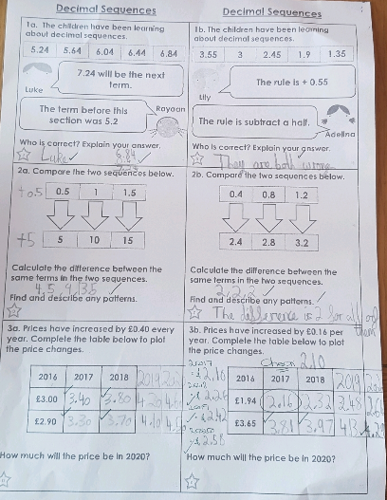
Here’s what Y5&6 have been focusing on at home today.
Cameron working hard on his decimal sequences

Slide 31
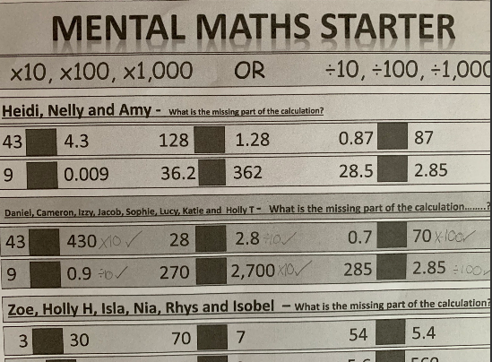
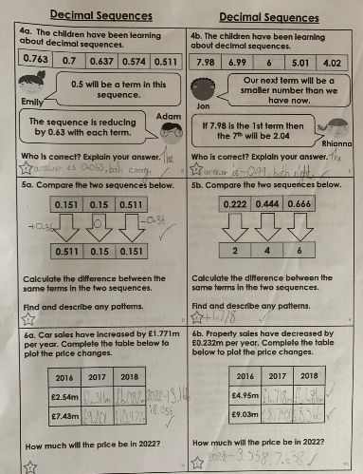
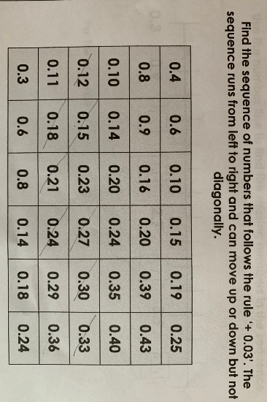
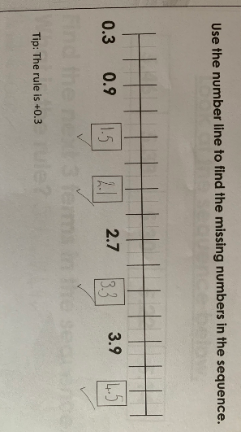
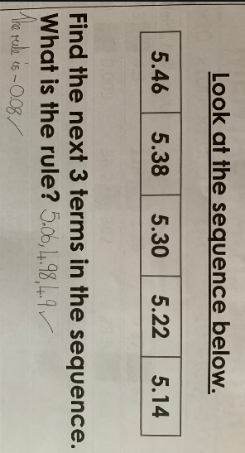
Here’s what Y5&6 have been focusing on at home today.
Sophie has been working hard on all aspects of her maths this morning.

Slide 32
Here’s what Y5&6 have been
focusing on at home today.

Slide 33
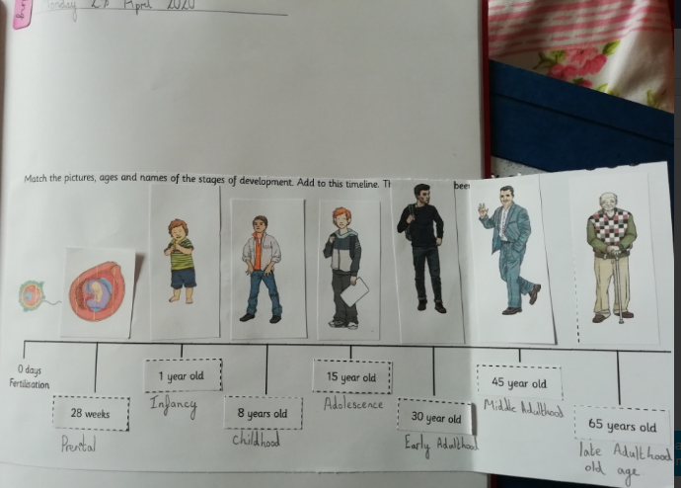
Here’s what Y5&6 have been focusing on at home today.
Amy is ordering and matching the stages of human development in Science.

Slide 34
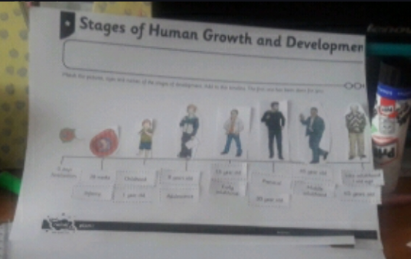
Here’s what Y5&6 have been focusing on at home today.
Chloe is ordering and matching the stages of human development in Science.

Slide 35
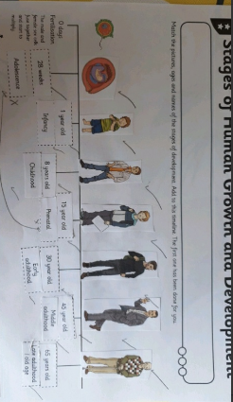
Here’s what Y5&6 have been focusing on at home today.
Bethany is ordering and matching the stages of human development in Science.

Slide 36
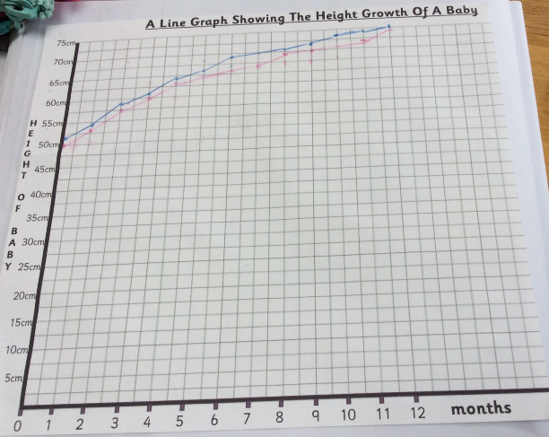
Here’s what Y5&6 have been focusing on at home today.
Reuben’s line graph showing the difference between boys and girls growth as babies in Science.

Slide 37
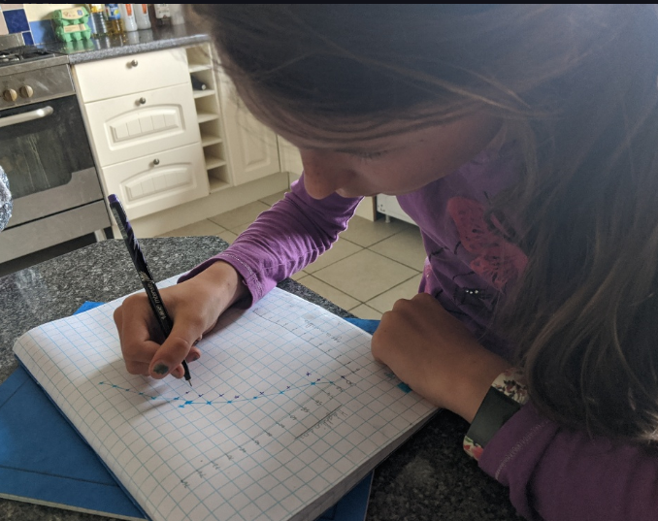
Here’s what Y5&6 have been focusing on at home today.
Lucy’s line graph showing the difference between boys and girls growth as babies in Science.

Slide 38
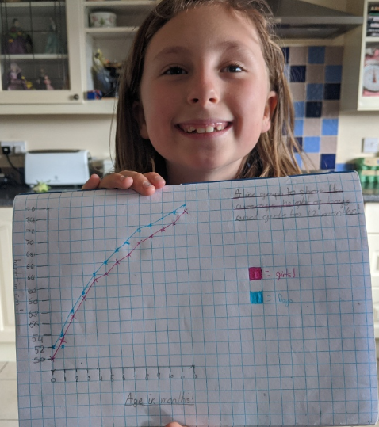
Here’s what Y5&6 have been focusing on at home today.
Katie’s line graph showing the difference between boys and girls growth as babies in Science.
Excellent presentation.
You’re rightly very proud of this!

Slide 39
Here’s what Y5&6 have been focusing on at home today.
Zoe’s line graph showing the difference between boys and girls growth as babies in Science.

Slide 40
Here’s what Y5&6 have been focusing on at home today.
Isobel’s line graph showing the difference between boys and girls growth as babies in Science.

Slide 41
Here’s what Y5&6 have been focusing on at home today.
Lily’s line graph showing the difference between boys and girls growth as babies in Science.

Slide 42
Here’s what Y5&6 have been focusing on at home today.
Toby’s line graph showing the difference between boys and girls growth as babies in Science.

Slide 43
Here’s what Y5&6 have been focusing on at home today.
Nelly is ordering and matching the stages of human development in Science.

Slide 44
Here’s what Y5&6 have been focusing on at home today.
Nelly’s line graph showing the difference between boys and girls growth as babies in Science.

Slide 45
Here’s what Y5&6 have been focusing on at home today.
Isla’s creating her line graph showing the difference between boys and girls growth as babies in Science.

Slide 46
What else have we been doing at home today?
Bethany’s yoga and reading to start her day.

Slide 47
What else have we been doing at home today?
Bethany tries out her brother’s skateboard.
Keep that balance Bethany!

Slide 48
What else have we been doing at home today?
Isobel’s been making some chocolate brownies!

Slide 49
What else have we been doing at home today?
Katie and Lucy have been writing letters to the locals to give them a morale boost.

Slide 50
What else have we been doing at home today?
Lily has been practising her spellings, whilst contributing to keeping Y5&6 at the top of the league on Spelling Shed.

Slide 51
What else have we been doing at home today?
There aren’t many puddles around at the moment, but Lily found one!

Slide 52
What else have we been doing at home today?
Dante has started the week really well, focusing hard on everything!

Slide 53
What else have we been doing at home today?
Reading with Nelly Day Three
Do you know the answer to her question?

Slide 54
What else have we been doing at home today?
Isla is issuing a ticket to her younger brothers for driving without a licence and car insurance.

Slide 55
What else have we been doing at home today?
Isla is now testing them on their driver’s theory test.

