Slide 1
What I’m learning in ART today
(ART) Date: Thursday 30th April 2020
L.Obj: *I can paint the eye of an Ancient Greek creature, the phoenix

Slide 2
What I’m learning in Art today
In Ancient Greek mythology, a phoenix is a long-lived bird that cyclically regenerates or is otherwise born again. Associated with the sun, a phoenix obtains new life by arising from the ashes of its predecessor.
Task:
Can you paint the eye of a phoenix?
Click here to take you to the link

Slide 3
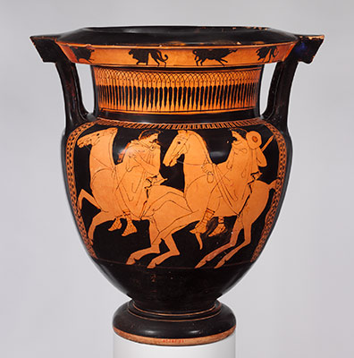
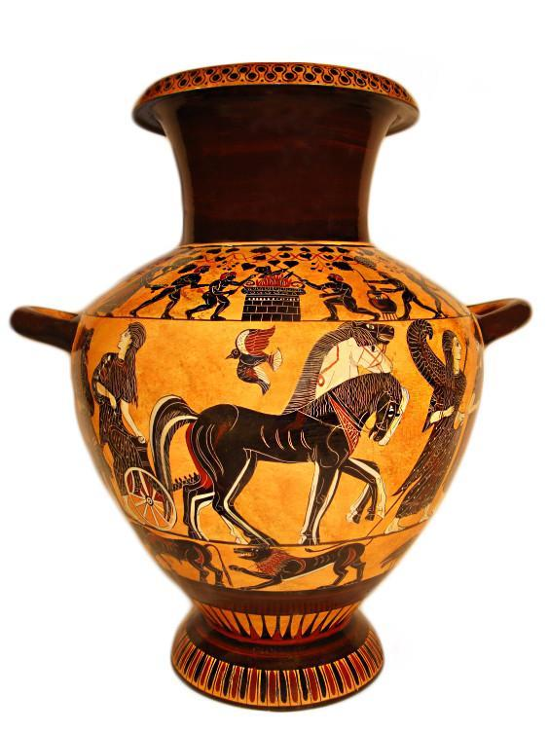
What I’m learning in ART today
(ART) Date: Thursday 30th April 2020
L.Obj: *I can draw Ancient Greek vases with accuracy and attention to detail.

Slide 4
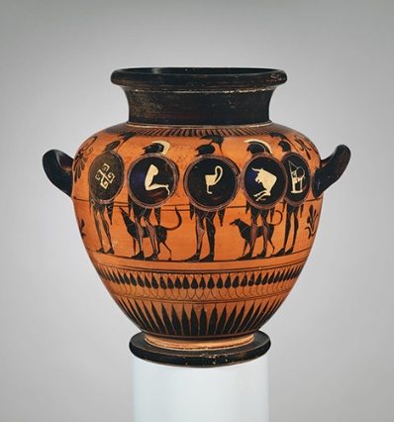
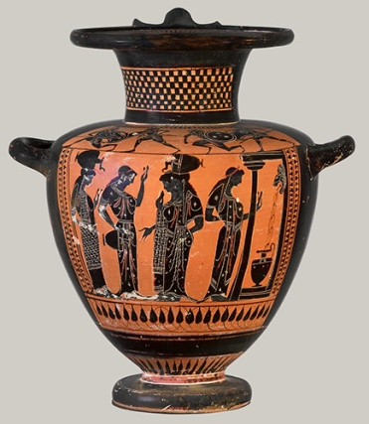
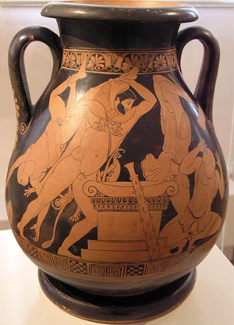
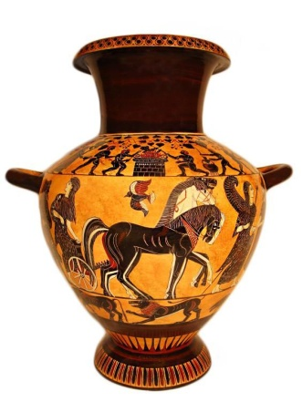
What I’m learning in Art today
Ancient Greek art was an important part of the lives of the people. Vase painting was important, and the pots would normally feature paintings of people or figures. Vases were part of a way that the Ancient Greeks made money and artists would sell and trade vases to make a living.
Vase Painting
The most popular vase painting was when the Ancient Greeks would paint a red or a black pot. These vases were used mostly for holding wine and for holding water. The vases were popular in homes, especially the homes of wealthy people. They were considered pieces of artwork and were also practical because they held important things.

Slide 5
What I’m learning in Art today
Shapes
The shape of the vase was different during different times of Ancient Greece. Some of the vases would be made as different sections. There would be a foot, a neck and handles. The sections were joined together and would be dried. Each vase was unique and had a unique shape and a unique size. The vases might be small, or they might be large.
Depending on what the vase was going to hold, the artist would decide what shape it was going to be. The most common was wine holders and it was called a krater and it was used to mix the water into the wine. A vase for pouring the wine would be called a oinochoai.
The cups that had stems were also considered vases and they were called kylixes. To hold oil or perfume, the vase maker would make a lekythoi jar. They were sturdy and had handles so that they could be carried easily. Each one would then be decorated to the buyer or artists choice.

Slide 6
What I’m learning in Art today
Pottery
The vases were made on a pottery wheel and they were made out of clay. The handles and other shapes would be added with clay slip.
This would allow the parts to stick together and then the pot would dry.
Painting
The vase would then be decorated, and it would depend on the time as to what style was used. The vase would be painted with black or other coloured paint and the marks would be put on the vase with a small brush. The brush would be made out of feathers or animal tail. When a vase was painted, the painter would put on multiple layers of paint and the paint would eventually chip off.
Firing
The vase would have to be put into a fire so that it would harden and last for a long time. The pottery was considered softer than modern pottery and that is because of the lack of heat the vase would be put in.

Slide 7
What I’m learning in Art today
Painter
The painter of the vases usually was considered an artist, or a specialist and they would paint the vases and sell them to make a living. Each painter had their own style and design and people could tell if a certain artist painted a vase. Painters painted vases in workshops and was usually considered a master potter. The artists did not have any type of government control over them and they were allowed to paint whatever they wanted on the vase.
Most of the workers were paid the same as manual labourers or crafters and it would usually only cost the buyer a day wage to purchase a vase. Some artists made over 200 vases.
Task: Can you sketch an Ancient Greek vase?
Click here to take you to the link

